Slide 1
A Geographer’s Toolkit
Introduction to Geography, Tools & Technology, & 6 Essential Elements

Slide 2
Cornell Note-Taking Method
Notes color-coded in RED go on this side of the line.
These items will include:
Main Ideas
Big Concepts
Vocabulary Words
Notes color-coded in BLUE go on this side of the line.
These items will include:
Supporting details
Dates, Times, and Biographic details
Vocabulary Definitions
Any items in BLACK text are optional. Remember: the more thorough your notes, the more prepared you will be for exams.

Slide 3
History of Geography
Ancient Era, Age of Discovery, Modern Era

Slide 4
Ancient Era
Geography- the study of the distribution and interaction between physical and human features on Earth’s surface
“Geo” (the Earth), “Graphia” (to describe)= To describe the Earth
Notable Greek Geographers
Eratosthenes- Chief Librarian in Alexandria, 1st to calculate circumference of the Earth, 1st to calculate tilt at Earth’s axis
Pythagoras- asserted the Earth was round
Hipparchus- developed the grid system, lines of latitude and longitude that run across the Earth

Slide 5
Ancient Era
Chinese Geographers
The Chinese studied and developed geographic theories simultaneously as the Greeks, but not many records were left behind.
Liu An, Pei Xu, Jia Dan…
Islamic Geographers
Developed and studied maps before the Greeks (Babylon, 9th Century BCE), and became more advanced as time went on.
Abu Rayhan Biruni- mapped cities, measured distances, used trigonometry to calculate Earth’s circumference (off by 17km)

Slide 6
Age of Discovery
European Age of Discovery
Christopher Columbus, Marco Polo, John Cook revived need for accurate mapping details.
John Harrison invented the chronometer to establish the distance between meridians
18th/19th Centuries
Geography became an actual academic subject
20th Century- new methods and tools come into use, including study of geometrics (the storage, processing, and delivery of geography information) and statistics

Slide 7
Modern Age
Physical Geography
Human Geography
Examines the natural environment and how climate, vegetation, water, soil, and landforms are produced and interact.
Examines the human use of and understanding of the world and their interactions with it.
Focus on SUSTAINING the development of the built world.

Slide 8
A Geographer’s Toolkit

Slide 9
Tools
Maps
Globes
Two- Dimensional (2D)
Show a specific area of the Earth at one time
Drawn to scale
Portable & easy to use
Maps are distorted due to spherical Earth being flattened
Three- Dimensional (3D)
View the way the Earth travels in space
Only half of the Earth can be viewed at one time
Not practical or portable

Slide 10
How Are Maps Made?
Cartographers, a person who creates maps, decides what type of map they want to create.
Field surveys are conducted, in which observations, measurements, and records are made of the specific area.
Remote Sensing- use of satellite and/or aerial photos of the area.
Information is stored in a database, like GIS.
Computers transform measurements into a map.
Map Projection- the representation of a globe on a flat map, using a grid of lines of latitude and longitude

Slide 11
Geography Technology
GPS
GIS
Global Positioning System
System of satellites and radio-signal devices that make it possible to accurately pinpoint your geographic location
Can also be used to generates routes for travel
Geographic Information System
Computerized system that gathers information about Earth’s surface in order to better understand patterns, data, and trends.
Makes it possible to digitally layer maps on top of each other to fully understand information about location.

Slide 12
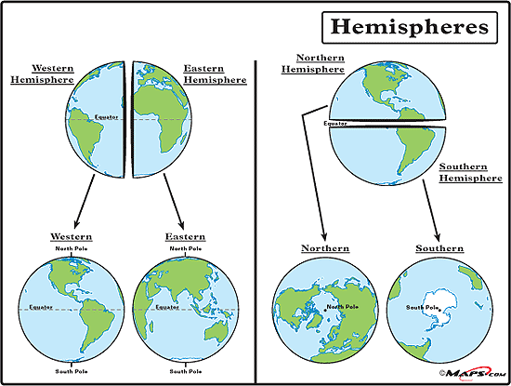
The Grid System
Grid System- the parallels and meridians that form an imaginary grid over Earth’s surface, making it possible to locate a specific point.
Hemispheres- one of the halves into which the Earth is divided.
Prime Meridian- 0˚, divides the Earth between Eastern and Western Hemispheres.
Runs directly through Greenwich, England, UK

Slide 13
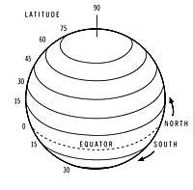
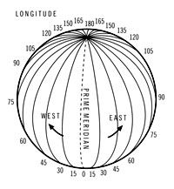
The Grid System
Latitude
Longitude
aka Parallels, lines that never intersect.
a geographic coordinate that specifies the North-South positions of a point on Earth’s surface
aka Meridians, intersect at North and South Poles.
a geographic coordinate that specifies the East-West positions of a point on Earth’s surface

Slide 14
A Geographer’s Playlist
What Do These Songs Have In Common?
“It’s a Small World”
From that one ride at Disneyland
“We Know the Way”
From “Moana”
“Go the Distance”
From “Hercules”
“Good Directions”
By Billy Currington
“Maps”
By Maroon 5
“East Bound & Down”
By Jerry Reed
“Take Me Home, Country Roads”
By John Denver
“Uptown Girl”
By Billy Joel
“A Thousand Miles”
By Vanessa Carlton
“Highway 20 Ride”
By Zac Brown Band

Slide 15
6 Essential Elements of Geography

Slide 16
6 Essential Elements
Used by geographers in order to categorize information about the changes taking place on Earth’s surface. (aka 5 Themes of Geography)
Spatial Terms
Places & Region
Physical Systems
Human Systems
Environment & Society
Uses of Geography

Slide 17
Spatial Terms
Location- WHERE IS IT?
Absolute Location- exactly where it is using latitude and longitude or an address ( 37N, 63 W or I live at 123 North Ave.)
Relative Location- Where something is located according to something you already know ( I live Near the Baptist Church or Tampa is about an hour west of Orlando.)

Slide 18
Places & Regions
Place ( what it is like, makes it unique or special) –
Physical Characteristics- Mother Nature put it on the earth, natural
Human Characteristics- people put it on the earth, man-made
Region- share more than one characteristic with another place, like natural characteristics (climate, landscape) or cultural characteristics (language, religion, government)
Formal Region- countries, states, and cities that share certain characteristics like the same language, laws, government, etc.
Functional Region- A central place and the surrounding places affected by it; ex. RGV, DFW, Houston Metro
Perceptual Region- Area defined by people’s feelings and attitudes about the area; ex. The Valley, Cowboy Country,

Slide 19
Physical Systems
Natural changes – How physical processes or disasters like hurricanes, volcanoes, and glaciers shape and change the earth’s surface
Communities of Plants and Animals – how they depend on the one another and their surroundings for survival (biomes and natural habitats)

Slide 20
Human Systems
Movement is how things move from place to place. (This can be the exchange of people, ideas and/or beliefs, and goods.)
Describes how people have shaped our world.

Slide 21
Environment & Society
Human-Environment Interactions- studying the social factors that causes changes in the environment, the impact people have on those changes, and the efforts to solve or limit those changes.
How humans effect the environment:
Good effects- planting trees for oxygen
Bad effects-pollution from industries
How the environment effects human:
Good effects- growing crops on the side of the mountain
Bad effects- the weather effects the clothing and shelter

Slide 22
Uses of Geography
Understand the relationships among people, places, and environments over time
Understand the past and prepare for the future

