Slide 1
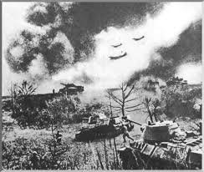
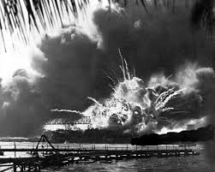
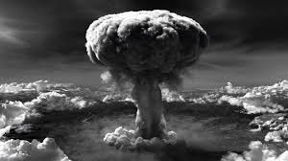
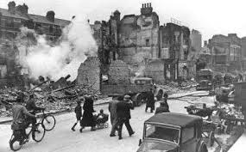
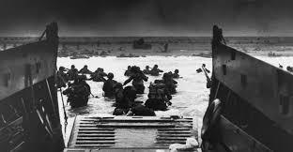
Battles of World War II

Slide 2
For this assignment…
Use this PowerPoint to complete the “Battles of World War II” timeline
Follow the events in CHRONOLOGICAL order
Do NOT do any off-site Googling! All the info you need to answer all questions are on the PowerPoint!

Slide 3
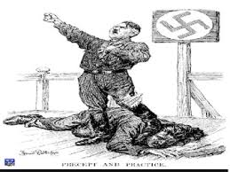
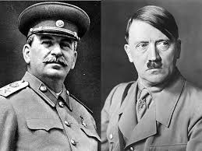
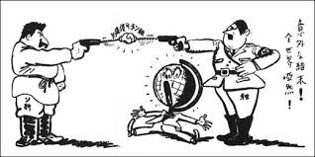
Non-aggression Pact
August 23,1939- German-Soviet Non-Aggression Pact is signed; both countries agree to avoid military action against each other for next 10 years
Agree not to invade the other’s country
Agree to each invade Poland and split it evenly among themselves
Also agree not to aid other countries who attack either nation
Pact is meant to dissuade Great Britain from declaring war on Germany, who believe Hitler will not live up to previously made agreements
Great Britain and France issue declarations of aid to defend Poland if it is attacked by Germany or Russia
June 22, 1941- Hitler voids the Non-Aggression Pact and invades Russia

Slide 4
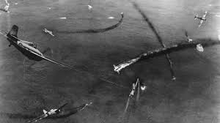
Invasion of Poland
September 1, 1939- German troops invade the Polish borders on land, Luftwaffe initiates blitzkrieg attacks by air, and U-boats attack naval forces in Baltic Sea
Blitzkrieg- “lightning war”, military tactic meant to create confusion among enemy forces with quick use of artillery from multiple directions
Dogfight- aerial warfare between two planes at close range; used to keep bombers from reaching their targets
Results in quick German victory, which Hitler claimed was in self-defense in order to avoid punishment under Treaty of Versailles
September 3, 1939- Britain & France declare war on Germany

Slide 5
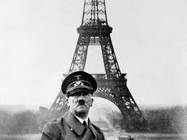
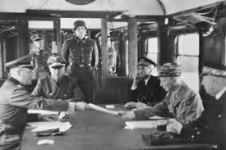
Fall of France
Maginot Line- defense built along France’s border with Germany after WWI, including concrete fortifications, massive fortresses, and underground bunkers
May 1940- Hitler’s army moves through the Ardennes mountains and goes around the Maginot Line through Belgium; they reach France’s northern coast in 10 days
France sent the best of their modernized armies north but were encircled by the Germans and forced to retreat
Loss of heavy amounts of weapons, armored artillery, and troops
Germans were still marching towards Paris
June 22, 1940- France surrenders; Hitler insists on using the same train Germany used to sign their surrender in WWI

Slide 6
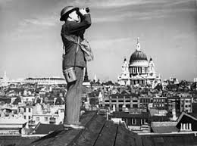
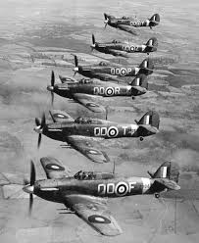
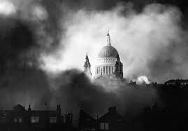
Battle of Britain
July 10-October 30, 1940 - one of the first major war campaigns to be fought entirely by air forces; RAF (Royal Air Force) pilots defended the United Kingdom from bombing attacks by the German Luftwaffe
New technology allows British RAF to hold off Germany and prove Hitler can be stopped
Enigma – German code machine used to send military instructions securely; British mathematician Alan Turing cracks the code in 1940 which allows British time to prepare and resist attacks
Radar – used by the British Royal Air Force (RAF) to see when German bombers were approaching and where they were headed
The Blitz- German bombing offensive of Great Britain that lasted from September 1940 to May 1941; concentrated on night attacks to avoid detection by the RAF
Failed military strategy
Meant to destroy or discourage British war production, but factories simply moved to other cities that were further apart

Slide 7
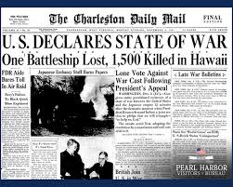
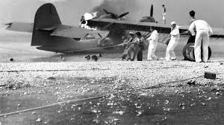
Pearl Harbor
Relations between Japan and United States are extremely tense- Japan attempts to expand into China and take over its import markets
U.S. places economic sanctions against Japan as punishment
Japan is cut off from trade money and essential supplies like oil, causing an energy crisis during a harsh winter
December 7, 1941- Japanese launch surprise attack on the US in retaliation for trade embargoes; 19 American ships sunk or damaged and more than 2,400 troops and civilians killed
U.S. officially enters the war on December 8th; Japan’s allies Germany and Italy declare war on U.S. same day

Slide 8
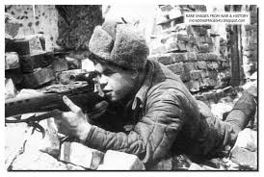
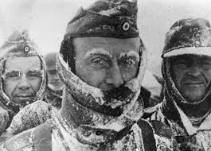
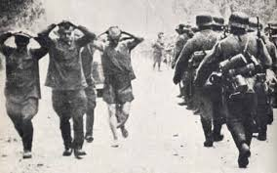
Stalingrad
Operation Barbarossa- June 1941, Germany breaks non-aggression pact & invades the Soviet Union
Scorched Earth Policy- used by Soviets to hold back Germany at Leningrad; Germany prevails and moves on to Moscow and Stalingrad to seize the oil fields and industrial center
Stalingrad- Luftwaffe bombed the city to rubble, over 1 million Soviets die and the city is 99% destroyed but Soviets continue to resist and push Germans back.
February 1943 – what was left of the German soldiers surrender to the Soviet Union due to unpreparedness for Russian winters, many have died due to starvation and exposure
Italy fell to Allied forces, Mussolini had previously been killed in August 1942

Slide 9
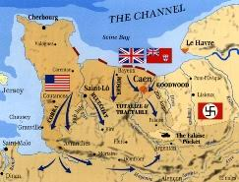
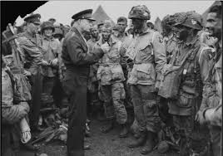
D-DAy
June 6, 1944- Largest land and sea attack in history, refers to the landing of Allied forces at Normandy Beach in France
Part of Operation Overlord, massive invasion of Europe planned by Supreme Allied Commander Dwight D. Eisenhower
Normandy, France selected as best location due to broad beachfront access, allows for multiple attacks against German strongholds in Brittany, port of Cherbourg, and overland marches into Paris and Germany
Leads to the eventual liberation of Belgium, France, and Luxembourg
Allied soldiers push into Paris and free France
Soviet army closes in on Germany from the east
US & British forces advance from the west

Slide 10
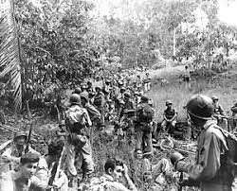
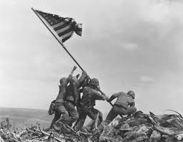
Battles of the Pacific Theater
Battle of Midway- June 4, 1942; Japan selected Midway to target remaining U.S. aircraft carriers from Pearl Harbor, but U.S. forces successfully attack Japanese aircraft carriers
Turning point of the war in the Pacific
Battle of Guadalcanal– August 1942- February 1943; Allies attacked Japanese airbase in Solomon Islands
Battle turned into a savage struggle & ended with more than 24,000 dead
Iwo Jima– February-June 1945; brutal fighting over small islands, Iwo Jima & Okinawa, close to Japan.
American forces need the islands to establish a base for aircraft returning from raids in Japan, who unsuccessfully fight to keep American troops pushed back
Extremely high casualties on both sides

Slide 11
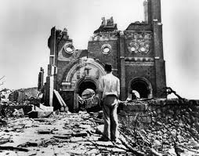
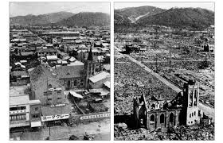
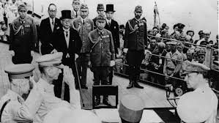
Hiroshima & Nagasaki
August 6, 1945- world’s first atomic bomb, Little Boy, was dropped on Japanese city of Hiroshima
August 9, 1945- second atomic bomb, Fat Man, dropped on Nagasaki
Approximately 140,000+ Japanese civilians died in the atomic bombs
Radiation fallout killed more over many years
Japan refuses to surrender, even though Allied forces have defeated Germany and Italy. Anxious to end the war, President Truman is informed an invasion of Japan might cost a million lives
Dropping the bomb would be the quickest possible end to war AND it would ensure the dominance of the United States as a world power
Led to Japanese surrender on August 15, 1945

