Slide 1
The Industrial revolution
Why Did It Begin in England?

Slide 2
Graphic organizer
Trim the edges and cut the lines of the organizer, leaving four flip squares attached by a title in the middle
Glue the title down on the page, do NOT glue the flaps down
Use the information on the following slides to fill in the notes underneath the flap in your notebook
Draw pictures that show your understanding of what you have read on the front of the flap

Slide 3
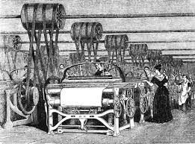
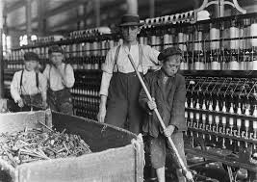
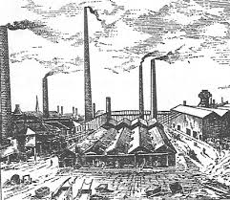
What was the industrial revolution
Time Period: 1760- 1840 CE
Predominantly agricultural, rural societies in Europe and America became industrial and urban (living in cities).
Industrialization created:
increased volume and variety of manufactured goods
an improved standard of living for some, it
also resulted in often grim employment and living conditions for the poor and working classes.

Slide 4
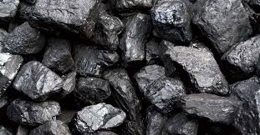
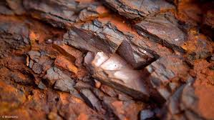
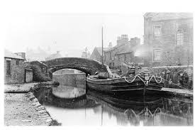
Natural Resources
Great Britain had abundant natural resources like iron ore, coal, and rivers which had many different uses.
Coal- used to power and create steam for the large machines in factories
Iron Ore- essential to the development and production of new machines such as engine, tools, and the locomotive.
Rivers- used to transport raw materials and finished products from one place to another
Thousands of jobs for workers became available in the mines that harvested these items

Slide 5
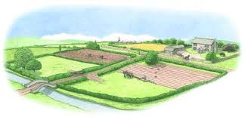
Agricultural Revolution
Gradual transformation in farming during the 18th century that led to improvements in nutrition and population growth
Crop Rotation- routinely changing plants allows the land to remain fertile, since different crops require different nutrients from the soil. Rotation allows the soil to replenish what the plants have used.
Enclosure Movement- landowners fence off their pieces of land, eliminating community use of the soil and the quicker overuse of the nutrients

Slide 6
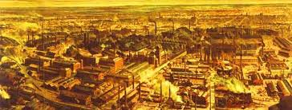
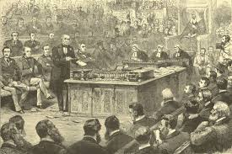
Britain’s government & Economy
Despite the turmoil and revolutions of the 1770’s, Great Britain had grown to be a relatively stable nation, especially in comparison with the United States and France.
They developed a banking system, trade, & wealth
No recent wars had taken place in England
Parliament supported business, and enacted legislation to prevent companies from selling technology to other nations
No political revolutions

Slide 7
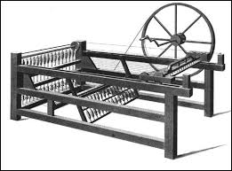
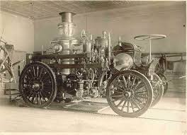
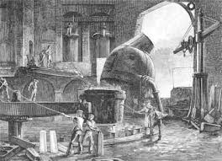
Inventions
Spinning Jenny- invented by James Hargreaves to quickly spin and weave thread using 8 spindles at once
Steam Engine- invented by James Watt to power machines, used steam from heat produced by burning coal and heating water
Steel Production- a process invented by Henry Bessemer that created stronger and cheaper steel
Other inventions include cotton gin, telegraph, daguerreotype, phonograph, and locomotives

