Slide 1
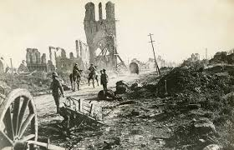
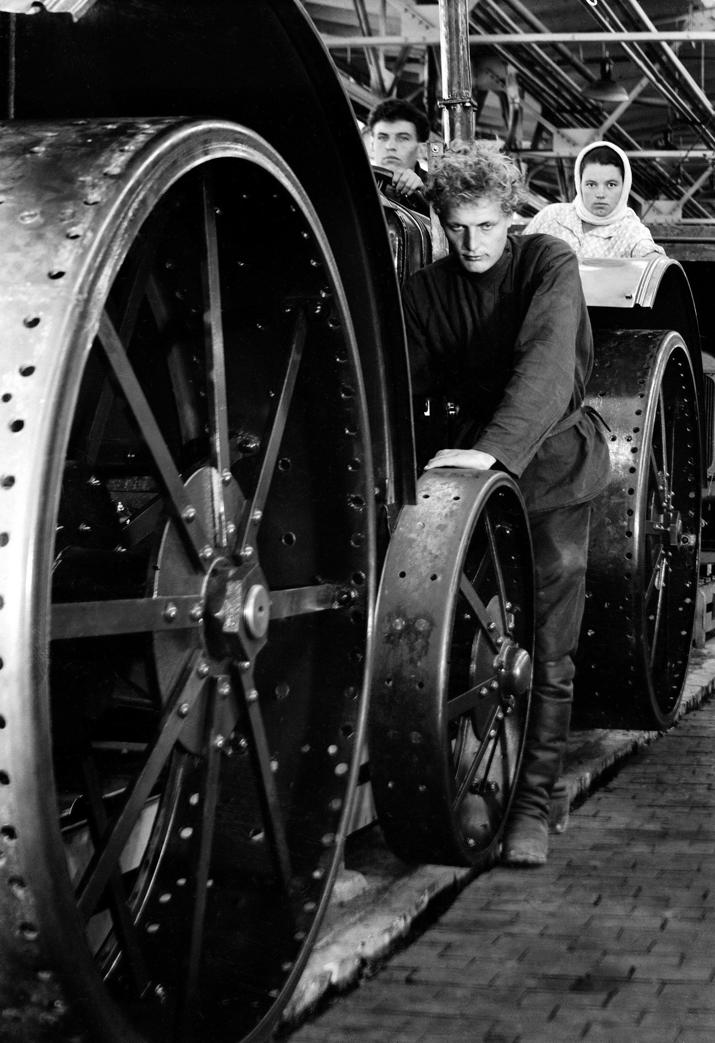
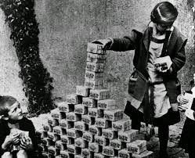
Between the World Wars
International Economics
New Nation-States
Global Depression

Slide 2
Cornell note-taking method
Notes color-coded in RED go on this side of the line.
These items will include:
Main Ideas
Big Concepts
Vocabulary Words
Notes color-coded in BLUE go on this side of the line.
These items will include:
Supporting details
Dates, Times, and Biographic details
Vocabulary Definitions
Any items in BLACK text are optional. Remember: the more thorough your notes, the more prepared you will be for exams.

Slide 3
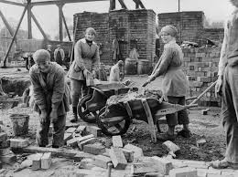
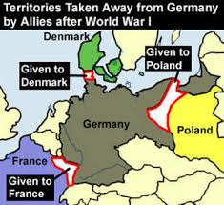
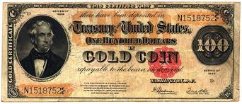
International economics

Slide 4
Effects of the Great War
During World War I, European nations committed huge amounts of money, resources, and soldiers to the war effort. In the end:
10 million Europeans were killed
7 million were permanently disabled
15 million seriously wounded
Soldiers were mostly young men of working age.
Combined with the destruction of land and property, damage from the war in Europe totaled billions of dollars.
6 ½ times as much as the total national debt of the entire world during the years from 1800 to 1914.
France, where war was fought, incurred the most debt and damage

Slide 5
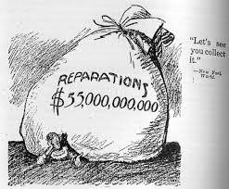
Europe’s Mounting Debt
Treaty of Versailles punished Central Powers severely, including reparations payments which were considered impossible.
Germany lost 15% of its pre-war capacity, including all of its foreign investments (colonies and the money they could generate).
In Austria, agricultural production fell 53% from pre-war levels, and starvation became a persistent problem.
Inflation hit all of Europe in the first years after the war, as demand increased but production declined due to a shortage of raw materials.
Prices in Hungary were 23,000 times what they had been before the war
In Russia, prices were 4 million times what they were pre-war.

Slide 6
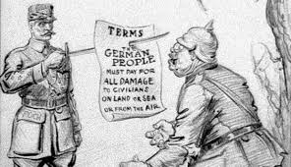
Europe’s Mounting Debt
Debtor countries increasingly found it impossible to pay their war debts.
Germany pleaded for a hold on reparations payments, but France would not agree. In 1923, Germany defaulted on its payments.
Most nations were forced to abandon the gold standard, causing their currencies to depreciate rapidly and creating rampant inflation.
Allied Powers ended the war deep in debt to the United States, who demanded payment in gold and dollars
Allies borrowed from creditor nations, creating even more debt elsewhere.
Dawes Plan- the total sum owed by Germany would remain the same, but the yearly payments were reduced, and Germany was granted a loan for the payments.
German mark began to stabilize, and Germany was able to pay on time for a short while.

Slide 7
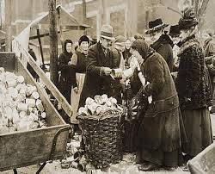
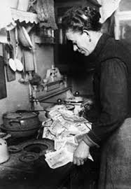
Effects of Debt
From 1925 to 1929, Europe entered a period of relative prosperity and stability. However:
unemployment remained high
population growth outpaced economic growth.
In 1930, the Young Plan replaced the Dawes Plan to help Germany, who is still struggling to meet payments
There was no international agreement on how to fix inflation or stabilize currency, so each nation tried their own solutions.
Results were varied and distributed unevenly throughout Europe

Slide 8
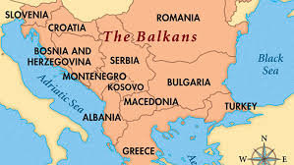
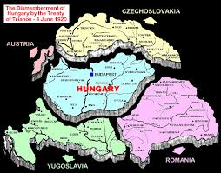
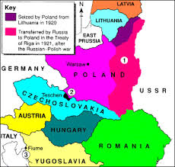
New Nation-States

Slide 9
Political Instability
Self-Determination- process where a group of people form their own state and choose their own government
Eastern Europe was dominated by the major powers before World War I, and many new nation-states found themselves granted autonomy for the first time.
Baltic States- Finland, Estonia, Latvia, and Lithuania had formerly been dominated by Germany (west) or Russia (east).
Finland- able to maintain economic and political stability as partners with other Scandinavian countries.
Others struggled with democracy, and became ruled by dictatorships. In September 1934, the three states signed a ten-year pact to cooperate in foreign affairs.

Slide 10
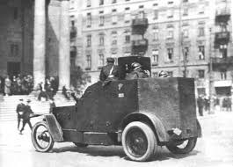
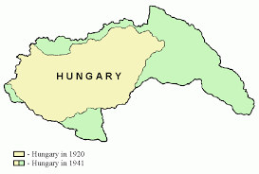
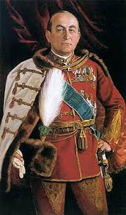
Political instability
Poland established democratic government in 1922, but due to social and economic distress, became a dictatorship in 1926.
Elite politicians consolidated power and instituted a “non-party” system after the 1935 elections.
Camp of National Unity (OZN), group based on principles of nationalism and social justice, took power in 1937.
Hungary, tied to Austria since before World War I, declared itself a democracy but was overthrown by communist forces in 1919.
In January 1920, National Constituent Assembly was elected to determine the future of Hungarian government. It decided on monarchy, but instead essentially became a dictatorship run by the aristocracy.
In 1932, General Gyula Gombos came to power as prime minister, an office he used as a dictatorship. Hungary floundered economically, and was unstable politically for most of the interwar period.

Slide 11
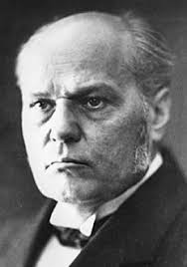
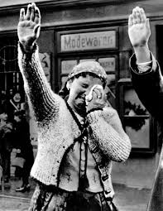
Czech yourself before you wreck yourself
Czechoslovakia proved the only nation in Eastern Europe able to function as a democracy during the interwar period.
October 18, 1918- Czechoslovakia declared its independence from Hungary and established the National Assembly in Prague.
Government worked to fix economic problems, establish reforms and land redistribution.
Parties within the Czech government worked together and created stability between 1922 to1929, ruled by Antonin Svehla.
Ethnic tensions grew stronger during depression, and the nation's 3 million ethnic Germans, most of who lived near the German border, became convinced it would be better to follow the German Nazi Party.
Czechoslovakia was not able to fend off German expansionism, and on September 18, 1938, under the Munich Pact, Britain and France officially recognized German Control of the Czechoslovakian Sudetenland.

Slide 12
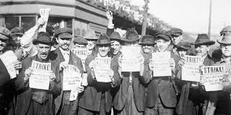
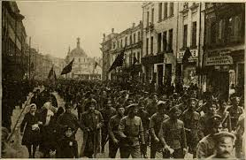
Why democracy failed
Democracy was hailed as the best system by which to introduce self- determination to a new nation.
Newly defined geographic regions under newly formed governments in Europe were unaccustomed to deciding their own fate.
In a region where democracy was unfamiliar, the system had many problems, including:
The general public had no experience with democracy, and was accustomed to following orders and having no political impact; could be easily manipulated.
Politicians were not used to democratic deliberation and proceeded cautiously, afraid that a wrong move would put them out of favor with the population or lead the government down a dangerous path.
Indecision on many issues led to chaos and allowed others to usurp and abuse power, forming oppressive, fascistic dictatorships. To many it seemed better than aimlessly drifting government.

Slide 13
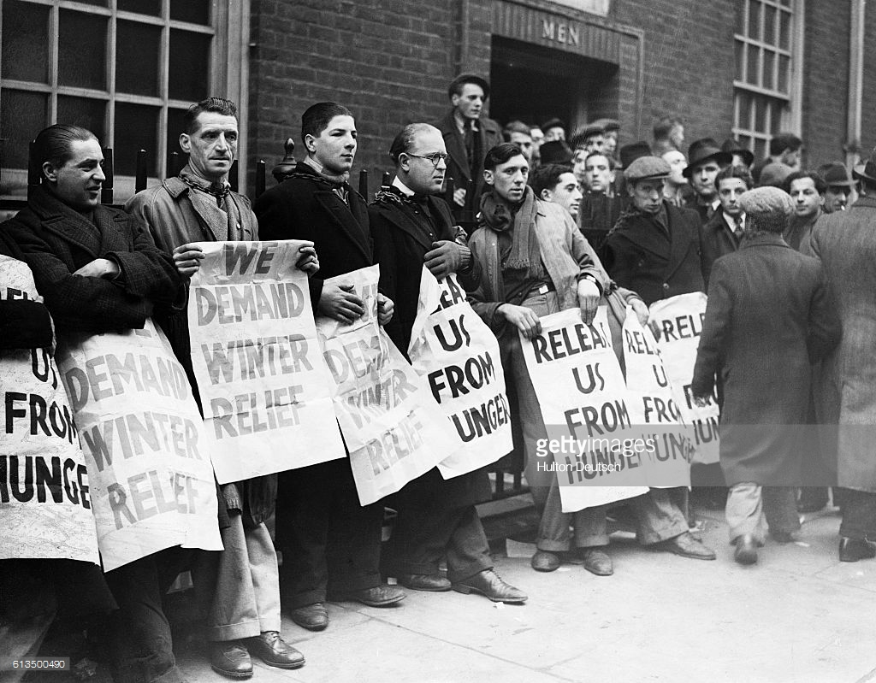
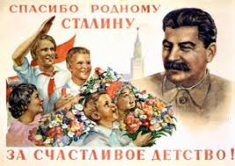
Global Depression

Slide 14
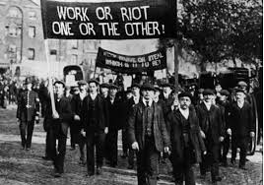
The Great Depression
October 29, 1929- New York Stock Market crashes after nearly a decade of over speculation, production decline, and rising unemployment
Leads to Great Depression that in the United States, and will begin to spread throughout Europe in the early 1930s
Banks fail, losing investor’s money.
Despite international loans, German and European currencies collapsed and all hope of stability was dashed.
Efforts to stabilize world prices and European employment would fail, and Europe remained in depression until the outbreak of World War II.

Slide 15
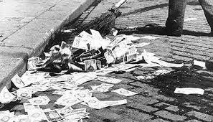
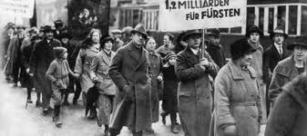
Germany
In Germany, where the post-war recovery had been particularly weak, the depression hit hard.
Six million Germans were unemployed in the early 1930s.
In 1931, when German and Austrian economies were in danger of collapse, the United States placed a hold on reparations payments.
The deal did not do much to help either country’s economy, but it hurt other European countries instead.
The British, who relied on German reparations payments to make their own repayments to the U.S., suffered a near-collapse of their financial system.

Slide 16
Communist Russia
To the depressed economies of Europe in the 1930s, Communist Russia’s economy seemed like a major success; seen as a signal that capitalism could be replaced by Communism.
Industrial output quadrupled during Stalin’s first two Five Year Plans.
The Soviets produced their own tractors and the best tanks in the world
They created their own aircraft industry, and the Soviet air force was equal to the German Luftwaffe
Russia’s economy was ruined because of World War I (1914-17) and Russian Civil War (1917-21).
Industrial production dropped to 18%
Agriculture was less than half of prewar levels
Unemployment was rampant.

Slide 17
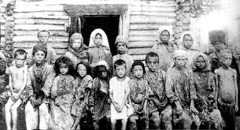
Communist Russia
Joseph Stalin’s Five Year Plans involved nation-wide industrialization, but Russia’s industry was not developed enough
Claimed that Russia was 50 to 100 years less industrialized than the Western powers.
Stalin used propaganda to promote worker enthusiasm, promising that rewards were only a few years away
Began enormous projects that could only be completed with the help of the workers, including providing electricity to all of Russia
Collectivization enabled the government to make agriculture into an industrial enterprise, which would theoretically produce more and eliminate the peasant class (who are now workers).
Farms had to meet quotas for the government to redistribute; surpluses could be kept by the farmer.
If a farm only met the quota, the government took everything.
Westerners did not see the famines that resulted from crop failures and pressure of collectivization
Millions of Russians die from famines

