Slide 1
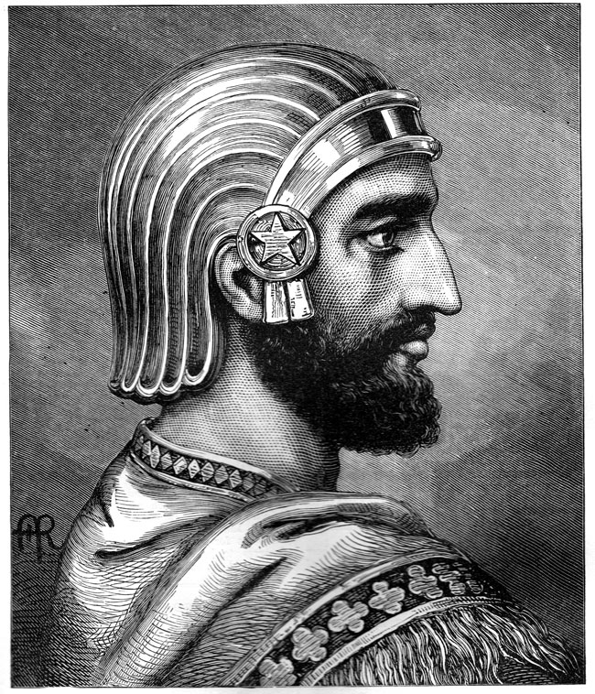
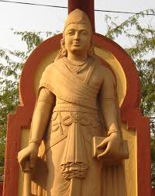
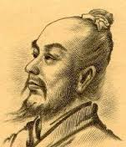
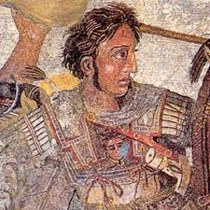
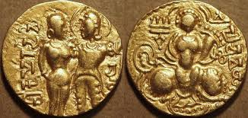
Classical Civilizations
Persia
Ancient Greece
Rome
Indian Empires
Qin & Han Dynasties

Slide 2
Cornell note-taking method
Notes color-coded in RED go on this side of the line.
These items will include:
Main Ideas
Big Concepts
Vocabulary Words
Notes color-coded in BLUE go on this side of the line.
These items will include:
Supporting details
Dates, Times, and Biographic details
Vocabulary Definitions
Any items in BLACK text are optional. Remember: the more thorough your notes, the more prepared you will be for exams.

Slide 3
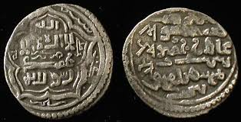
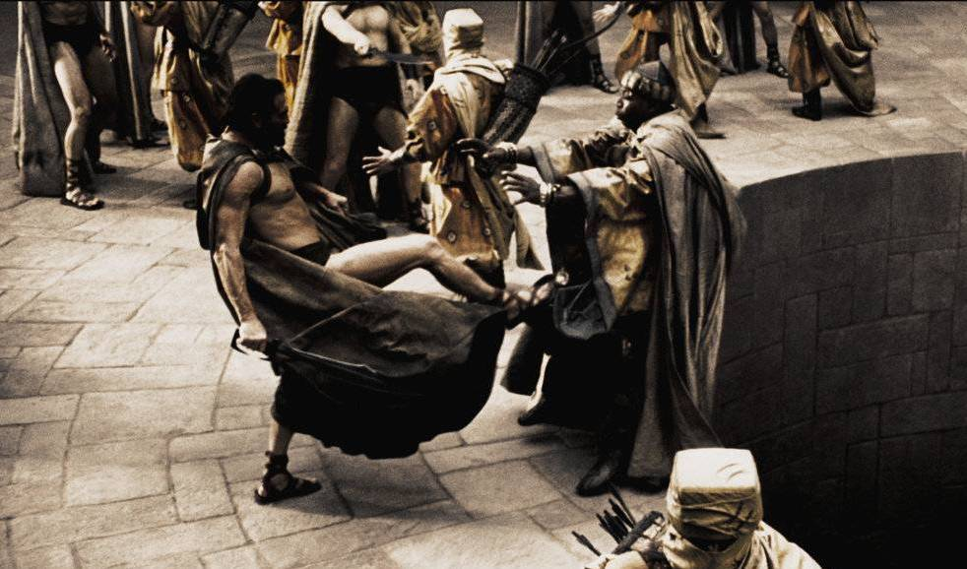
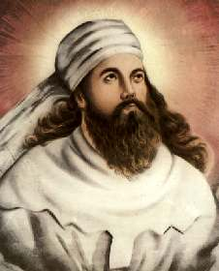
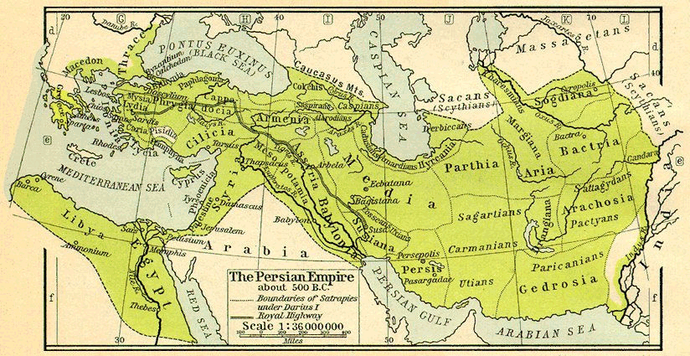
Persia
Empire Builders
Zoroastrianism
Decline

Slide 4
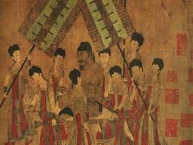
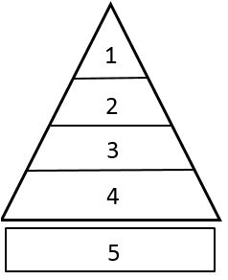
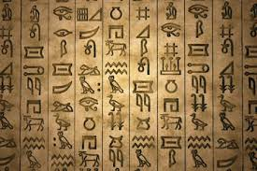
Influence of River valley Civilizations
Empire-builders expanded their territory, usually by conquering neighboring groups of people
Empires were influenced by developments from river valley civilizations:
Foundations for centralized government and organization
Monument-building
Written record-keeping of legal codes
Social classes
Civilizations began reflecting more on morality and the meaning of life, leading to emergence of religions and philosophical thought
Included contributions to art, literature, and science & technology

Slide 5
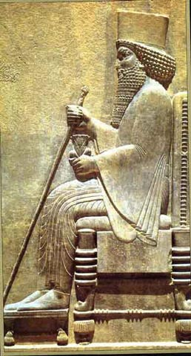
Persia: Empire Builders
2000 BCE – 100 BCE
Cyrus the Great- first emperor of Persia, conquered the Ionian Greeks and other surrounding territories
Cyrus honored local religious customs, welcomed Jews to return to Jerusalem, did not allow armies to loot, and was kind toward conquered peoples
Empire stretched to Indus River in the east and Tigris-Euphrates in the west
Peak: circa 500 BCE

Slide 6
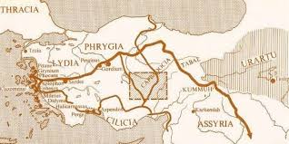
Persia: Empire Builders
Darius the Great- unified empire by building Persian Royal Road, a network of roads used for trade and communication
Divided the empire into different provinces, each with their own laws, that collected taxes paid to the empire.
Introduced standard units of measurement and weight, minted coins to increase the value of trade, and established a post office and mail-carriers

Slide 7
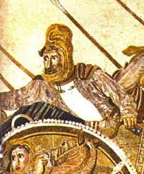
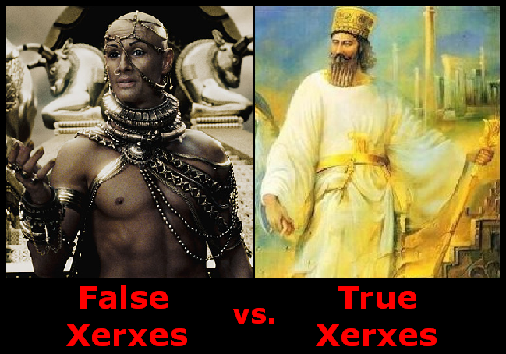
Persia: Decline
Ionian Greeks rebelled against Persia to gain independence
Athens helped the Ionian Greeks by sending aid
Persia stopped the Ionian rebels, and wanted revenge on Athens for interfering with their business (First Persian War)
Xerxes I- Darius’ son, launched military campaigns to invade Greece in an attempt to conquer and expand the Persian empire.
Xerxes’ descendants find it difficult to maintain a huge empire; they begin to raise the taxes paid to them by the provinces, leading to more rebellions
Darius III- defeated by Alexander the Great in Gaugamela, and Persia is absorbed into the Greek Empire

Slide 8
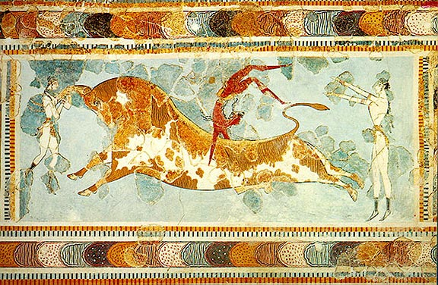
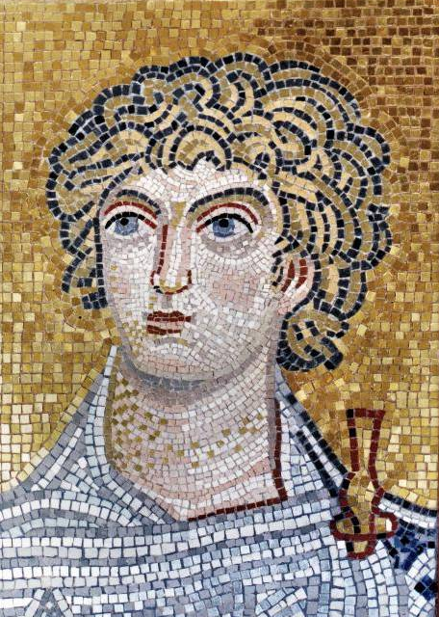
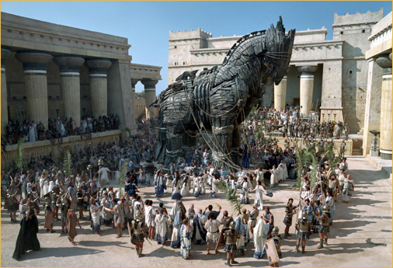
Ancient Greece

Slide 9
Ancient Greece: Early Greek Empires
Minoans- lived on the island of Crete & traded in Mediterranean region, flourished from 3000-1100 BCE
Frescoes show scenes of Minoan life and religion
Mycenaeans- founded when Indo-Europeans from central Asia intermarried with native Hellenes on mainland Greece; Flourished 1900 - 1100 BCE
Adopted Minoan customs, said to have fought in legendary Trojan War, setting of Greek Myths & Homer’s epics
Dorians- Move into Greece from the north; Mycenaeans weakened by infighting, defeated by Dorians using iron weapons
Dorian period known as “Dark Ages” in Greece, last from about 1100-800 BCE

Slide 10
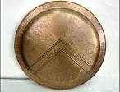
Ancient Greece: This is Sparta
Sparta- Greek city-state whose culture revolved around a strong, loyal military; reached peak power from 404-371 B.C.E.
All Spartan men were professional soldiers, with warrior training beginning at the age of 7
Loyalty to state & military came before personal needs, family, or friendships
Spartan women were well-educated and enjoyed more freedoms than other Greek city-states; all domestic tasks were performed by a slave class of conquered prisoners
Spartan citizens who were not fit for military training were cast out from society, left to fend for themselves
Battle of Thermopylae- aka the Battle of the 300 in 480 B.C.E., Persian King Xerxes I invaded Greece but was delayed by Spartan King Leonidas and 300 soldiers.
Xerxes took half of his troops through a mountain passage and surrounded the Spartans, killing them all and continuing his campaign into Athens, where he was defeated.

Slide 11
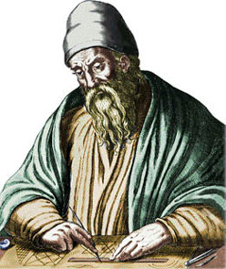
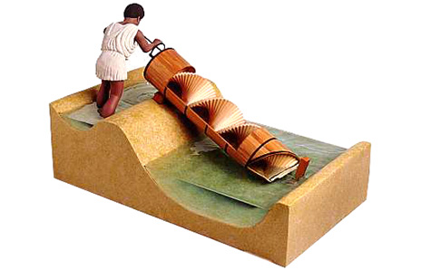
Ancient Greece: Building the Empire
After winning the Persian War, Athens began collecting tribute (gifts and money) from other city-states for protection and expansion of the Greek empire
Pericles- Rules Athens from 461-429 BCE; extended democracy to most adult males, rebuilds Athens after the war
Pericles’ rule will be known as the “Golden Age” because of the contributions to art, history, music and literature from this period.
Thucydides- wrote accurate historical accounts, Peloponnesian Wars
Significant developments in math & science:
Archimedes- mathematician & inventor, learns to calculate volume
Hippocrates- doctor; modern Hippocratic Oath is named for him
Pythagoras- measured triangles, Pythagorean’s Theorem

Slide 12
Ancient Greece: Hellenic vs. Hellenistic
HELLENIC
HELLENISTIC

Slide 13
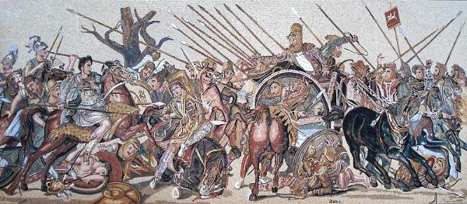
Ancient Greece: Alexander the Great
Alexander the Great- born in Macedonia, a kingdom north of Greece, son of King Phillip II
Student of Aristotle
Well-trained in military ops and hand-to-hand combat
Conquered the Greeks in 338 BCE, conquers Syria & Egypt in 331 BCE, and begins conquering parts of Persia
Eliminates all his rivals, uses force and diplomacy to put down revolts across Greece
In 332 BCE he wins the Battle of Gaugamela, which leads to the fall of the Persian Empire
Invades India in 326 BCE but his troops demand to finally stop
In 323 BCE, Alexander dies in Babylon

Slide 14
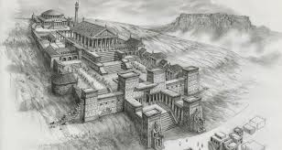
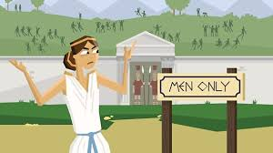
Ancient Greece: Decline of the Empire
Alexander died before unifying his conquered territory; the military leaders he left in charge were unable to maintain the expansive lands
Portions of the empire were quickly taken over by other groups
Most of it was taken over by Rome
The Greek empire, while under Alexander’s control, had many cultural achievements, including:
blending of east and west (Hellenistic culture)
Alexandria in Egypt became a major city & contains the world’s best library (original burned during the Roman Conquest)
New status & opportunities for women in society, including education and physical training

Slide 15
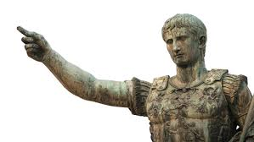
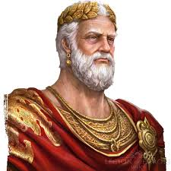
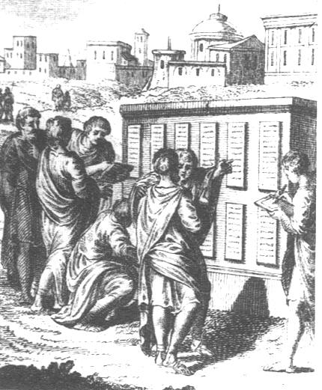
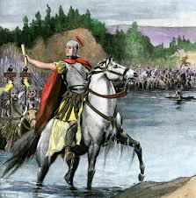
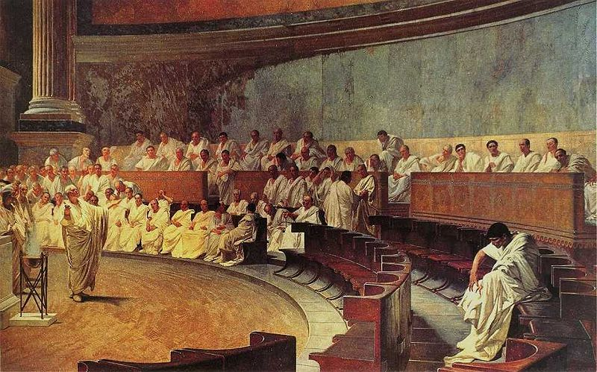
Rome

Slide 16
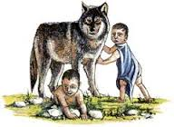
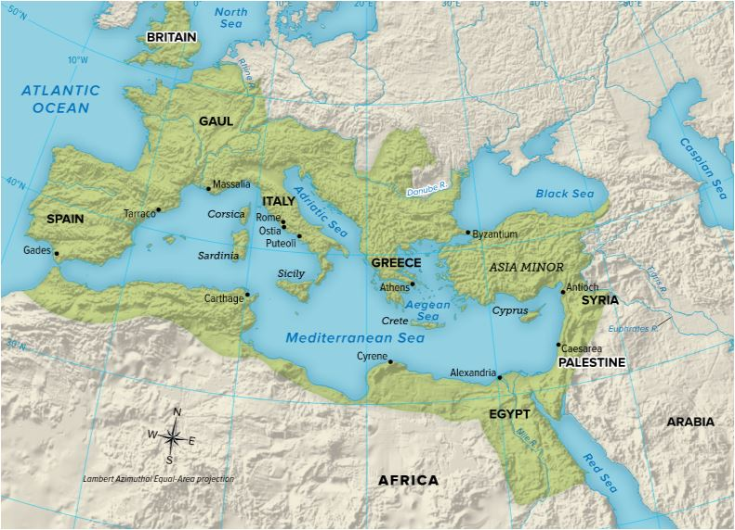
Rome: Early Empire
Rome (named for founder and first king, Romulus), located on the Apennine (aka Italian) Peninsula on Mediterranean Sea, was settled by different groups
Latins- built the original settlement of Rome
Greeks- colonized southern Italy and Sicily
Etruscans- native to northern Italy
Even before the establishment of the Republic, Rome was divided between two social classes:
Patricians- wealthy landowners, held most of the power
Plebeians- farmers, merchants, artisans who made up the majority of the population

Slide 17
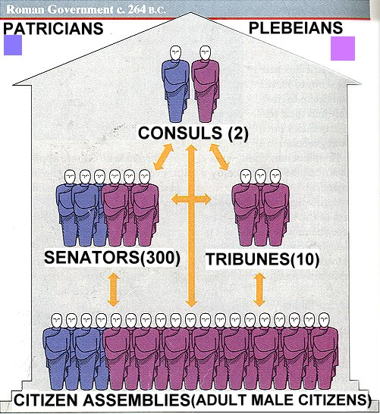
Rome: The republic
Roman Republic established in 509 B.C.E
Republic- a form of government in which power rests with citizens that vote for their leaders.
Senate- legislative branch of Roman government; made up of 300 members who proposed laws, nominated consuls, and served lifetime terms
Consul- 2 officials (1 Plebeian, 1 Patrician), served a one-year term, one was chosen to act as a dictator during wartime
Tribunes- elected to protect plebeian interests, had veto power, allowed them gained access to higher offices & Senate
Didn’t have to use war or revolution to gain power
Veto is a Latin word meaning “I forbid it.”

Slide 18
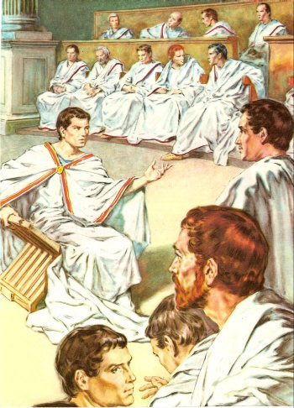
Rome: the Republic
Dictator- elected during a crisis to rule for 6 months, could be appointed by consul or magistrate, had absolute authority
Twelve Tables- Written law code that was carved on 12 tablets.
Until 451 B.C.E there were no written laws
Established the idea that all free citizens had a right to protection of the law.

Slide 19
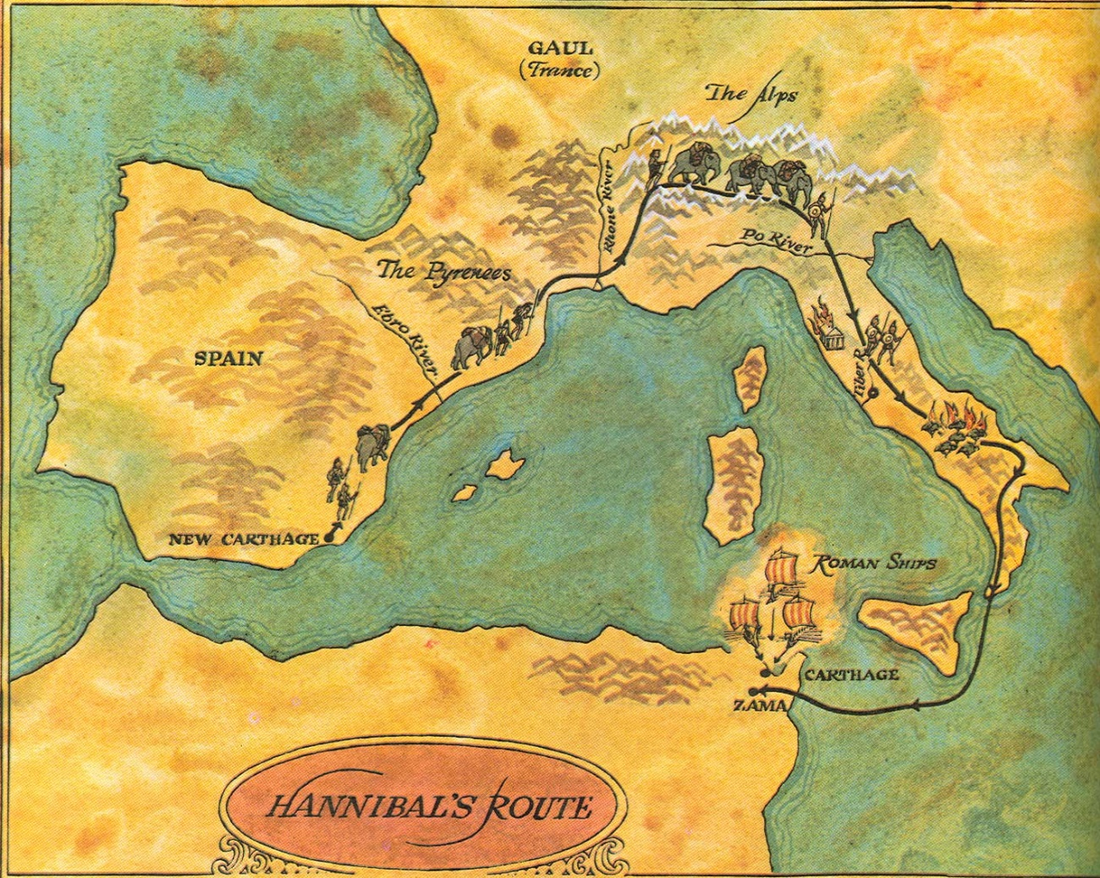
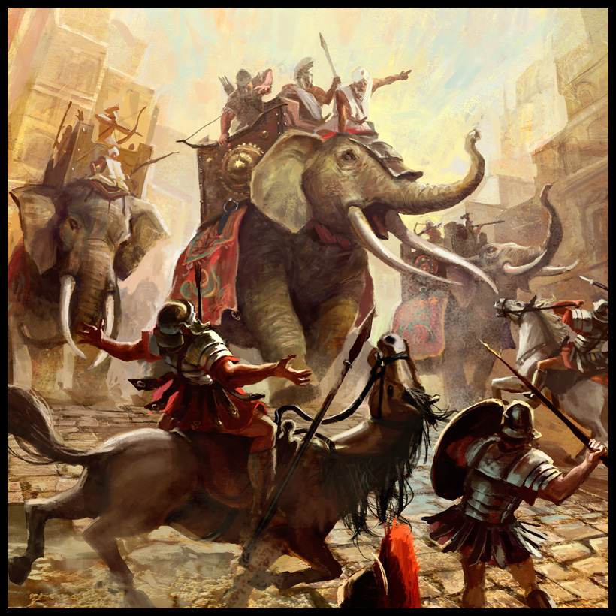
Rome: Punic Wars
Legions- groups of 6000 men, all male citizens who owned land required to serve in army, well-trained and disciplined
1st Punic War- Carthage was competing with Rome for trade, control. Carthage has strong navy, Rome builds one to fight it. Rome defeats Carthage, gains Sicily
2nd Punic War- Hannibal, a general from Carthage went through Spain & Gaul to attack Rome by land
Terrorized the Roman countryside
Finally defeated in Africa
3rd Punic War- Romans attack and burn Carthage, enslave people, and ends up with control of the Mediterranean
“Carthago delenda est” (Carthage must be destroyed)

Slide 20
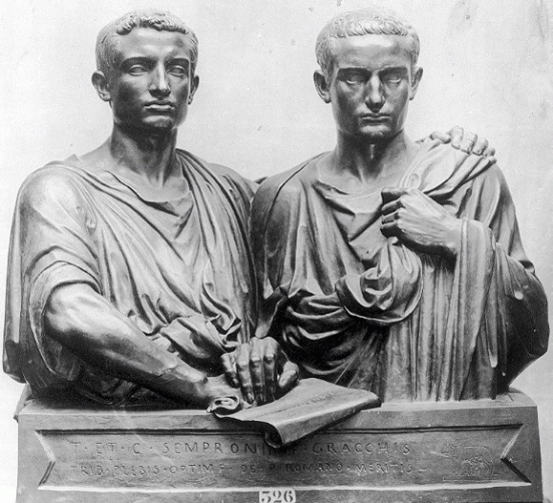
Rome: Maintaining the republic
Spartacus led rebellion of 70,000 slaves against Rome after years of complaints of corrupt officials, widening of the gap between rich and poor, and treatment of slaves
Brothers Tiberius and Gaius Gracchus attempt to initiate reforms in the Republic, including giving land to the poor, but both were assassinated in the Senate
Military reforms by using paid, equipped soldiers (mercenaries); they also gave land to veterans at the end of their time served
This is the beginning of a professional fighting force
Soldiers become more loyal to generals than republic

Slide 21
Rome: Civil war
First Triumvirate- alliance of Caesar, Crassus, & Pompey that combined the ability of all three men; lasted from 60 B.C.E – 53 B.C.E
Julius Caesar- enormous popularity and great legal reputation, wins military campaigns in Gaul
Crassus- great wealth and influence, dies after a battle in Persia
Pompey- very wealthy and great military skills; elected as Consul, but is jealous of Caesar’s fame and success
Tells Caesar to disband his army & return home.
Caesar denies the request and marches his army across the Rubicon River, interpreted as a sign of war
Caesar has committed treason by crossing the Rubicon with his army
Pompey’s legions fight Caesar’s in Greece; Pompey is defeated and flees to Egypt, but Caesar’s men find him and kill him
Caesar continues on toward Egypt

Slide 22
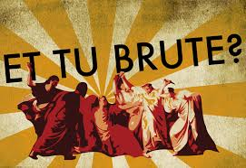
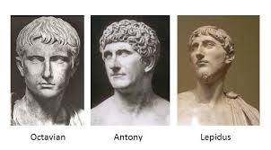
Rome: Hail Caesar
Caesar defeats Ptolemy's army and makes Cleopatra the ruling pharaoh of Egypt
Falls in love with her and she gives birth to his son, Caesarion
Caesar returns to Rome & is elected dictator for life
Helps the poor get jobs, expands Rome’s territory, increases soldier’s salaries, and creates the Julian Calendar
The Senate is upset about how much power he has
“Beware the Ides of March”- March 15, 44 BCE, Caesar is stabbed 23 times by his closest friends, Brutus and Cassius
Second Triumvirate- made up of Caesar’s friend Mark Antony, adopted son Octavian, & the politician Lepidus; they turn on each other and Octavian defeats Marc Antony
Octavian becomes the first Roman Emperor and changes his name to Caesar Augustus

Slide 23
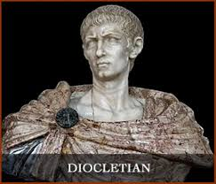
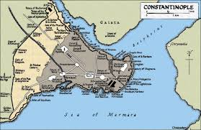
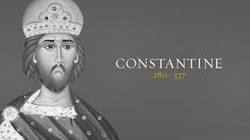
Rome: Decline of the empire
Pax Romana ends in AD 180; power is taken by a series of short-lived emperors, high taxes placed on citizens and poor farmers work for the wealthy in partial slavery
Diocletian- ruled as Emperor from 284 – 305 CE; divided empire into two parts, east and west
Fixed prices to maintain the economy
Farmers stay on their land
All must follow their father’s job
Constantine- ruled as Emperor of Rome from 312 – 337 CE, issued the Edict of Milan which grants tolerance to Christians, orders building of Constantinople

Slide 24
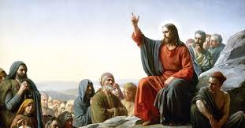
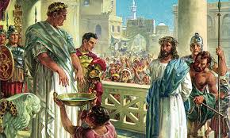
Rome: Birth of Christianity
Christianity is centered on the life and teachings of Jesus of Nazareth, referred to in Christian Bible as Jesus Christ, the promised Messiah of Jewish prophecies
Jesus of Nazareth was a Jewish carpenter who began preaching around age 30; worked with the poor, sick, and outcasts of society
Parable- stories about everyday life with a divine message as the resolution; was often used by Jesus in his teachings
Disciples- Jesus’ followers who continued his ministry after his death
Claimed that he spoke with Divine authority (voice of God), sparking anger with Jewish leaders who turned him over to the Romans under charges of starting a rebellion
Convicted of heresy and sentenced to death by crucifixion

Slide 25
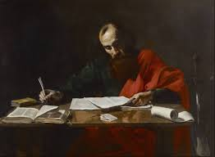
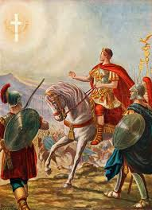
Rome: Birth of Christianity
Paul of Tarsus- missionary whose work is credited with building the early Christian faith were essential for the development and success of the early church
St. Paul's teaching centered on understanding the death and resurrection of Jesus Christ as a central turning point in history.
His letters to fledgling churches throughout the Roman Empire are contained in the New Testament.
St. Paul established Christian churches throughout the Roman Empire, including Europe, and beyond - even into Africa. However, followers were persecuted under tyrannical Roman emperors like Nero, Domitian (under whom being a Christian was an illegal act), and Diocletian.
Constantine’s conversion led to Christianity becoming the official religion of the Roman Empire, creating Christian tolerance and growth of political power

Slide 26
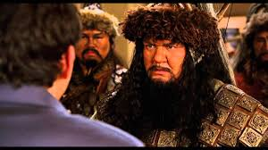
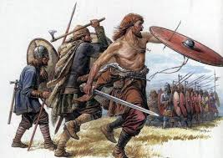
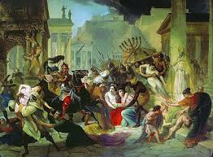
Rome: Decline of the Empire
Foreign Invasions- 400-500 CE, invaders from the North begin to terrorize Rome
Attila the Hun- migrated from central Asia, led the Huns who raided the eastern empire, terrorized Italy, then retreated to eastern Europe after Attila’s death
Visigoths- powerful Germanic tribe who rebelled against Romans, they captured and sack Rome in 410 CE
Vandals- 2nd Barbarian group to sack Rome, overthrow the emperor in 476 CE, marking the end of Western Roman Empire

Slide 27
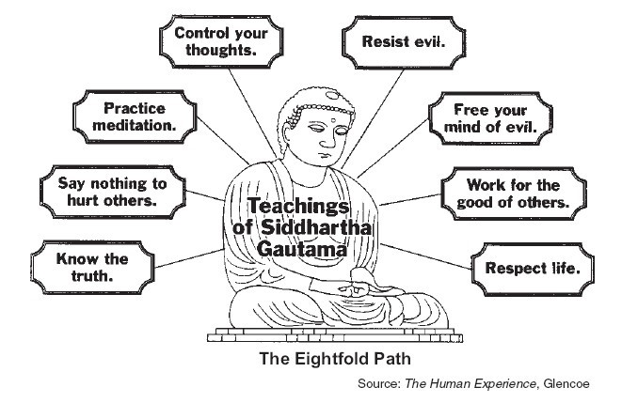
India

Slide 28
India: Caste System
Indo-Aryans- nomadic hunters that invade India around 1500 BCE, bring sacred scriptures of Hinduism that are first sung then later written in Sanskrit.
Caste System- a social hierarchy brought by the Aryans and formalized by written law; split between two concepts, Varna and Jati.
Varnas – class level is determined based on your temperament
Brahmin: study/teach;
Kshatriya: power/protect;
Vaisya: earn/give;
Sudra: serve
Jati – class level is determined based on your occupation. You are born into your class, and there is little to no mobility.
Farmer, barber, shepherd, etc. (occupation)
Untouchables- the lowest classes, considered outsiders, given impure jobs, like trash collector and grave digger

Slide 29
India: Mauryan Empire
Chandragupta Maurya- unified India in 321 BCE, reclaimed portions of empire taken by Alexander the Great, stabilized economy until end of reign in 297 BCE
Bureaucracy- system of departments and agencies that carry out the work of the government.
Divided the empire into 4 provinces
Hired district officials who assessed taxes and imposed laws within these provinces
Taxed citizens heavily to raise an army of 630,000 men and 9,000 elephants
Kautilya- Maurya’s advisor, wrote guidelines for rulers called Arthasastra, which outlined strict policies designed to hold the vast territory together
Use of spies, assassinations, secret police, and an elaborate government

Slide 30
India: Asoka
Asoka- Mauryan emperor, Chandragupta’s grandson; converted to Buddhism, a religion that promoted peace, after a particularly violent conquest resulted in deaths of 100,000 soldiers
Known as humane and just ruler; encouraged religious tolerance and vegetarianism, limited Hindu animal sacrifices, and spread Buddhism throughout Asia using missionaries
Built up the empire, including:
Rock Edicts- stone pillars inscribed with his new policies and laws
Extensive road system
Constructed hospitals
Unfortunately, after Asoka’s death the empire crumbled due to lack of unification.

Slide 31
India: Gupta Empire
Chandra Gupta I- took power in 320 CE, organized a strong central government and ensured peace and prosperity
Power was left in the hands of individual leaders and city government officials
Trade flourished under the Guptas, bringing empire into contact with Asia and Middle Eastern kingdoms. Other accomplishments of his empire include:
Development of Hindu culture (art, music, literature, and architecture)
Astronomy, Mathematics & Medicine
Created calendar based on the sun & proved Earth was round
Like many other empires, Gupta’s descendants were unable to manage a large empire. Civil wars, weak rulers, and invaders also undermine stability.
Fractures back into the many kingdoms that existed before unification
No new empire seen in India for nearly 1000 years

Slide 32
Ancient China

Slide 33
China: Philosophy
Confucianism- developed in 500 BCE. Based on the life and teachings of Chinese philosopher Confucius, followers seek to reform society including social order of family and government
Daoism/Taoism: established by Laozi, addresses order, harmony, and balance between man and nature
Legalism: does not focus on spirituality; instead, it stressed reforming society through government order and stability.
Citizens need rules to force them to behave in a moral manner
Clear definitions of power and responsibility
Punishment over Rewards

Slide 34
China: Qin Dynasty
Ruled by Qin Shi Huangdi, who used Legalist ideas to unify China through autocracy.
Negative: Jailed, tortured and killed all critics; burned all books of Confucian thinkers or any critics of Legalism
Positive: Built highways, set standards for law, currency, and weights, builds canals, expands trade
Great Wall of China- built as a barrier to keep out northern invaders, viewed as symbol of the strength of China
Forced labor and high taxes necessary for the wall’s construction made Qin Shi Huangdi very unpopular

Slide 35
China: Han Dynasty
Liu Bang: relied on Confucius policy rather than the harsh legalist ideals of Qin dynasty,
Emperor Wudi: longest serving emperor, considered to be most important; known as the Martial emperor because he expanded empire through war
Eliminated Legalist policies and implemented policies based on Confucianism
Improved canals and roads
Imposed a government monopoly (complete control of a product or business) on iron and salt
Unpopular political decisions will weaken the dynasty through internal conflicts, leading to the Han downfall in 9 C.E.

Slide 36
China: Accomplishments
Civil Service- Officials should win positions by merit rather than through family background; to find those most qualified they set up a system of exams
Poor couldn’t afford it
Women were prohibited from taking it
Paper, yokes, plow, wheelbarrow, improved iron tools, use of water power to grind grain
Agriculture was considered the most important profession in China, but trade still thrived under Han rule.
Government monopolies produced silk which was traded as far west as Europe

Slide 37
China: The Silk Road
Stability of Classical Civilizations allowed merchants and traders to safely travel between regions
Trade routes originated in China, where merchants sold silk during the height of the Han Dynasty
Networks will eventually reach Greece & Rome- over 4000 miles away!
Spices, jade, and porcelain traded from the East (China) to the West (Europe)
Olive oil, wine, cloth traded from West (Europe) to East (China)
Positive: Buddhism will spread through China, Hinduism will spread through India, and math concepts will spread through the Middle East along the Silk Road
Negative: Diseases, especially bubonic plague, will spread from Asian origins to Europe through human contact

