Slide 1
culture
What is it…really?

Slide 2
Elements of culture
Culture refers to a people’s way of life, how they meet their basic needs for food and shelter, their beliefs about the world and religion, music, art, and technology.
Elements of Culture include:
Language
Religion
Social Structure & Ethnic Groups
Customs
Family Structure & Gender Roles

Slide 3
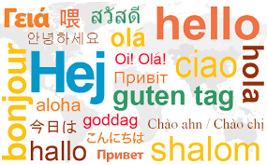
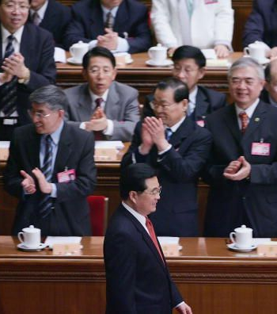
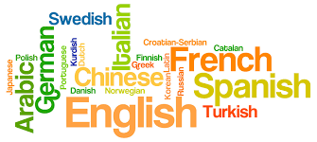
Language
Language is a system of words and symbols people use to communicate with each other
Includes full languages (English, French, Spanish), slang (Spanglish), and body language
Language unites peoples from many different places on Earth.
Spanish is spoken on every habitable continent except Australia.

Slide 4
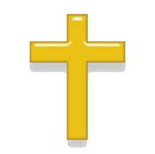
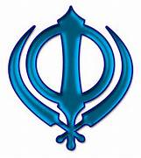
Religion
Religion is a set of beliefs about the meaning of life, the nature of the universe, and the existence of a God or Supreme Being.
Includes customs and practices that are related to the worship of God or several Gods that set the rules for living a good life.
Organizations like churches, temples, or mosques where religious practices are conducted.
One of the most important aspects of culture.

Slide 5
Social Structure & ethnic groups
Social structures provide a way for members of a society to work together to meet needs. People are organized into different social classes when they share similar levels of wealth, power, and influence. Vary from culture to culture.
Upper Class- earns or inherits wealth, owns large shares of property in society, luxurious lifestyles, often serve in leadership roles
Middle & Working Class- educated, mostly successful people (managers, small business owners, professionals, shopkeepers).
Peasant & Lower Class- labor workers and the unskilled/uneducated.
Ethnic Groups – people that share a common language, history, place of origin
Homogeneous societies- where everyone belongs to same ethnic group
Multicultural societies- one dominant ethnic group and several minorities; ethnic groups are mixed throughout the country, certain groups sometimes stick to a specific region

Slide 6
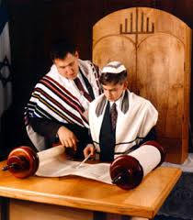
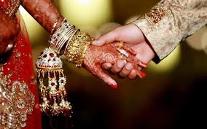
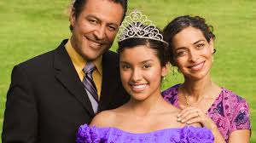
customs
Traditions and learned behaviors that people participate in, including:
Clothing & Traditional Dress
Food
Rules for Behavior
Customs also include how they celebrate holidays and rites of passage, such as:
Births
Coming of Age (Bat Mitzvahs, Quinceaneras, Sweet 16s)
Marriage
Parenthood
Death

Slide 7
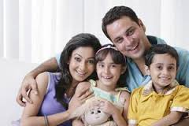
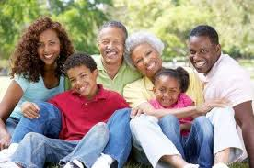
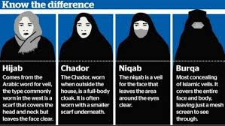
Family structure & gender roles
Family Structure- a support system in which there are positions that serve specific purposes for providing care for members (ex: mother, father, child, grandmother, uncle…)
Gender Roles- social norms that dictate how people are expected to behave
In advanced societies, gender roles are changing to represent modern social norms- both parents may work, men may provide child care, women work in influential business and political positions.
In traditional societies, women are expected to stay at home and be accompanied by a male in public. Both men and women are expected to wear specific clothing, though women’s clothes are much more restrictive than mens.

