Slide 1
Great Greek Thinkers
Socrates
Plato
Aristotle

Slide 2
The study of life, knowledge, problems, reality, & reason
Philosophers = “lovers of wisdom”
Sophists =“workers of wisdom”

Slide 3
Professional philosophy teachers who traveled Greek city-states; usually taught using methods of reasoning and moral skepticism
Also taught music, rhetoric, and athletics
Charged fees for their teaching

Slide 4
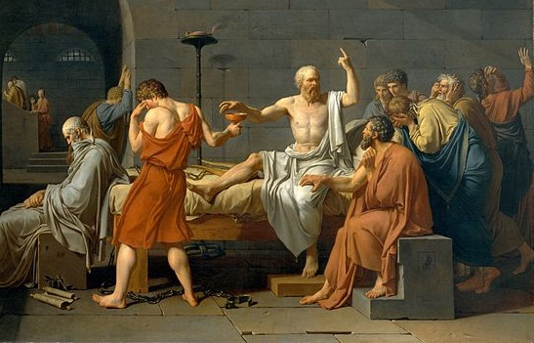
470 – 399 BCE
Critic of Sophists but popular with Athens’ youth, he believed one’s purpose in life should be to seek answers to tough questions
Finding those answers would provide all humans need to live full lives
Put on trial for corrupting the youth
Sentenced to death & drank poison hemlock

Slide 5
The Socratic method
Socrates’ teaching method, one of the world’s oldest (and still used) strategies
Argumentative dialogue between individuals, based on asking and answering questions to draw out ideas and conclusions
Designed to foster deep understandings
Encourages critical thinking

Slide 6
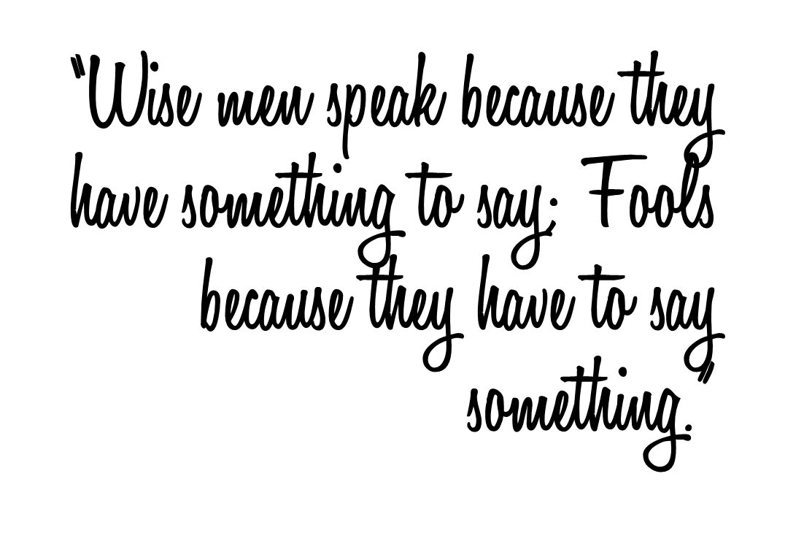
427 – 348 BCE
Student of Socrates, preserved his teachings and continued his work after his death
Philosophies centered on reality and the human perception of it, the three parts of a soul, and preserving balance between them to live a full, healthy life
Author of The Republic
Founded a school – The Academy

Slide 7
Plato’s Academy
Founded in Athens
Described as the 1st European university

Slide 8
384-322 BCE
Student at Plato’s Academy
Developed Logic as a field of study
Tutored Alexander the Great

Slide 9
Tutored Alexander the Great
Opened The Lyceum – a school
Influential ideas on government & science

Slide 10
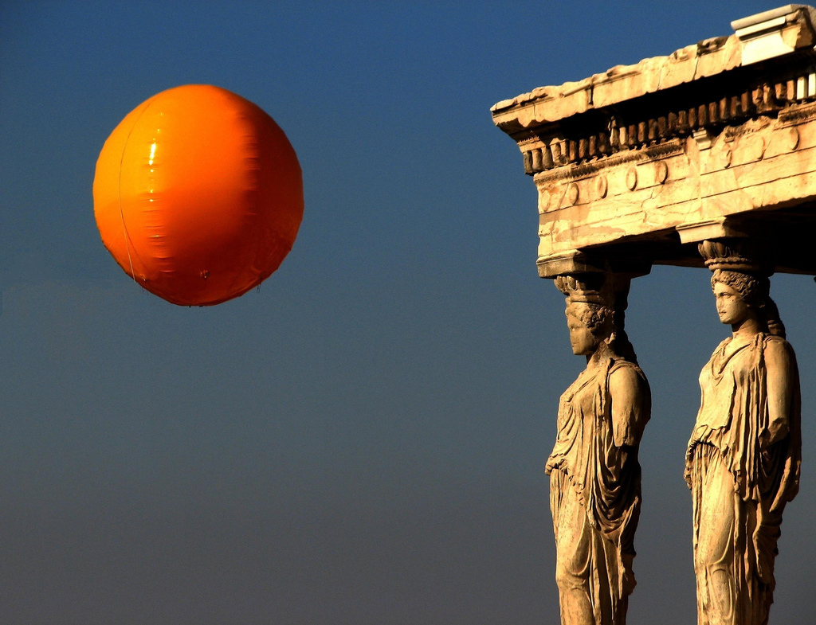
Encouraged deep thought
The Scientific Method and tests on ideas
Critical thinking about government and rule
Good short review video here: https://youtu.be/GmHAdgDkcCw

