Slide 1
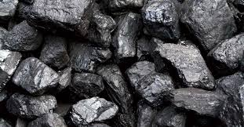
Introduction to economic systems
-Natural Resources
-Needs & Wants
-Types of Economies

Slide 2
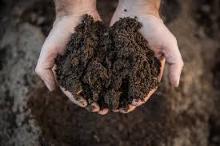
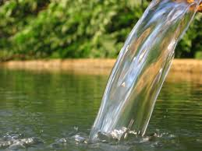
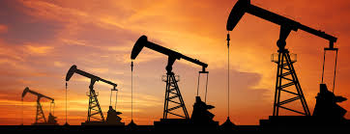
Natural Resources
Materials or substances like plants, minerals, water, fertile soil, or fossil fuels that are produced by nature and used by humans.
Used to produce goods and services people need
Natural resources are not evenly distributed all over the world- this can lead to upsetting the balance of power and greed in many regions.
Some countries use their wealth in resources to control and manipulate regions with fewer resources.
Other countries and regions have even gone to war over the management, ownership, allocation, use and protection of natural resources

Slide 3
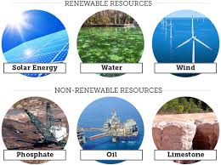
Natural Resources
Renewable Resources- materials that are constantly available or can be reasonably replaced or recovered.
Plant and Animal fibers (wool, leather, fur, etc.)
Water
Wind & Solar Energy
Non-renewable Resources- some resources can be replaced, but they may take many years to replenish, if ever.
Minerals (diamonds, metals, chemicals, etc.)
Trees
Fossil Fuels- oil, coal, and natural gas deposits that formed when prehistoric plants and animals died and were gradually buried by layers of rock and formed over millions of years, non-renewable

Slide 4
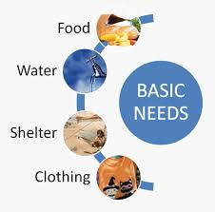
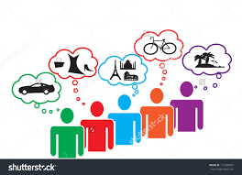
Needs & Wants
Needs- goods or services that are required for survival, such as clothing, food, water, and shelter
Wants- goods or services that are extra, that humans wish for or desire, such as brand-name clothing, electronic devices, Internet service, etc.
Scarcity- uneven distribution of natural resources in addition to the consumption rate leads to not having or producing enough materials for everyone
Three questions help society figure out how to distribute limited resources:
What should we produce?
How should we produce it?
Who should get it?

Slide 5
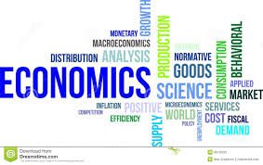
Economics
Economics- the study of how individuals, businesses, and nations make, buy, and sell products to make money.
Economics helps answer 3 Questions of Distribution.
Economic Systems are they ways each society chooses to answer those 3 questions. There are 4 economic systems:
Traditional
Free Enterprise (Capitalism)
Communist
Socialist

Slide 6
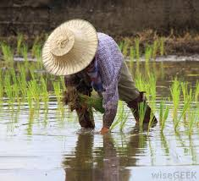
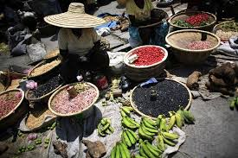
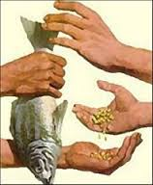
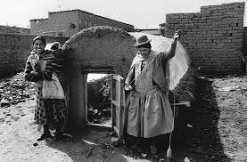
Traditional Economy
Traditional Economy- goods and services are produced in the same way as previous generations, change is discouraged, and progress happens very slowly
Based on agriculture (farming)
Hand-made goods or items
Exchange for other goods or hand-made items
Only enough goods and services are produced to meet the needs of family members or one village
Very little, if any, trade with outsiders
Subsistence Agriculture- farmers only grow enough produce to feed their families or villages. Many crops can be produced on these farms throughout the year.
Surplus- excess of products that are needed; extras
Commercial Agriculture- crops are harvested on a large scale to sell to grocery stores or international suppliers

Slide 7
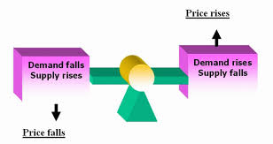
Free enterprise (capitalism)
People are free to take part in any business, buy any product, charge any prices, or sell any legal product in order to make a profit.
Supply & Demand- determines product prices and allocation of resources
When demand is high, price goes up
When supply is high but demand is low, price goes down
Limited Government Involvement- somewhat regulates business practices and maintains a money system, but the true power rests with business owners and producers

Slide 8
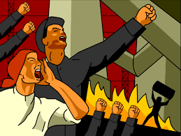
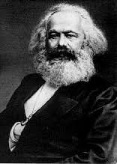
Communism
Economic system in which all major decisions on production, distribution, and use of resources is made by the government.
No private property; all lands, factories, farms, stores, and resources are owned collectively by the government.
Profit is shared equally by all citizens, regardless of amount of input labor or completed education.
Goal is to achieve a classless society and universal equality among citizens

Slide 9
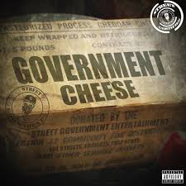
Socialism
Many decisions concerning production and resources are made by the government with some input from business owners
Major industries are owned by the government with some private ownership.
Goals:
Government should use its power to create equal distribution of wealth and resources
Bring an end to poverty by providing public services to meet basic needs

