Slide 1
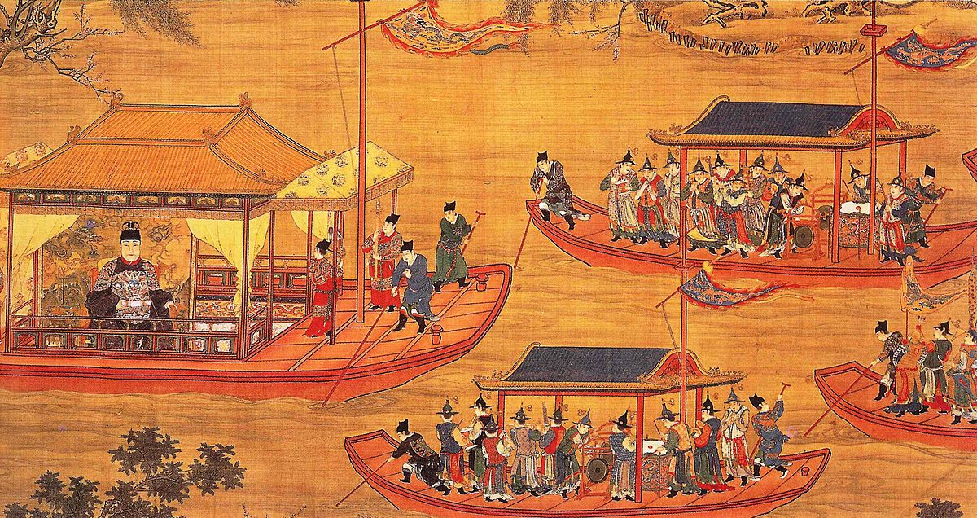
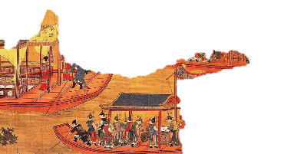

Slide 2
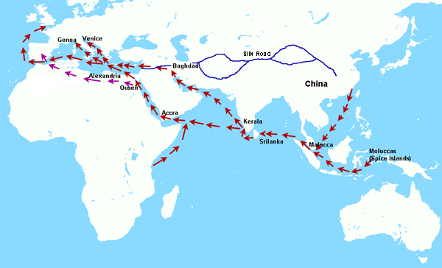
East Asia was a hot spot for luxury goods
Many Europeans were looking to trade with China and Japan

Slide 3
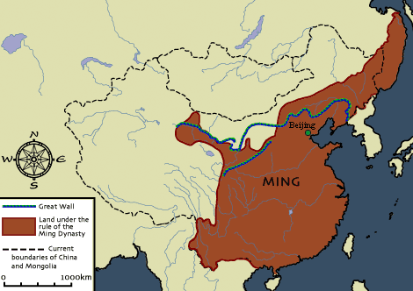
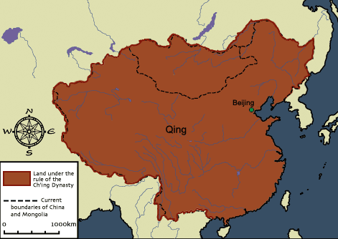
The Chinese people had rebelled and driven out their Mongol (Yuan) rulers and had established the Ming Dynasty (1368-1644)
The Ming government had ruled for 200 years and was weakening
Later, the Manchus, people from Manchuria, invaded China and established the Qing Dynasty which ruled for 260 years

Slide 4
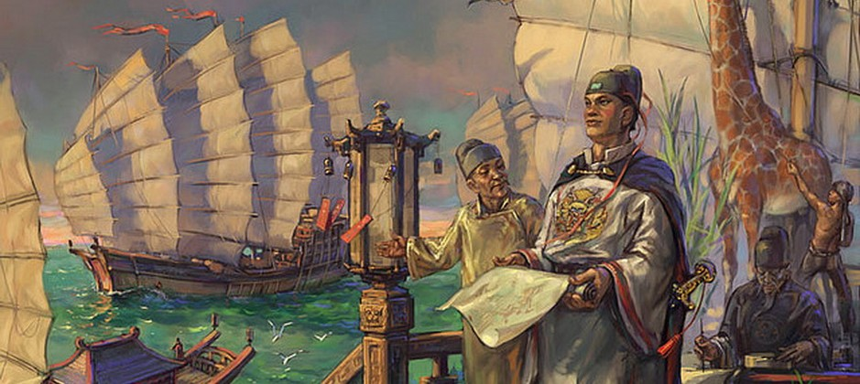
Emperor Hongwu and son Yonglo were curious about the outside world & launched voyages of exploration
Chinese Admiral Zheng He led seven voyages
Purpose of Voyages: Show of China’s might and power

Slide 5
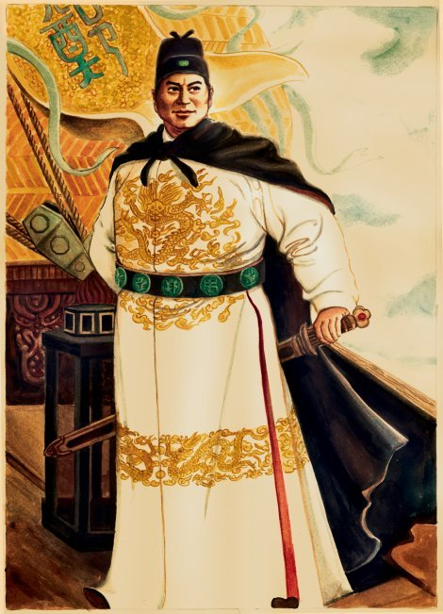
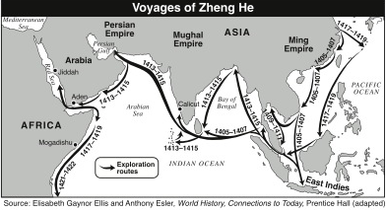
Voyages ranged from Southeast Asia to eastern Africa
From 40 to 300 ships sailed on each voyage
Some ships were 400 feet long

Slide 6
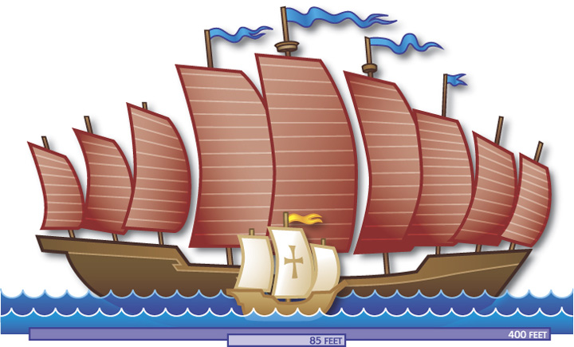
Voyages included sailors, soldiers, carpenters, interpreters, accountants, doctors and religious leaders
After 7th voyage and Zheng He’s death, China withdrew into isolation and destroyed the fleet

Slide 7
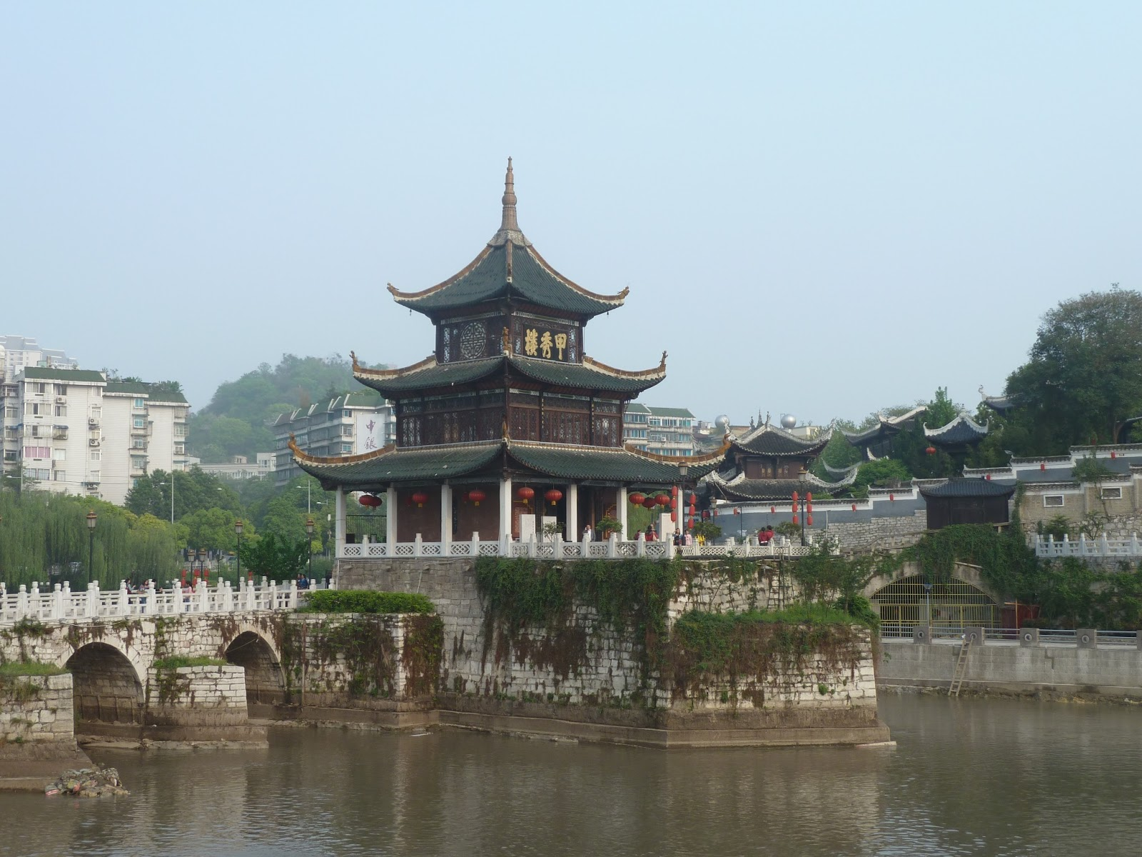
China’s trade policies in the 1500s reflected isolation
If foreign states wanted to trade with China, they would have to follow Chinese rules because the Chinese did not want Europeans threatening the peace and prosperity the Ming had brought to China.
China had a long history of being self-sufficient as well

Slide 8
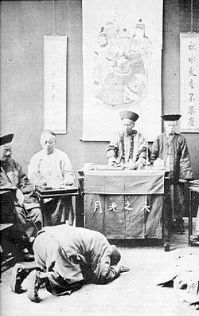
Only the government was allowed to conduct foreign trade
Trading was only allowed at certain ports
China expected Europe to pay tribute to Ming leaders;
Tribute is a peace tax
Kowtow ritual: kneeling in front of the emperor and touching forehead to ground 9 times
The Dutch accepted these restrictions and were allowed to trade

Slide 9
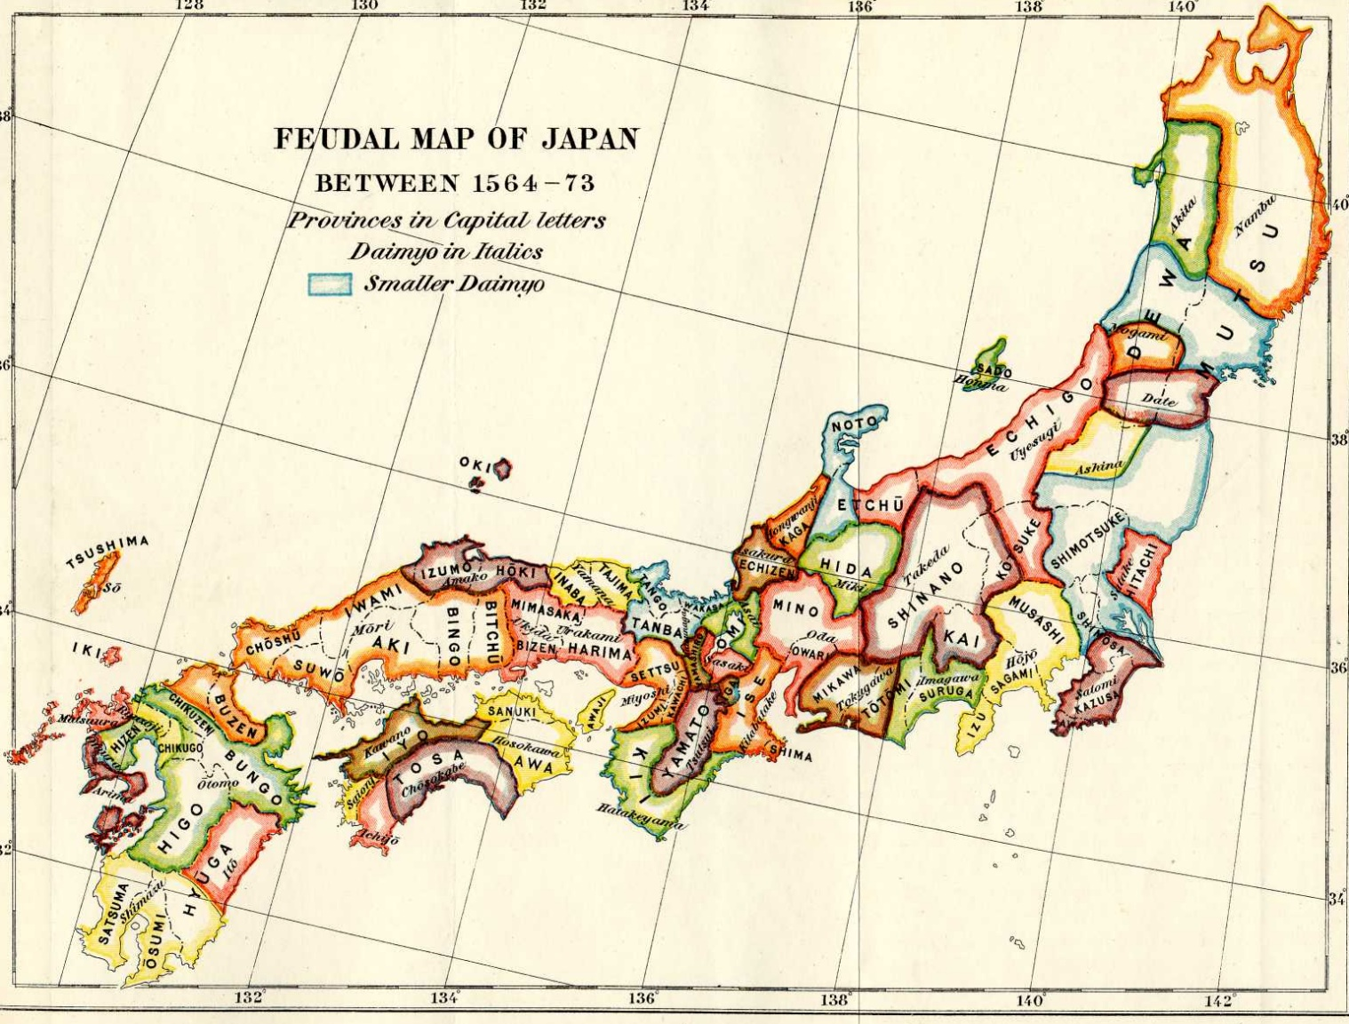
In 1467, civil war shattered Japan’s feudal system and the country became chaotic
Warrior chieftains called daimyos became lords in a new Japanese feudalistic system

Slide 10
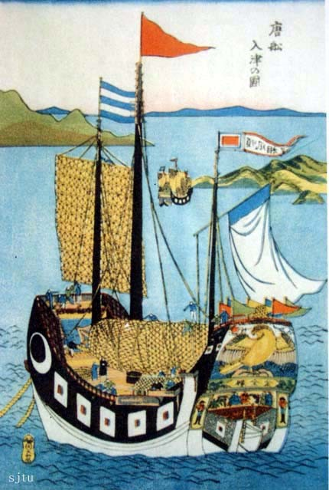
Europeans began coming to Japan in the 16th century and were welcomed
Within a century, the aggressive Europeans had worn out their welcome
The Portuguese brought clocks, eyeglasses, tobacco, and firearms
By 1600, European missionaries had converted 300,000 Japanese to Christianity
After peasant rebellion (most were Christian) the shoguns ruthlessly persecuted Christians and led to the formation of an exclusion policy
Notes:
Picture: A Chinese ship in Japan, at the beginning of the Sakoku period (1644–48 Japanese woodblock print)

Slide 11
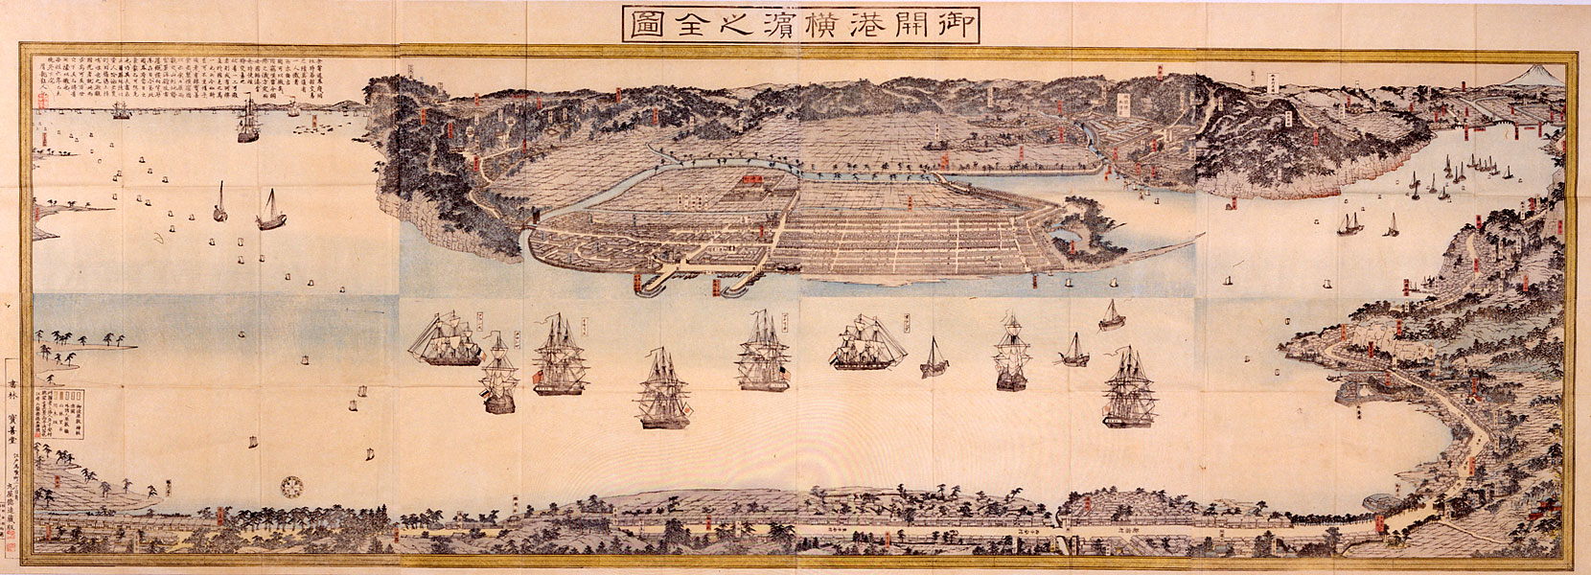
In 1639 shoguns sealed Japan’s borders and excluded merchants and missionaries
Only port of Nagasaki remained open but only to Dutch and Chinese traders
Lasted for more than 200 years
Why?
Japanese were forbidden to leave so as to not bring back foreign ideas
Japan wanted to continue to develop as a self-sufficient country
Notes:
Picture: “Complete Picture of the Newly Opened Port of Yokohama” by Sadahide, 1859-60

Slide 12
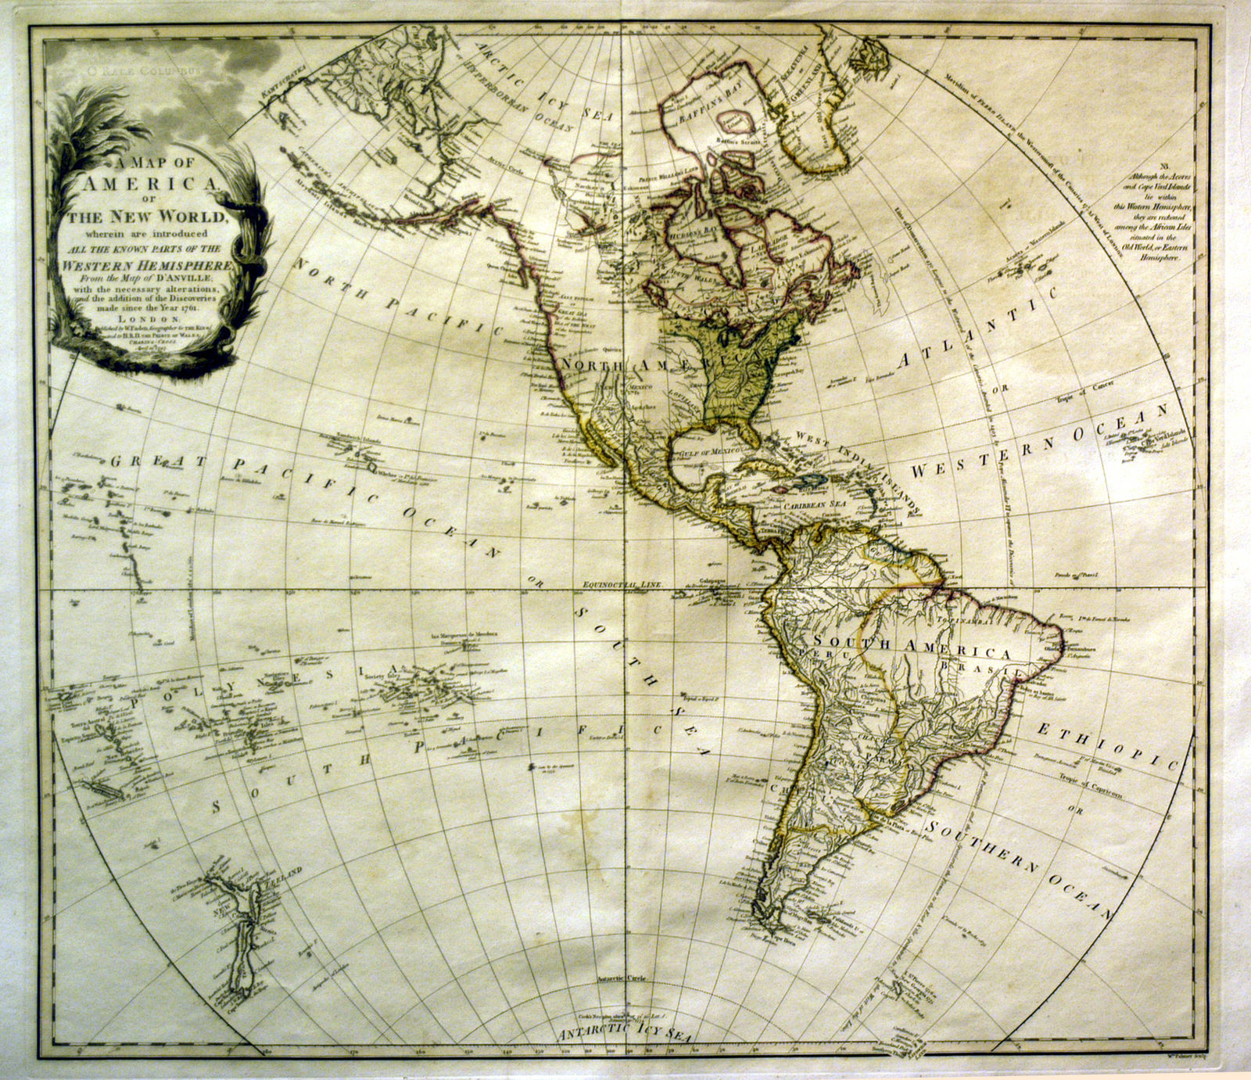
Europeans begin to explore west across the Atlantic Ocean to the New World.

