Slide 1
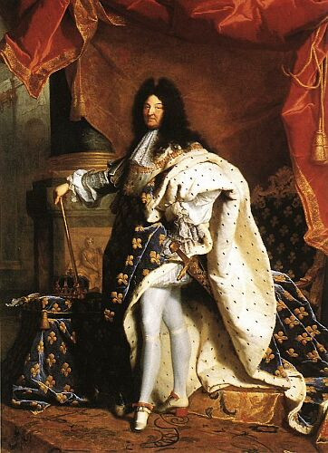
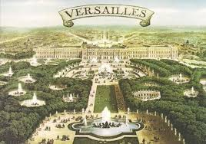
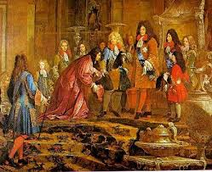
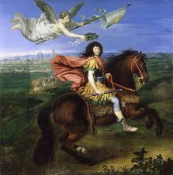
Louis XIV & Absolutism
The Sun King
Versailles
Absolutism

Slide 2
Cornell note-taking method
Notes color-coded in RED go on this side of the line.
These items will include:
Main Ideas
Big Concepts
Vocabulary Words
Notes color-coded in BLUE go on this side of the line.
These items will include:
Supporting details
Dates, Times, and Biographic details
Vocabulary Definitions
Any items in BLACK text are optional. Remember: the more thorough your notes, the more prepared you will be for exams.

Slide 3
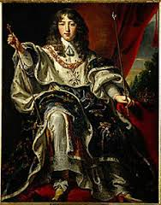
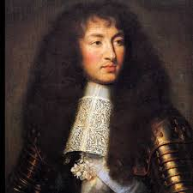
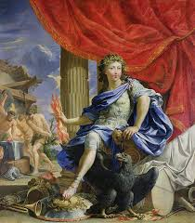
The Sun King
Louis Dieudonne
The Fronde
Personal Rule

Slide 4
The Sun King: Louis DieuDonne
Louis XIV- born in 1638; considered to be a “miracle” after his parents had been married for 23 years without children, origin of Louis’ belief that monarchs were direct representatives of God
Full name was Louis Dieudonne, literally “Louis, the Gift from God”
Crowned monarch after death of his father, at the age of 4. His mother, Anne of Austria, and her advisors were established as regents during his childhood.
Regent- an advisor appointed to administer and govern a country on behalf of the true monarch, who is unable to serve
Anne and her advisors introduced policies that centralized the monarchy’s power, angering nobles and members of the legal aristocracy.

Slide 5
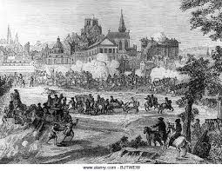
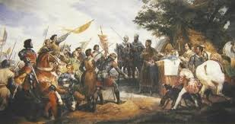
The Sun King: The Fronde
During the Middle Ages, nations were divided between powerful nobles who made their own decisions but were required to maintain the King’s policies- some did, but most did not.
Led to many rebellions amongst nobles against each other and against the King, which weakened his authority.
The Fronde- in 1648, discontent among the French nobles erupted into a civil war, which forced the royal family to flee Paris
11 more civil wars would follow between 1648 through 1653
Instilled Louis’ lifelong fear of rebellion, and he distrusted not only aristocrats and commoners alike, but also Paris itself

Slide 6
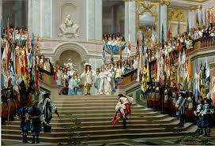
The Sun King: Personal Rule
Personal rule began in 1661, when Louis XIV decided to continue ruling without any administrators or representatives, making political, economic, and military decisions on his own.
Centralized power in the monarchy and reigned over a period of unprecedented prosperity during which France became the dominant power in Europe and a leader in the arts and sciences.
"L'État, c'est moi" (the state is me)
“Sun King”- symbol of Louis XIV’s reign and modeled after solar system. The King was the center of France; rays of sun reflect off of monarch onto subjects and all the lands he owned.

Slide 7
Versailles

Slide 8
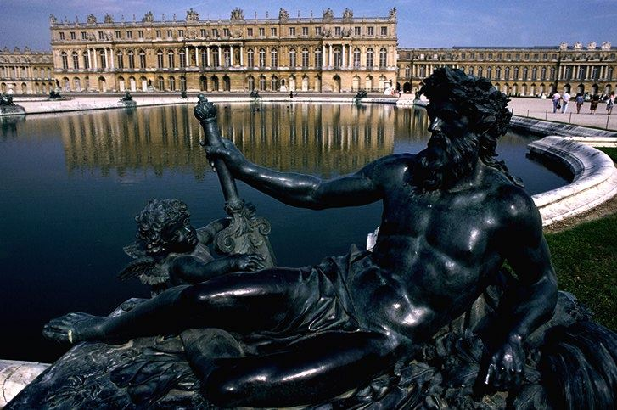
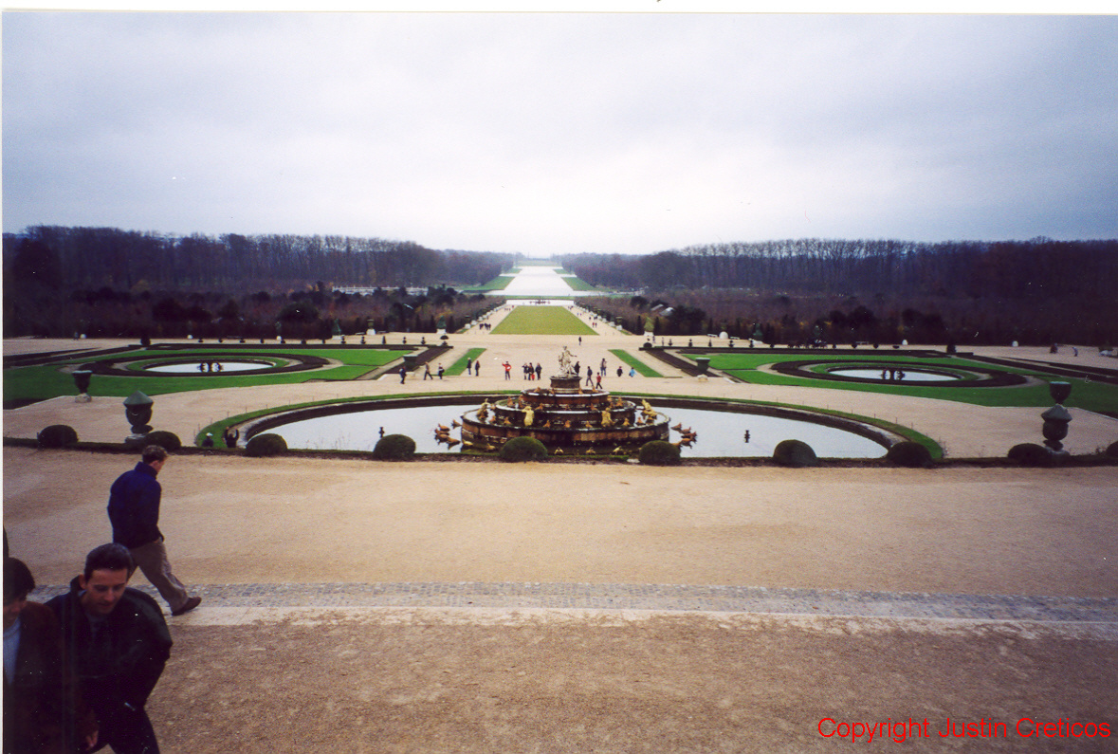
Versailles
Versailles- built by Louis XIV into a large, ornate palace to serve as the monarchy’s permanent home in 1661.
Work was finally complete in 1820
After French Revolution, Versailles was turned into a museum in 1837 and is opened to millions of visitors worldwide
Louis XIV ordered all nobles to move to Versailles in order to monitor their actions and prevent rebellions
Ancien Regime- the political and social order created during Louis XIV’s rule; everyone was a subject of the king of France as well as a member of an estate and province.

Slide 9
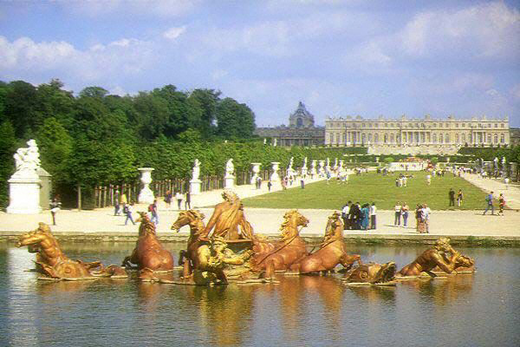
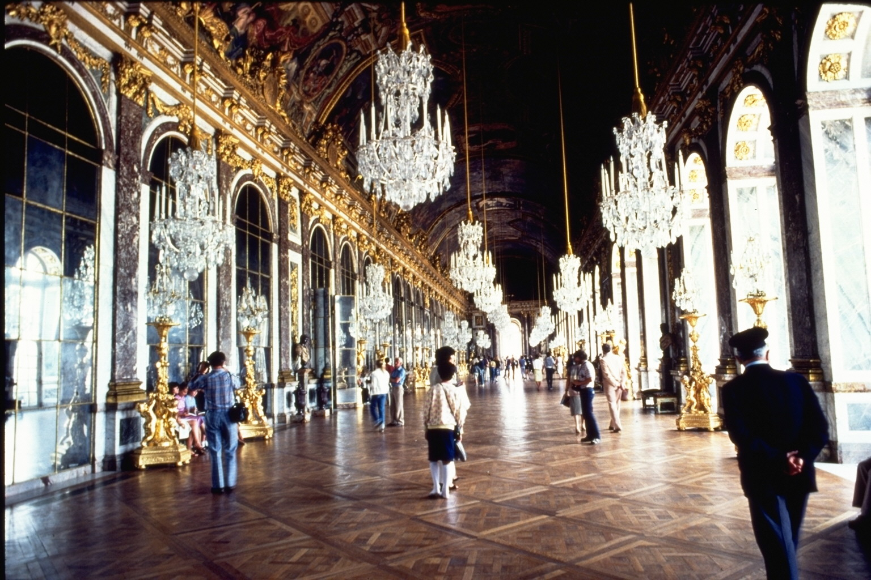
Versailles
Versailles was a grand spectacle of Louis XIV’s power; his rules, style, and ceremony emphasized political strength
The palace was filled with paintings and sculptures, ornately designed rooms, and technological innovations such as pressurized water fountains in its gardens that jetted water into the air.
Hall of Mirrors- a 235-foot long ballroom lined on one side with 17 HUGE mirrors and windows, incorporating the Sun as Louis XIV’s personal symbol

Slide 10
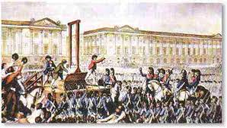
Absolutism

Slide 11
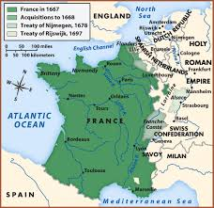
Absolutism
Louis XIV ruled for 72 years, the longest reign in European history
He inherited a kingdom that was internally divided, militarily exhausted, and nearly bankrupt; but he left to his heirs the greatest power in the Western world
Absolutism- the political practice of unlimited, centralized sovereignty, especially in a monarch or dictator.
Ruling power is not subject to challenges or checks by any other agency, like judicial, legislative, religious, economic, or electoral branches.

Slide 12
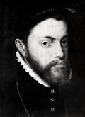
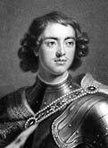
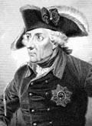
Absolutism
Divine Right of Kings- political theory that the monarch receives his power from God, not a government or his citizens.
Uses religion to fully extend monarch’s power and political agenda
Louis XIV was the not the first monarch to claim divine rights, but he used it to his advantage the most effectively
Other Absolute Monarchs:
Phillip II of Spain
Peter I of Russia
Frederick of Prussia

Slide 13
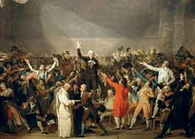
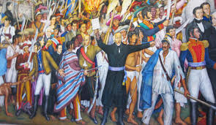
Absolutism
One man’s power to rule over others will be the main idea philosophers will argue against during the Enlightenment
Enlightenment ideals will encourage rebellions against monarchies and colonialism beginning in the late 17th century, including:
American Revolutionary War
French Revolution
Latin American Wars for Independence

