Slide 1
Conflict zones
The Middle East

Slide 2
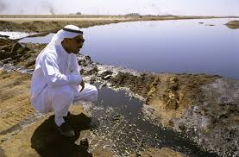
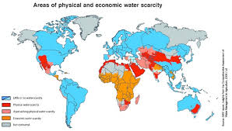
Conflict: Water
14 out of 33 countries ranked by drought experience are located in the Middle East
Droughts & extreme heat contribute to crop failures, which leads to people leaving farming communities to work in large cities.
Population growth also puts pressure on dwindling resources
Largely dependent on aquifers, which supply water to Arabian Peninsula and other dry areas
Desalination- removal of salt and other minerals from seawater to make it drinkable

Slide 3
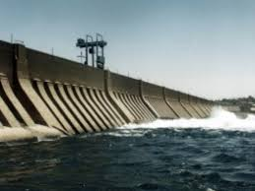
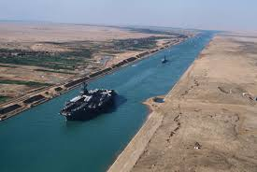
Conflict: water
Despite being plagued by droughts, flooding is also a major issue in some parts of the Middle East:
Aswan High Dam- maintains water levels during flood season along Nile River
Control of water passages is also a source of conflict:
Suez Canal-used for shipping oil from the Persian Gulf among international trade ports, especially Europe & US

Slide 4
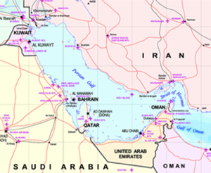
Conflict: oil
Persian Gulf- located between Iran and the Arabian Peninsula, has large percentage of world’s oil reserves.
Overall, the region has a higher standard of living compared to other regions in the Middle East.
Distribution of resources is unequal, resulting in countries that have vast amounts of wealth (ex. United Arab Emirates) or poverty (ex. Yemen)

Slide 5
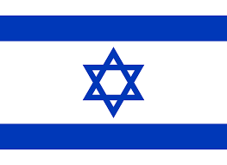
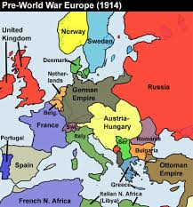
Conflict: israelis &palestinians
Palestine- considered the ethnic and historical homeland of the descendants of Abraham, the first prophet in Judaism & Islam
Palestinian Arabs- Muslim descent; prior to WWI, led the Ottoman Empire that controlled Palestine
Israelis- Jewish descent; began immigrating to Palestine as part of the Zionist movement, aka the return to the homeland.
1947- United Nations splits Palestine into a two-state nation called Israel.
Palestinians attack Israelis and begin a war to reclaim lost territory, Israel campaigns to take over whole nation

Slide 6
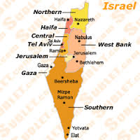
Conflict: Israelis & Palestinians
Gaza Strip- valuable because of its coastal location, under Palestinian control
West Bank- location of Jerusalem and major Holy Sites for Jews, Arabs, and Christians
Violence in the area is almost continual; Oslo Accords in 1993 set current policy of land ownership in place, but is deeply unpopular with both Palestinians and Israelis.

Slide 7
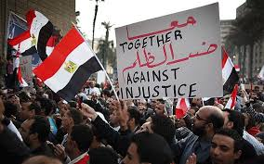
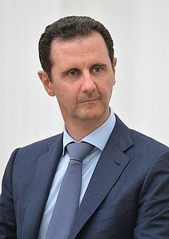
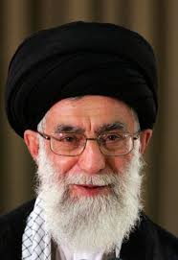
Conflict: arab spring
Series of political protests and revolutions in Middle Eastern nations with varying degrees of success, began in 2010
Goals: increased opportunities for education, less government corruption, and democratic forms of government
Brought an end to many monarchies and dictatorships in some Middle East countries
Led to an increase in violent oppression in others
Oligarchy- a small group of people having control over a government or organization, usually rely on brutal public oppression tactics
Ex. Al-Assad Royal Family of Syria
Theocracy- a God or Deity is considered the supreme ruler and religious laws are followed as the law of the state
Ex. Taliban, Sharia Law

