Slide 1
Introduction to Religions
Monotheism

Slide 2
Monotheism
The belief in a single all-powerful deity, or god-like being
Differs from earlier historical beliefs that life on Earth was under the guidance of hundreds of different gods who were responsible for different tasks (Polytheism)
Earliest people prayed to spirits of inanimate objects (like trees and rocks) or animals (like birds and wolves) as they were thought to have the power to control their well-being (Animism)

Slide 3
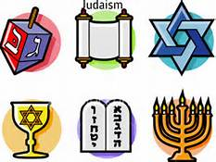
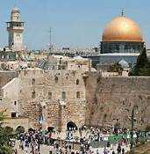
Judaism
Followers: Jew, Jewish
Origin: Abraham established a covenant with God in exchange for being led to “The Promised Land” (Israel) in 2000 BCE
Deity: God, aka Yahweh, El-Shaddai, Elohim in Hebrew. Judaism is the world’s oldest monotheistic religion.
Worship: Shabbat begins at home on Friday night; Rabbi leads prayer in Synagogue on Saturday night
Tenets: “God’s Chosen People”, protect and show loyalty to Jerusalem
No Heaven/Hell,
Awaiting the Messianic Era
Do not actively convert people
Kosher food products; No Pork or Shellfish

Slide 4
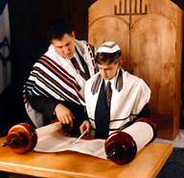
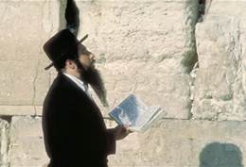
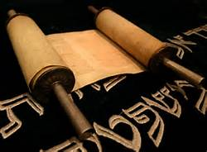
Judaism
Rituals: High Holidays (Holiest days of the year)- Yom Kippur, Rosh Hoshannah
Blessings recited before mealtimes (Berakhot)
Bar/Bat Mitzvah (“Coming of Age”) at 13
Sects: Orthodox (STRICT following of Torah & Talmud), Conservative (traditional interpretations), & Reform (liberal interpretations)
Sacred Texts: Tanakh- divided into Torah (5 Books of Moses), Nevi’im (Prophets) and Ketuvim (Writings)
Language: Hebrew (formal, traditional), Yiddish (slang)

Slide 5
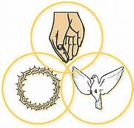
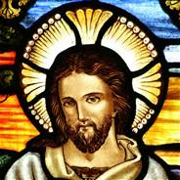
Christianity
Followers: Christian or name of each sect (i.e. Catholic, Baptist, Methodist, etc.)
Origins: Roman Empire province of Judea (Jerusalem).
Deity: God of Abraham, aka God the Creator, God of Holy Trinity (Father, Son, Holy Spirit).
Tenets: Originally a sect of Judaism, Christianity is the largest monotheistic religion.
Jesus Christ, aka the Messiah, await the 2nd coming.
Heaven/Hell (Purgatory)

Slide 6
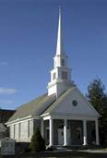
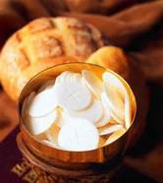
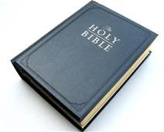
Christianity
Worship: Minister/Priest leads prayers, readings from Scripture, sermon in church on Sundays.
In Catholicism, Rosary can be prayed daily.
In other sects, Bible Study can be conducted at home.
Rituals: Baptism welcomes you into Christianity in youth, Confirmation in adulthood.
Communion taken weekly (by sect).
Sects: Roman Catholicism, Protestantism, Eastern Orthodoxy
Sacred Texts: Holy Bible (New/Old Testament)
Language: No sacred language

Slide 7
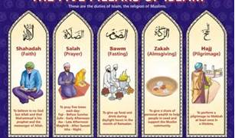
Islam
Followers: Muslim, Islamic
Origins: Saudi Arabia (Arabian Peninsula)
Deity: Allah (same God of Abraham, the Creator, the Father, etc.)
Tenets: Shares many of the same prophets as Judaism & Christianity, but Mohammed is considered the TRUE prophet.
Prayers must be recited towards Mecca, the holy city
5 Pillars of Faith: the standards that all Muslims are expected to observe & complete
Only one God, Mohammed is his messenger
Pray 5x daily
Fast during Ramadan
Charitable contributions
Hajj: Make pilgrimage to Mecca

Slide 8
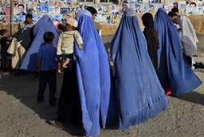
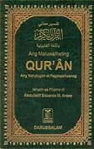
Islam
Worship: Prayers, readings, & sermon are led by Imam on Fridays in a mosque
Rituals: All followers must wear modest clothing (women wear more based on group),
Genders are separated
No pork or alcohol
Sects: Disagree over Muhammad’s heir/ leadership of Islam nation
Sunni
Shi’a (Shi’ite)
Sacred Texts: Qu’ran
Language: Arabic
Only language Qu’ran can be in
Translations not allowed

Slide 9
Sikhism
Followers: Sikh (seek)
Origin: Founded in the Punjab region of Pakistan and India by Guru Nanak
Deity: Waheguru, one Supreme Being
Worship: Gurdwara, house of worship where one should meditate
Beliefs: Teachings emphasize principle of equality of all humans regardless of race, gender, or caste.
Three Pillars-Meditation, Earn Honest Living, Community
Five Thieves- Lust, Anger, Greed, Material Attachment, Pride
Five Virtues- Truth, Contentment, Compassion, Humility, Love

Slide 10
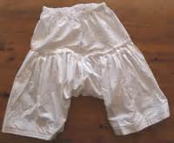
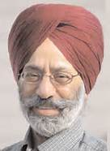
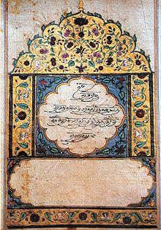
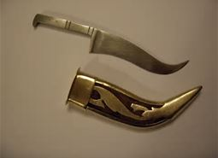
Sikhism
Rituals: 5 Articles of Faith
Kirpan (sword)
Kachera (cotton undergarments)
Kara (steel bracelet)
Kangha (wooden comb)
Kesh (both men & women do not cut hair)
Language: Punjabi, Sant Bashi (combination of Punjab, Hindu & Persian)
Sects: No clear cut divisions, as it goes against unifying theme in Sikhism
Sacred Text: Guru Granth Sahib, collection of hymns describing the qualities of God (There are 10 Gurus total)

