Slide 1
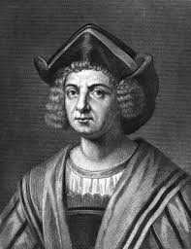
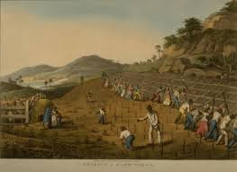
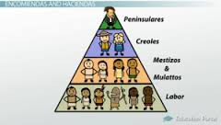
The Age of Expansion
The Columbian Exchange
Expansion
Atlantic Slave Trade

Slide 2
Cornell note-taking method
Notes color-coded in RED go on this side of the line.
These items will include:
Main Ideas
Big Concepts
Vocabulary Words
Notes color-coded in BLUE go on this side of the line.
These items will include:
Supporting details
Dates, Times, and Biographic details
Vocabulary Definitions
Any items in BLACK text are optional. Remember: the more thorough your notes, the more prepared you will be for exams.

Slide 3
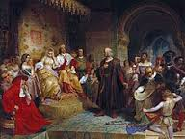
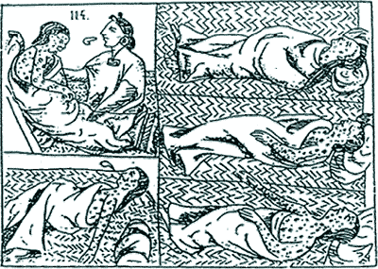
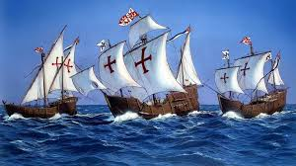
The Columbian Exchange

Slide 4
Christopher ColUmbus
Christopher Columbus- explorer credited with opening up the Americas to trade and colonization; he discovered them while seeking alternate passage to Asia
Sponsored by King Ferdinand & Queen Isabella of Spain, Columbus set sail with the ships Nina, Pinta, and the Santa Maria in 1492
Made three additional voyages between Spain and the Americas, continuing search for silk and spices of Asia but establishing European customs and systems of trade with Native populations.

Slide 5
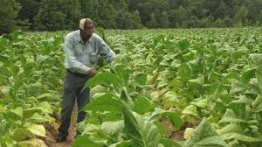
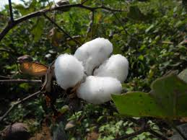
Positive Effects
Over the years, the Europeans continue to travel to New World in search of riches and territory to add to empires.
Beasts of Burden- a large animal, like an ox or a cow, used by humans to make agriculture easier
Europeans brought crops to the Americas such as wheat, barley and rice.
Maize (corn) and potatoes did not exist in Europe before, but they drastically changed the way Europeans ate. People became stronger, healthier, and lived longer lives.
Cash Crops- products grown specifically for sale and profit, rather than for the farmer’s own use.

Slide 6
Negative Effects
Conquistadors (Spanish invaders) destroyed native civilizations that had been built over centuries:
Damaged religious temples
Killed those who refused to convert to Christianity
Forced natives into slavery
Spaniards brought guns to trade to the natives, which increased the death toll among tribes fighting amongst one another
Diseases (smallpox, malaria, and influenza) did not exist in the New World prior to the European’s arrival, and the natives did not have any immunity to these diseases.
95% (20 million people) of native population died from exposure

Slide 7
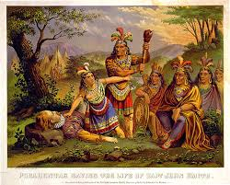
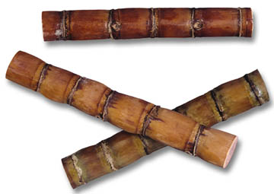
Exploration

Slide 8
Spain
While personal profit may have been a motive for Hernan Cortes and Francisco Pizarro, their priority was creating profits for SPAIN
Plantations- large pieces of land where crops are specifically grown for sale that use a large labor force
Sugar Cane was introduced to Americas in 1500s, and refined for use as sugar, molasses & rum
Cocoa & Tobacco became popular crops as well
Encomiendas-created by the Spanish to control and regulate American Indian labor and behavior during the colonization of the Americas
Encomiendas meant to be fair labor, but led to brutal slavery, starvation & cruel treatment to those who resisted

Slide 9
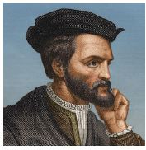
France
Jacques Cartier- sailed up the St. Lawrence River in Canada, which was named New France.
Cartier was one of the first explorers to acknowledge that the Americas were separate landmasses from Asia.
Established “Mount Royal” (Mont Real = Montreal, modern city in Canada) and the French fur trade (trading of animal pelts for tools and weapons with the Natives)
Territories claimed by France were very large, but sparsely populated (very little people living there)
France was mostly interested in trade, not establishing colonies, building towns or large settlements

Slide 10
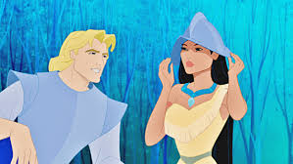
English & Dutch
Jamestown- named for King James, who approved a charter by English investors to found a colony in North America in 1607.
Settled on the coast of Virginia, famous for the adventures of John Smith and Pocahontas
After a disastrous beginning of searching for gold, farmers discovered their own type of gold- growing tobacco
The Dutch (from the Netherlands) establish New Amsterdam (location of modern-day New York City)
Henry Hudson- Englishman in service of Netherlands looking for route to Asia, established trade with Iroquois Indians
Expanded the Fur Trade; like the French, they had lots of profit, but limited colonists

Slide 11
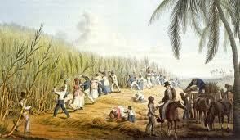
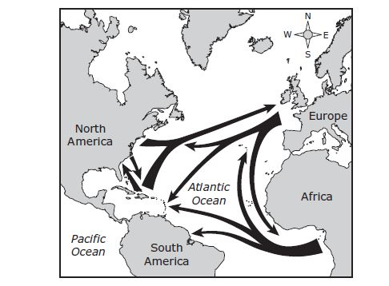
The Caribbean
Spain settled some Caribbean islands first, but eventually they were colonized by other European nations
French – Haiti, Guadalupe, Martinique
English – Barbados and Jamaica
Dutch – Antilles and Aruba
Each colony builds huge cotton and sugar plantations to capitalize on their popularity in Europe, but they require huge amounts of labor
Most of Native population killed off by smallpox
African slaves were promoted by merchants to replace the Native population
Beginning in the 1500s, thousands of enslaved Africans were shipped to the Americas as part of the Atlantic Slave Trade.
As slave trade expanded, so did agricultural production in the Americas

Slide 12
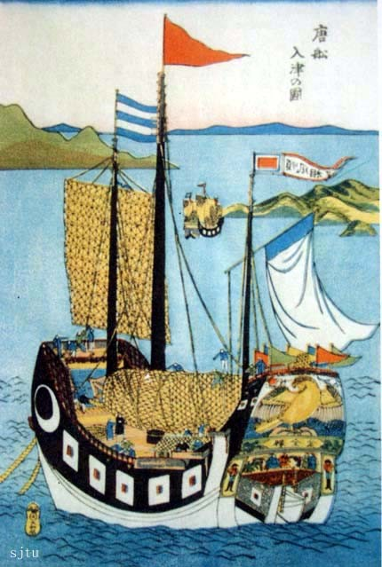
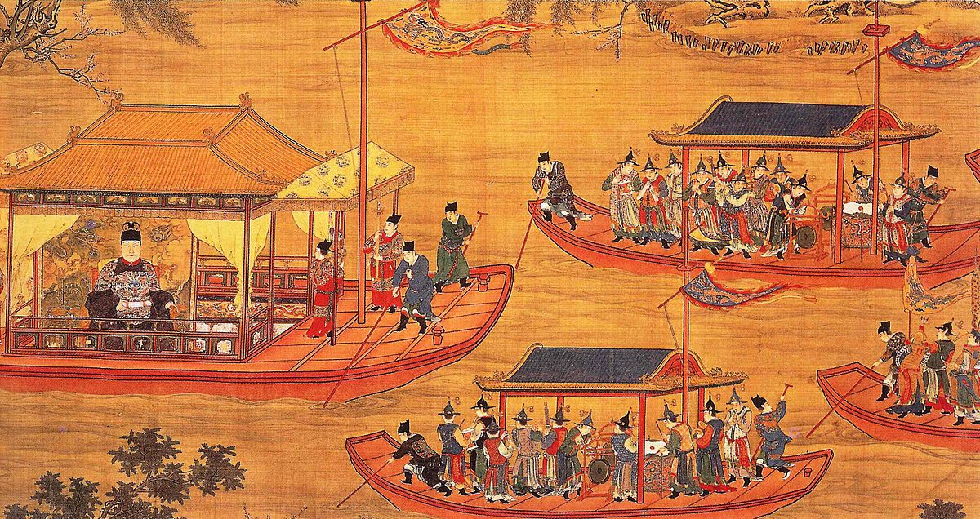
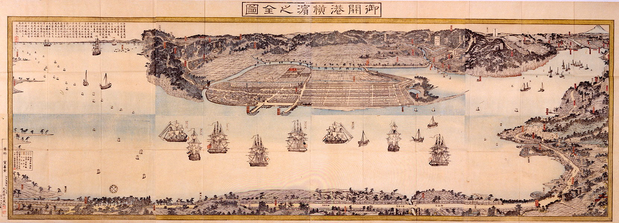
Isolation in China & Japan

Slide 13
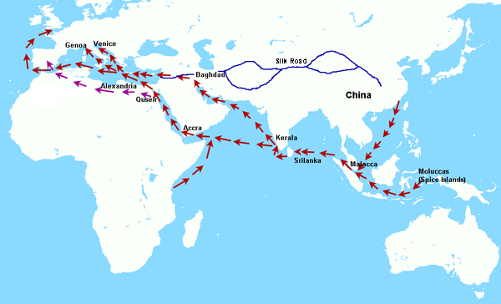
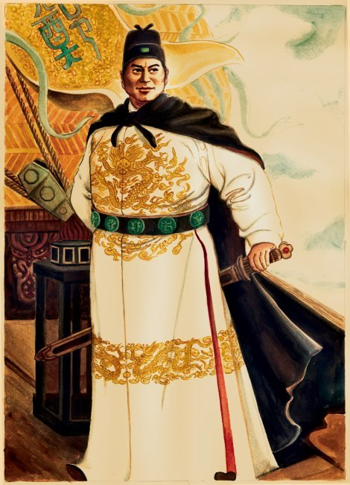
China: Ming & Qing Dynasties
East Asia was a hot spot for luxury goods; many Europeans were looking to trade with China and Japan
Chinese had rebelled and driven out their Mongol (Yuan) rulers and had established the Ming Dynasty (1368-1644)
The Ming government had ruled for 200 years and was weakening
Manchus, people from Manchuria, invaded China and established the Qing Dynasty which ruled for 260 years
Emperor Hongwu and son Yonglo were curious about the outside world & launched voyages of exploration
Chinese Admiral Zheng He led seven voyages

Slide 14
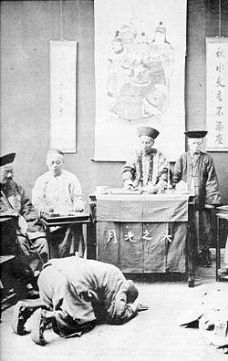
Trade policies in the 1500s reflected isolation; foreign states had to follow Chinese rules because the Chinese did not want Europeans threatening the peace and prosperity the Ming had brought to China.
China had a long history of being self-sufficient
Only the government was allowed to conduct foreign trade
Trading was only allowed at certain ports
China expected Europe to pay tribute (peace tax) to Ming leaders, which the Dutch accepted and were allowed to trade with China
Kowtow ritual: kneeling in front of the emperor and touching forehead to ground 9 times

Slide 15
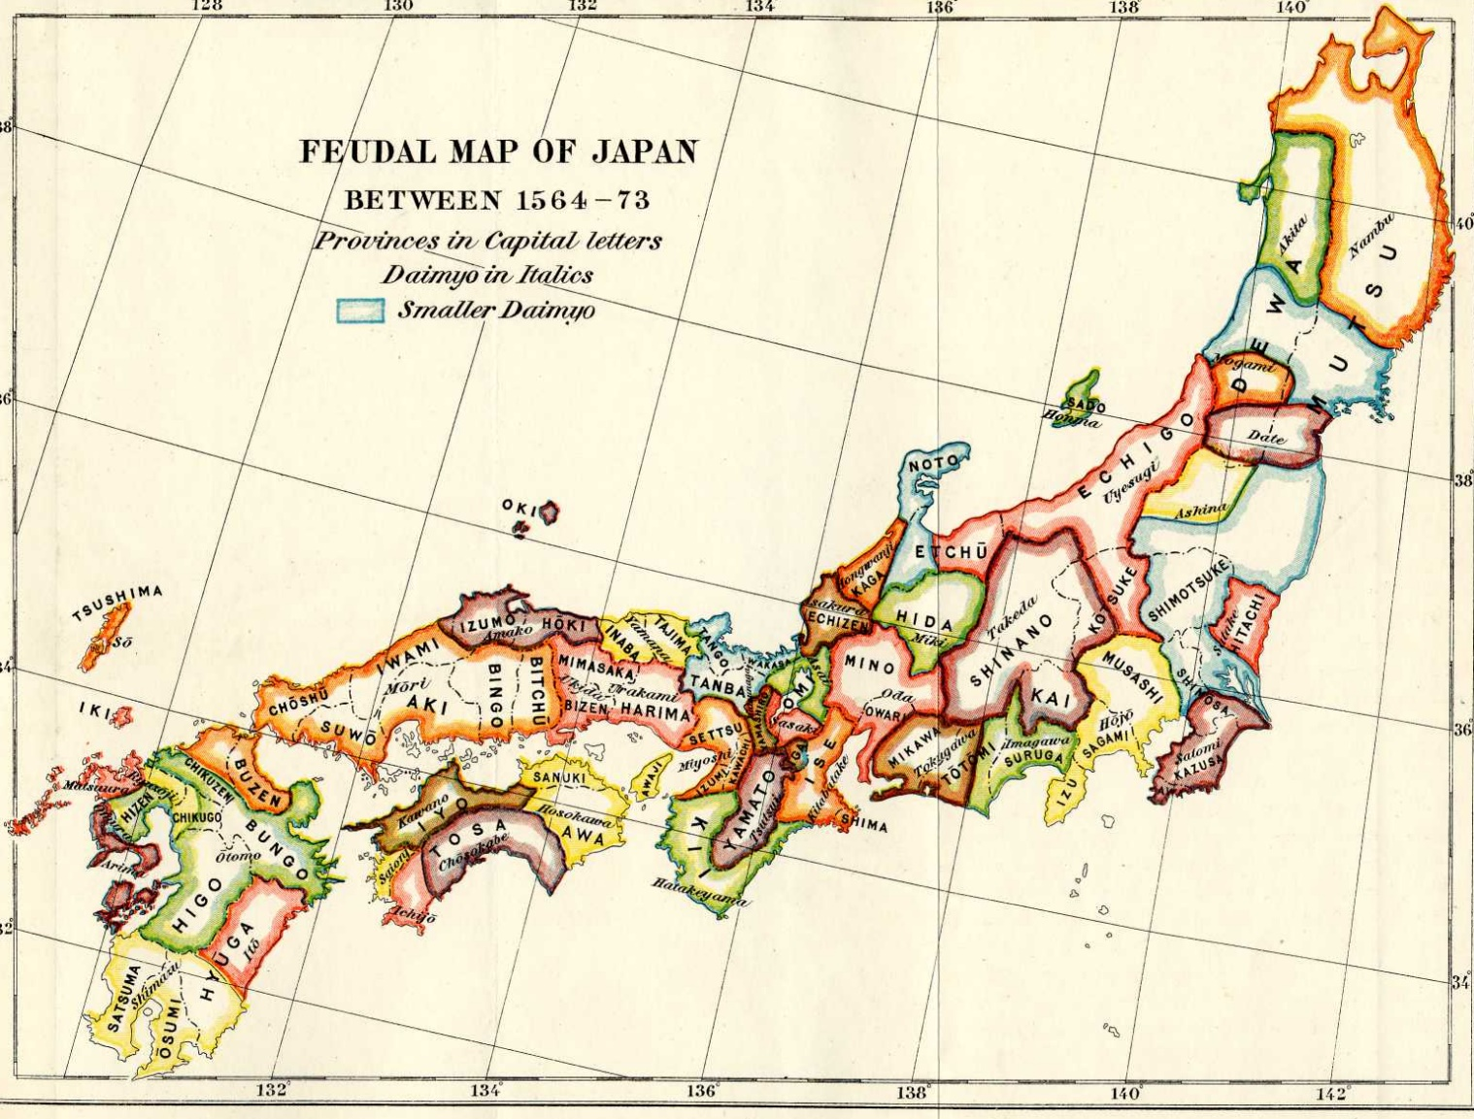
Japan
Civil war shattered Japan’s feudal system in 1467, causing chaos throughout the country’s feudal groups
During the 1500s, Europeans were encouraged to trade in Japan and were welcomed; however, within a century, the aggressive Europeans had worn out their welcome
The Portuguese brought clocks, eyeglasses, tobacco, and firearms
By 1600, European missionaries had converted 300,000 Japanese to Christianity
After peasant rebellions (most were Christian) the shoguns ruthlessly persecuted Christians and led to the formation of an exclusion policy

Slide 16
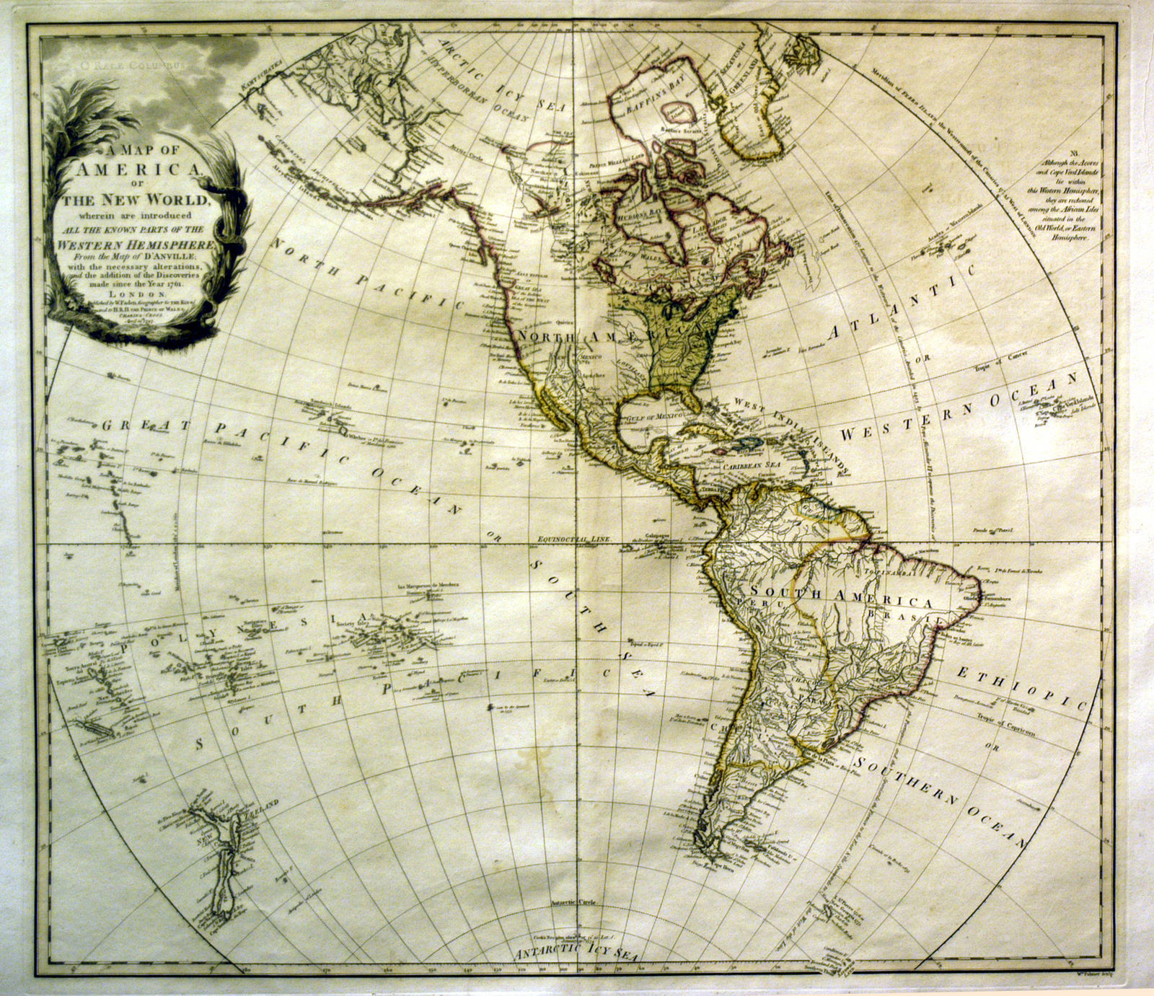
Japan: Closed Country Policy
In 1639 shoguns sealed Japan’s borders and excluded merchants and missionaries
Only port of Nagasaki remained open but only to Dutch and Chinese traders
Lasted for more than 200 years
Japanese were forbidden to leave to avoid bringing back foreign ideas
Japan wanted to continue to develop as a self-sufficient country
Europeans begin to explore west across the Atlantic Ocean to the New World.

