Slide 1
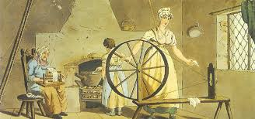
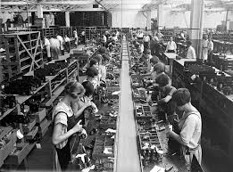
Effects of industrialization
Political
Economic
Geographic
Social

Slide 2
Cornell note-taking method
Notes color-coded in RED go on this side of the line.
These items will include:
Main Ideas
Big Concepts
Vocabulary Words
Notes color-coded in BLUE go on this side of the line.
These items will include:
Supporting details
Dates, Times, and Biographic details
Vocabulary Definitions
Any items in BLACK text are optional. Remember: the more thorough your notes, the more prepared you will be for exams.

Slide 3
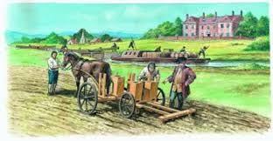
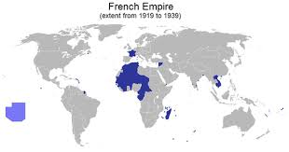
Political Effects

Slide 4
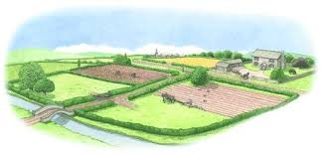
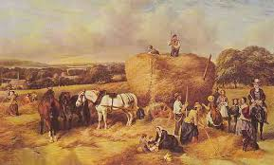
Agricultural Revolution
Agricultural Revolution- changes made to farming practices increased food production, which led to people being stronger, healthier, and living longer
Enclosure Movement- Parliament passed a series of laws in the 1800s to close off pieces of land for landowners and farmers, who looked for more efficient farming techniques.
Landowners could charge higher rent to the people working the land, which led to peasants leaving the countryside to work in factories
As raw materials became more necessary for production of good, European nations needed to seek out more resources to expand their profits.

Slide 5
Industrialization leads to Imperialism
Congress of Vienna outlawed any European empires on the European continent, so governments began looking to Africa, Asia, and South American countries for availability of natural resources.
Some nations establish colonies and claims lands as their territory:
Great Britain- India and parts of Africa & South America
France- Southeast Asia
US- Louisiana Purchase, Texas, & California (Manifest Destiny)

Slide 6
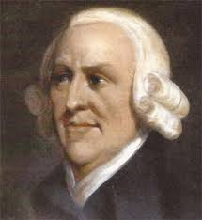
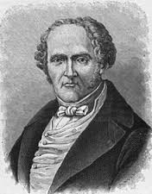
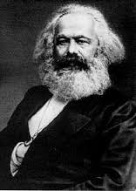
Economic Effects

Slide 7
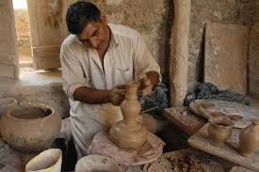
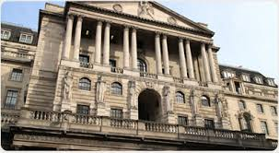
Before Industrialization
Cottage Industry- products were made mainly in people’s homes; merchants provided raw materials and basic equipment, then picked up the finished product.
Most communities were located close to rivers, because water produced the amounts of energy required to power the machines on a consistent basis
Banking- Bank of England established in 1694, issues money for the government and financially supports merchants and traders, creating economic prosperity

Slide 8
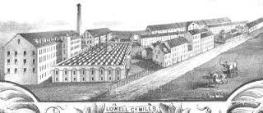
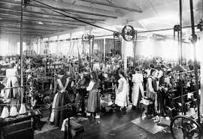
Factory system
Factory System- Merchants began moving away from cottage industries to mass-produced items made on machines in large buildings with many workers because labor, prices, and profits were easier to regulate.
Some upper level jobs required basic skills, but most factory jobs only needed people who were willing and able to work to fill daily quotas (numbers).
Assembly Line- parts (usually interchangeable) are added as the semi-finished product moves from workstation to workstation where the parts are added in sequence until the final product is assembled.

Slide 9
Economic Theories
Adam Smith- economist who published the Wealth of Nations, considered to be the model of modern capitalism
Capitalism- government should have as little involvement in the economy as possible in order to maximize profits
Charles Fourier- French philosopher who was an early promoter of class equality, feminism, and modern socialism
Socialism- government should provide resources equally to all citizens, with some input from businesses
Karl Marx- German intellectual who published The Communist Manifesto, a doctrine on class struggles and what the poor must do to be free
Communism- the government should provide all services and own all businesses and lands in order to eliminate differences between citizens and end class warfare

Slide 10
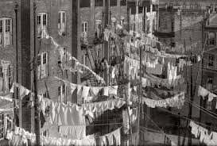
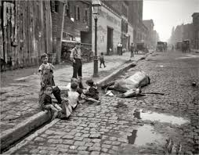
Geographic effects

Slide 11
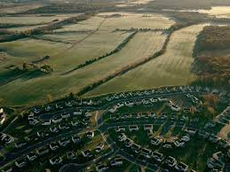
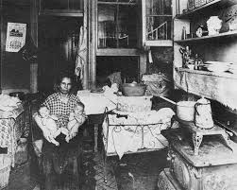
Human Migration
Urbanization- towns and cities are growing to accommodate people migrating to find factory jobs, taking usable space away from farmlands.
During the late 1850s, after many technologies were introduced to the US and Irish Potato Famine devastated food supplies, many Europeans began immigrating to the United States.
Tenements- apartments and other single-family dwellings that were divided even more to create more spaces for people to rent.
By 1900, 2.3 million people lived exclusively in tenements in New York City

Slide 12
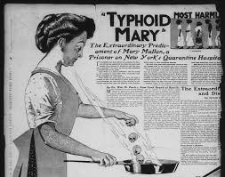
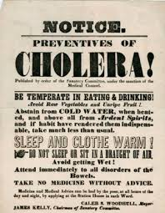
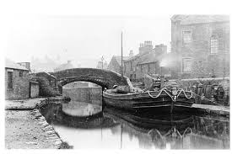
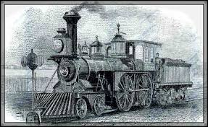
Human Migration
Housing was overcrowded and unclean, causing the spread of typhoid, cholera, and smallpox.
Transportation was expanded during this time, as raw materials needed to be brought from the country to the factories. This included:
the construction of canals & railroads
improvements to the roads
Modes of transportation also made it easier for people to migrate to new areas where jobs were becoming available

Slide 13
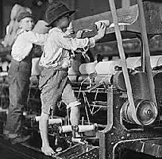
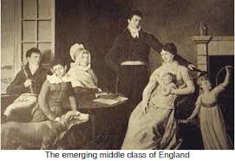
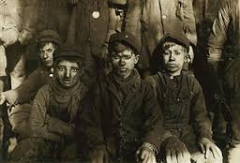
Social Effects

Slide 14
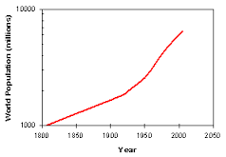
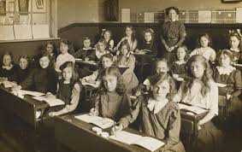
Changing Social Classes
During the Industrial Revolution, population grew to 700 million.
Job growth and stable profits provided a shift to a higher standard of living, which included consistent payment of wages, better education and literacy, and better health care
The Middle Class grew more powerful and influential, and they took advantage of the newly affordable amenities like furniture and fine clothing.
They were also able to educate their children, so that their social standing would be maintained or even rise with the next generation.

Slide 15
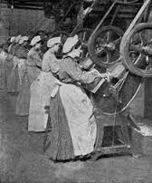
Struggles of the Laborers
Cost of living is much higher in the cities than in the country, so many members of a family unit had to find work:
Women- worked in textile factories, as maids and cooks, and in coal mines
Children- worked for much less than adults, and could work quicker because they were much smaller
Poor laborers worked the longest hours, had the lowest wages, and lived in the worst conditions. Safety was very poor in early industrial factories and mines- injuries included: cut off fingers, mild burns, severe arm and leg injuries & amputation of limbs and death.
Air in factories and mines had long-term effects to the workers. They caused chest diseases, coughs, blood-spitting, hard breathing, pains in chest, and even death.

Slide 16
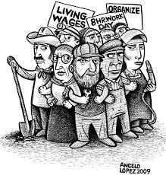
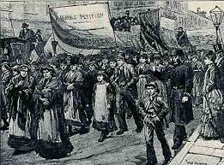
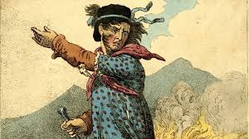
Labor Movements
Unions- demanded better working conditions by going on strike, forcing employers to decide between giving in to demands or suffering the cost of the lost production.
Regulation of Child Labor Law 1833- established paid inspectors to inspect factories on child labor regulations and enforce the laws
Set the maximum working in a week to 48 hours
Made school mandatory for children, which created education opportunities and higher literacy levels
Luddites- destroyed machinery as a form of protest, as it was believed they threatened the jobs and livelihoods of skilled workers that were to be replaced by cheaper and less skilled workers

