Slide 1
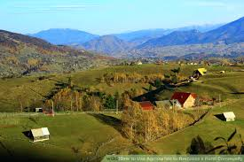
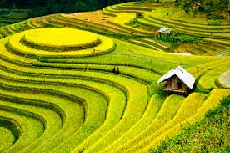
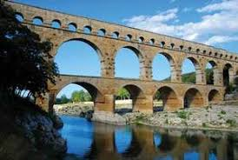
Human-Environment interactions
Human Adaptations & Modifications
Rural Networks
Urbanization

Slide 2
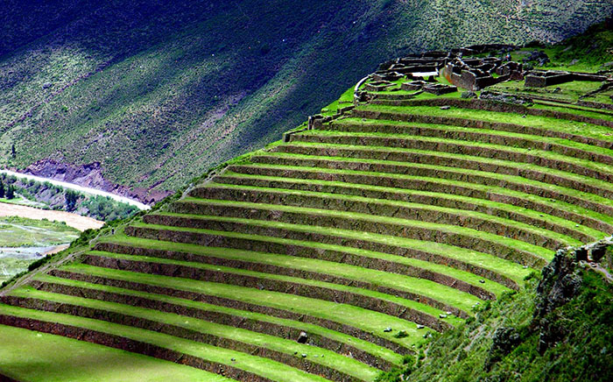
Human-Environment interactions
Human-Environment Interactions- the changes people make to their surroundings and the impact those changes have on those surroundings.
Adaptations- humans change their own behaviors or actions to suit their environment
Many choices humans make are determined by their environment, including availability of food, shelter, clothing choices, and general ways of life
Modifications- humans change their surroundings to suit their behaviors and/or actions
Humans have the ability to make changes to their environment through agriculture, urbanization (growth of cities), and technology

Slide 3
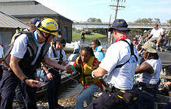
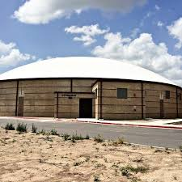
Adaptations
People change their behavior in order to increase their chances of survival in their environment
Understanding how people are affected by their surroundings is vital for finding solutions to modern problems, including:
Responses to extreme weather & natural disasters
Desalination techniques to purify drinking water
Using heating & air conditioning to live in various climates
Building shelter for protection from elements

Slide 4
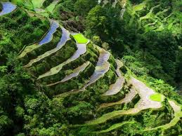
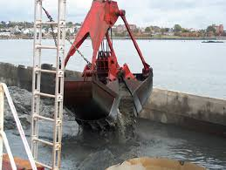
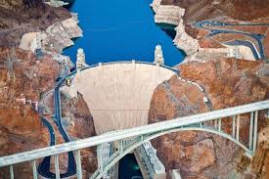
Modifications
Humans have also changed their environment based on what they need to survive; these changes often vary from region to region, including:
Terrace farming on mountain slopes
Land reclamation projects in marshes/swamps
Mechanical dredging to rebuild coastlines
Dam construction
Unfortunately, these changes in the environment on a global scale have resulted in both positive and negative effects, e.g.:
Pollution
Shortage/Overuse of resources
Climate Change

Slide 5
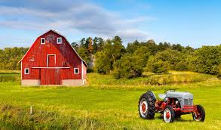
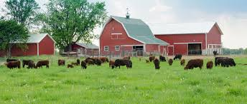
Rural Networks
Green Revolution
Agricultural innovations
Depletion of Arable Land
Sustainable Development

Slide 6
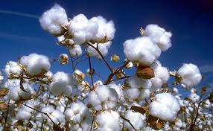
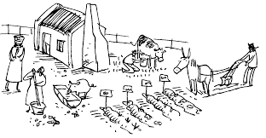
Rural Networks
Rural Networks- communities that are predominantly involved in primary economic activities (farming) because they rely on natural resources for productivity
Rural areas will generally have small populations and low population density
Settlement Patterns- the specific areas where people decide to live. Physical and human factors help people find the best areas that will support many different economic activities.
Physical Factors-people will settle in areas where they have access to natural resources.
areas that have access to fresh water
low-lying areas near fertile soil
temperate and mild climate regions

Slide 7
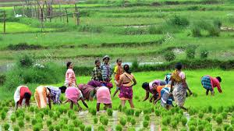
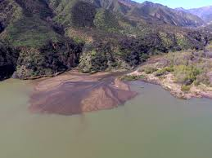
Green revolution
Green Revolution- research and technology initiatives developed between the 1930’s and 1960’s that increased agriculture production worldwide.
Brought mechanized irrigation, fertilizer use, and pesticides into common usage among farmers
Reduced the energy needed to produce crops while increasing the output the crops yielded
Population has grown 4x due to minimalizing crop famines and malnutrition (illnesses that result from not getting enough food nutrients)
Agriculture- systematic growing of crops to provide food and other products needed for survival
Sedimentation- water carries broken down rocks, clay, and sand particles and deposits them in other areas, creates nutrient-rich soil

Slide 8
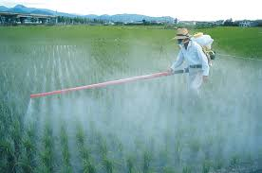
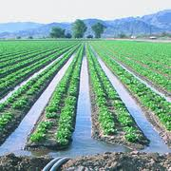
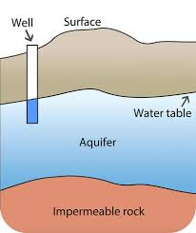
Agricultural Innovations
Pesticides- chemical substance used to kill insects or organisms that are harmful to crops and domesticated animals
Irrigation- the artificial application of water for growing crops in dry areas and during periods of little rainfall.
Aquifer- an underground layer of water-bearing permeable rock that groundwater can be extracted from, usually from a water well
Aqueduct- series of pipes, canals, and tunnels constructed to carry water from a source to a distribution point far away

Slide 9
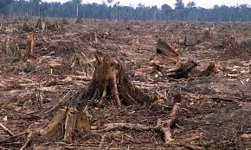
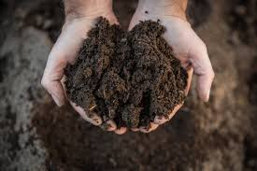
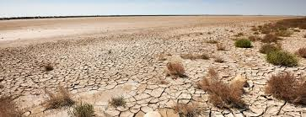
Depletion of Arable land
Arable Land- land that can be used to grow crops; many practices used in growing those crops can lead to the loss of topsoil and destruction of soil
The health of soil is a primary concern to farmers and the global community whose livelihoods depend on-well managed agriculture.
Degraded lands are less able to hold onto water, which can worsen flooding. As land loses its fertile soil, agricultural producers move on, clear more forest and continue the cycle of soil loss.
There are many challenges to maintaining healthy soil, including:
Deforestation
Overgrazing/Overfarming
Use of agrochemicals (pesticides, growth hormones, etc.)
Increased pollution
Desertification/Climate Change

Slide 10
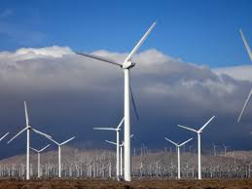
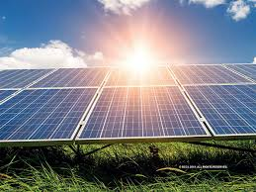
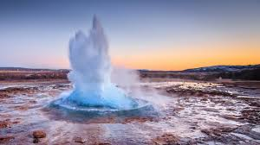
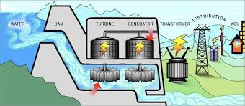
Sustainable Development
Sustainable Development- maintaining the continued ability of the surrounding environment to provide natural resources that the economy depends on and meet the development goals of society.
Sustainable land use can help to reduce the impacts of agriculture and livestock, preventing soil degradation and erosion and the loss of valuable land.
Alternative Energy- renewable energy sources that have lower carbon emissions. These include:
Wind Energy
Solar Energy
Geothermal Energy
Hydroelectric Energy

Slide 11
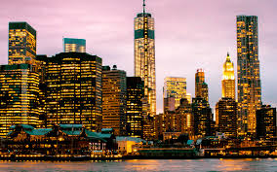
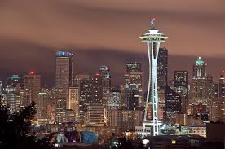
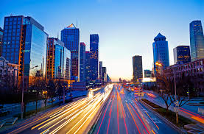
Urbanization
Types of Cities
Urban Sprawl
Pollution & Climate Change

Slide 12
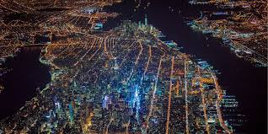
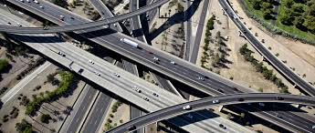
Urban Networks
Urban Systems- areas that include and surround a city; most inhabitants will have non-agricultural jobs
Urban areas have a higher population density and are very developed. Unlike rural areas that have lots of space, urban areas will have many man-made structures like:
Commercial buildings
Roads
Bridges & Railways
Designated Residential Areas

Slide 13
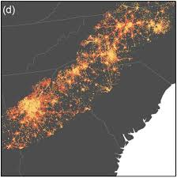
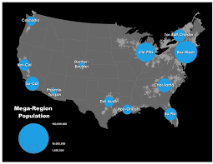
Urban networks
Metropolitan- a densely populated urban center and the surrounding, less populated areas that share housing, roads, and job opportunities.
AKA megacity
Rio Grande Valley is considered a metro area because people travel between Brownsville, Harlingen & McAllen for work
Megalopolis- an urban area that is made up of many large cities and suburbs that are very close together; most are connected through a complex system of movement (highways, railways, waterways, etc.)
Dallas- Ft. Worth (Arlington, Richardson, Dickinson)
Primate City- a city whose population is greater than two times the next largest city in a nation (or contains over one-third of a nation's population). The primate city is usually very expressive of the national culture and often the capital city
Paris (France), London (England), Mexico City (Mexico)

Slide 14
Brain Quest: Map the World’s primate cities
Jakarta, Indonesia
Seoul, South Korea
Manila, Philippines
Mexico City, Mexico
Moscow, Russia
Cairo, Egypt
Bangkok. Thailand
Paris, France
Buenos Aires, Argentina
Tehran, Iran

Slide 15
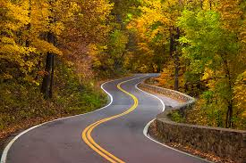
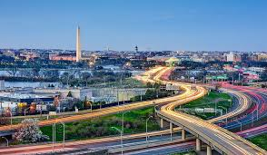
Effects of urbanization
Urbanization- the process of populations moving from rural to urban areas, causing the growth cities and towns.
Positive Effects of Urbanization:
creation of employment opportunities,
technological advancements,
improved transportation and communication,
quality educational and medical facilities,
improved standards of living.
Infrastructure- fundamental physical structures and facilities needed for the operation of a society
Ex: paved roads, highways, schools, hospitals, power suppliers

Slide 16
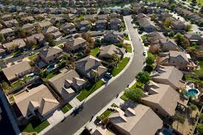
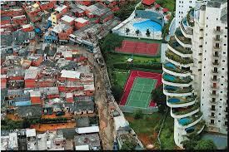
Effects of urbanization
Negative Effects of Urbanization:
With the increase in the number of people living in urban centers, individual houses are scarce; most individuals live in apartments.
Unemployment rates are highest in urban areas and it is even higher among the educated people, who have difficulty finding jobs to match their skill level.
Costs of living in urban areas will take up most of a person’s salary
Favelas- a slum or shantytown where squatters, who can’t afford cost of living in the city, occupy vacant land and construct homes of salvaged or stolen materials.
Located within/on outskirts of Brazil's largest cities, especially Rio de Janeiro and São Paulo
Spatial Inequality- unequal amounts of resources (drinking water, arable land, fuels) and services (schools, hospitals, police)
People with same social class (ethnicity, race, economics) will stay together
Poor areas will stay poor until resources and services are introduced

Slide 17
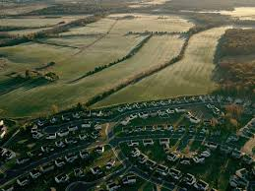
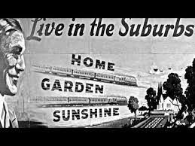
Urban sprawl
Urban sprawl- the migration of a population from populated towns and cities to low density residential development over more and more rural land.
Suburbs- smaller residential communities that are on the outskirts of a city or large town; most people live in these areas and travel to the city for work
Rancho Viejo is a suburb of Brownsville
Bayview, Olmito, Treasure Hills are suburbs
Reasons why people migrate to suburbs:
Cost of undeveloped land
Improved infrastructure (because taxes can be spread out more in suburbs)
Increase in Standard of Living

Slide 18
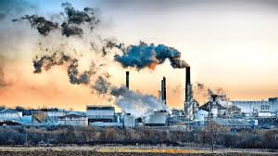
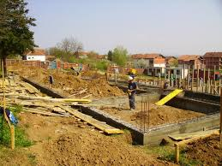
Urban sprawl
Negative Effects of Urban Sprawl:
Increased spending- taxes are used to maintain roads, schools, and emergency services; an increase in population always means an increase in taxes
Environmental Effects- increase in suburban population can severely disrupt the environment
development of land disrupts wildlife and natural habitats,
increase in garbage and use of non-recyclable materials in home-building,
the use of cars increases pollution
Health Effects-
Pollution- the presence or introduction into an environment of a substance that has poisonous or harmful effects
Pollution hotspots- areas where emissions from water or air pollution exposes location population to increased health risks

