Slide 1
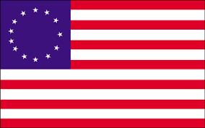
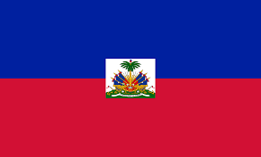
Revolution in the Americas
American Revolutionary War
Mexican Independence
Latin American Wars for Independence

Slide 2
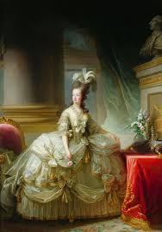
History Through Artwork
For this note-session, you will take notes on the graphic organizers provided and complete the following information:
Historical Event: write the name of the event depicted in the picture
Year: What year did this event happen?
Description:
4th- write a brief summary of the historical event; remember, the more thorough your notations, the more prepared you are for exams
5th- follow directions on organizer

Slide 3
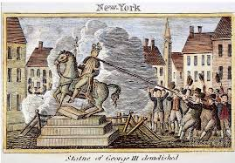
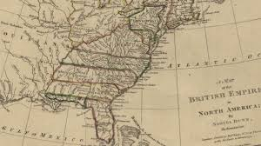
American Revolutionary War
1776-1783

Slide 4
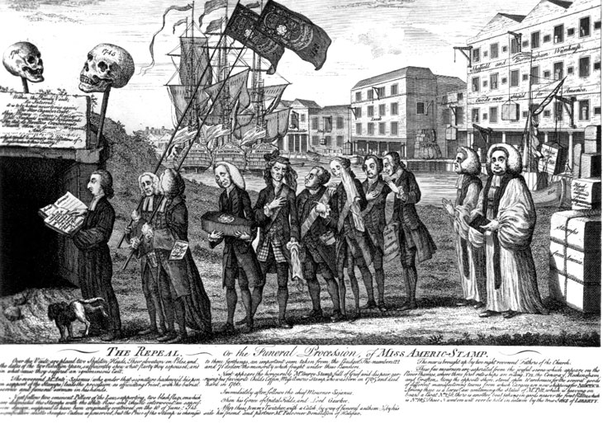
Trouble in the Colonies
Historical Event: Taxation without Representation
Year: 1765-1775
Description: After the French & Indian War (1754-63) left Britain with crippling debts, British Parliament issued a series of taxes on the Thirteen Colonies to generate revenue. Colonies were not given a vote or representative in Parliament, and were forced to pay taxes or be jailed for not paying.
Stamp Act- tax on all printed documents, newspapers, wills, etc.
Sugar Act- tax on sugar, molasses, and rum imports and milk, cheese, and fabric exports that they traded with Caribbean Islands
Townshend Act- taxed glass, ink, oil, paper, and tea
The Funeral of the Stamp Act
Artist: Benjamin Wilson
Publication: 1766

Slide 5
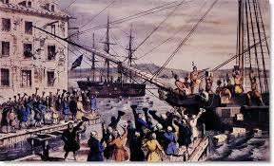
The Last Straw
Historical Event: Boston Tea Party
Year: December 16, 1773
Description: Samuel Adams and the Sons of Liberty boarded three ships and threw 342 chests of tea into Boston Harbor. This solidified the resistance to Britain’s absolute rule, and Parliament passed the Coercive Acts of 1774 to punish the colonies in general and Boston for the pattern of resistance it exemplified.
April 1774- Delegates gather at the First Continental Congress to protest Coercive Acts
April 1775- British soldiers and American Patriots fight first battle of Revolution at Lexington & Concord.
The Destruction of Tea at Boston Harbor
Artist: Nathaniel Currier (Currier & Ives)
Year: 1846

Slide 6
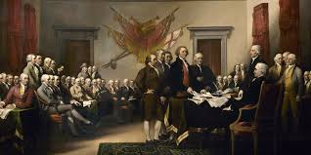
Declaring Independence
Historical Event: Adoption of the Declaration of Independence
Year: July 4, 1776
Description: The Second Continental Congress reconvened in July 1776 and voted to separate from Britain. The Declaration of Independence, written by Thomas Jefferson, was influenced by Enlightenment philosophes like Voltaire, John Locke, and Jean Jacques Rousseau.
“We the People, in order to form a more perfect union…”
“We hold these truths to be self-evident, that all men are created equal…”
Declaration of Independence
Artist: John Trumbull
Year: 1817

Slide 7
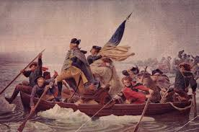
Major Battles of the Revolutionary War
Historical Event: American Revolutionary War
Year: 1776-1783
Description: The Revolutionary War did not start well for the Patriots, who lost many significant battles. After George Washington crossed the Delaware on Christmas 1776 and secured a victory against the British, the French agreed to an alliance that would provide money, weapons, and trainers for the Army.
Marked a turning point in the Revolution, which ended with the British surrender at Yorktown on October 19, 1791.
Treaty of Paris- signed on September 3, 1783; United States was formally recognized as an independent nation, ending the Revolutionary War
Washington Crossing the Delaware
Artist: Emanuel Gottlieb Leutze
Year: 1851

Slide 8
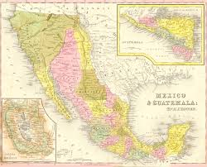
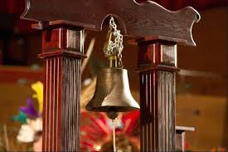
Mexican Independence
1810-1821

Slide 9
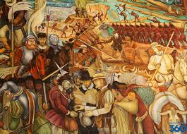
Spanish Conquest of the Aztecs
Historical Event: Spanish Domination in the New World
Year: 1521-1800
Description: Hernan Cortes conquered the Aztecs in 1521. Cortes took advantage of Aztec hospitality, smaller groups who rivaled the Aztecs, and the superior weapons of his soldiers. The Catholic Church considered the Indians heathens and worked to convert them to Catholicism, but efforts to protect the natives were lost to Spanish demand for wealth and power.
Smallpox and other diseases killed the native Americans by the thousands
The Spanish colony was built with Indian forced labor.
Large land grants included the right to force labor from all Indians living on that land.
Exploitation of Mexico by Spanish Conquistadors
Artist: Diego Rivera
Year: 1945

Slide 10
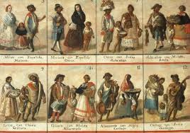
Encomienda System
Historical Event: Encomienda System in the Americas
Year: 1530-1821
Description: The Spanish divided social classes in the New World based on skin color and heritage.
Indians were on the bottom, followed by the mestizos (children of Spaniards and Natives). These classes were enslaved and lived in poverty and harsh conditions.
Criolles (people of pure Spanish descent born in Mexico) were the wealthy upper class.
Peninsulares (Spaniards born in Spain) filled the top positions in government, Church, and the military
Las Castas Mexicanas
Artist: Ignacio Maria Barreda
Year: 1777

Slide 11
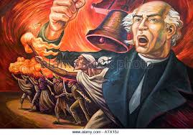
Mexican Independence
Historical Event: Grito de Dolores
Year: September 16, 1810
Description: Father Miguel Hidalgo led the revolt of Indians and Mestizos against Spanish rule and the power of the peninsulares. His grito, or rallying cry, is considered to be the start of the Mexican Independence War.
“My children- a new dispensation comes to us today. Will you receive it? Will you free yourselves?”
Father Hidalgo was executed on July 30, 1811, by forces loyal to Spain, but his fellow revolutionary Miguel de Allende kept up morale.
Today, September 16, is celebrated as Mexican Independence Day with a ceremonial grito every year.
Mural de Grito de Independencia
Artist: Unknown
Year: 2010

Slide 12
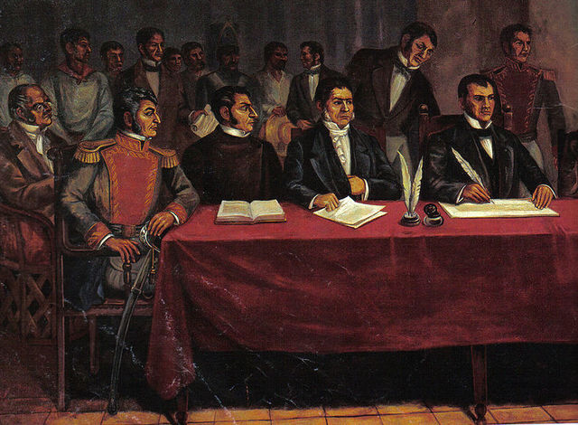
Mexican Independence
Historical Event: Treaty of Cordoba
Year: August 24, 1821
Description: Around 1815, criollos who were loyal to the Spanish crown switched their allegiance to the revolutionaries in order to maintain their privileged position after the end of the war. Agustín de Iturbide defeated the Royalist forces, who lacked money, provisions, and troops, and were forced to accept Mexican independence by signing the Treaty of Cordoba.
Mexico was established as a separate constitutional monarchy, and Iturbide was declared Emperor, but he was deposed by General Santa Ana and Guadalupe Victoria who reformed Mexico as a republic.
Congress of Apantzigan
Artist: Rafael Gallegos
Year: 1950

Slide 13
Latin American Wars of Independence
1791-1902

Slide 14
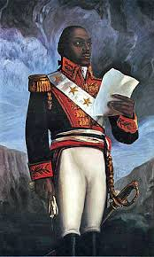
Haiti
Historical Event: Haitian Revolution
Year: 1791- 1804
Description: In 1791, a slave revolt erupted on the French colony, and Toussaint L’ouverture, a former slave, organized an effective guerrilla war against the island’s colonial population. In1801, he conquered the Spanish portion of island, freeing the slaves there as well. After his arrest and death in 1803, his protégé Jean-Jacques Dessaline led a new uprising of Africans against the French. Haiti became the second independent nation in the New World.
Dessaline declared himself dictator and was killed in an uprising in 1806.
The Haitian Revolution was the only slave uprising that led to the founding of a state free from slavery and ruled by non-whites and former captives.
Le General Toussaint L’ouverture
Artist: Antoine Laday
Year: Unknown

Slide 15
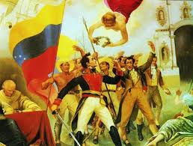
Venezuela, Ecuador, Colombia and Peru
Historical Event: Independence for Northern South America
Year: 1806-1824
Description: The independence struggle in northern Latin America began in 1806, but did not gain momentum until Simon Bolivar fought the Spanish in Venezuela, Ecuador and Colombia for several years, decisively beating them several times.
Bolívar set his sights on Peru, the last and mightiest Spanish colony, which achieved independence on December 9, 1824.
The South American nation of Bolivia is named after him.
Bolivar el Libertador
Artist: Tito Salas
Year: 1928

Slide 16
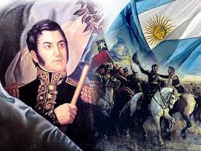
Argentina & Chile
Historical Event: Battle of Maipú
Year: 1810-1818
Description: José de San Martín led the Argentine Rebellion beginning in 1817. He crossed the Andes into Chile, where the rebel army had been fighting the Spanish without progress since 1810. The Chileans and Argentines defeated the Spanish at the Battle of Maipú on April 5, 1818, effectively ending Spanish control over the southern part of South America
Jose de San Martin
Artist: Unknown
Year: 1820

Slide 17
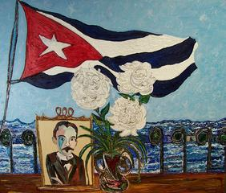
Cuba
Historical Event: Battle of Dos Rios
Year: 1895-1902
Description: Though Spain lost most of its colonies in Latin America, it maintained control in the Caribbean until the early 1900s. Cuban poet José Martí led a rebellion at the Battle of Dos Rios, but was defeated. Rebellion was still simmering in 1898 during the Spanish-American War and Cuba became a US protectorate. Cuba was granted independence in 1902.
La Voz de Jose Marti, a Cuatro Vientos
Artist: Aimee Perez
Year: 2010

