Slide 1
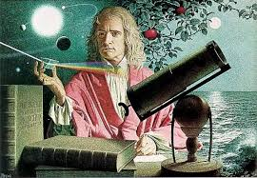
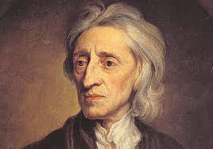
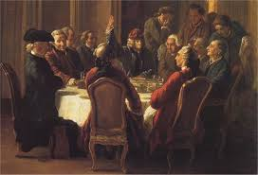
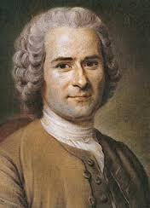
History’s A-Ha!! Moment
Scientific Revolution
The Enlightenment
Enlightenment Thinkers & Artists

Slide 2
Cornell note-taking method
Notes color-coded in RED go on this side of the line.
These items will include:
Main Ideas
Big Concepts
Vocabulary Words
Notes color-coded in BLUE go on this side of the line.
These items will include:
Supporting details
Dates, Times, and Biographic details
Vocabulary Definitions
Any items in BLACK text are optional. Remember: the more thorough your notes, the more prepared you will be for exams.

Slide 3
The Scientific Revolution
Evolution of Education
Scientific Breakthroughs
Other Achievements

Slide 4
The Scientific Revolution: Evolution of Education
Natural philosophers in the Middle Ages relied on a few ancient authorities for their scientific knowledge.
During the Renaissance, humanists had mastered other developments that encouraged new ways of thinking.
Mathematics played a key role in scientific achievements, as it was seen as the key to navigation, military science, and geography.
The invention of new instruments, such as the telescope and microscope, made scientific discoveries possible.
The printing press helped spread new ideas quickly and easily.

Slide 5
The Scientific Revolution: Evolution of Education
Scientific Revolution- 1550 to 1700 CE; time period known for changes in math, science, and educational organizations.
Before 1550, people believed the Ptolemaic system, which supported geocentric theory (that Earth was the center of its universe)
Copernicus used math and astrological observations to prove the heliocentric theory, which determined the Sun was the center of the universe.
Galileo confirmed these theories with the development of the telescope

Slide 6
The Scientific Revolution: Scientific breakthroughs
Isaac Newton- English math professor that defined the laws of motion of planetary bodies and objects on Earth.
Universal Law of Gravitation- explains why the planets continue their elliptical orbits and explains all movement in universe.
Every object in the universe is attracted to every other object by a force called gravity.
Scientific Method- a systematic procedure for collecting and analyzing evidence; was crucial to the evolution of science in the modern world.
Inductive reasoning- process of gathering knowledge of the natural world should be achieved through observation and experimentation.
Developed by Francis Bacon, who believed that scientists should not rely on the ideas of ancient authorities.

Slide 7
The Scientific Revolution: Other Achievements
New concepts of the universe developed during the Scientific Revolution strongly influenced views of humankind.
Rationalism- system of thought is based on the belief that reason is the chief source of knowledge and emphasized the importance of one’s own mind.
Reason- the application of the scientific method to an understanding of all life in order to progress toward a better society.
The questioning of accepted theory, and the procedural collection of data to challenge these theories, became the backbone of philosophical arguments of the Enlightenment.

Slide 8
The Enlightenment
The Enlightenment
Natural Rights
Freedom of Speech
Freedom of Religion
Women’s Rights

Slide 9
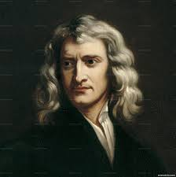
The Enlightenment
1685-1815 CE; period of intellectual productivity and the application of reason to the human and natural worlds
Emerged in response to absolute monarchs and their control over citizens
Works produced during period fueled democratic revolutions and religious tolerance
Goal of Enlightenment thinkers was to apply Isaac Newton’s scientific methods of natural law with John Locke’s ideas of exposing people to the right influences, then people could be changed to create an ideal society.

Slide 10
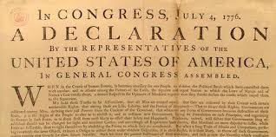
The Enlightenment: Natural Rights
One of the major ideals of the Enlightenment, natural rights stressed the recognition of every person as a valuable individual with inalienable, inborn rights
Challenged absolutism beliefs that all people were subjects of the king
Based on beliefs that man had the ability to reason, power the government, and make decisions for himself.
Promoted by John Locke, Thomas Paine, Jean Jacques Rousseau
Used by Thomas Jefferson in the Declaration of Independence

Slide 11
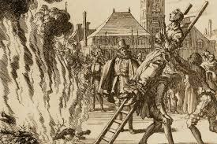
The Enlightenment: Freedom of Religion
Many Enlightenment thinkers were skeptical of religious institutions, as it seemed to be the root of many confrontations. As a result, people should be free to worship as they wished.
These thoughts also led to beliefs in the separation of church and state, the idea that government is one body of laws that should not be influenced by religious matters.
Promoted by John Locke, Voltaire, Denis Diderot
Guaranteed in the Bill of Rights in the U.S. Constitution and French Declaration of the Rights of Man

Slide 12
The Enlightenment: Social Contract
John Locke and Jean-Jacques Rousseau, philosophers who focused on politics, stated that a social contract is formed between a government and the people when that government takes power.
In exchange for ceding some freedoms to the government and its established laws, the subjects expect and demand mutual protection.
The government’s authority, meanwhile, lies only in the consent of the governed. When a government has gone back on its promise, is it up to the people to take back their freedoms.
Contributed to growing discontent with absolutism and monarchies, especially in the North American colonies

Slide 13
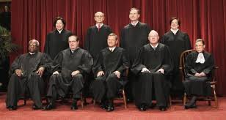
The Enlightenment: Balance of Power
Political philosophers wrote that power in government should be divided into separate branches in order to ensure that no one branch of a governing body can gain too much authority
Judicial- defenders and interpreters of the law, like judges and lawyers
Legislative- lawmakers and representatives whose goals were determined by the will of the people
Executive- the main decision maker, but kept in line by the other two branches

Slide 14
Enlightenment Thinkers

Slide 15
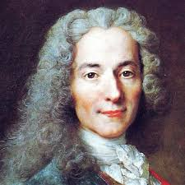
Voltaire
Time Period: 1694–1778
Famous Works: Candide, philosophies on freedom of speech, religious toleration, separation of church & state
French writer and the primary satirist of the Enlightenment, who criticized religion and leading philosophies of the time. Voltaire’s numerous plays and essays frequently advocated freedom from the ploys of religion, while Candide (1759), the most notable of his works, conveyed his criticisms of optimism and superstition.
Influenced: American & French Revolutions, Secularism

Slide 16
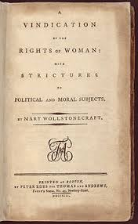
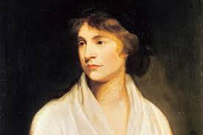
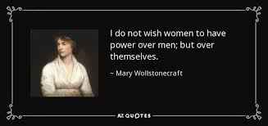
Mary Wollstonecraft
Time Period: 1759-1797
Famous Works: A Vindication of the Rights of Woman
Argued that women are not naturally inferior to men, but appear to be only because they lack education. She suggests that both men and women should be treated as rational beings to create a social order founded on reason.
Influenced: Elizabeth Barrett Browning, 20th century suffrage movements, Elizabeth Cady Stanton

Slide 17
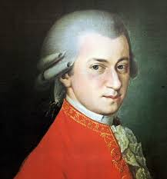
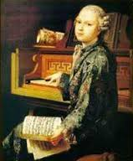
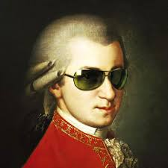
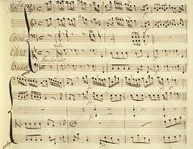
Wolfgang Amadeus Mozart
Time Period: 1756–1791
Famous Works: Requiem, Minuet, Symphony No. 40
Austrian composer who began his career as a child prodigy and considered to be a genius. Authored some of the most renowned operas and symphonies in history. Mozart’s music has never been surpassed in its blend of technique and emotional breadth.
Influenced: Beethoven, Chopin, Tchaikovsky

Slide 18
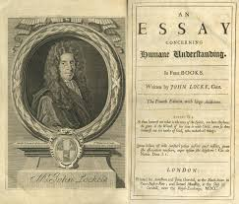
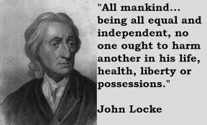
John Locke
Time Period:1632–1704
Famous Works: Two Treatises of Government
English political theorist who focused on the structure of governments, believed that men are all rational and capable people but must compromise some of their beliefs in the interest of forming a government for the people. He championed the idea of a representative government that would best serve all constituents.
Influenced: Jonathan Edwards, Voltaire, Founding Fathers of the United States

Slide 19
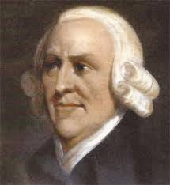
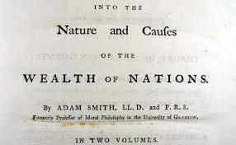
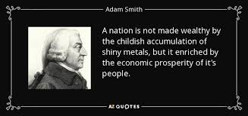
Adam Smith
Time Period: 1723–1790
Famous Works: Wealth of Nations
Scottish economist who objected to the mercantilist systems that left little room for economic growth. In response, Smith wrote a dissertation criticizing mercantilism and describing the many merits of a free trade system, which formed the basis of modern capitalism.
Influenced: Karl Marx, Alan Keynes, Noam Chomsky

Slide 20
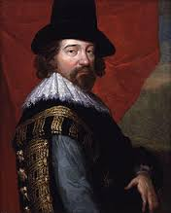
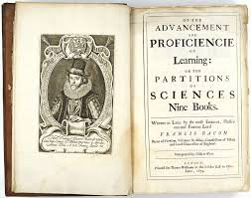
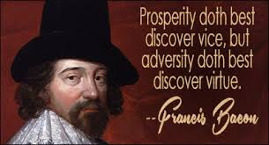
Sir Francis Bacon
Time Period: 1561–1626
Famous Works: Inductive Reasoning, Observation & Investigation
An English philosopher and statesman who stressed observation and scientific reasoning as a means for coming to general conclusions.
Influenced: Rene Descartes

Slide 21
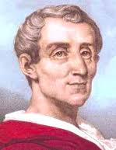
Montesquieu
Time Period: 1689-1755
Famous Works: The Spirit of Laws
The foremost French political thinker of the Enlightenment, Baron de Montesquieu expanded John Locke’s political study and incorporated the ideas of a division of state and separation of powers. Montesquieu spent a considerable amount of time researching various cultures and their climates, ultimately deducing that climate is a major factor in determining the type of government a given country should have
Influenced: Paine, Rousseau, Alexis de Tocqueville

Slide 22
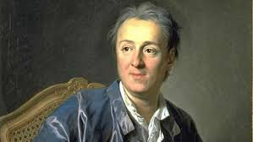
Denis Diderot
Time Period: 1713–1784
Famous Works: Encyclopédie, thirty-five-volume compilation of human knowledge in the arts and sciences
A French scholar who, along with commentary from a number of Enlightenment thinkers, became a prominent symbol of the Enlightenment and helped spread the movement throughout Europe.
Influenced: von Goethe, Kundera, Karl Marx

Slide 23
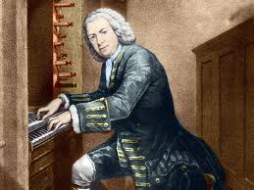
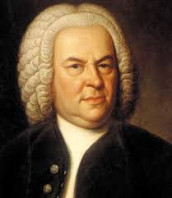
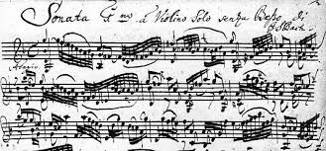
Johann Sebastian Bach
Time Period: 1685–1750
Famous Works: Prelude Cello Suite No. 1, Goldberg Variations, Mass in B Minor
German composer who, best known by his contemporaries as an organist. Bach also wrote an enormous body of both sacred and secular music that synthesized a variety of styles and in turn influenced countless later composers.
Influenced: Beethoven, Mendelsohn

Slide 24
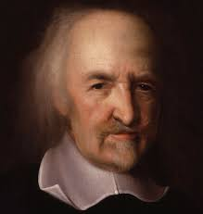
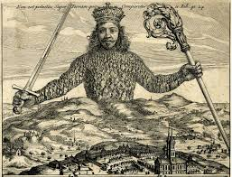
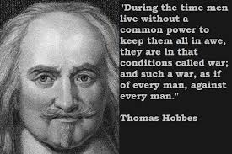
Thomas Hobbes
Time Period: 1588–1679
Famous Works: Leviathan
Philosopher and political theorist whose works effectively kicked off the English Enlightenment. Hobbes’s theory that all humans are inherently self-driven and evil and that the best form of government is a single, all-powerful monarch to protect the people.
Influenced: Western political philosophy and sociology, future Enlightenment thinkers

Slide 25
Jean Jacques Rousseau
Time Period: 1712–1778
Famous Works: The Social Contract, Confessions, development of Romanticism
Rousseau, an eclectic Swiss-French thinker who brought his own approach to the Enlightenment, believed Government is an agreement or contract between ruler & people and that man was at his best when unshackled by the conventions of society. Rousseau conceived of a system of direct democracy in which all citizens contribute to an overarching “general will” that serves everyone at once.
Influenced: American & French Revolutions (politics); Goethe (philosopher), and Tolstoy, Byron, Hawthorne & Thoreau (authors)

Slide 26
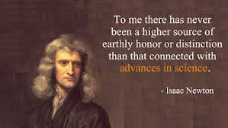
Sir Isaac Newton
Time Period: 1642–1727
Famous Works: Universal Law of Gravitation, Laws of Motion
English scholar and mathematician regarded as the father of physical science. Newton’s discoveries anchored the Scientific Revolution and set the stage for everything that followed in mathematics and physics.
Influenced: Gottfried Liebnitz (inspired to the point of copying), Albert Einstein

Slide 27
Thomas Paine
Time Period: 1737–1809
Famous Works: Common Sense, Age of Reason, Rights of Man
English-American political writer who argued that the British colonies in America should rebel against the Crown. Paine’s work had profound influence on public sentiment during the American Revolution, which had begun just months earlier
Influenced: Thomas Jefferson, Founding Fathers

Slide 28
GeorgE Fredrick Handel
Time Period: 1685–1759
Famous Works: Messiah, Water Music, Zadok the Priest
A German-English composer of the late Baroque period. Handel was an active court composer, receiving commissions from such notables as King George I of England. He wrote operas and concertos, but was most famous for choral music written for royal ceremonies still used today. Buried in Westminster Abbey
Influenced: Mozart, Bach, Ludwig van Beethoven

Slide 29
Olympe de Gouge
Time Period: 1748–1793
Famous Works: Declaration of the Rights of Woman and the Female Citizen (1791)
Olympe de Gouge was a French feminist, author, and supporter of the Revolution.
Considered a feminist pioneer, de Gouges was an advocate of women's rights. Even in revolutionary France, feminist ideas were considered radical. In 1793, she was executed for crimes against the government
Influenced: Mary Wollstonecraft, Elizabeth Cady Stanton

Slide 30
William Blackstone
Time Period: 1723-1780
Famous Works: Commentaries on the Laws of England (1766), A Discourse on the Study of Law (1758), An Analysis of the Laws of England (1756)
Blackstone graduated from Pembroke College with a degree in civil law. Blackstone went on to become a university administrator, judge, and was the first professor to teach common law in any major university in the world. He published a number of works on English law, including the Commentaries on the Laws of England. This four-part collection was Blackstone's attempt to make English common law understandable and accessible. Blackstone outlined the laws and legal precedents, presented the common law system as rational and comprehensible, and justified the common laws as being righteous and accurate. The Commentaries are considered to be the first systematic study of English common laws.
Influenced: Alexander Hamilton, John Marshall, John Jay, John Adams, Abraham Lincoln, frequently cited in U.S. Supreme Court decisions

