Slide 1
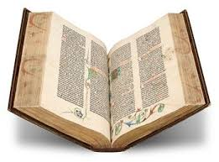
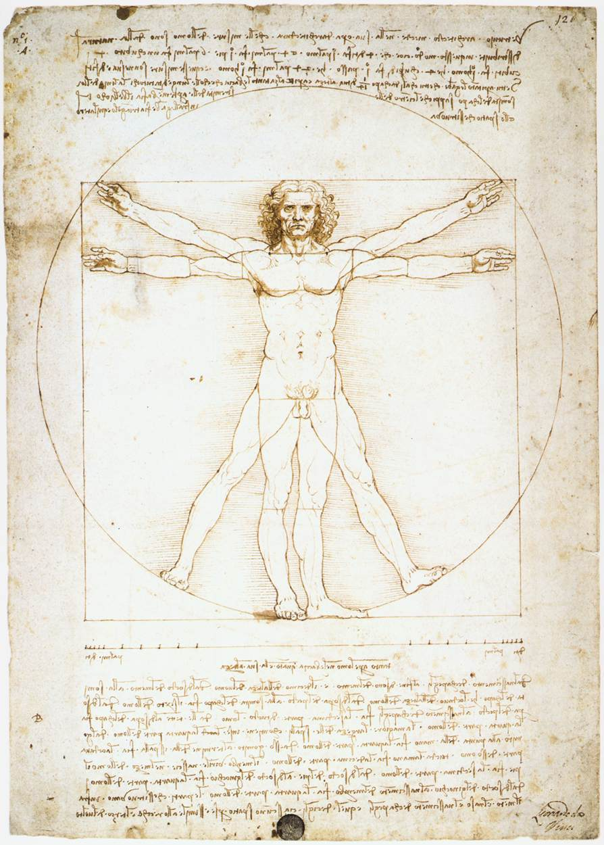
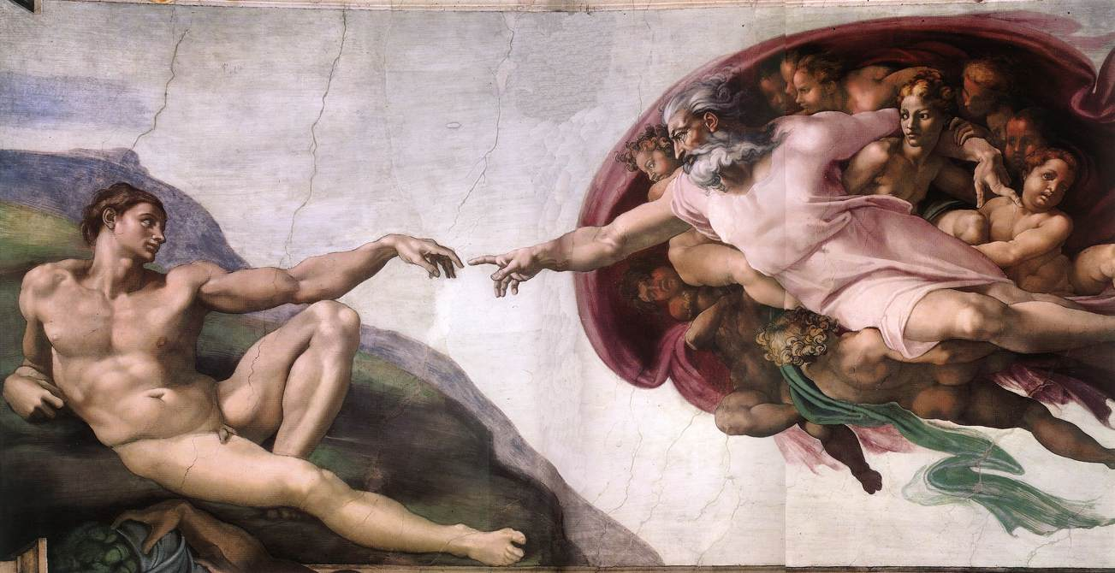
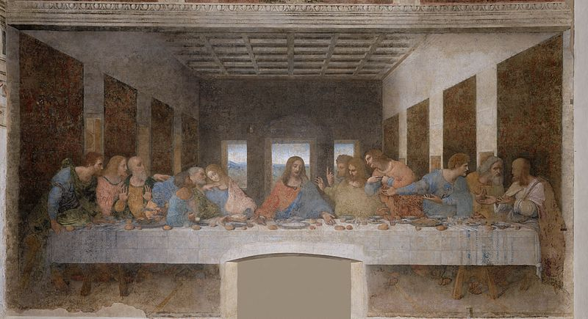
The Renaissance
Rise of Italian City-States
Contributions
Effects of the Renaissance

Slide 2
Cornell note-taking method
Notes color-coded in RED go on this side of the line.
These items will include:
Main Ideas
Big Concepts
Vocabulary Words
Notes color-coded in BLUE go on this side of the line.
These items will include:
Supporting details
Dates, Times, and Biographic details
Vocabulary Definitions
Any items in BLACK text are optional. Remember: the more thorough your notes, the more prepared you will be for exams.

Slide 3
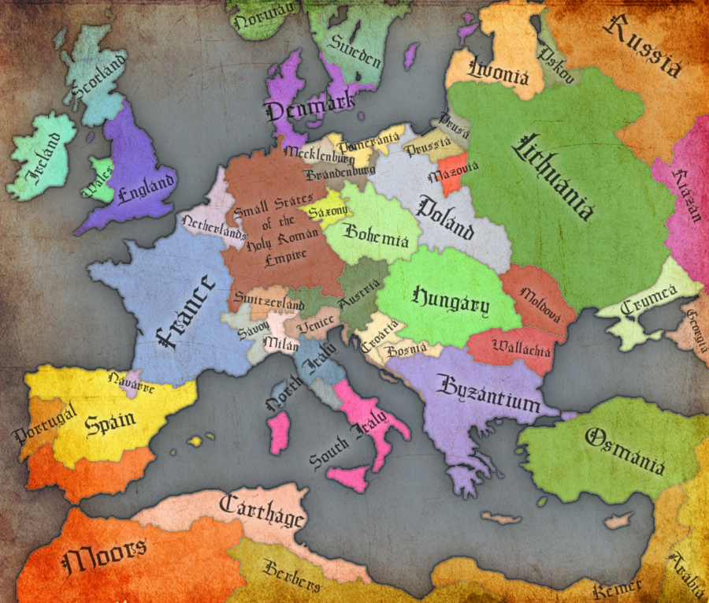
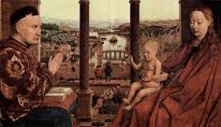
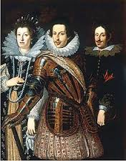
Rise of the Italian City-States
End of the Dark Ages
Trade & the City-States
Medici Family

Slide 4
The End of the Dark Ages
Renaissance- means “rebirth”; refers to a cultural awakening in Europe that began in Italy, lasted from about 1350 – 1600
Known as the “Rebirth” of classical knowledge, including:
Art
Learning
Writing
Philosophy
Europe was recovering from the Dark Ages (the Middle Ages) and the Black Death. People had lost their faith in the church and began to put more focus on human beings.

Slide 5
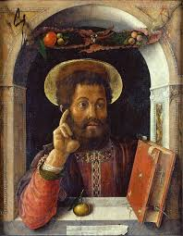
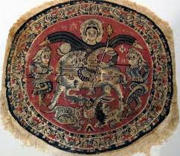
End of the dark ages
Individualism – emphasis on person as individual rather than part of a group
The Crusades increased the amount of goods exchanged between Europe and the Islamic empire
Demand increased for Middle Eastern products
Systems of credit and banking established in Middle East became more popular in Europe
Both Byzantine & Islamic empires preserved vast amounts of Greco-Roman knowledge and history from the Classical Civilizations

Slide 6
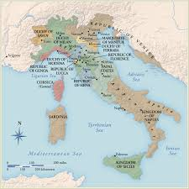
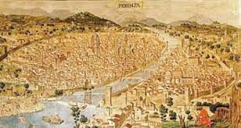
Trade & the city-states
Italy was the “crossroads”, where all trades routes met up and passed through to other destinations
More trade equaled more money
City-state- a region that is independently ruled by a major city. During the Renaissance, Italy was broken up into city-states that were controlled by different rulers:
Vatican City- the Pope & Catholic Clergy
Florence- Medici Family
Venice- The Doge
Florence had become the most powerful and wealthiest city-state, mainly a result of textile (fabric) production and development of banking centers

Slide 7
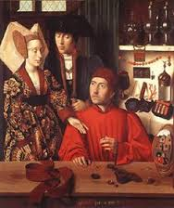
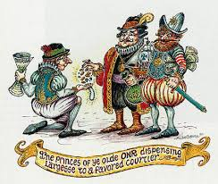
Trade & The City-States
Patrons- wealthy businessmen and merchants who asked artists and craftsmen to create something for them (commission).
Had the money to spend on purchasing art
The more art they owned, the higher their social status was
Demand inspires competition between artists to create the best products, which leads to quality of art increasing and new thoughts on science & philosophy emerging

Slide 8
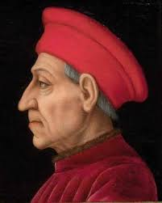
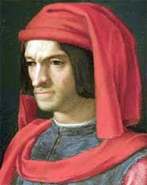
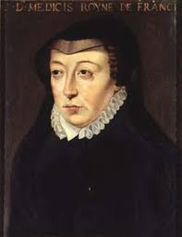
The medici family
Medici Family- wool merchants and banking family that amassed a large amount of wealth; most famous for patronage of various artists
Giovanni de Medici- first leader of the family, influenced Florence merchants
Support allowed artists to work without worrying about money
Family’s influence extended over the next 200 years:
Cosimo- leader of Florence government; patron of sculptor Donatello
Lorenzo- patron of Michelangelo, da Vinci, and Botticelli
Giovanni Lorenzo- first of four Medici to become Pope, reigned as Pope Leo X; patron of Raphael
Catherine- Queen of France in 1547 and Regent for 3 French kings (her sons); brought ballet to court

Slide 9
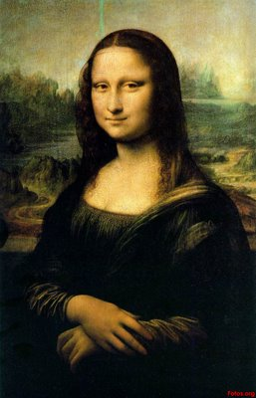
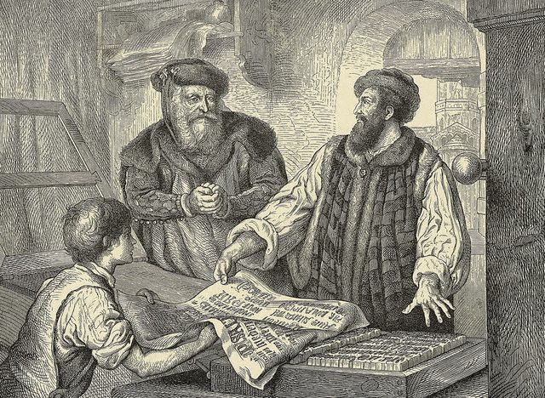
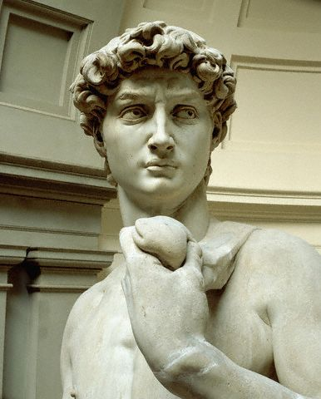
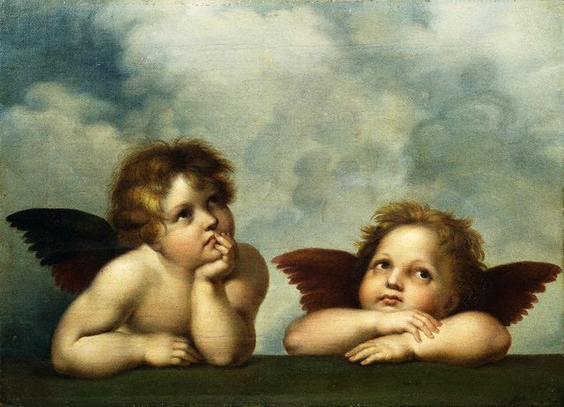
Contributions
Art
Literature
Philosophy

Slide 10
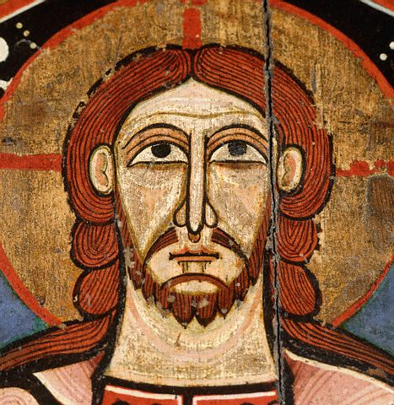
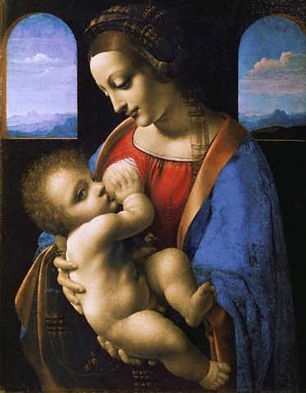
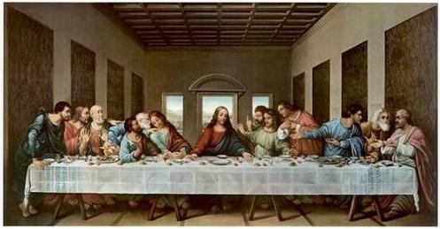
Contributions to Art
Renaissance Art differed greatly from Medieval Art:
Medieval art and literature focused on the Church and salvation
Renaissance art and literature focused on individuals and worldly matters, along with Christianity.
Leonardo da Vinci- artist, scientist, inventor; painted Mona Lisa and The Last Supper
“Renaissance man”- refers to da Vinci’s interest in so many subjects, and his excellence at learning them
Today, refers to someone who is good at many different things

Slide 11
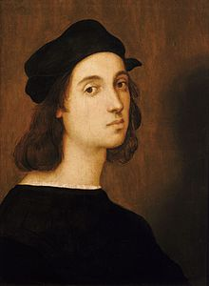
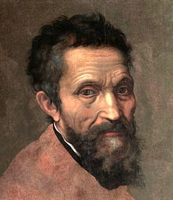
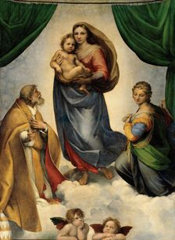
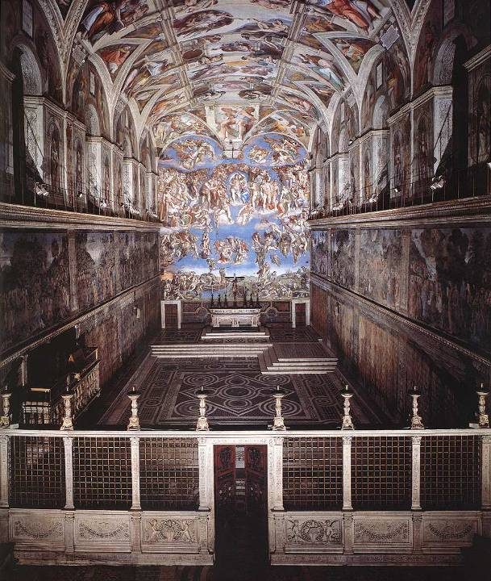
Contributions to Art
Michelangelo- artist, painter, and sculptor; Born in 1475 near Florence, considered to be one of the most inspired artists of Renaissance
Sculpted the David in 1504
Commissioned by Pope Julius II to paint the Sistine Chapel
Raphael- painter and teacher; lived from 1483-1520, received many commissions from both Pope Julius II & Pope Leo X
The School of Athens
The Sistine Madonna- most famous for cherubs at the bottom

Slide 12
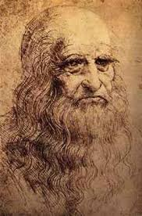
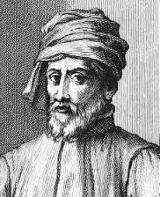
Just FYI…

Slide 13
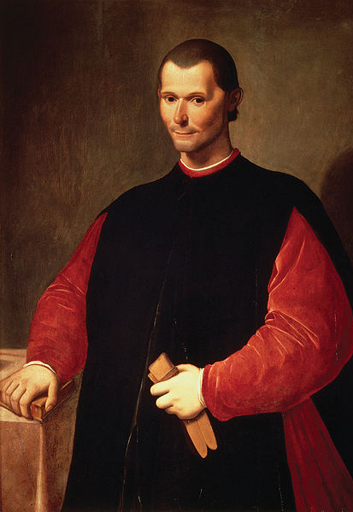
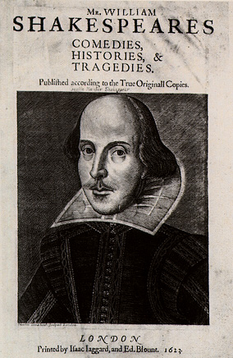
Contributions to Literature
Niccolo Machiavelli- Italian political philosopher; wrote The Prince on how to be an effective ruler
supported absolute power
“end justifies the means”
try to do good, but be evil if needed
William Shakespeare- English playwright; works are credited with introducing 3000 words to English language
Wrote Romeo & Juliet
Johannes Gutenberg- in 1455, printed a copy of the Bible using moveable type; books became a tool for mass communication, spreading knowledge, and availability of education

Slide 14
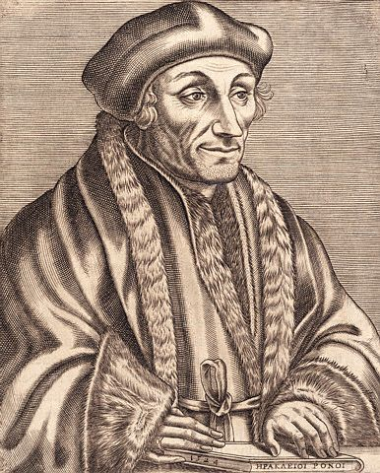
Contributions to philosophy
Erasmus- Used humor to show the immoral and ignorant behavior of people, including the clergy.
felt people should be open minded and be kind to others.
Pushed for the Bible to be printed in the vernacular, the native and informal language of local populations
Thomas More- wrote Utopia, “the perfect society”; believed men and women could and should live in harmony.
No private property, no one is lazy, all people are educated and the justice system is used to end crime instead of executing criminals.

Slide 15
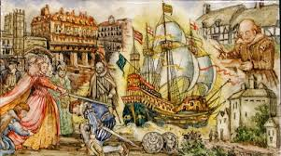
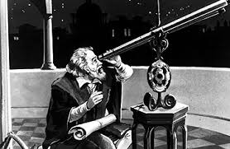
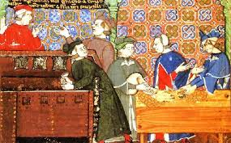
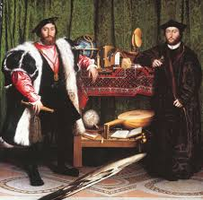
Effects of the Renaissance
Political
Economic
Intellectual
Social
Cultural

Slide 16
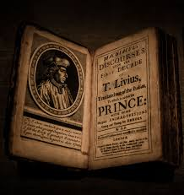
Political Effects
England experienced such growth and change that historians often refer to it as the “Golden Age” or Elizabethan era
Elizabeth I- ruler of England; after defeating the Spanish, wealth, prosperity, and peace that followed was attributed to her rule and policies
Wealth of the Italian city-states increased their political power and weakened the Church’s power & influence
Following the publishing of Machiavelli’s The Prince, rulers collected taxes, raised armies, hired professional soldiers (mercenaries), and exchanged ambassadors to monitor relations between countries

Slide 17
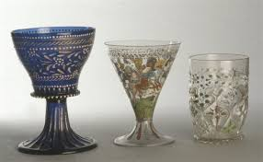
Economic Effects
Wealth led to accumulation of luxury goods, as they indicated social status
People wore better clothes, owned more material things (furniture, artwork, jewelry), and shifted away from agricultural-based economies
Increased trade led to greater availability of a variety of products, and merchants traveled to different areas for specific time periods to allow people to shop
Continued growth of cities

Slide 18
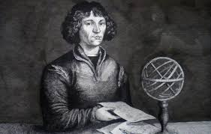
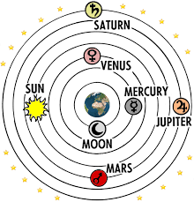
Intellectual Effects
Gutenberg’s printing press allowed for information to be released to the public faster, creating a more educated population
More authors wrote on secular subjects and in their native languages.
Rabelais (French), William Shakespeare (English), and Cervantes (Spanish)
Writers described the dignity of man, pleasures of the senses, and instructed nobles in how to behave at court
Copernicus- a scientist, concluded that the Earth orbited the sun. His work was banned by the Church (Church taught that Earth was the center of the universe)
Galileo Galilei- Italian scientist, studied motion and laid the foundation for modern physics. Invented one of the first telescopes and wrote about his belief in Copernicus’ theory.

Slide 19
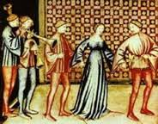
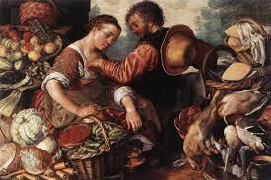
Social Effects
Artists and merchants who were paid by their patrons became members of the emerging middle class, people who were not extremely wealthy or poor.
During the Renaissance, most marriages were arranged to create financial or political alliances between families.
Parents tried to arrange for their daughters to marry men who would improve the family’s wealth or status in society.
Middle & Upper Class men and women also had designated gender roles:
Males managed all the finances, property, and made all the important decisions for everyone in the household.
Female roles were maintaining the household, respecting her husband’s authority, and looking after her children.

Slide 20
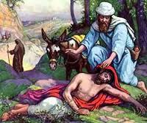
Cultural Effects
In addition to contributions to art, literature, and philosophy, there were many other major cultural shifts during Renaissance.
Secularism- people moved away from life in the church and focused more on material objects and enjoying life
Reason – used observation and experience to explain the world rather than Christian teachings
Humanism – emphasized dignity, worth, and uniqueness of individuals. (man is the focus of all things)
Petrarch – the “Father of Humanism”; collected and studied ancient texts
Christian Humanism – a movement in northern Europe that promoted reason through Christian teachings

