Slide 1
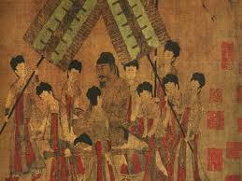
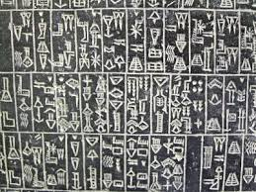
The Rise of civilizations
Neolithic Revolution
River Valley Civilizations
Religious Development

Slide 2
Cornell note-taking method
Notes color-coded in RED go on this side of the line.
These items will include:
Main Ideas
Big Concepts
Vocabulary Words
Notes color-coded in BLUE go on this side of the line.
These items will include:
Supporting details
Dates, Times, and Biographic details
Vocabulary Definitions
Any items in BLACK text are optional. Remember: the more thorough your notes, the more prepared you will be for exams.

Slide 3
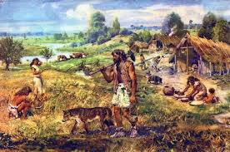
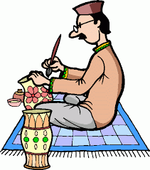
Neolithic revolution
Early Hunter-Gatherers
Neolithic Revolution

Slide 4
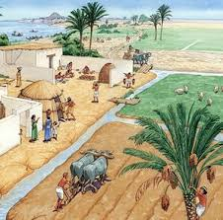
Neolithic revolution
Nomads- early humans met their needs for food, water, and shelter by creating temporary homes and following their food sources
Hunter-Gatherer lifestyle
Men: hunted animals with spears and basic weapons
Women: gathered edible leaves, berries, and plants
Neolithic Revolution- 8,000 to 5,000 BCE, shifted away from hunter-gatherer lifestyles and developed permanent settlements, civilizations, and agriculture
Agriculture- systematic growing of crops to provide food and other products needed for survival
Crop Cultivation- provided reliable food sources, ex. Wheat, barley, and rice
Animal Domestication- adapted animals for meat, milk, and clothing resources; could also be used for farm work
Effects of Neolithic Revolution:
Built walls for protection and storage units for surplus goods
Development of traditional economy, bartering & exchanges
Definition of gender roles: men farmed, women looked after home & children
Creation & use of tools made for farming, ex. Backhoes, machete, blade-sharpening

Slide 5
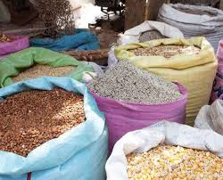
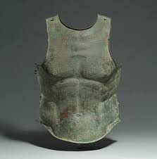
Neolithic revolution
Surplus- extra; when the resources produced exceeds the demand for the product
Not as many farmers will be needed
Managing surplus will lead to division of labor and the creation of social classes
Artisans- skilled workers, made goods from local resources to trade with neighbors
Experimented with melting metal and pouring into casts (shapes) to create copper, which was used for pots, weapons, and tools, around 4000 BCE
Melting copper and tin together created bronze, which would be used around 3000 BCE, aka the Bronze Age
Iron will replace bronze in the Iron Age, around 1000 BCE
Towards the end of Bronze Age, many people will cluster around settlements near river sources, leading to creation of cities

Slide 6
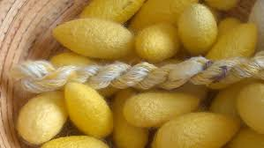
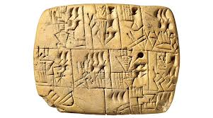
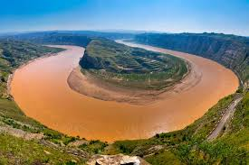
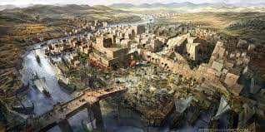
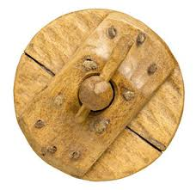
River valley civilizations

Slide 7
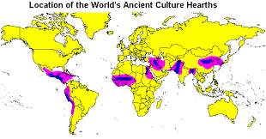
In World Geography, You learned…
Settlement Patterns- factors that help people determine where they are going to live
Physical- water sources, fertile soil, best economic activities for your skills
Human- ethnicity, language, race, social class
All world cultures have descended from 7 cultural hearths, the locations of the world’s earliest civilizations
Social Classes- are an important part of culture; People are organized into different social classes when they share similar levels of wealth, power, and influence.

Slide 8
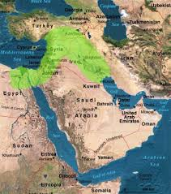
River Valley civilizations: Mesopotamia (3500-1700 BCE)
Mesopotamia- translates to “land that is located between the two rivers”; once known as the “Cradle of Civilization”, frequently called the Fertile Crescent
The geographic area between the Tigris and Euphrates rivers, near present-day Iraq; area had fertile soil and fresh water supply
Contributions- some of the world’s most important developments came from Mesopotamia.
Sumerians: invented the wheel, the sailboat, and created tools with copper and bronze
Developed writing system called cuneiform, carving symbols on clay tablets
Hammurabi’s Code- earliest legal system, “eye for an eye”
City-state- a central city and the surrounding territories that are dependent on it

Slide 9
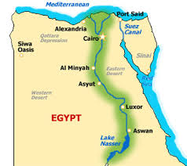
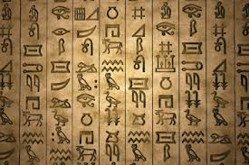
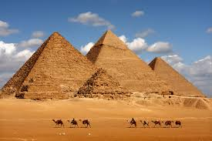
River Valley civilizations: Nile river valley (3200-500 BCE)
Civilization formed around the Nile, while being surrounded by desert and seas protected them from diseases and enemy attacks
Located in Present-day Egypt in northeast Africa
Egyptians developed geometry to build pyramids, tombs built to house and honor the body of the Pharaoh, and used astronomy to create a 365-day calendar.
Used hieroglyphics, picture symbols, to maintain communication and history
Invented papyrus, paper made from reeds, to replace clay tablets

Slide 10
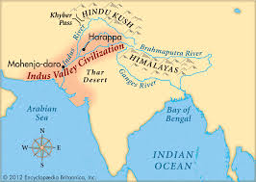
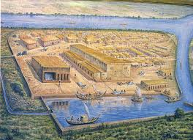
River valley civilizations: Indus river valley (5000-1500 BCE)
Ancient peoples known as Harrappans clustered around the Indus River on the western Indian continent, where citizens were known for their advanced government, trade practices, and technological contributions to their society.
Civilization flourished until 1500 BCE, when it mysteriously collapsed.
The Harrapans built large urban centers, including Harrappa and Mohenjo-Daro, which contained more 30,000 people.
Urban advances included docks, granaries, brick platforms, and protective walls
First to develop public sewers to carry away waste

Slide 11
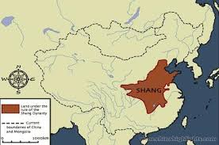
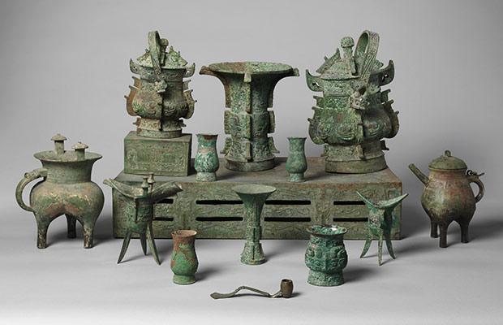
River Valley Civilizations: Huang He River Valley (4500-1000 BCE
China’s first civilization gathered around the Huang He (Yellow) river and its surrounding floodplain
Huang He is called Yellow because the silt it carries is yellow
Aristocracy- upper classes whose wealth is based on the amount of land they own. The power and control of these lands is hereditary, and passes ownership through generations.
Cultivated worm cocoons to make silk, which will become a precious trade for next 1000 years.
Worked extensively with bronze

Slide 12
Brain Teaser!!
What do the songs on your Unit 1 Playlist have in common?
- Mr. Blue Sky - Circle of Life
- Walking on Sunshine - Supermassive Black Hole
- The Big Bang Theory Theme - Mouth of the River
- Ain’t No Mountain High Enough - River of Love
- Have You Ever Seen the Rain? - (Sittin’ on) The Dock of the Bay
- Hungry Like the Wolf - Here Comes the Sun
- The Bare Necessities - Country Man
- Jurassic Park Theme - Take Me Home, Country Roads

Slide 13
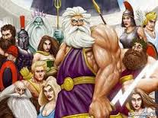
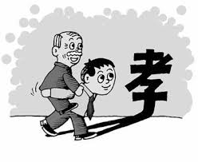
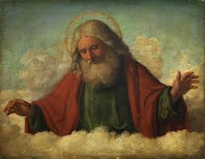
Religious Development
Polytheism & Monotheism
Judaism
Daoism
Filial Piety

Slide 14
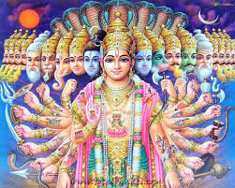
Monotheism & polytheism
Polytheism- The belief in multiple gods or goddesses; may have a Supreme deity and lesser deities that followers pray to or worship, or ghost-like forces or bad spirits may have equal or lesser status in prayers.
All major civilizations followed some form of animistic (spirits of animate & inanimate objects) and polytheistic religion until 920 BCE
Monotheism- The belief in a single all-powerful deity, or god-like being; differs from earlier historical beliefs that hundreds of different gods were responsible for different tasks
Judaism, Christianity, Islam are monotheistic

Slide 15
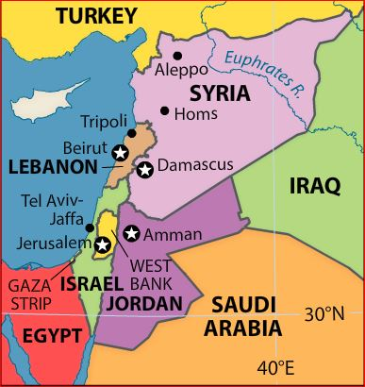
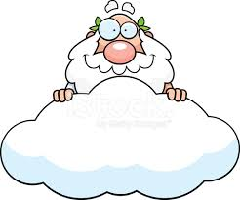
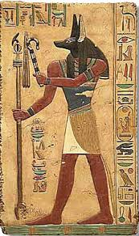
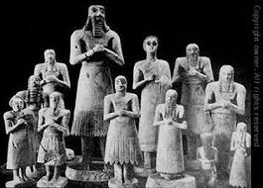
Judaism
Israelites (ancient Hebrews) originated from Phoenicia, the location of present-day Israel, Lebanon, & Jordan
Heavily influenced by both Mesopotamian and Egyptian civilizations
Hebrews believed in a universal God that was just, expected moral behavior, and was a powerful force that created the world.
Differs from Mesopotamian religions that gave their gods human characteristics
Differs from Egyptian religions that gave their gods animal heads or bodies

Slide 16
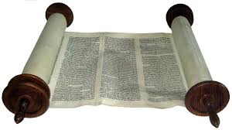
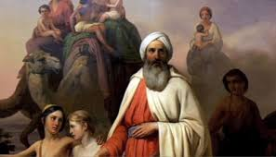
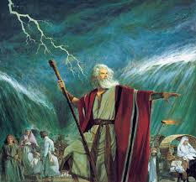
Judaism
The Torah (5 Books of Moses), which is the equivalent of the Old Testament in the Christian Bible, documents the history of the Jewish people.
Abraham, originally from Ur, formed a covenant (contract) with God in exchange for being led to the Promised Land (Canaan= Israel)
After many years of drought and famine, Hebrews migrated to Egypt, where they were enslaved
Moses, a Hebrew raised as an Egyptian prince, led the Hebrews out of slavery and back to the Promised Land
Ten Commandments- moral code of conduct for Jews and Christians that prohibits stealing, murder, adultery, etc.
Israel had been re-occupied, which led to many ethnic wars, leading the Hebrews to capture Jerusalem, where they established their capitol.

Slide 17
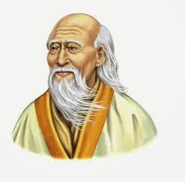
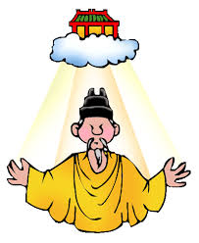
Daoism
Daoism (Taoism) evolved from ancient Chinese traditions, but was organized by the writings and teachings of Dao de Jing by Lao Zi around 500 BCE, though it draws on folk religion and traditions from long before that time.
Mao Zedong and the Communists worked to suppress Daoism in the 1950s, but there are many areas of China that still show Dao influence
Zhou dynasty believed that they received the Mandate of Heaven, divine rights to rule China.
Dynasty- series of rulers from the same family, usually lasting decades or centuries
Leaders must govern according to the Dao, the proper Way. The Dao encompasses theories of Heaven, Earth, and Humanity, but can’t be defined by any one of those terms

Slide 18
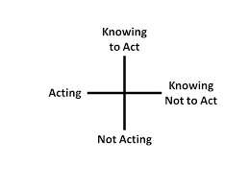
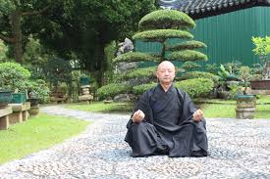
Daoism
The Dao teaches wu-wei, the way of no-action and no-selfishness; to live in a plain and modest way and not to struggle for material gain.
The goal of Daoism is immortality, as the Value of Life and maintaining life’s energy is the most important thing and should be sought through meditation and exercise.
Humanity uses Yin and Yang to create a harmonious balance between opposites on Earth. Yin is female while Yang is male; the need to balance yin and yang can be applied to everything, including:
martial arts (Tai Chi)
food (macrobiotics)
the arrangement of living conditions (feng shui)

Slide 19
Filial Piety
The duty for members of a family to place their needs behind the overall need of that family, especially the will of the patriarch (male leader).
Every member of the family has his/her place
China doesn’t officially have religions, but the cornerstone of Chinese life is family. Filial piety is present in Asian philosophies such as Daoism and Confucianism.
In ancient China, crop cultivation took a lot of work from a lot of people, so couples had large families to distribute work among the children.
Children were expected to listen and honor their parents and their family name, and sons provided for their parents in old age.

