Slide 1
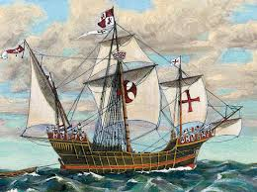
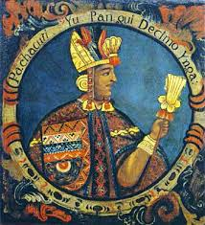
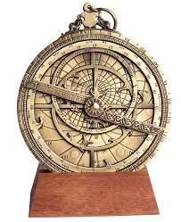
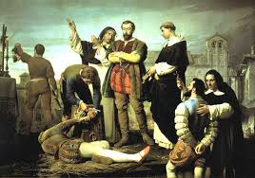
The age of exploration
Explorers
Conquistadors

Slide 2
For this assignment…
Use the information in the PowerPoint to complete the note charts on Explorers and Conquistadors
For the Explorers:
After you have filled in the chart, use the maps on the slide to complete “Age of Explorers Route Map”. Use a different map color for each explorer’s route- do not repeat colors.
For the Conquistadors:
After you fill in the “Accomplishments” on the chart, decided whether the conquistador you are reading about is a hero or a villain.

Slide 3
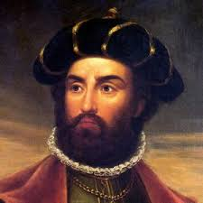
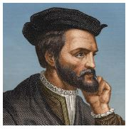
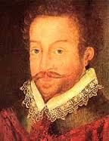
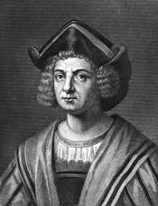
Explorers

Slide 4
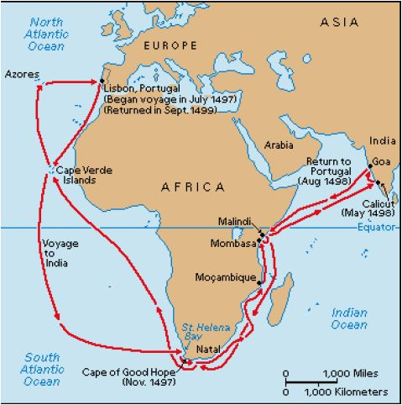
Vasco De Gama
Vasco de Gama was a Portuguese explorer and one of the most successful explorers in the European Age of Discovery. De Gama was the commander of the first ships to sail directly from Europe to India. He went south from Europe, staying close to the African coastline until he sailed around the southern tip of Africa. De Gama and his crew then turned north toward India.
This eventually began a lucrative trade route between India and Europe that brought great wealth to Portugal. For a short time in 1524, De Gama was made Governor of Portuguese India under the title of Viceroy.

Slide 5
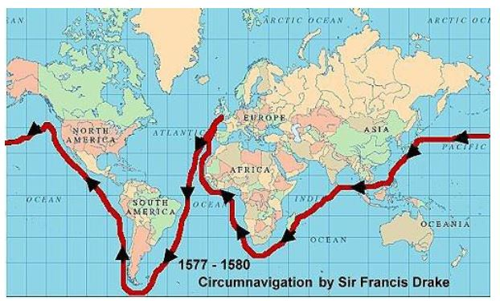
Francis Drake
Francis Drake was an English sea captain, privateer, and pirate of the Elizabethan era. Elizabeth I of England awarded Drake a knighthood in 1581. He was second-in-command of the English fleet when it famously defeated the Spanish Armada in 1588. This forever made England dominant of Spain on the seas. His exploits were legendary, making him a hero to the English but a pirate to the Spaniards to whom he was known as El Draque, 'Draque' being the Spanish pronunciation of 'Drake'. He is most famous for being the first Englishman to successfully sail around the world from 1577 to 1580.
He died of dysentery in January 1596 after unsuccessfully attacking San Juan, Puerto Rico.

Slide 6
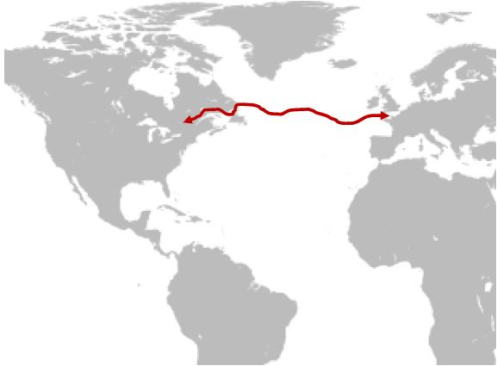
Jacques Cartier
Cartier was a French explorer who claimed present-day Canada for France in 1534. He was the first European to describe and map the Gulf of Saint Lawrence and the shores of the Saint Lawrence River, which he named “The Country of Canadas”, after the Iroquois names for the two big settlements he saw at Stadacona (Quebec City) and at Hochelaga (Montreal Island).
Cartier eventually made 3 separate trips that explored the eastern coast of modern-day Canada. Cartier was also one of the first explorers to formally acknowledge that the New World was a separate land mass from Europe/Asia.

Slide 7
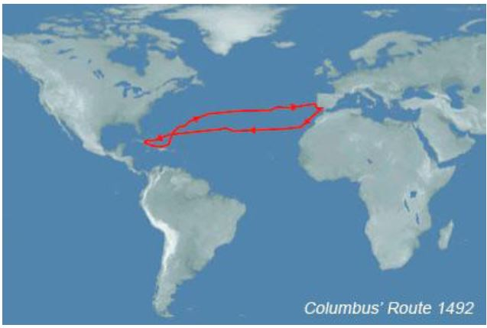
Christopher Columbus
Columbus was a navigator, colonizer, and explorer from Genoa, Italy whose voyages across the Atlantic Ocean led to general European awareness of the American continents in the Western Hemisphere. He was unable to get funding for his voyages from Italy so he turned to Queen Isabella of Spain. The Spanish gave him money for 4 voyages of exploration and several attempts at establishing a settlement on the island of Hispaniola, . He initiated the process of Spanish colonization which foreshadowed general European colonization of the "New World".
The anniversary of Columbus's 1492 landing in the Americas is usually observed as Columbus Day on October 12 in Spain and throughout the Americas, except Canada. In the United States it is observed annually on the second Monday in October.

Slide 8
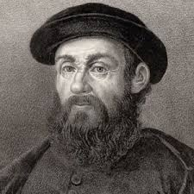
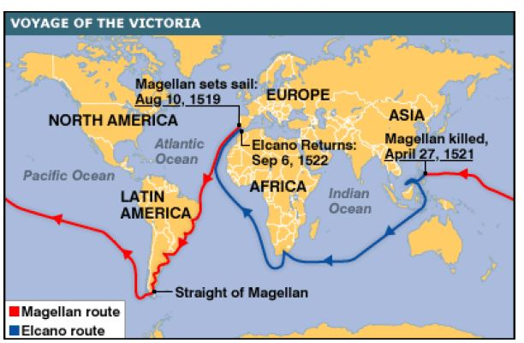
Ferdinand Magellan
Magellan was a Portuguese explorer. His expedition of 1519–1522 became the first expedition to sail from the Atlantic Ocean into the Pacific Ocean and the first to cross the Pacific. It also completed the first circumnavigation (meaning going all the way around) of the Earth.
Magellan himself did not complete the entire voyage. When his ship stopped in the Philippines, Magellan was killed during the Battle of Mactan. His crew escaped and finished the voyage, however, and became the first ship to sail around the world.

Slide 9
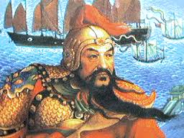
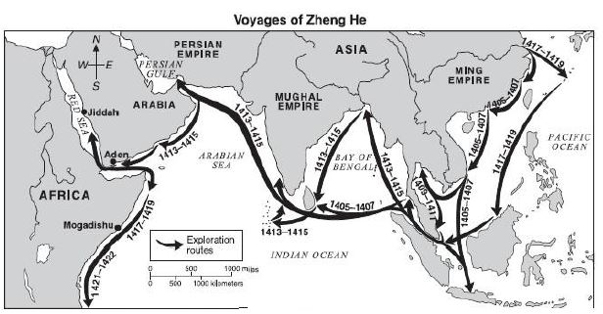
Zheng He
Zheng He was a Chinese mariner, explorer, diplomat and fleet admiral, who commanded voyages to Southeast Asia, South Asia, and East Africa from 1405 to 1433. His extraordinary ability and vision found brilliant expression in the great achievements of his life, including maritime exploration, foreign diplomacy, and military affairs. He sailed huge treasure ships to Africa and India and brought back great wealth from these empires for the emperor of China.
There is evidence of Zheng He's visits in over thirty Asian and African countries and regions. These seven voyages, unprecedented in size, organization, navigational technology, and range, demonstrated not only the power and wealth of the Ming Dynasty, but also Zheng He's extraordinary command ability. Loaded with Chinese silk, porcelain, and lacquerware, his ships visited ports around the Indian Ocean. Here, Arab and African merchants exchanged the spices, ivory, medicines, rare woods, and pearls so eagerly sought by the Chinese imperial court.

Slide 10
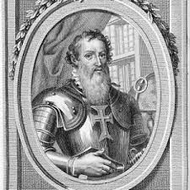
Prince Henry the Navigator
Prince Henry the Navigator was not himself an explorer. He was Prince of the Kingdom of Portugal and an important figure in the early days of the Portuguese Empire. He was responsible for the early development of European exploration and maritime trade with other continents.
Henry encouraged his father to conquer Ceuta (1415), the Muslim port on the North African coast across the Straits of Gibraltar from the Iberian peninsula. He learnt of the opportunities from the Saharan trade routes that passed through there, and became fascinated with Africa in general.
Henry opened a school for navigators and map-makers in Portugal to help exploration. He employed cartographers to chart the coast of Mauritania after the voyages he sent there. It was thanks to his efforts that Portuguese explorers were able to achieve so much.

Slide 11
Conquistadors

Slide 12
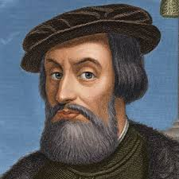
Hernan Cortes
Cortés was born in Spain in 1485. He studied law, but he soon gave that up to seek his fortune in the New World. Cortés was eager for power and conquests, so he talked the Spanish government into letting him lead an expedition to Mexico in 1519.
Cortés learned of the Aztecs and began to make his way inland to the Aztec capital city, Tenochtitlán. In November 1519, Cortés met Montezuma II. The Aztecs treated him and his soldiers well, but Cortés was afraid that the Aztecs might soon try to get rid of him, so he took Montezuma hostage and asked for a huge ransom of gold and jewels. The Aztecs finally drove him and his men out of their city, but Cortés regrouped and returned in the summer of 1521 to capture Tenochtitlán.
Cortes built Mexico City on the Aztec ruins and brought many Europeans over to live there. He was made governor and captain general of New Spain in 1523. In 1539, he went back to Spain, and he died near Seville in 1547.

Slide 13
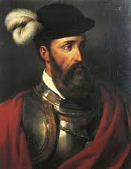
Francisco pizarro
Francisco Pizarro (1478-1541) was a Spanish conquistador who traveled through much of the Pacific coast of America along Peru. He "discovered" the Incan empire and conquered it brutally and quickly, stealing immense hoards of gold, silver, and other treasures.
Pizarro landed at San Mateo Bay in 1532; he and his men (including Hernando de Soto) arrived at Cajamarca and captured Atahuallpa, the 13th and last emperor of the Incas. Pizarro ambushed him and killed thousands of his men. A ransom for the Emperor's release was demanded and Atahualpa filled a room with gold in exchange for his release. Pizarro instead took the treasure and had Atahuallpa strangled on Aug. 29, 1533; this was the end of the Incan empire.
After looting and generally destroying the Incan capital of Cusco, Pizarro founded Lima, the capital city of Peru. Pizarro was assassinated in 1541 by Spanish soldiers who wanted to seize Lima for its riches.

Slide 14
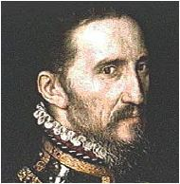
Francisco Coronado
Francisco was born into a noble family in Salamanca, Spain, in 1510. He came to the Americas at the age of twenty-five as an assistant to New Spain's viceroy. Inspired by rumors of seven cities of gold, Coronado led a royal expedition into what is now the American West.
In July 1540 Coronado and his cavalry encountered a Zuni pueblo, Hawikuh. Coronado arrived at the pueblo during the high point of Zuni summer ceremonies. Understandably, they were not receptive to his order to "acknowledge the Church as the ruler of the whole world, the high priest called Pope, and in his name the King and Queen" of Spain. Unimpressed but perhaps angered, the Zuni began firing arrows at the Spaniards. The better-armed and mounted Spaniards quickly entered the pueblo and forced the Zuni to flee.
Coronado and his men found no gold in the Zuni pueblos, which drove them to make even more arduous journeys. Coronado sent out parties that ranged all the way to the Colorado River on the present border between California and Arizona, exploring the Grand Canyon and much of what is now New Mexico.
Disappointed, Coronado returned home to Mexico, where the Viceroy branded his expedition a failure. Coronado managed to resume his governorship, but he was removed from office in 1544 and moved to Mexico City. He died in 1554.

Slide 15
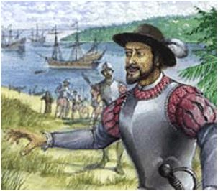
Juan Ponce de leon
Juan Ponce de Leon was a Spanish explorer and soldier who was the first European to set foot in Florida. He sailed on Christopher Columbus' second expedition to the Americas in 1493. He conquered the neighboring island of Boriquen (now Puerto Rico), claiming it for Spain.
Ponce de Leon began searching for the Fountain of Youth (a legendary spring that gave people eternal life and health). He sailed from Puerto Rico on March 3, 1513, and reached the east coast of Florida in April 1513. Ponce de Leon named the land "Pascua de Florida" (feast of flowers) because they first spotted land on April 2, 1513, Palm Sunday. He then claimed the land for Spain.
They left on April 8, heading south in the warm current now known as the Gulf Stream. This oceanic current would become very important for Spanish trips from Europe to America. After returning to Puerto Rico, Ponce de Leon resumed fighting with the Native Americans (putting down their rebellions against Spanish rule). He returned to Spain and was named a Captain General by the King of Spain on September 27, 1514.
His last expedition was in 1521. His men landed on the west coast of Florida, but were met by Native American warriors, who wounded many of the men with arrows, including Ponce de Leon. Ponce de Leon later died in Havana, Cuba. He is buried in San Juan, Puerto Rico.

Slide 16
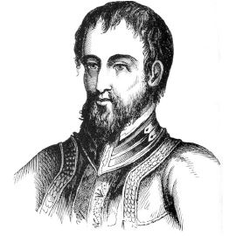
Hernando de soto
Hernando De Soto was a Spanish explorer who sailed the Atlantic Ocean and was the first European to explore the southeastern United States. De Soto was born in the Spanish province of Extremadura (near Portugal). In 1524, he went on an expedition to Nicaragua, South America, with Francisco de Cordoba.
Francisco Pizarro enlisted de Soto for an expedition to Peru (1531-1532). During this expedition they met and killed Atahualpa, the ruler of the Incas, and conquered the Inca empire. De Soto returned to Spain in 1536, and was granted the rights to conquer Florida and was named governor of Cuba in 1537.
De Soto spent four years searching for gold and silver and coming into contact with native societies, including the Cherokees, Seminoles, Creeks, Appalachians, and Choctaws. De Soto died during the explorations and was buried on the banks of the Mississippi River in late June, 1542.

