Slide 1
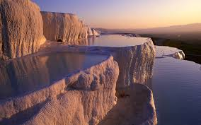
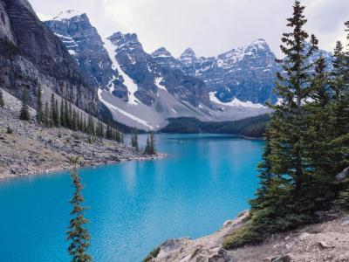
HYDROSPHERE & ATMOSPHERE
Weather & Climate
Earth-Sun Relationships
MELCO Factors

Slide 2
COLOR-CODED NOTES
Follow the legend below to see which notes you NEED to write down and which notes are optional:
PINK- important PEOPLE and PLACES
GREEN- key IDEAS
BLUE- key EVENTS
ORANGE- CAUSE and EFFECT
YELLOW- VOCABULARY
Any items in BLACK text are optional.
You DO NOT have to color code your own notes.
Remember: the more thorough your notes, the more prepared you will be for exams.

Slide 3
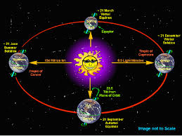
EARTH-SUN RELATIONSHIPS

Slide 4
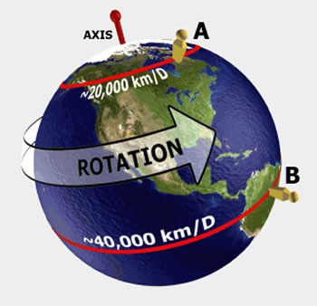
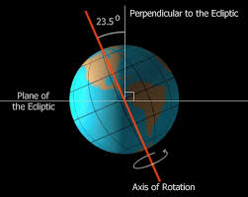
REVOLUTIONS & ROTATIONS
Revolution- Movement of the Earth around the Sun; one revolution equals 365 days (one year)
Rotation- Spin of Earth on its axis; one rotation equals 24 hours (1 Day)
Tilt- Earth’s axis is slanted at 23 ½°, which distributes the Sun’s heat evenly, allowing sustained life and better vegetation growth.
Also determines which season each hemisphere will have (always opposites)

Slide 5
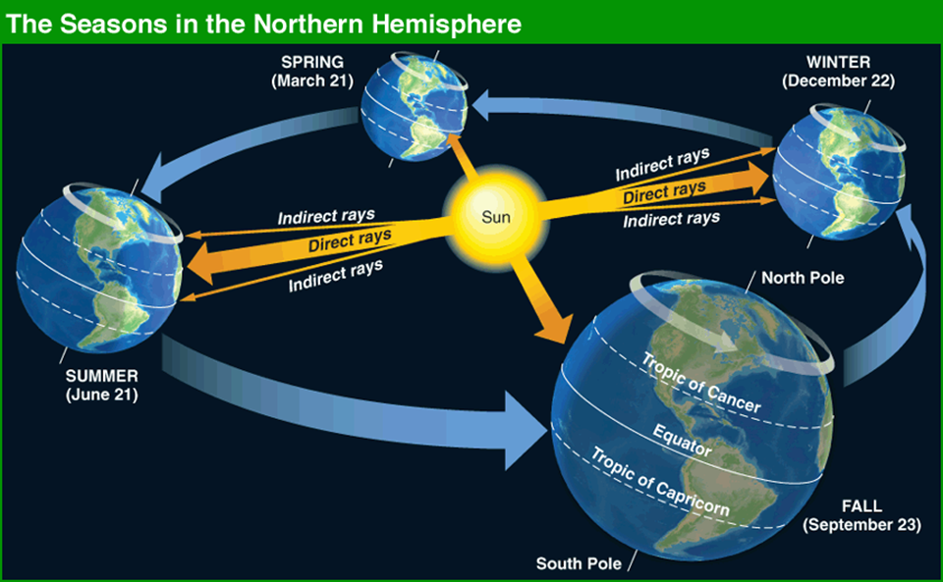
EARTH’S SEASONS
Direct Rays- when a hemisphere is tilted toward the sun, the sun’s light (or angle of incidence) is higher and it is summer in that hemisphere.
Indirect Rays- When a hemisphere is tilted away from the sun, the sun’s light (or angle of incidence) is lower and it is winter in that hemisphere.
Equinox
Spring (March 20th)
Fall (September 22nd)
Solstice
Summer (June 21st)
Winter (December 21st)

Slide 6
GREENHOUSE EFFECT
Layer of gases (ozone, methane, carbon dioxide, and water vapor) that absorbs heat from the Sun’s rays and distributes it around the Earth.
Natural way for Earth to retain its warmth and for plants and animals to survive.
Global Climate Change –refers to the change in climate due to actions by man.

Slide 7
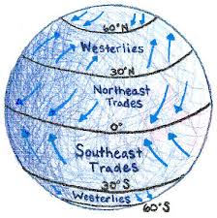
MELCO FACTORS

Slide 8
HOW DO PHYSICAL FEATURES DETERMINE WHERE PEOPLE LIVE?
MELCO Factors
Mountains- location, size, etc.
Elevation- temperature
Latitude- the most influential factor that determines climate
Currents- wind & water
Oceans-proximity to water

Slide 9
MOUNTAINS & LANDFORMS
Mountains, plains, valleys and other landforms affect local climate by forcing wind to rise as it crosses over them.
For example, the hottest and driest area in the United States is Death Valley, California. Death Valley is dry due to the warming of air flowing down the inner side of the Sierra Nevada mountains.

Slide 10
ELEVATION
Air cools as it rises up the windward side of a mountain, but cool air cannot hold as much moisture as warm air. As the air moves up the mountain and cools, it becomes saturated and releases its moisture as precipitation.
Temperatures tend to be cooler at higher elevations
Precipitation freezes, will turn into snow and ice.
When air descends along the downward slope of a mountain, however, it warms and holds its moisture, creating dry conditions.

Slide 11
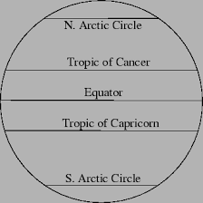
LATITUDE

Slide 12
LATITUDE ZONES
Earth’s climates shift with each change in latitude, depending on nearness to the Equator (which is warmer). Although there is no specific ‘type’ of climate, there are three general climate zones: arctic, temperate, and tropic. The climates categorized as any of the three are dispersed between three latitude zones:
Low Latitude- between 23 ½° N and 23 ½ ° S (Tropics of Cancer and Capricorn)
Tropical Grassland, Tropical Rainforest, Desert
Mostly warm & hot, two extremes: dryness and rain
Mid Latitude- between 23 ½ °N and 66 ° N and 23 ½ ° S and 66 ° S (between Tropics and Arctics)
Grassland, Mediterranean, Humid Continental, Marine West Coast
Seasonal changes, low to moderate precipitation
High Latitude- Poles; above 66 ° N and below 66 ° S (Arctic and Antarctic Circle)
Subarctic, Arctic, Highland
Affected most by elevation, mostly cold and little rainfall

Slide 13
CLIMATE ZONES BASED ON LATITUDE
High Latitudes
Arctic Circle
Tropic of Cancer
Equator
Tropic of Capricorn
Antarctic Circle
66 ½° N
Middle Latitudes
Middle Latitudes
23 ½ ° N
Low Latitudes
0 °
Low Latitudes
23 ½ ° S
Middle Latitudes
Middle Latitudes
66 ½° S
High Latitudes
Notes:
Teachers may want to add a slide with a climate map that also illustrates water currents.
Note: Online the Equator (Latitude) and the Prime Meridian (Longitude) are shown with solid lines. The Tropic of Cancer, Tropic of Capricorn, Antarctic Circle, and Arctic Circle are shown with dashed lines. The Tropic of Cancer and Tropic of Capricorn are shown at 23 ½° N and S of the Equator (respectively) because that is the degree tilt of the Earth. The Antarctic Circle 66 ½° S and Arctic Circle 66 ½° N –the ½° is due to the tilt of the Earth. Latitude is mathematical measures of the distance from the Equator. So… if something is 30 degrees N of the Equator –you can actually measure the angled distance from the Equator to find it at 30 degrees. Longitude is measured in time and the distance between lines becomes closer together the closer you are to the poles –whereas latitude lines are parallel to one another.
Low Latitude refers to the low latitudinal numbers –anything between 23 ½° N and 23 ½° S
Middle Latitude refers to the middle range of lines of latitude. –anything between 23 ½° N and 66 ½° N AND 23 ½° N and 66 ½° S
High Latitude refers to the higher range of lines of latitude. This is anything between 66 ½°N and 90°N AND 66 ½°S and 90°S

Slide 14
CURRENTS
Wind currents, air moving from high to low pressure areas, influence both local weather and global climate.
Surface winds will also determine the ocean current and the direction they move
Coriolis Effect- Winds blow across the Earth from high-pressure systems to low-pressure systems.
If the Earth did not rotate, the atmosphere would circulate between the poles (high pressure areas) and the equator (a low pressure area) in a simple back-and-forth pattern.
But because the Earth rotates, circulating air is deflected:
Northern- Circulates to the Right
Southern- Circulates to the Left

Slide 15
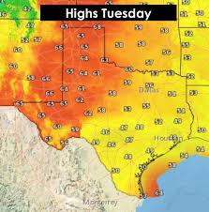
OCEANS
Large bodies of water can also affect climate as air can pick up humidity from the water, and the water also influences the temperature of air currents.
Water heats and cools slower than does land
Milder climates near large bodies of water
More extreme climates away from large bodies of water (continental climate)

