Slide 1
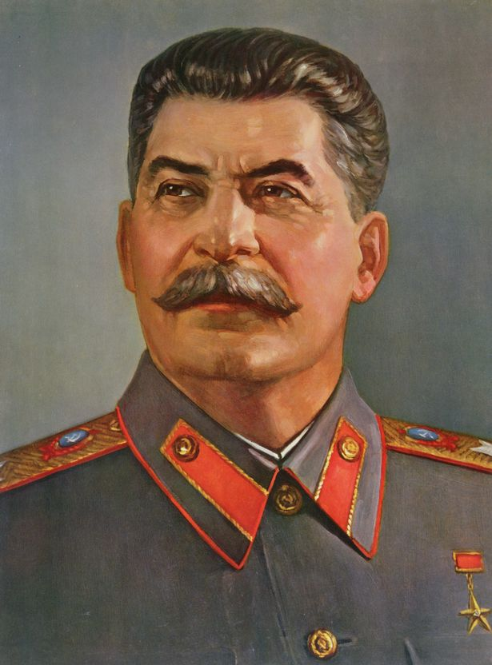
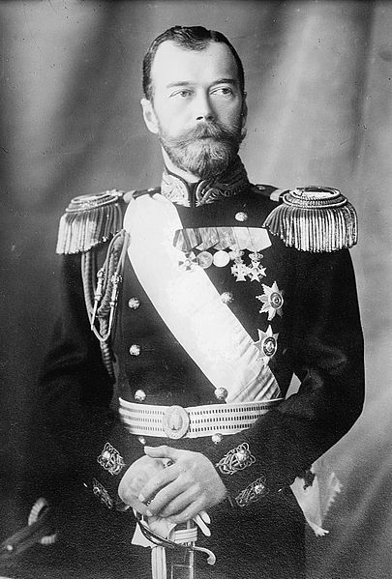
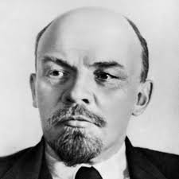
The Russian Revolution
Pre-Revolutionary Russia
Bolsheviks
Communists

Slide 2
Cornell note-taking method
Notes color-coded in RED go on this side of the line.
These items will include:
Main Ideas
Big Concepts
Vocabulary Words
Notes color-coded in BLUE go on this side of the line.
These items will include:
Supporting details
Dates, Times, and Biographic details
Vocabulary Definitions
Any items in BLACK text are optional. Remember: the more thorough your notes, the more prepared you will be for exams.

Slide 3
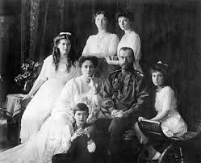
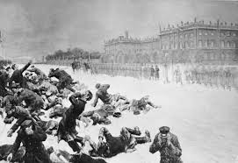
Pre-Revolutionary Russia

Slide 4
Nicholas II
Romanov- royal dynasty that had ruled Russia as tsar/czar for 300 years
Members included:
Peter the Great- consolidated territories into one Russia
Catherine the Great- modernized public reforms and political powers
Alexander II- ended serfdom in 1856
Nicholas II- inherited throne in 1884, was vastly unprepared to rule when his father unexpectedly died. Maintained control of power but did not execute it well.

Slide 5
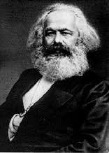
Bloody Sunday
Russia is the only true autocracy left in Europe by 1910
Nicholas II is the only decision-maker in Russia; there are no other political institutions to represent the people
Karl Marx’s theories on communism and the right of the worker become extremely popular
Proletariat- the working class; in Marxism, the largest population but weakest politically
Bloody Sunday- urban workers and peasants gathered to petition the czar for better working conditions and voting rights on January 22, 1905; guards fired rifles into the crowd, sparking more violent protests
Duma- Russian congress formed to work with the czar on behalf of peasants, but Nicholas sent away members who didn’t agree with him. He dissolved the Duma weeks later.

Slide 6
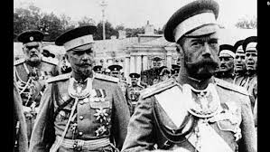
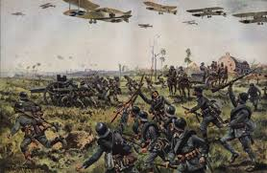
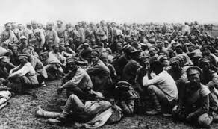
World War I
Russia enters the Great War to defend its ally, Serbia.
Imperial Army is completely unprepared for the new technology and strategies of the war, costing huge amounts of money and deaths of thousands of soldiers
Peasants, who made up the bulk of the troops, are not invested emotionally in the main ideas of war- nationalism, pride, and alliances with other nations.
While Nicholas is managing the war front, he left his wife Alexandra in charge of home politics

Slide 7
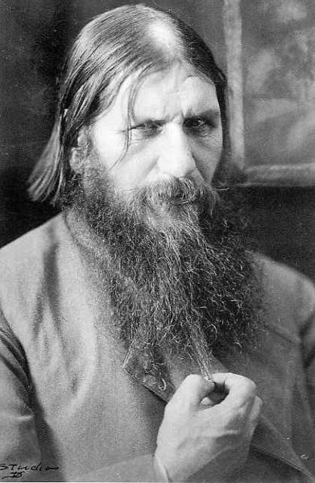
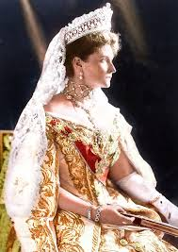
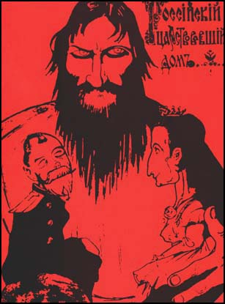
Alexandra
Alexandra- Czarina of Russia, granddaughter of Queen Victoria; born a German princess, she is not liked by the Russian people due to the war her cousin Wilhelm II has caused
Nicholas and Alexandra have a son who is very sick, and she relies on Rasputin, a self-proclaimed holy man to help him.
Alexandra frequently replaced officials with those favored by Rasputin, throwing the government into chaos
Tensions between the monarchy and the citizens grow over mismanagement of wartime economy, accusations of treason, and collapse of the government
Rasputin is assassinated in December 1916

Slide 8
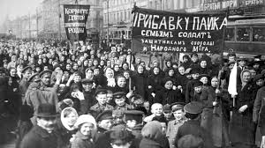
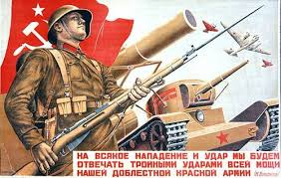
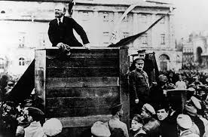
Bolshevik Power

Slide 9
February Revolution
“Peace, Land, Bread!”
Protestors begin rioting for bread, clashing with police of St. Petersburg, spreading to huge mobs of workers who protested for a month
Protesting workers formed soviets, local councils meant to carry out terms of revolution
Duma declared itself a provisional government, forming after Nicholas II dismissed them for a third time, in order to attempt to gain control of the revolution
Nicholas II abdicates the throne on March 15, 1917, ending the rule of imperial monarchs in Russia.
Nicholas, Alexandra, and their children are assassinated on July 18, 1918

Slide 10
October revolution
Vladimir Lenin- leading Marxist revolutionary who is committed to class struggle and revolution
Previously exiled to Siberia for anti-czarist protests, he returns in 1917 to take the lead and implement socialist reforms
Bolshevik Red Guards- workers take over government offices and arrest the leaders of the Provisional government
All private property of wealthy classes was abolished and divided among the peasantry
Largest industrial enterprises nationalized
Political Police are organized

Slide 11
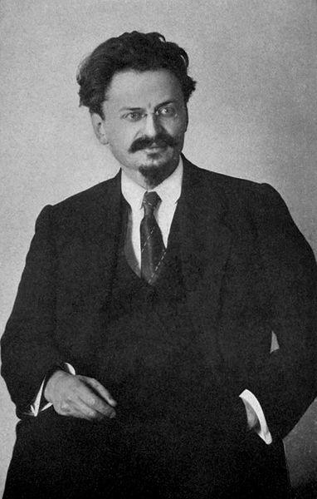
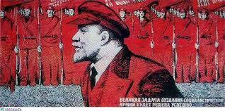
October revolution
Leon Trotsky- close friend of Lenin, member of the October Revolution, and commander of war and foreign affairs under the Bolshevik government
Red Army- military unit created under Trotsky’s command, made up of workers and laborers who were drafted into service
Bolshevik Party renamed Communist Party in March 1918
Treaty of Brest-Litovsk- negotiated a cease-fire between Russia and Germany without either side declaring victory, allows Russia to leave WWI

Slide 12
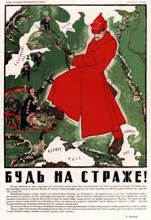
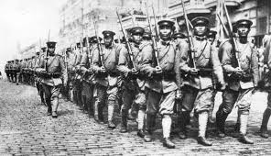
Russian Civil War
Fought between 1917-1921, Bolsheviks were challenged for control of Russia by the White Imperial Army
Reds- were made up of Bolsheviks & Red Army, controlled the supply lines, railroads, and factories that produced weapons and artillery
Whites- former army officers, members of the bourgeoisie, Cossacks, and moderate revolutionaries
Received support from England, France, USA, & Japan
Reds ultimately victorious, and the development of the communist state in Russia remained unchallenged

Slide 13
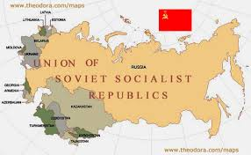
Communist State

Slide 14
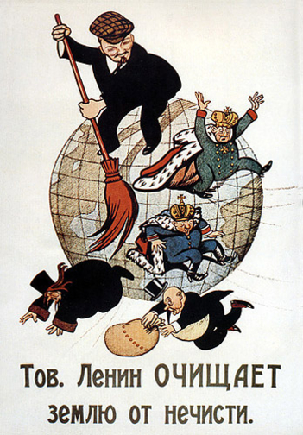
Soviet Union
Lenin reorganized the country & renames it the Soviet Union in 1922
Implements the ideas of Karl Marx; becomes known in Russia as a figure who “swept away” oppressive regimes such as monarchies, capitalism, and religion
New Economic Policy- issued in 1921 by Lenin, allowed some capitalist practices in order to generate revenue
Peasants were allowed to sell produce for profit and run small businesses, even though the main idea of communism was to have equal distribution of wealth

Slide 15
Stalin’s rise to power
Joseph Stalin- Bolshevik revolutionary who was appointed general secretary of the party’s Central Committee; consolidated power following Lenin’s death in 1924
Created a fully communist state
Stalin retracted Lenin’s NEP’s and created “5 Year Plans” of industrialization, bringing production under government control; used to modernize Soviet Union
Viciously eliminated any political opponents; Leon Trotsky was one of Stalin’s eliminated political enemies
His secret police allowed no opposition or freedoms; newspapers were heavily censored or owned completely by the government
Ordered the execution of millions

