Slide 1
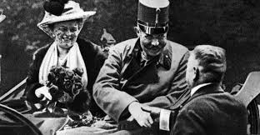
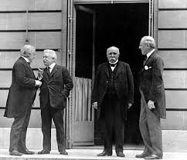
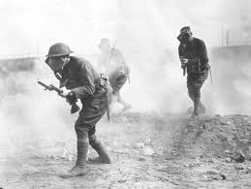
The Great War

Slide 2
Cornell note-taking method
Notes color-coded in RED go on this side of the line.
These items will include:
Main Ideas
Big Concepts
Vocabulary Words
Notes color-coded in BLUE go on this side of the line.
These items will include:
Supporting details
Dates, Times, and Biographic details
Vocabulary Definitions
Any items in BLACK text are optional. Remember: the more thorough your notes, the more prepared you will be for exams.

Slide 3
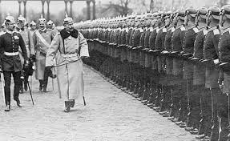
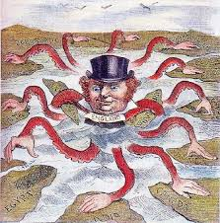
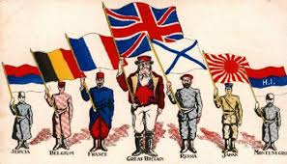
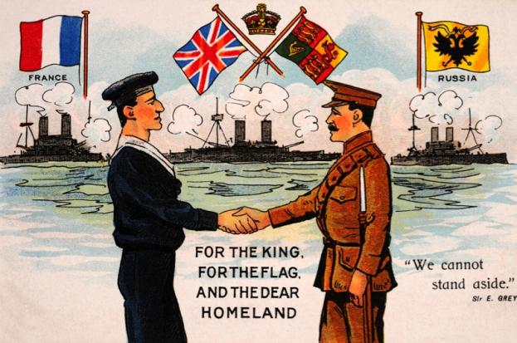
MAIN Causes of World War I
Militarism
Alliances
Imperialism
Nationalism

Slide 4
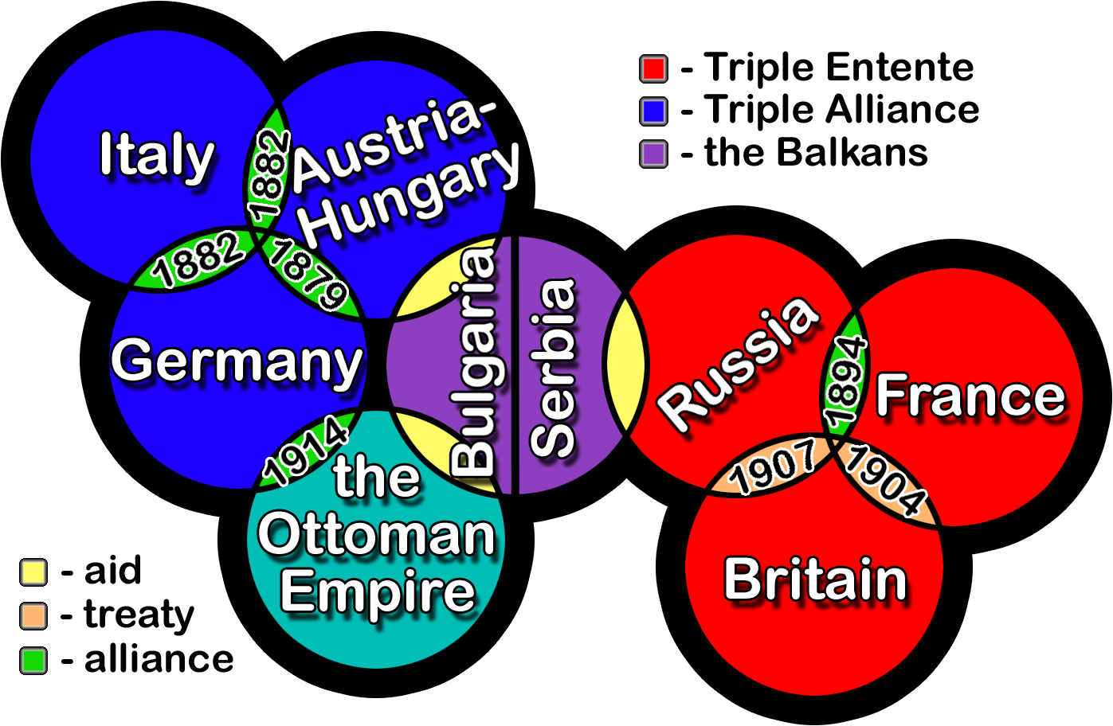
Four main Causes of World War i
Militarism- government belief that a country should maintain a standing army and be prepared to aggressively to defend or promote national interests
New Military Technologies- tanks, machine guns, artillery, poison gas, flamethrowers, etc.
Arms Race between countries- rival nations wanted to show off who had the bigger, better, and faster weapons
Glorification of War- “no greater duty” than to serve your country
Alliances- agreements made between countries that promised to give aid or defense in case one country was attacked
Most nations have formal treaties, while others are created through marriage with government leaders; some will sign secret alliances
These alliances will be the basis between the Central Powers and Allied Powers

Slide 5
Four main causes of World War I
Imperialism- competition for colonies that contained raw materials and natural resources caused tension between European nations
Many smaller wars and battles had been fought for control and ownership of certain valuable colonies
Nationalism- extreme pride in the cultural, economic, and military superiority of one’s own country (mostly European nations)
Ethnic groups wanted to establish their own independent, self-governing nations away from Imperial control
Pan-Slavism- nationalism for Slavic ethnic groups of the Balkans, Ottoman Empire, and Austro-Hungarian Empire

Slide 6
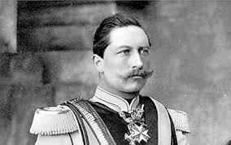
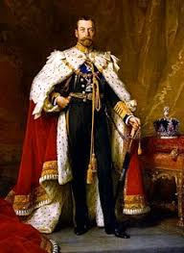
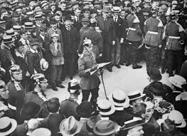
The Powder Keg

Slide 7
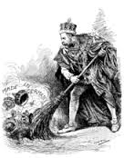
Bitter rivals: Germany vs. Britain
Throughout industrialization and imperialism, Germany has trailed Great Britain. By 1914, they are locked in a bitter family feud.
Kaiser Wilhelm II- emperor of Germany, grandson of Queen Victoria, nearly bankrupts nation trying to build army and navy just like Britain’s
George V- King of Great Britain, grandson of Queen Victoria; the Army, Navy, and colonial interests reach their peak under his rule
Many European nations purchased weapons, built up their militaries, and established alliances with AND against each other to protect their countries and colonies.

Slide 8
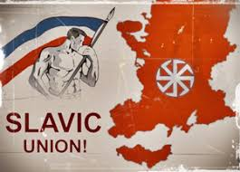
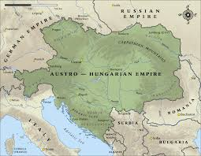
Tensions in the Balkans
Throughout the 1800s, the Ottoman Empire lost many territories in Eastern Europe after the ethnic groups living in those areas rebelled against their rule.
Russia and Austro-Hungarian empires try to absorb those territories by supporting their split from the Ottomans
Slav Nationalism, the idea that all Slavic ethnic groups should be their own independent nation was supported by Russia in exchange for alliances
Austria-Hungary did not want independent nationalism to spread to its own territory, and tried to start war with Serbia many times

Slide 9
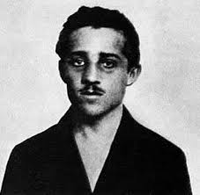
Assassination of Franz Ferdinand
Archduke Franz Ferdinand- heir to the Austro-Hungarian empire; shot and killed in Sarajevo, Bosnia on June 28, 1914
Bosnia had just been annexed by Austria-Hungary, and Franz Ferdinand’s presence angered the Black Hand, a Serbian nationalist group
Gavrilo Princip- Serbian nationalist who assassinated Franz Ferdinand; the Serbian government was blamed for his actions
July 28, 1914- Austria-Hungary demands penalties be placed on the Serbian government as punishment; when demands aren’t met, Austria-Hungary declares war

Slide 10
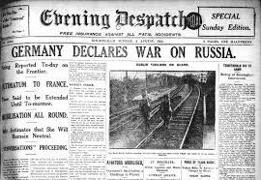
Germany stirs the pot
Russia had a previous agreement with Serbia, so they declared war on Austria-Hungary in response
Germany, allied with Austria-Hungary, declared war on Russia
Germany declares war on France, then invades Belgium
Felt they were surrounded by enemies, and war would happen eventually
Great Britain, upset that Germany has gotten involved and caused so much trouble, enters the war as an ally of Russia

Slide 11
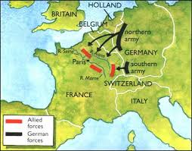
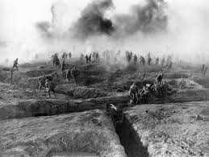
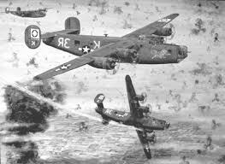
The War to end all wars

Slide 12
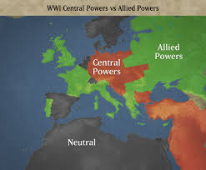
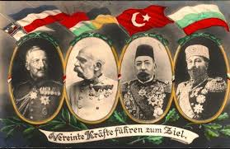
War begins
Schlieffen Plan- Germany’s blueprint for victory; planned for the defeat and capture of France in the West, after which troops would transfer to the East to defeat Russia
Central Powers- alliance that originated between Germany and Austria-Hungary, then joined by the Ottoman Empire and Bulgaria (nations trying to stabilize or expand imperial claims)
Allied Powers- aka Triple Entente, alliance between nations that were teamed up against German aggression
France, Great Britain, Russia, United States, Greece, Montenegro, Italy, Romania, and Serbia

Slide 13
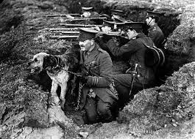
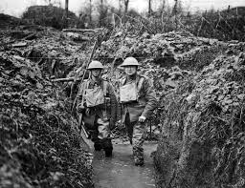
Western Front
Beginning in August 1914, most of the fighting took place on the Western Front, open fields of France where fortified trenches were dug by the armies of each side
Trench Warfare- deep ditches are dug for soldiers to hide in and shoot at their opponent; strengthened by sandbags, beams, and barbed wire.
From 1915-1917, there were no decisive victories and both sides suffered heavy casualties
Battle of the Marne- first major battle that established the Western Front and use of trenches
Battle of the Somme- heavy losses suffered on both sides; 600,000 Allies, 465,000 Central
Battle of Verdun- casualties totaled 1.25 million over the course of the battle, which lasted from February to July 1916

Slide 14
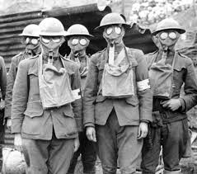
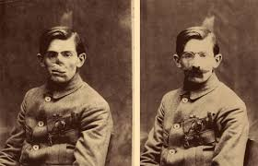
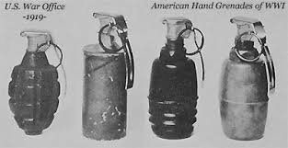
War Technology
In order to break the stalemate, each side would introduce new weapons to weaken their opponent
Gas Warfare- Germans introduced chlorine gas in 1914 and mustard gas in 1917; Allies introduced gas masks; both sides increased use of chemical attacks
Air Warfare- machine guns were installed on airplanes to shoot down enemy aircraft or attack camps behind enemy lines
Artillery- machine guns, grenades, tanks, handguns, etc. were used for the first time during WWI
Submarines- Warcraft that is capable of independent underwater operations (radar, gunfire, navigations)

Slide 15
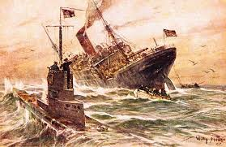
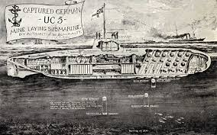
Unrestricted submarine warfare
Germany declared the seas around Great Britain as a war zone, and attacked all ships that came in or out of their blockade.
Lusitania- British passenger ship sunk by Germany submarine on May 7, 1915 that carried small supplies of artillery (Germany’s excuse)
128 Americans were killed in the sinking, angering the American public
U.S. President Woodrow Wilson pressured Germany into stopping submarine warfare or else the U.S would get involved in the war

Slide 16
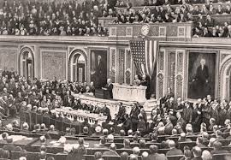
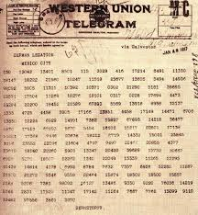
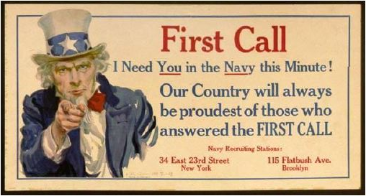
Total war

Slide 17
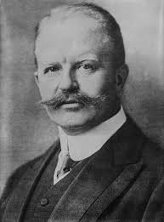
U.S. Entry into War
When war was declared, the United States officially maintained neutrality, not supporting or helping either side of the war
Even though Germany promised to end unrestricted submarine warfare, they still continued “accidentally” sinking US merchant ships
Zimmerman Telegram- sent to Mexican government that promised the return of Texas, New Mexico, and California if Mexico allied with Germany
U.S. formally entered the war on April 6, 1917

Slide 18
Total War
Nations that participated in WWI directed all resources of society (economic, civilian, military, etc.) towards the war effort
Conscription- the draft; non-voluntary entry into the armed forces, filled by healthy young men over the age of 18 in WW1
Propaganda- biased or misleading information used to promote a certain political cause or point of view
Actively used by both Central and Allied Powers
State of total war completely destroys the Russian monarchy, leading to their withdrawal from WWI in 1917 in order to control all-out revolution at home

Slide 19
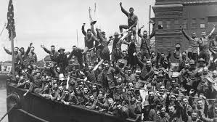
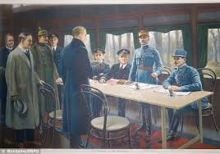
Allies make progress
The addition of U.S. troops refreshed fighting on the front lines of the Western Front
Allies began racking up actual victories, taking over more and more of France until they came close to Germany’s borders
Germany, out of manpower, weapons, and other supplies, realized that an invasion was imminent
Germany surrenders in November 1918, ending World War I

Slide 20
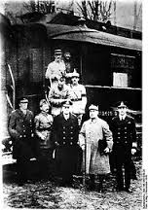
Armistice
“11th hour of the 11th day of the 11th month” of 1918, the fighting of World War I ended
Celebrated annually as Remembrance Day in Europe, Veteran’s Day in US
On January, 8, 1919, President Woodrow Wilson presented Fourteen Points to Congress, which outlined the U.S.’ plan for building lasting peace in Europe
“Peace Without Victory”
Maintain open seas for trade
Restoration of conquered territories
Grant sovereignty to states of ethnic groups, like in the Balkans
Outlined the beginnings for an international watchdog group to maintain world peace

Slide 21
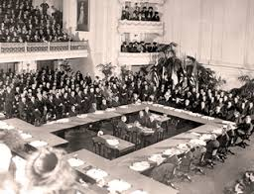
Treaty of Versailles
The Allied powers took control of peace negotiations but did not necessarily promote all of Wilson’s Fourteen Points
French demanded stiff penalties and a total elimination of German powers to prevent renewal of tensions over territories
Great Britain and U.S. wanted to prevent future wars
Treaty of Versailles- signed June 28, 1919, officially ending World War I and assigning blame for the conflict to Germany
French took charge of enforcing treaty
Germany signed it, but under strong allegations of mistreatment

Slide 22
Treaty of Versailles
According to the treaty, Germany had to make reparations, financial penalties to apologize for its role in the war
German territories and boundaries of the Central Power empires were redistributed and redrawn
Elimination of the Ottoman Empire
Germany loses claims to African colonies
Germany was prohibited from having a large army, and was not allowed to build or stock military weapons
Germany would not be allowed to join League of Nations until 1926.
Kaiser Wilhelm is removed from power, exiled to the Netherlands

