Slide 1
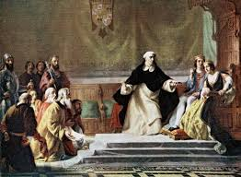
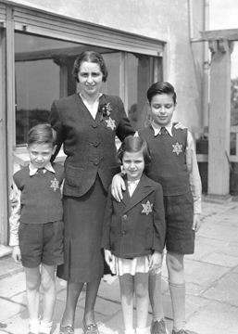
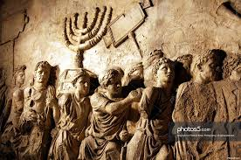
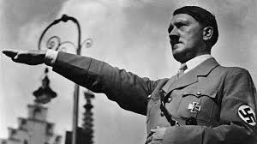
The Holocaust
Anti-Semitism in History
The Holocaust
Two Claims to Palestine

Slide 2
Cornell note-taking method
Notes color-coded in RED go on this side of the line.
These items will include:
Main Ideas
Big Concepts
Vocabulary Words
Notes color-coded in BLUE go on this side of the line.
These items will include:
Supporting details
Dates, Times, and Biographic details
Vocabulary Definitions
Any items in BLACK text are optional. Remember: the more thorough your notes, the more prepared you will be for exams.

Slide 3
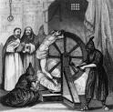
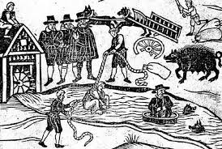
Anti-Semitism throughout history
The Diaspora
The Middle Ages
Spanish Inquisition
Russian Pogroms

Slide 4
Jewish Diaspora
Abraham -formed a covenant (contract) with God in exchange for being led to the Promised Land (Canaan, Palestine, Israel)
1st to establish belief in single deity
Three monotheistic faiths have religious and political ties to Israel, specifically Jerusalem:
Christianity: where Jesus was crucified and resurrected
Judaism: Zion, God’s own city, site of Solomon’s temple
Islam: 3rd holiest city, where Muhammad ascended to heaven
Diaspora- after refusing to worship Roman emperor as a Divine being in 65 CE, the Romans drove the Jews out of Israel (Palestine).
Jewish people or communities who live outside of Israel, even if they have never been there, are referred to as living “in exile”
One objective of Judaism is the relationship with Israel and the need to protect it

Slide 5
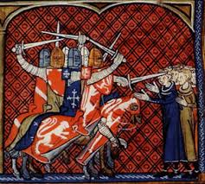
Anti-Semitism in the Middle Ages
Anti-Semitism- hostile behavior exhibited toward Jews just because they are Jewish; includes religious teachings, prejudices and stereotypes, or political efforts to isolate, oppress, or injure them.
The rise of Christianity greatly increased hatred of Jews. Leaders of the European Christian (Catholic) Church promoted false theories as facts, including:
all Jews were responsible for the crucifixion of Jesus of Nazareth
the Diaspora was punishment for refusal to abandon their faith and accept Christianity.
However, the conversion of individual Jews was also perceived as insincere and as having materialistic motives.
During Middle Ages, faith was the principal form of self-identity and influenced both public and private life. Jews found themselves increasingly isolated as outsiders to society, objects of stereotyping, and subject to acts of violence.
Many people believed that Jews brought on the "Black Death," the plague that killed millions of people in Europe in the 14th Century
Historians have now traced the origins of the disease to pests brought from Asia along the Silk Road.

Slide 6
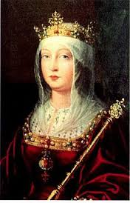
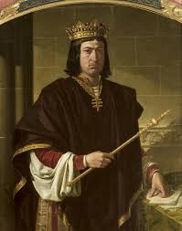
Spanish inquisition
Spanish Inquisition- court tribunals established King Ferdinand II and Queen Isabella to identify heretics in Spain; used brutal methods of torture to elicit confessions and promises to convert
Heretic- baptized members of the church who held opinions contrary to the Catholic faith.
Alhambra Decree in 1492- banned Jews from Spain; many Jews converted to Catholicism to remain in the country. These converts were accused of secretly continuing to practice Judaism and became targets of the Inquisition.
While questioning suspects, the Inquisition used torture mainly against those suspected of Judaism and Protestantism. Torture was always used to obtain the confession of the accused, not a punishment itself. It was applied without distinction of sex or age, including children and the elderly.
By 1490, the Inquisition had 2000 people burned at the stake. Over the course of its history, the Inquisition processed a total of 341,021 people accused of heresy, of whom at least ten percent (31,912) were executed.

Slide 7
Russian Pogroms
Pogroms- Russian meaning “to demolish violently”; refers to violent attacks approved by the government, committed by local populations against Jews
Anti-Jewish riots in Odessa in 1821
1881-1884 C.E.
In Tsarist Russia, economic, social, and political resentment of Jews reinforced traditional religious antisemitism.
May Laws- anti-Jewish legislation enacted by the Russian government in the 1880s, which restricted where Jews could settle, forbade non-Jews from issuing mortgages to Jews, and prohibited Jews from conducting business on Sundays.
Restricted the number of Jews who could attend universities and preventing Jewish law school graduates from joining the bar.
The Russian government adopted a systematic expulsion of the Jews from Moscow in 1891–92.
Mass Jewish emigrations began from Russia to the United States and other countries.
Led to various nationalist and Zionist movements among the Jews of Russia, which called for the creation of a Jewish state in the Biblical homeland of Canaan (called Palestine, then Israel)

Slide 8
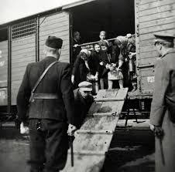
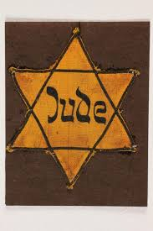
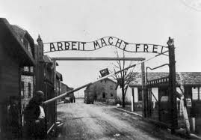
The Holocaust

Slide 9
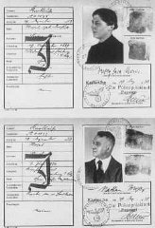
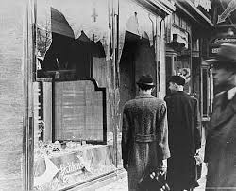
Jewish Persecution
The Holocaust- was the systematic, bureaucratic, state-sponsored persecution and murder of Jews and other “undesirables” by the Nazi regime and its collaborators.
Hitler wanted to create a “master race” where Aryan people would be considered a pure race and superior to other people
Like many anti-Semites in Germany, Adolf Hitler blamed the Jews for the country’s defeat in World War I
The Nazis believed that the Jews were an alien threat to the German racial community.
Many Germans’ acceptance of Nazi policies was facilitated by broader support for the Nazi regime during the years of economic improvement, the popularity of Hitler as a strong leader, and foreign policy successes in the 1930s that restored Germany’s power status
Nuremberg Laws- Passed in 1935, stated anyone with any Jewish blood would be considered a Jew
Further restrictions were placed and persecution of the Jews increased
Kristallnacht -“Night of Broken Glass” took place November 1938; Jewish stores, houses, and synagogues were destroyed with the government’s approval
Marks the beginning of widespread government-led violence against Jews

Slide 10
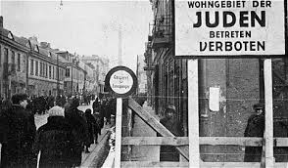
Jewish Persecution
Jewish Registries were created where all people with Jewish ancestry had to register with the government
Jews had to wear the Star of David badge everywhere the went
Forced to live in isolated ghettos
Ghetto- part of a city where a minority group (historically, Jewish groups) is forced to live due to social, economic, or legal administration.
Interaction with other minorities or races is not allowed.

Slide 11
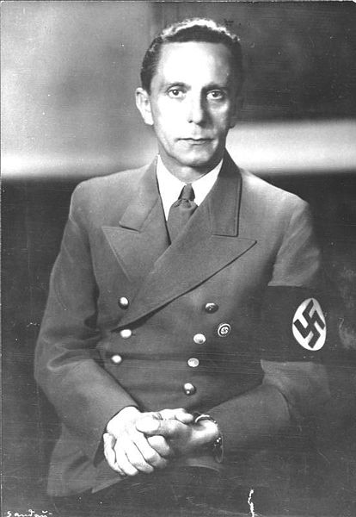
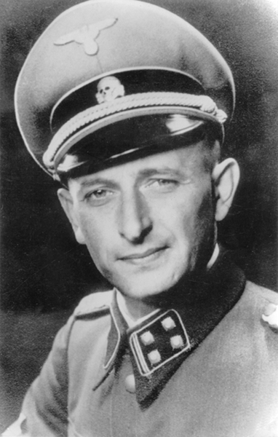
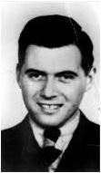
Final Solution
Plan developed in 1942 to eliminate all Jews from Europe; they were taken to concentration camps, where they were used for hard labor or killed
Dr. Joseph Goebbels- head of the Nazi Propaganda Ministry, controlled all communications, encouraged book burning to eliminate other ideas
Heinrich Himmler- leader of the SS, the Nazi’s secret police; formed death squads known as the Einsatzgruppen
Adolf Eichmann- helped organize the Holocaust, in charge of transporting Jews from ghettos to concentration camps
Dr. Josef Mengele- carried out experiments on Jewish people at Auschwitz

Slide 12
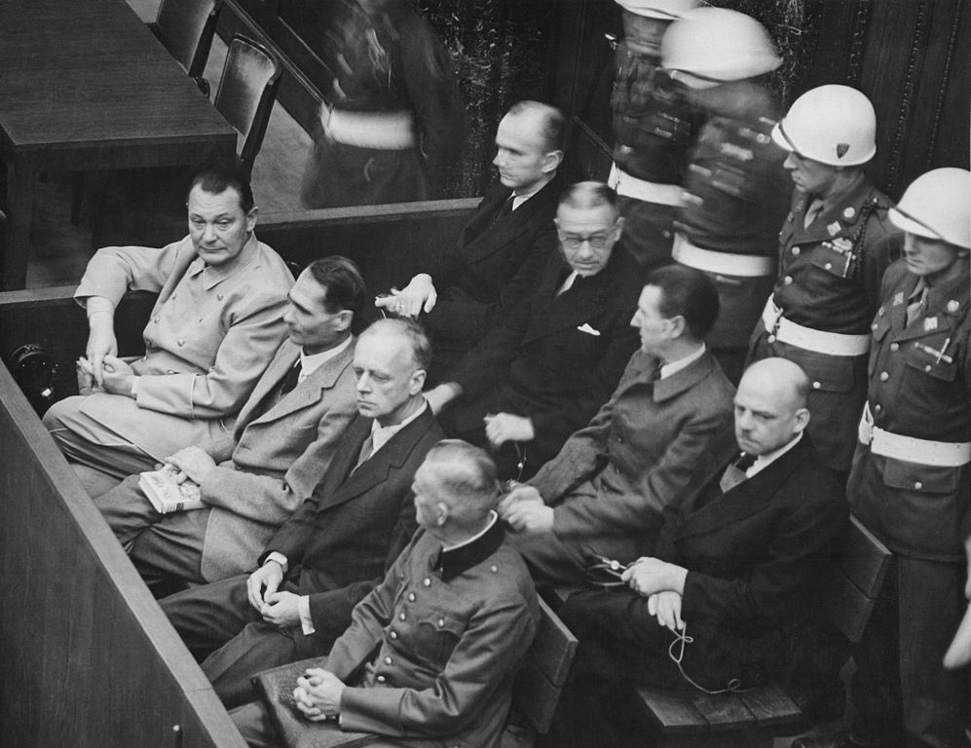
Liberation of the Jews
Allied forces reach camps starting in summer 1944; Soviet forces liberate Auschwitz and camps in Poland and Eastern Germany
American forces liberate Buchenwald and camps in the west
Nuremberg Trials- 22 major Nazi criminals were tried for their crimes in Nuremberg; most claimed to be “just following orders”,12 were sentenced to death
As the war ended, many top Nazis committed suicide while others escaped to South America where they hid for years

Slide 13
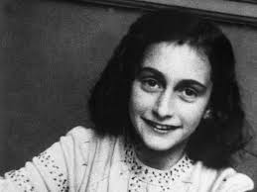
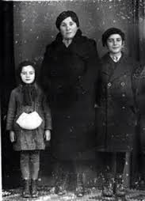
Liberation of the Jews
Genocide- the deliberate killing of a large group of people, especially those of a particular race or ethnic group
6 Million Jews, 1.5 Million Romani (Gypsies), 270,000 disabled or mentally ill, and 10 million of various Slav ethnic groups from Europe were killed over the course of the Holocaust
Other genocides in history:
Cambodian Genocide (Khmer Rouge)- 3 Million Cambodian Minorities (Chinese, Korean, Vietnamese) were executed in the “Killing Fields”, locations of mass graves from 1975-1979
Rwandan Genocide (Hutu vs. Tutsi)- 1 million Tutsi, 1994
Bosnian Genocide- 8373 ethnic Bosnians, 1992-1995

