Slide 1
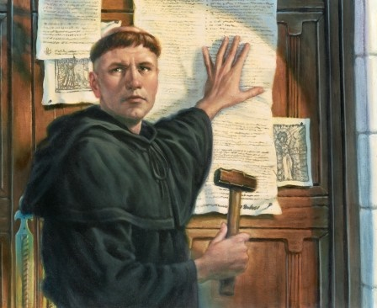
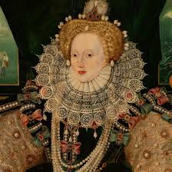
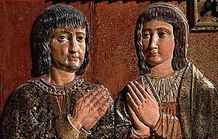
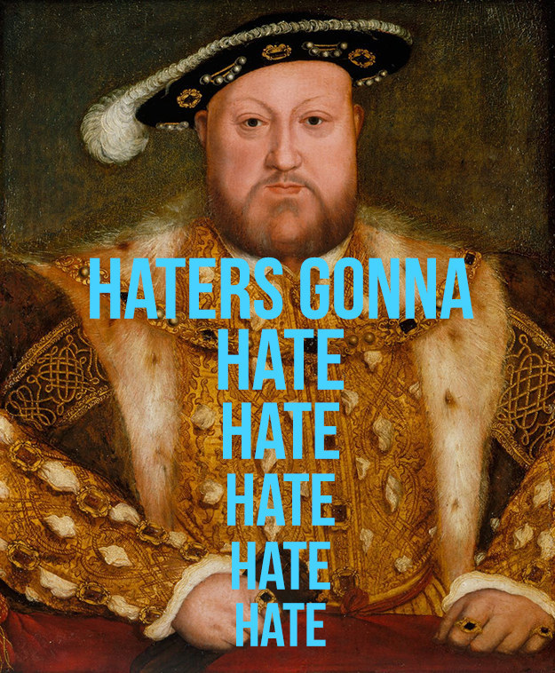
The Reformation
Protestantism
Anglicanism
Calvinism
Counter-Reformation

Slide 2
Cornell note-taking method
Notes color-coded in RED go on this side of the line.
These items will include:
Main Ideas
Big Concepts
Vocabulary Words
Notes color-coded in BLUE go on this side of the line.
These items will include:
Supporting details
Dates, Times, and Biographic details
Vocabulary Definitions
Any items in BLACK text are optional. Remember: the more thorough your notes, the more prepared you will be for exams.

Slide 3
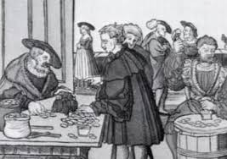
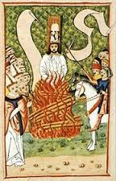
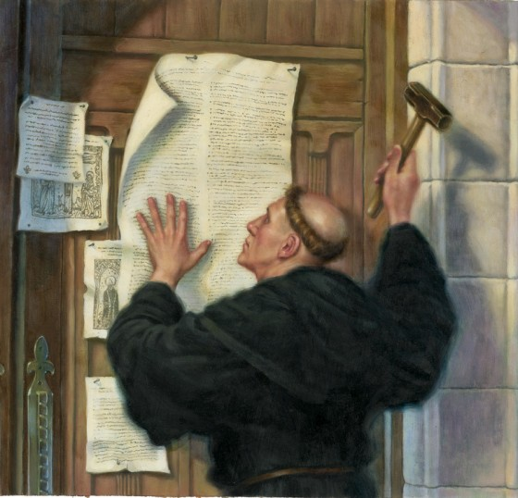
Protestantism
Causes of Reformation
Martin Luther
Effects of Reformation

Slide 4
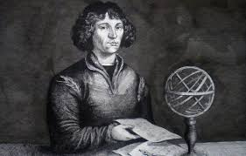
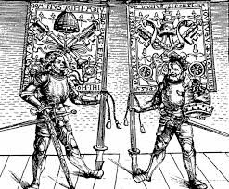
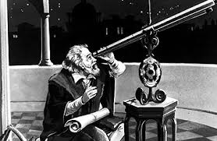
Causes of the Reformation
Tensions had been building between Catholic Church and its members for years, including issues with:
100 Years War- burning Joan of Arc for heresy
Black Death- priests would not comfort sick or dying for fear of getting sick
Clergy was heavily involved in politics, military, and world affairs- but they were not doing spiritual or charitable work
Scientific Advances (work of Copernicus, Galileo) that contradicted Church teachings
Indulgences – paying money for a pardon of sins or reward for good behavior; essentially, “get out of jail free” card

Slide 5
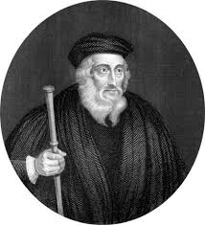
Causes of the Reformation
Renaissance ideals like secularism and humanism continue to be popular, distancing people from the Church’s power
Early Reformers:
John Wycliffe- translates the Bible into English, given a posthumous excommunication and execution by order of the Church
Jan Huss- led Church services in the vernacular, was burned at the stake for heresy
Both taught that the Bible had more authority than church leaders
Protestant- someone who protested against the Catholic Church
Reformation- when people demand changes

Slide 6
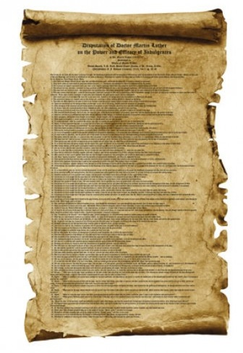
Martin Luther
German Monk who was dissatisfied with the Church, its teachings, and various policies. His issues with the Church included:
Faith saves people, not indulgences
Ultimate authority for Christians is the Bible
No one is more important in God’s eyes; all humans are equal before God
95 Theses- list of things Luther thought was wrong with the Catholic Church that he nailed to the church doors in Wittenberg, Germany in 1517
Leads to an even further decline in the authority of the Catholic Church

Slide 7
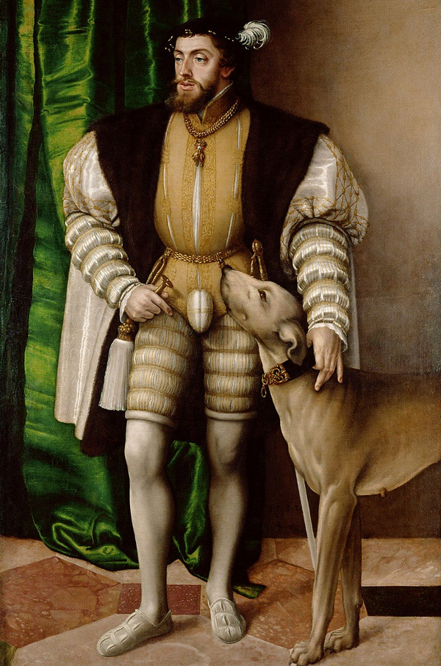
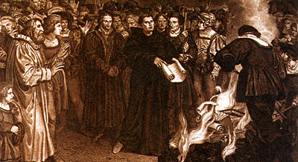
Martin Luther
In 1520 Pope Leo X (member of Medici family) ordered Luther to give up his beliefs
Luther burned the order and was excommunicated
Charles V, Holy Roman Emperor, summoned Luther to trial in the town of Worms
Diet of Worms- official assembly gathered by Charles V, where Luther was declared an outlaw and heretic
New religious group formed- Lutherans
Northern German princes supported Luther; but other princes agree to join forces against them
Charles V declared war against Protestants
Peace of Augsburg- beginning in 1555, religion of each German state would be decided by its ruler

Slide 8
Effects of the Reformation
Many different forms of Christianity (Lutheranism, Calvinism, Baptism, etc.) will splinter off from Protestantism
Catholic Church will try to re-establish power through a series of counter-protests with allies, like Holy Roman Empire, France, and Spain
First major rejection of established authority, which will play a role in future revolutions to remove absolute monarchs from power

Slide 9
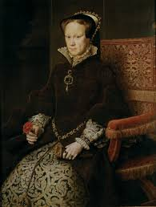
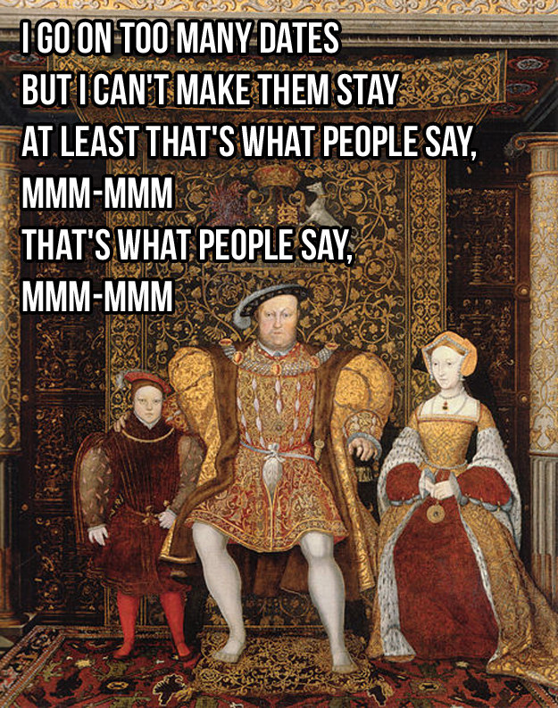
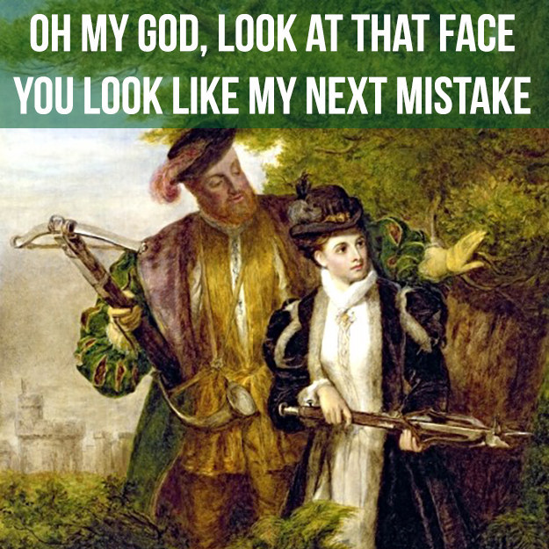
Anglicanism
Henry VIII
Elizabeth I
Church of England

Slide 10
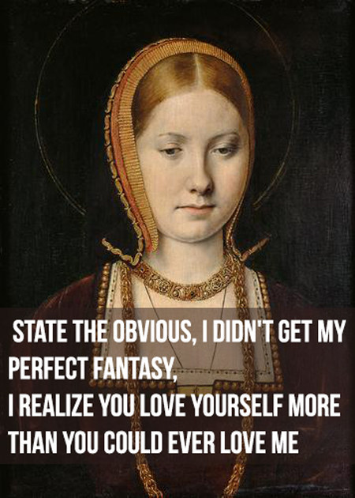
Henry Vii
Henry VIII- King of England; originally an opponent of Reformation, even titled “Defender of the Faith” by Pope
Anxious to have a male heir to secure his legacy, bloodline, and a peaceful transfer of power upon his death
Henry and Catherine have one legitimate child, Mary I, future Queen of England
Catherine of Aragon- daughter of Isabella & Ferdinand of Spain, niece of Holy Roman emperor; cannot give Henry a boy, he requests an annulment

Slide 11
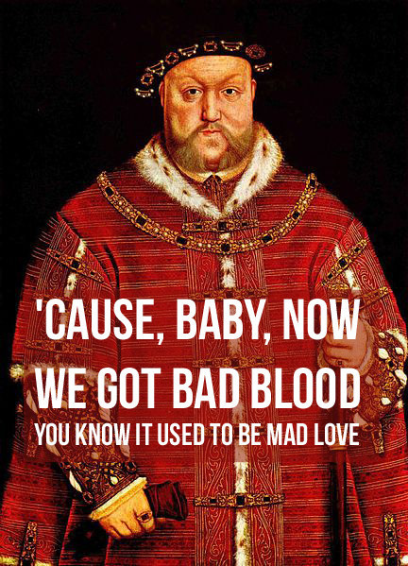
Henry VIII
The Pope could annul (set aside) a marriage, but refused to avoid offending Catherine’s relatives, especially Holy Roman Emperor Charles V (most powerful ally)
Henry appoints new archbishop who annuls his marriage; Henry breaks off all ties completely with Rome
In 1534, Parliament passes Act of Supremacy, making Henry head of a new Church, the Church of England (also known as the Anglican Church)
Anglicanism- retains some elements of Catholicism (prayers, saints, Sunday mass) but invests authority in hereditary monarch, not a pope or bishop
England officially becomes a Protestant country

Slide 12
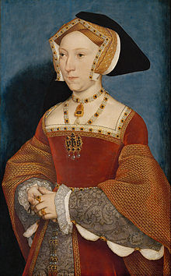
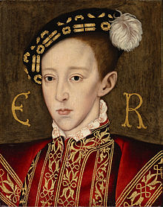
Henry VIII
Anne Boleyn- Henry’s 2nd wife; their relationship leads to conflict between Henry and Catholic Church
Ends up having a daughter, future Queen Elizabeth I
Convicted of witchcraft and executed
Jane Seymour- Henry’s 3rd wife; gives birth to a boy but dies after childbirth
Edward VI- Henry’s son with Jane Seymour, will become King after Henry’s death at age 10.
Edward is extremely sick, so Henry continues to marry in order to provide an heir
Edward VI dies 6 years after Henry VIII

Slide 14
Elizabeth I
To secure the Crown, Henry VIII reinstated his daughters into the line of succession before he died.
Mary I- inherited the throne after the death of Edward VII; she ruled England as a Catholic Monarch with her husband, Phillip II of Spain.
Approved the persecution of hundreds of Protestants, most of which ended in public executions (burning at the stake)
Elizabeth I- daughter of Henry VIII and Anne Boleyn, the last of the Tudor dynasty; she inherits the throne after the death of Mary I
Will rule for 47 years (3rd longest reign in British history)

Slide 15
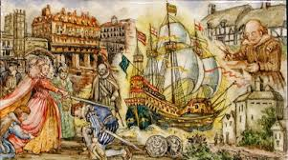
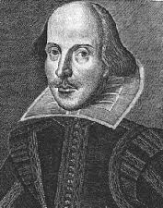
Elizabeth I
Elizabethan Age- during Elizabeth’s reign, England reached new heights of economic stability, literary and artistic production, and territory expansion
William Shakespeare- most influential writer of the Elizabethan age; several of his plays were about English history and lives of the kings
Elizabeth was more tolerant than Henry, Edward, or Mary; she ended persecutions for both religions and combined Catholic traditions with Protestant teachings to appease both populations

Slide 16
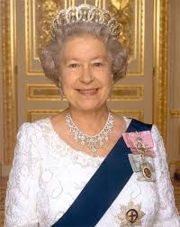
Anglican Church
aka Church of England
British Monarch is the symbolic authority of the Church (current: Queen Elizabeth II)
Archbishop of Canterbury (current: Justin Welby) heads the Church, updates policy, and leads services
Combines elements of Catholicism (follows Jesus and the Apostles’ teachings & writings) and Protestantism (rejecting Pope’s authority, use of local languages, power of priests & clergy reduced)

Slide 17
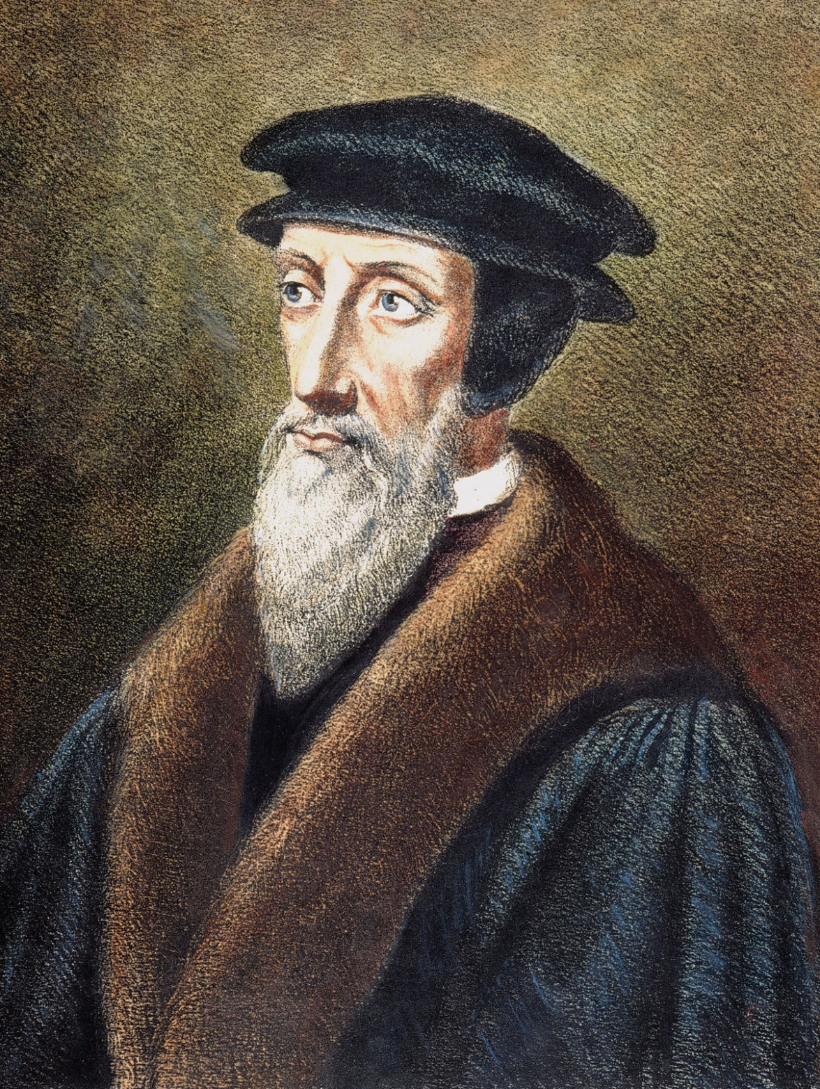
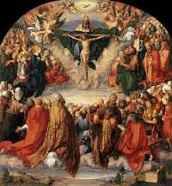
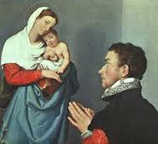
Calvinism

Slide 18
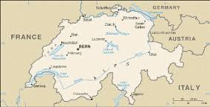
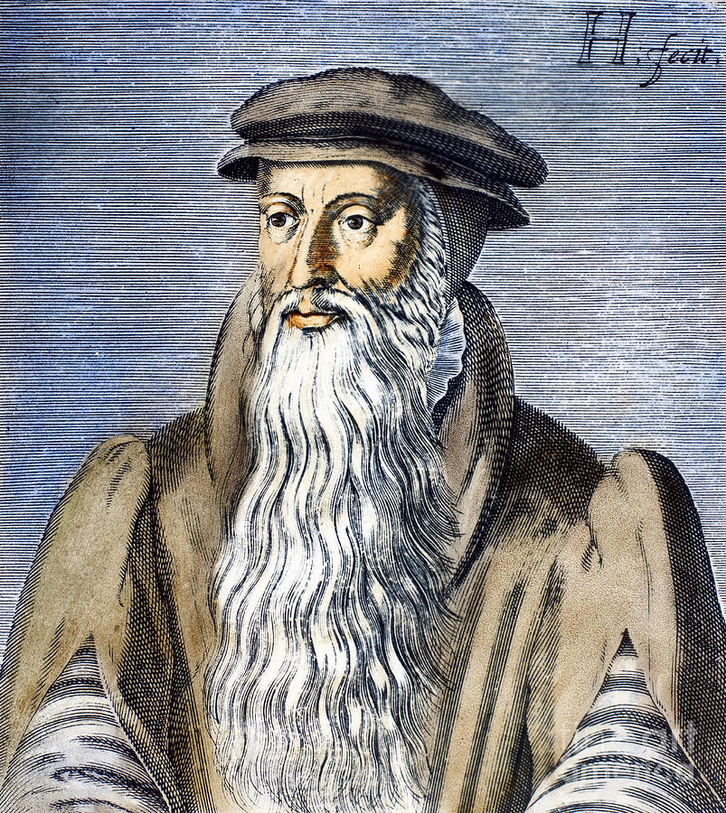
John Calvin
John Calvin- built a community in Geneva, Switzerland, where he expected citizens to follow religious law
Community stressed hard work, discipline, and spending wisely (no ornate clothing, jewelry, or finery)
Fines for swearing, laughing in church, and dancing
Theocracy- no separation between Church and state; religious law is followed at all times
John Knox- visited Calvin in Geneva and liked his teachings so much that he began preaching in Scotland; his followers were called Presbyterians

Slide 19
Predestination
Calvin and Knox taught that salvation can only be received through Predestination
Predestination- only God can choose who goes to heaven, you don’t get there by good works (charity, paying indulgences) or through a priest’s decision (Last Rites)
Determined at birth, your moral life will reveal if you’re chosen by God to go to heaven or hell
Work ethic, righteous life that honors God

Slide 20
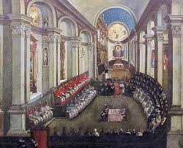
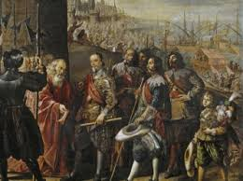
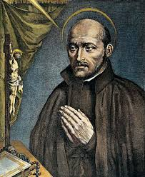
Counter-Reformation
Spain
Countering the Protestants
Council of Trent
Thirty Years’ War

Slide 21
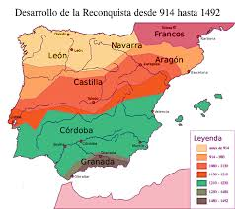
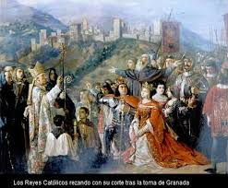
Spain
Catholic Church’s most loyal ally is Spain, and they initiated many holy wars on behalf of the Church
Reconquista- intermittent war between Christians and Muslims for control of Iberian peninsula between 728-1492 CE, when the Muslims were pushed back to African coast for last time
Muslims and Jews living in Spain were forced to convert to Catholicism, creating a large converso population treated as second-class citizens

Slide 22
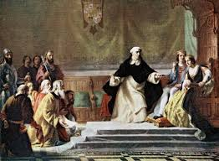
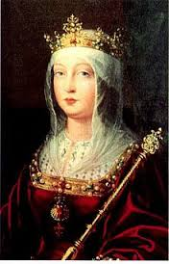
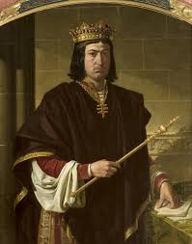
Spanish inquisition
Isabella & Ferdinand- (ruled from 1478-1504) royals whose marriage united Iberian kingdoms under one country, Spain.
Parents of future 1st wife of Henry VIII, Catherine of Aragon
Spanish Inquisition- court tribunals established to identify heretics in Spain; used brutal methods of torture to elicit confessions and promises to convert
Muslims and Jews living in Spain were forced to convert to Catholicism, creating a large converso population treated as second-class citizens
Reasons for authorizing Spanish Inquisition:
Desire to create religious unity
Need to weaken family alliances and local authority that challenge power of new joint monarchy
Confiscating lands of wealthy Jews and Muslims creates income revenue to fight end of Reconquista
Inquisitions outlawed in 1821

Slide 23
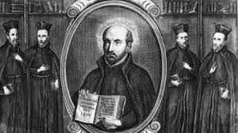
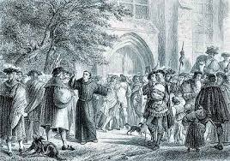
Countering the Protestants
Counter Reformation- period of Catholic resurgence after the initial Protestant Reformation; intended to reconvert Protestant areas and attract new members
Papal Bull- official order, announcement, or decree authorized by a Pope
Ignatius de Loyola- commanded by Papal Bull to establish Jesuits in 1540; won back many Europeans who had joined Protestantism during Reformation
Jesuits- religious order of Catholic priests that provide education and charitable works in areas where Catholic church normally does not reach

Slide 24
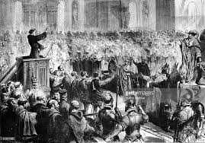
Council of Trent
Paul III- Catholic pope who reviewed and reworked Church institutions to win worshippers back to Catholicism. Problems he addressed included:
Popes and cardinals had become too worldly
Bribery to gain church office was widespread
Monasteries had lost their discipline
Sale of indulgences was widely abused.
Council of Trent- 25 meetings held between 1545-1563, authorized by Pope Paul III to reform the Church
While Council was meant to fix problems within the church, relations between governments opposed to Protestantism became bigger

Slide 25
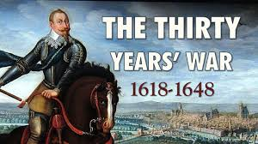
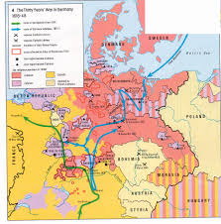
Thirty Years’ War
French Wars of Religion- various battles between Catholics and Protestants (called Huguenots) for control of France from 1562-1598
Edict of Nantes- separated French politics from French religion, guaranteed equal rights to Huguenots
Ferdinand II- Holy Roman Emperor in 1618, tries to establish unified Catholicism, but faces resistance from Protestant forces
Thirty Years’ War- Europe’s longest and deadliest religious war; fought almost exclusively between different regions of the Holy Roman empire, lasted between 1618-1648 CE

