Slide 1
Responses to Imperialism

Slide 2
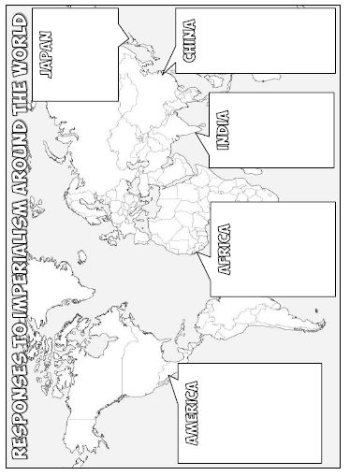
For this presentation…
Use the bubbles on the map to write notes about each region’s responses to Imperialism.
Write the name of the event and the year it took place (highlighted in red in the notes)
Write a short summary that details what happened. Be sure to include:
Countries or people involved
What was the outcome
Color in the country after you have written the notes

Slide 3
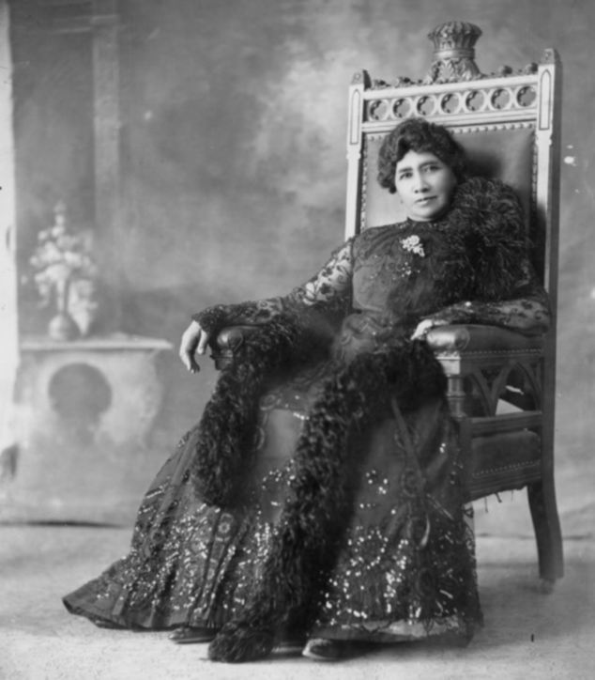
United States of America
Issues Monroe Doctrine (1823) to halt imperialism by European nations in Latin America
Overthrow of Hawaiian Monarchy (1893)- US sugar plantations in Hawaii become very valuable, but new Hawaiian Queen Liliuokalani threatens to take them under Hawaiian control in 1891
US sends envoy to overthrow the monarchy, but attempts to annex Hawaii stall after it was discovered that Hawaiians wished to remain independent
After recognizing the strategic importance of the Pearl Harbor naval base during the Spanish-American War, Hawaii became a US territory in 1898. Hawaii became the 50th U.S. state in 1959.

Slide 4
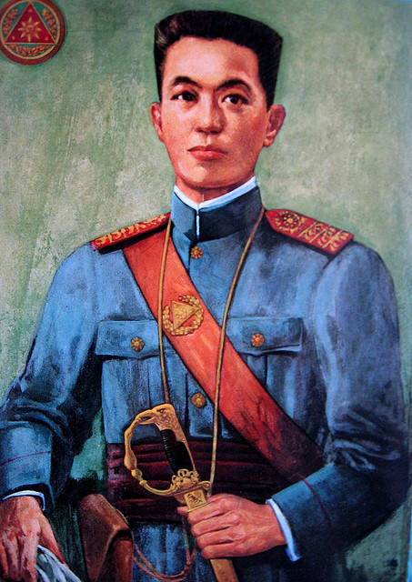
United States of America
Philippine Insurrection (1899-1902)- Philippine Islands thought they were fighting with the US against Spain for their independence, while the US used the Philippines to fight for them.
After the Spanish-American War ended, the US did not grant the Philippines their independence, which sparked rebellions against their occupation.
Emilio Aguinaldo leads a bloody 3 year conflict which was longer and much more brutal than the Spanish-American War.
US is victorious & controls the Philippines until 1946

Slide 5
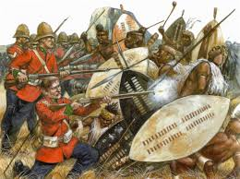
Africa
Anglo-Zulu War (1879)- the Zulu kingdom resisted attempts at annexation and religious conversion by the British. When Great Britain demanded that the Zulu follow their rules, the Zulu refused to negotiate.
The Zulu won many battles in the beginning, but ultimately the British declared victory after 5 months of warfare
Great Britain annexed the Zulu territories, ending the Zulu Kingdom
Modern South Africa

Slide 6
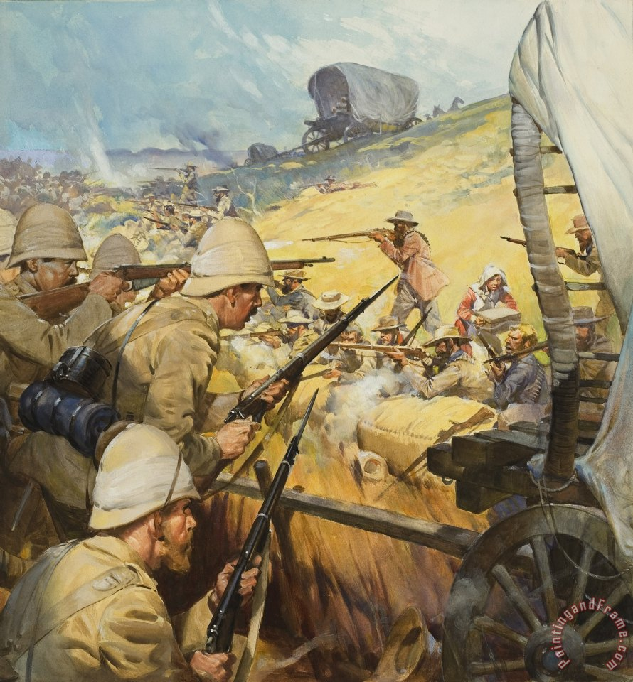
Africa
Boer Wars (1899 to 1902)- fought between former Dutch farmers, called Boers, and the British in southern Africa
Boers are resentful of British power, anti-slavery policies, and religious mandates
The British win, and they formally annex the Cape Colony (South Africa) into their territories
Due to strong anti-rebellion sentiment, any other protests against British rule and independence movements in Africa are ended

Slide 7
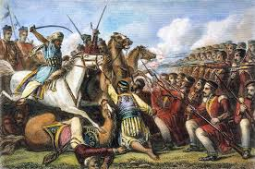
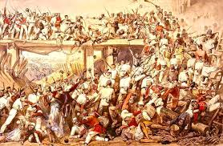
India
Sepoy Rebellion (1857)- Indian soldiers rebelled against their treatment by the East India Company
Sepoys were offended by a rumor that animal fat was used in their rifle cartridges (which they would need to bite off to load the rifle). The consumption of animal products is offensive in both the Hindu and Muslim religions.
Indian National Congress would be created to push for Indian independence, along with the efforts of Mohandas K. Ghandi. India was finally awarded independence in 1947.
Britain puts down rebellion but takes over direct control of India

Slide 8
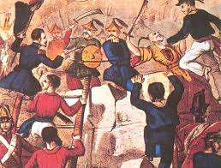
China
Opium Wars- a series of battles fought between 1839-1842 and 1856-1860, China becomes increasingly upset over Great Britain importing opium into the country, even though they only have one port open
The British win both battles:
First Opium War- Great Britain demanded China open up more ports for trading
Second Opium War- China was carved into different spheres of influence taken by Great Britain, France, and Russia.

Slide 9
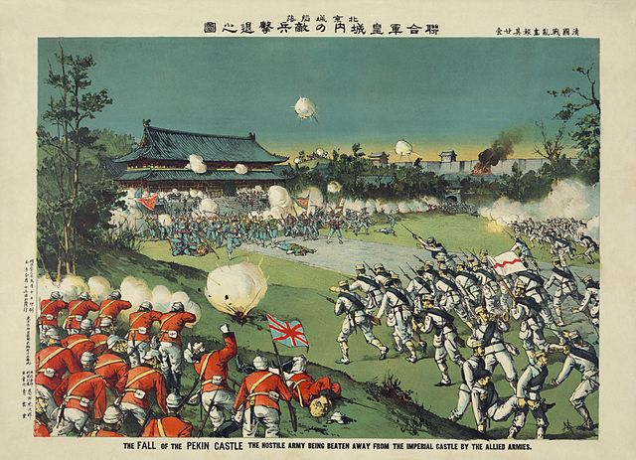
China
Boxer Rebellion (1899)- Chinese rebel groups, called Boxers, were angry over foreign influence in their country after the Opium Wars
The 8 Nation Alliance, consisting of Japan, Russia, Great British, France, the United States, Germany, Italy and Austria-Hungary, eventually crushed the rebellion after a brutal war.
The Chinese Empress Dowager Cixi supported the Boxers, who fought the combined armies for 55 days before being defeated.
The result of the rebellion was a weakening of the Imperial Qing Dynasty, but Westerners also gave up on colonizing China.
China forced to pay massive reparations

Slide 10
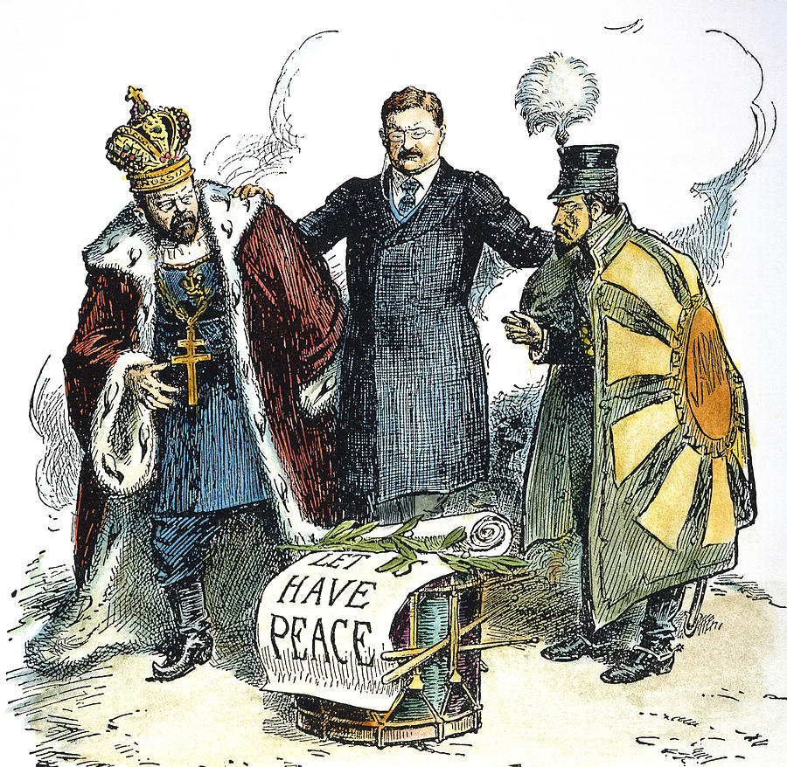
Japan
Russo-Japanese War (1904-1905)- Russia sought a warm-water port on the Pacific Ocean for their navy and trade. The Japanese government perceived a Russian threat to its strategic interests in Korea and chose to go to war.
After negotiations broke down, the Japanese Navy attacked the Russian fleet in a surprise attack.
Japan wins (surprisingly) and US negotiates the treaty

