Slide 1
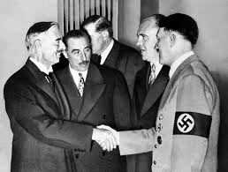
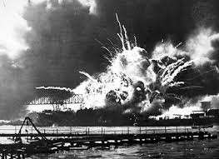
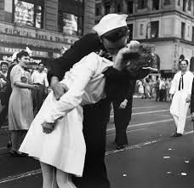
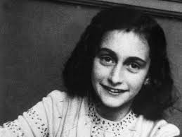
World war II
Rise of Adolf Hitler
World at War
V/E & V/J

Slide 2
Cornell note-taking method
Notes color-coded in RED go on this side of the line.
These items will include:
Main Ideas
Big Concepts
Vocabulary Words
Notes color-coded in BLUE go on this side of the line.
These items will include:
Supporting details
Dates, Times, and Biographic details
Vocabulary Definitions
Any items in BLACK text are optional. Remember: the more thorough your notes, the more prepared you will be for exams.

Slide 3
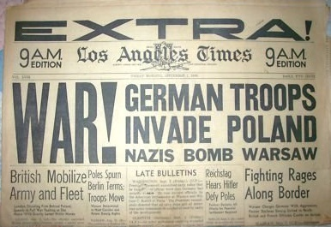
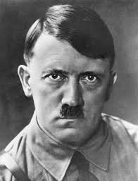
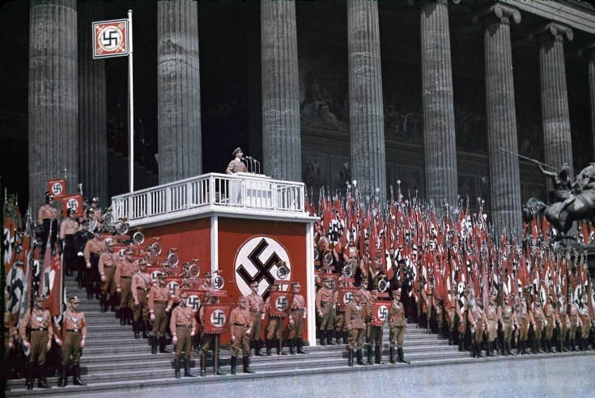
Rise of Adolf Hitler

Slide 4
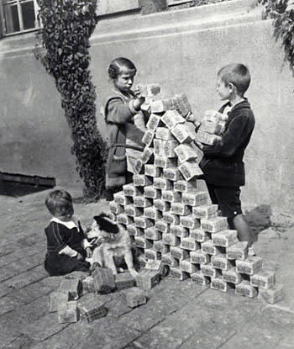
Treaty of Versailles Regulations
Germany had to accept blame for WWI and was forced to pay over $30 billion in reparations
Germany lost valuable territory, including its African colonies.
Germany’s armed forces was limited to 100,000 men and they were not allowed submarines or airplanes
After the exile of Kaiser Wilhelm, Germany reformed as the Weimar Republic. Paying reparations devalued the German Mark, and its currency became worthless, plunging the country into a deep economic depression.

Slide 5
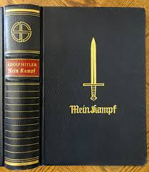
Adolf Hitler
Adolf Hitler- WWI veteran, considered war service to be best of his life, shocked when Germany submits to Treaty of Versailles. Joins the German Workers Party in 1919.
Nationalist Socialist Party- evolved from German Workers Party; anti-communism and anti-Marx, based on extreme nationalism and German pride
Hitler is their most popular speaker, and he is able to fundraise from industrialists who like profits. To keep him happy, Hitler is made leader of the party.
Mein Kampf- published in 1925 while imprisoned for rioting, Hitler detailed his political ideology and plans for German greatness. Jews are made to be the scapegoats for the majority of Germany’s problems.

Slide 6
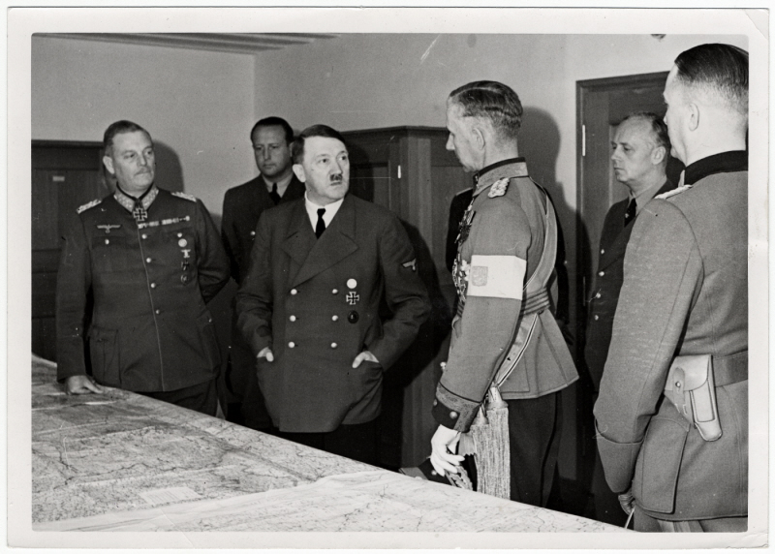
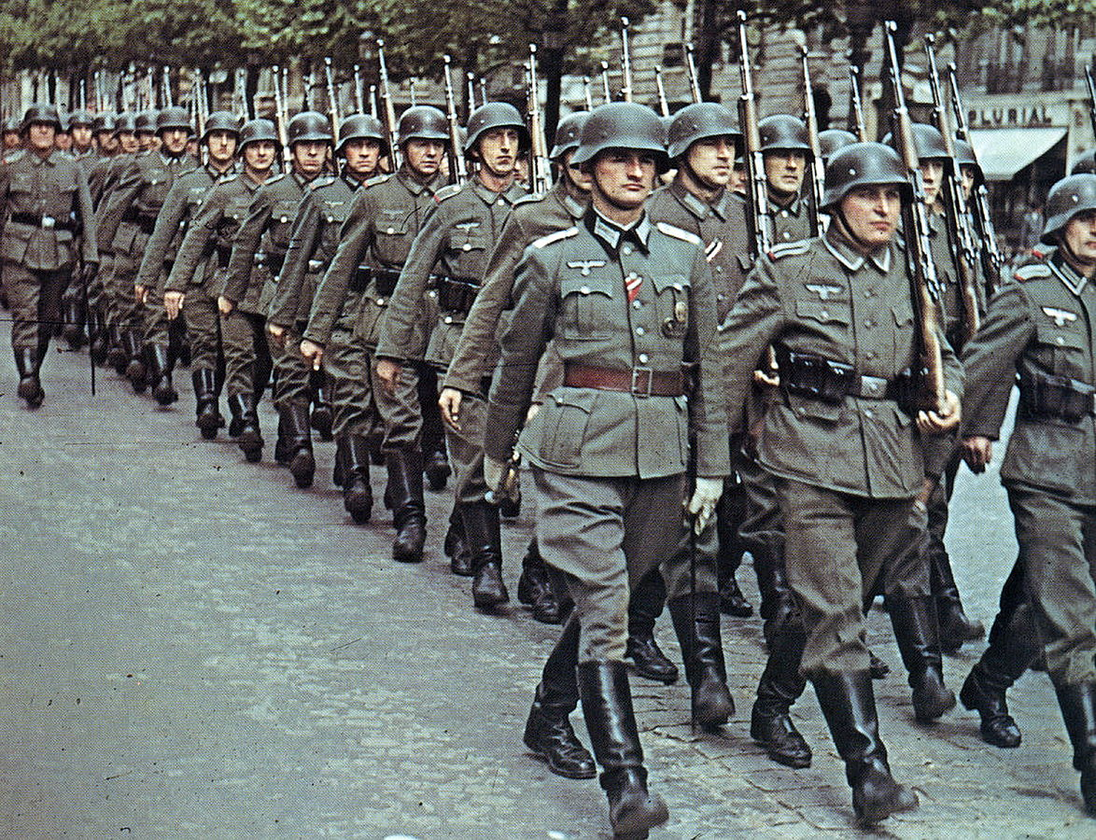
Adolf Hitler
The moderate political parties won’t work together, allowing the Nazi party to grow in popularity in elections from 1927-1932
In 1933, Hitler is appointed Chancellor of Germany, and immediately made himself absolute ruler
Wermacht- In 1936, Hitler ordered Hermann Göring to make the German army ready for war in four years. He rebuilds and expands the German army to 600,000 soldiers- even though specific provisions in the Treaty of Versailles prohibited Germany from rearming after World War I.
Military build-up stimulated the German economy.
German industry benefitted as well, and the country increased in prosperity
Liebensraum- claiming that Germany is threatened, Hitler takes over Rhineland, Czechoslovakia, and Sudetenland

Slide 7
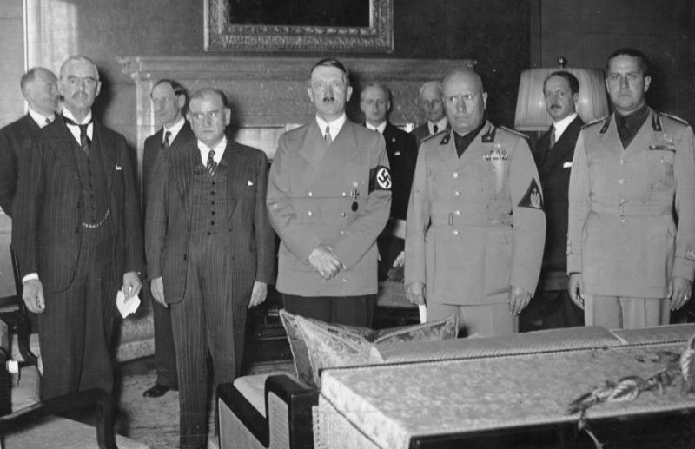
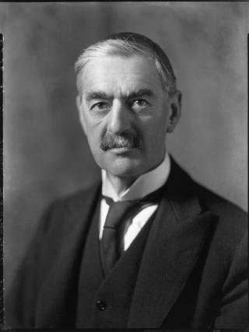
Appeasement
Anschluss- Hitler pursues an alliance with Austria, expressly forbidden by the Treaty of Versailles
Munich Conference- leaders of France, Great Britain, and Italy met with Hitler in September 1938 to discuss violations.
Appeasement- policy of letting one person, nation, organization, etc., act how they want to in order to avoid a larger conflict
Hitler was allowed to keep the territories he annexed as long as he didn’t invade any more countries, which was promoted by British Prime Minister Neville Chamberlain in order to keep the peace and avoid war.

Slide 8
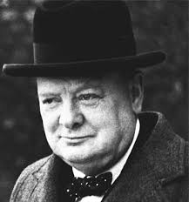
Act of war
September 1st, 1939- Germany invades Poland and takes over the entire country
Blitzkrieg- “lightning war”; Germany used tanks and other weapons and use planes to attack from the air, creating chaos that results in quick surrenders
Neville Chamberlain, realizing his ideas of appeasement are a failure, resigns as Prime Minister; Winston Churchill replaces him
Great Britain and France declare war on Germany on September 3rd, 1939

Slide 9
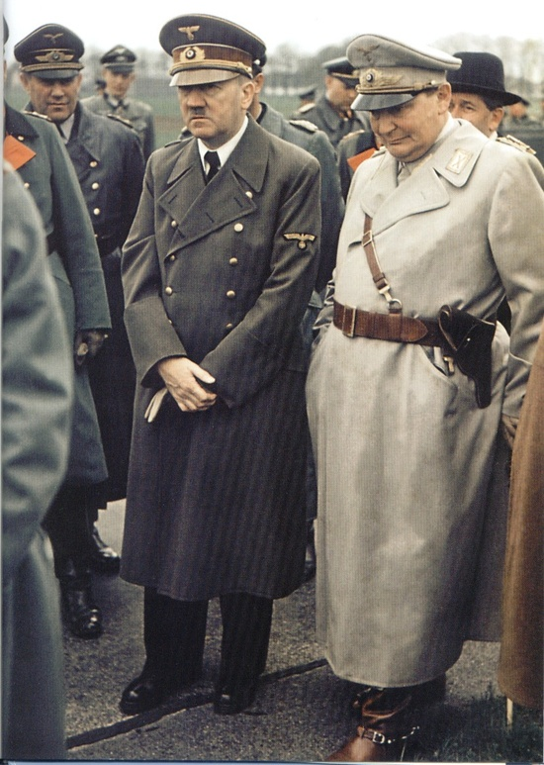
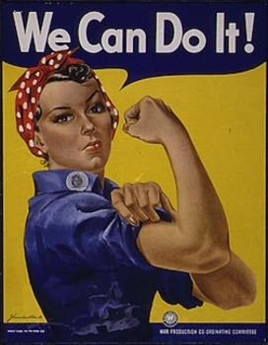
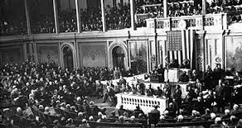
World at war

Slide 10
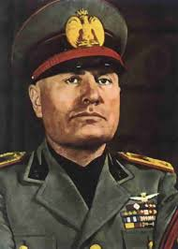
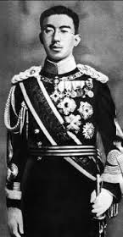
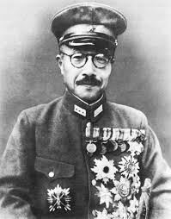
axis Powers
Three main leaders of the Axis powers were nations that were controlled by dictators
Germany allied themselves with Italy, whose leader Benito Mussolini created a fascist government with one party and one leader in control (Hitler’s personal hero)
Mussolini was often called “Duce”, so Hitler chose his own nickname based on its German counterpart, “Fuhrer”
Japan was led by Emperor Hirohito, and formed an alliance with Germany in order to fight the progression of communism in Asia

Slide 11
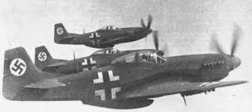
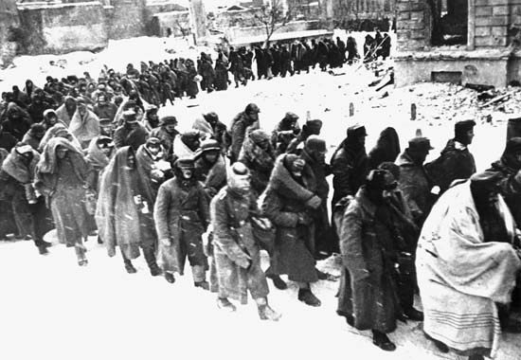
German aggression
Germany invades France by moving through the Ardennes Mountains, avoiding strong barriers at the Maginot Line (French-German border)
France surrenders 10 days after invasion
Blitz- air warfare strategy of nighttime bombings employed by Germany during the Battle of Britain, where they hoped to take over.
British use radar technology to locate and shoot down enemy aircraft, preventing German victory in Britain
Nazi-Soviet Pact- Hitler signs a treaty with Russia promising not to invade them; Germany then attempts to invade Russia to capture oil fields in 1941
Do not take freezing temperatures and Russia’s size into account, and they surrender in February 1943
Russia joins the Allies with Great Britain and France

Slide 12
Japanese aggression
Along with the global economy, Japan experienced severe economic depressions throughout the 1930s, and they began expanding into China to take control of their manufacturing and valuable raw materials.
The U.S. aided China by placing trade restrictions and economic sanctions on Japan, eventually cutting off their oil supply.
Pearl Harbor- U.S. Naval Base in Hawaii was attacked by Japan in retaliation for sanctions, resulting in the deaths of 2000 American servicemen and thousands more wounded on December 7, 1941.
President Franklin D. Roosevelt declares war on December 8, and Japanese allies Germany and Italy declare war two days later.

Slide 13
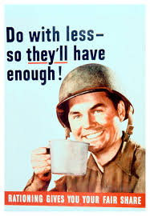
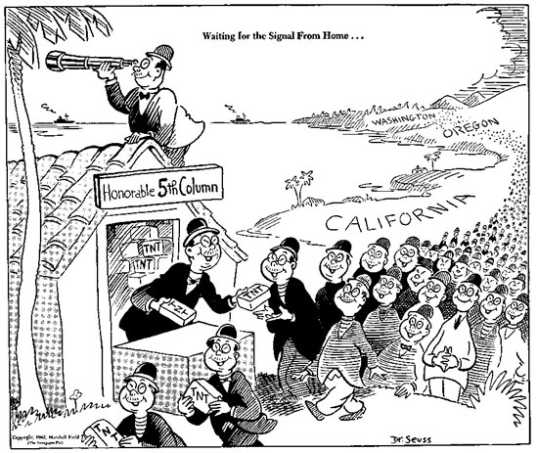
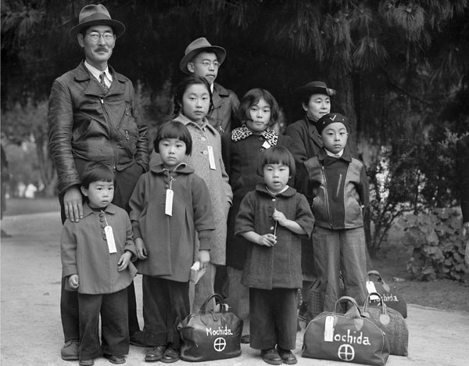
Response to war
Since the U.S. is still in a depression, conservation and rationing is a huge part of the war effort
Coupons required to purchase meat, sugar, coffee, canned foods, fuel, nylons, & shoes in limited numbers
Rosie the Riveter- used to recruit women to work in the factories and other jobs left by men who left to fight
Executive Order 9066- signed by FDR in 1942, Japanese-Americans were forcibly relocated to internment camps due to growing distrust between them and white Americans
All Japanese-Americans on West Coast were moved; most interned were American citizens, and 120,000 remained imprisoned until 1945

Slide 14
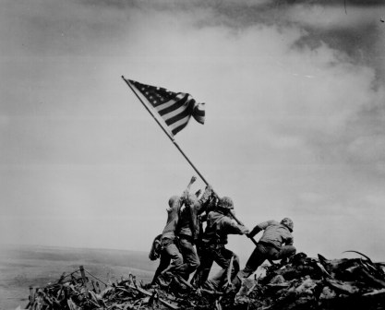
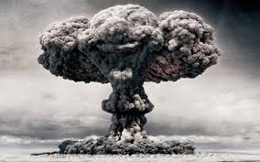
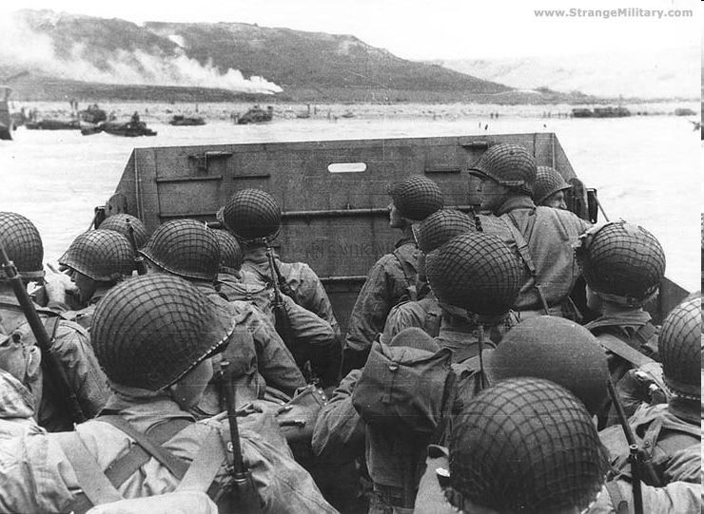
Victory over Europe & Victory over Japan

Slide 15
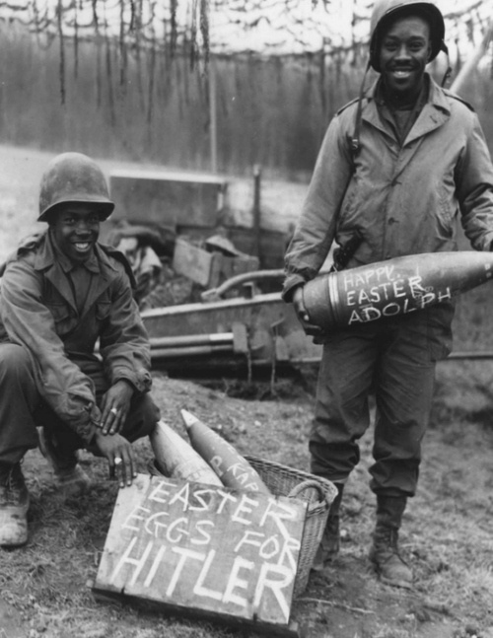
Liberation of Europe
D-Day Invasion- massive invasion of Europe planned by Supreme Allied Commander Dwight D. Eisenhower (Future President of U.S.)
Troops land in Normandy, France to push into Germany on June 6, 1944 and carry out largest land and sea attack in history
Allied soldiers push into Paris and free France, Luxembourg, and Belgium; US & British forces advance from the WEST
The Battle of Berlin- begins in April 1945; the Soviets close in on the Germans from the east and far outnumber their soldiers and have more weapons and ammunition.
Hitler commits suicide that month
Germany surrenders, and May 8, 1945 is celebrated as Victory over Europe, or VE Day

Slide 16
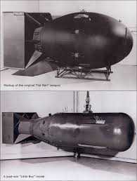
Pacific Theater
Battle of Midway- Japan targeted Midway Island to get the whole US fleet there, but the U.S. attacked Japanese aircraft carriers on June 4, 1942, creating a turning point of the war in the Pacific
Battles of Okinawa & Iwo Jima- from February to June 1945, brutal fighting erupted over small islands close to Japan, resulting in extremely high casualties on both sides
President Truman informed an invasion of Japan might cost a million lives, and dropping the atomic bombs “Fat Man” and “Little Boy” the Manhattan Project had been working on would be the quickest way possible end to war
Hiroshima and Nagasaki- bombs were dropped on August 6th & 9th, 1945. Approximately 140,000+ Japanese civilians died in the atomic bombs, but radiation fallout killed thousands more over decades.
Victory in Japan is declared on September 8th, 1945, signaling the end of World War II.

Slide 17
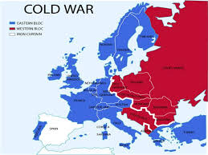
Legacy
At the Potsdam Conference after V/E Day, the Allies divide Europe between Communist-controlled East and Capitalist West, leading to the Cold War
China will transition to a fully communist state, calling themselves the “people’s democratic dictatorship” to cement their power but unite their people
The United Nations is formed to promote democratic principles throughout the world; and still exists to this day

