Slide 1
Factors of migration
PEGS

Slide 2
Why do people move?
Human Migration- people (in large groups or individually) move across the world for many different reasons
Push Factors- reasons that cause a person to leave
Negative
Weather is too cold, don’t like neighborhood, job doesn’t pay enough
Pull Factors- reasons that cause a person to want to live in a certain area
Positive
Job Availability, Political or Religious Freedom, Proximity to Chipotle

Slide 3
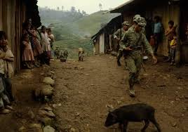
P.E.G.S.
Political Factors- When rulers of a nation oppress its people by denying their individual rights or eliminating their personal freedoms, citizens migrate in search of more just and fair places to live.
Push Factors
War
Instability
Pull Factors
improved political climate.
peace and stability,
a fair court system, and a government that guarantees individual rights and freedoms

Slide 4
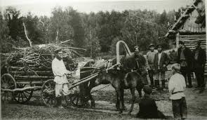
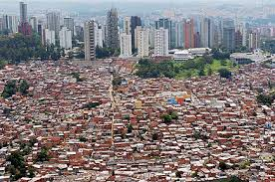
Economic Factors- Many people move because of money, either they cannot make enough in their current location, or they think they can make more in a different location, or both.
Push Factors:
Poverty
Limited Job Opportunities
Pull Factors:
More Job Opportunities
Higher Salaries
Lower Cost of Living (cheaper gas, food, rent prices)

Slide 5
Geographic/Environmental Factors: Undesirable weather, food shortages, or natural hazards can also influence migration.
Push Factors: natural disasters, pollution, radiation, drought, and undesirable climates
Pull Factors: Leaving the general area where these events take place often

Slide 6
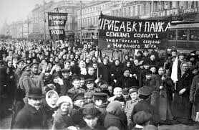
Social Factors- People who migrate for social factors move to locations that offer personal freedom and social equality
Push Factors:
Oppression based on race, religion, gender, etc.
Pull Factors:
Availability of personal and religious freedoms

