Slide 1
Political cartoons
Imperialism

Slide 2
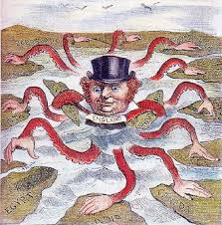
British Imperialism
The Devilfish in Egyptian Waters
Published by Punch Magazine, 1888

Slide 3
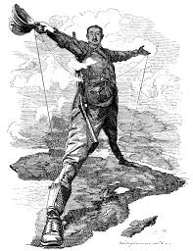
The Rhodes Colossus
The Rhodes Colossus Striding from Cape Town to Cairo
Edward Linley Sambourne
December 1892

Slide 4
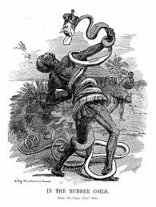
In the Rubber Coils
In the Rubber Coils of the Congo Free State
Edward Linley Sambourne
Published November 1906

Slide 5
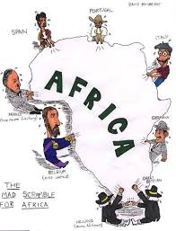
Mad Scramble for Africa
Mad Scramble for Africa
David Bainbridge

Slide 6
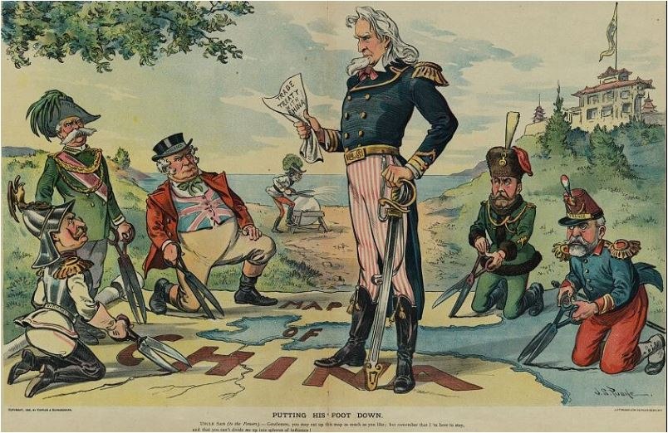
China
Putting His Foot Down
J.S. Pughe
Published by Puck Magazine, August 1899

Slide 7
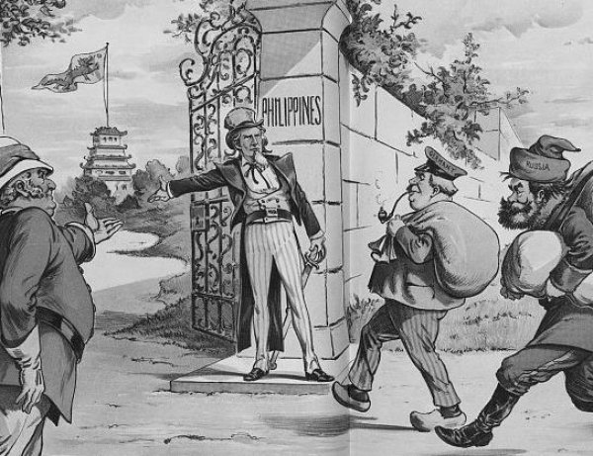
The Philippines
Welcome to the Philippines
J.S. Pughe
Published in 1899

