Slide 1
Introduction to Religions
Polytheism & Animism

Slide 2
Polytheism
The belief in multiple gods or goddesses
May have a Supreme deity and lesser deities that followers pray to or worship, or ghost-like forces or bad spirits may have equal or lesser status in prayers.
Some religions emphasize a goal that is more important than the deity (Buddhism). Teachings or behaviors may be the focus of the religion instead of gods (Sikhism & Confucianism).

Slide 3
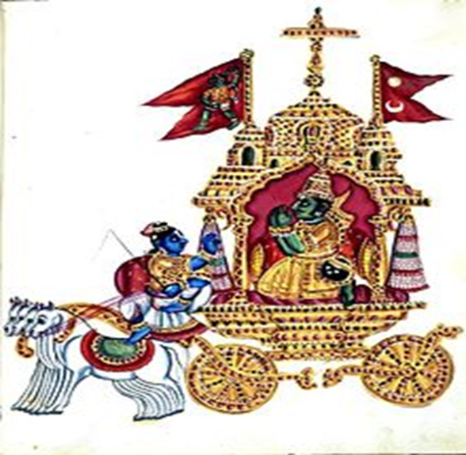
Hinduism
Followers: Hindu
Origin: Developed over thousands of years in India & Nepal, with many influences.
Deity: Believe in many gods, Three specifically that are a form of the One Supreme Being, Brahma.
Worship: Mandirs, temples dedicated to a specific Hindu god/ goddess. Shrines can also be made at home.
Sacred Texts: Vedas, written in Sanskrit, are the oldest Hindu scriptures, attributed to Brahma.
Upanishads describes human salvation
Bhagavad Gita tells 700 verse story of Krishna

Slide 4
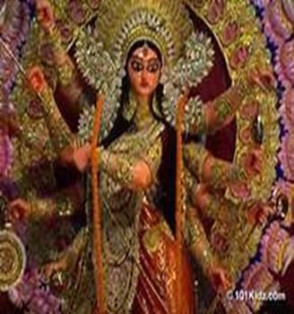
Hinduism
Beliefs: Reincarnation is the belief that the soul is reborn based on the good (or bad) works a person does in current life, aka Karma.
Cows are sacred; beef is not eaten.
Rituals: Puja is a prayer ritual that commemorates daily life and important events.
Various forms of Yoga are also practiced daily.
Sects: Vaishnavas (Vishnu), Shaivites (Shiva), Shakta (Shakti), Smartis (Five Deities in One)
Languages: Hindi (the regional dialect) is mostly derived from the ancient language of Sanskrit

Slide 5
Buddhism
Followers: Buddhist
Origin: Founded by Siddhartha Gautama around 500 B.C.E., based on beliefs & teachings of self-denial and meditation to achieve Nirvana.
Deity: Do not believe in a single Supreme Being. Soul will have many reincarnations.
Beliefs: The Four Noble Truths- Dukkha (suffering, anxiety, dissatisfaction), Origin of Dukkha is human desire, Freedom from Dukkha, Achieve the Eightfold Path in order to reach Nirvana
Worship: Pagodas and Stupas are types of Buddhist temples, but meditating in a shrine at home is acceptable.

Slide 6
Buddhism
Rituals: Eightfold Path leads practitioner to self-awakening and liberation from earthly desires
Right Understanding, Right Thought, Right Speech, Right Action, Right Livelihood, Right Effort, Right Mindfulness, Right Concentration
Language: Modern Buddhists speak Tibetan or Chinese; ancient texts are written in Sanskrit
Text: Beliefs follow writings called Sutras.
Sects: Theravada (Conservative), Mahayana (seek enlightenment for greater good), Vajrayana (Tantric=delayed satisfaction)

Slide 7
Confucianism
Followers: Confucian
Origins: China, 500 BC. Based on the life and teachings of Chinese philosopher Confucius.
Deity: N/A
Worship: Sacred spaces, like the family home; Ancestor Worship (tablets with deceased family names)
Beliefs: “Afterlife” beyond capacity to understand, so concentrate on doing the right thing in this life
The 5 Bonds
Ruler to Ruled
Father to Son
Husband to Wife
Elder to Younger Brother
Friend to Friend

Slide 8
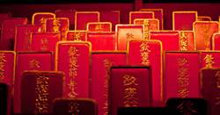
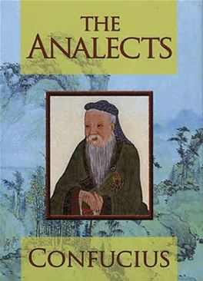
Confucianism
Rituals: Practice good manners & filial piety- respect your parents and elders
Language: Chinese
Sects: N/A
Sacred Texts: The 5 Classics, The Analects (Lun Yu), The Classic of Filial Piety

Slide 9
Animism
The belief in a supernatural being that organizes the universe whose spirit is possessed in both animate (things that move) and inanimate objects (things that don’t move).
Spiritual beings and presences manifests itself in soul of plants, animals, and stars.
Basis of multiple indigenous (native) religions, which are present on most continents, but in isolated areas (they don’t spread or convert).

Slide 10
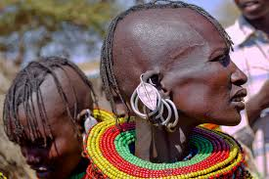
Africa
Most African religions are based on various tribal beliefs and locations
Recognize one main creator in addition to environmental spirits that control all aspects of life.
Include Turkana, Masai, and Berber tribes.

Slide 11
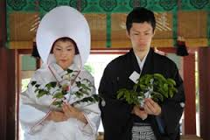
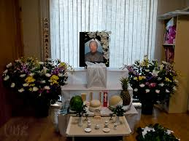
Asia
Shinto, founded in Japan, is the largest indigenous religion but has no formal doctrine.
Followers often incorporate aspects of Buddhism into Shinto
Focus on the balance between humanity and nature
Dates to prehistoric eras

Slide 12
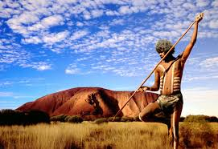
Australia
Aboriginal followers do not believe in a deity
The Dreaming is when all ancestors sprang from the Earth and created all life (human, plant, animal)
Ancestor Veneration- honor ancestors as they continue to control life creations

Slide 13
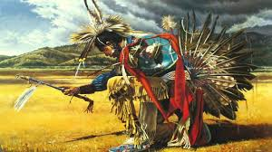
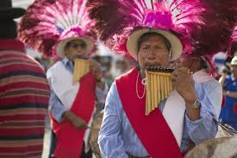
North & South America: Native Americans
Center on spiritual world, differ based on various tribes.
Great Spirit who works with other spirits through acts of nature (good and bad weather, natural disasters, rain) to create balance in life.
Rituals mark stages of life and are passed on through generations

