Slide 1
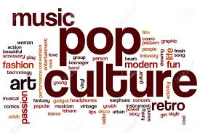
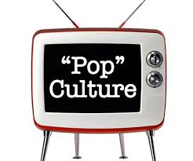
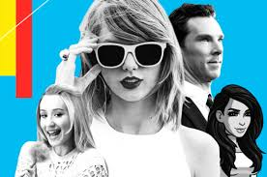
Pop culture

Slide 2
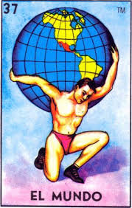
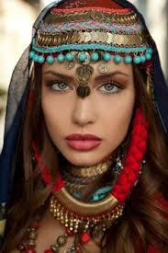
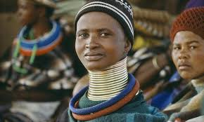
Folk culture vs. pop culture
Folk Culture- unifying components of everyday life that are practiced by local, tradition-bound groups
Dia de los Muertos
Loteria
Diwali
Folk culture is traditional, resistant to change, and usually limited in the appeal of its authentic, original form to "outsiders" of the particular society
Folk culture preserves the way a group lives, learns, communicates and interprets the world surrounding them

Slide 3
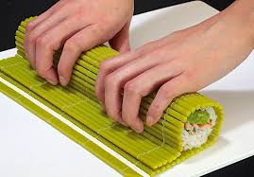
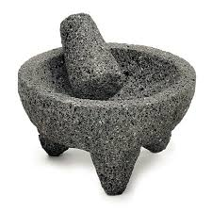
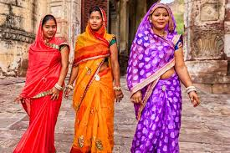
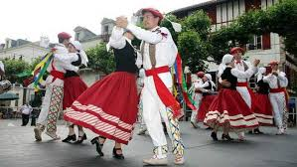
Folk Culture vs. pop culture
Material Culture- concrete and visible objects or “things” made and used by members of a particular cultural group
Food- tamales, sushi, pancit
Clothing- sari, kimono, china poblana
Housewares- molcajetes, Greek vases, makisu
Instruments- pan flute, gong, koto (harp)
Nonmaterial culture- aspects that are passed down as traditional (oral or written), includes:
Folktales & folklore
Songs
Dance
Beliefs & Superstitions
Customs

Slide 4
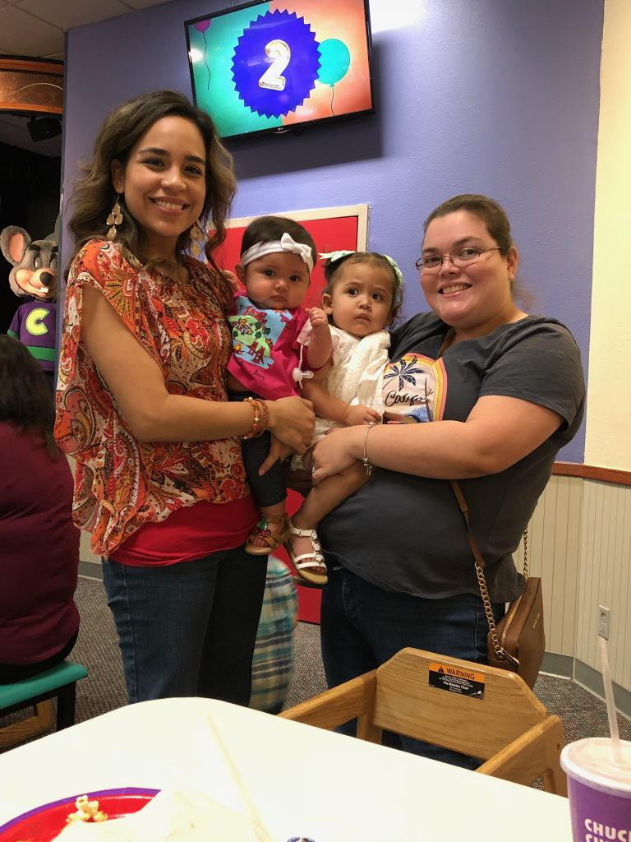
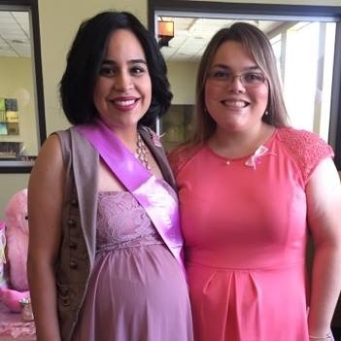
Folk Culture VS. Pop Culture
Commercialized/mass groups can take parts of folk culture and make it popular, but it loses its authenticity in the process; it never happens the other way around
Dreadlocks
Tribal tattoos
Pop Culture- ideas, perspective, attitudes and images that are considered within the mainstream of a society. Usually aided by mass media (newspapers, television, Internet, etc.) in influencing people within a large group.
1950
2001

Slide 5
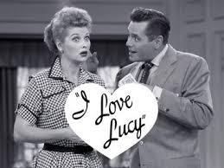
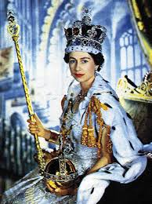
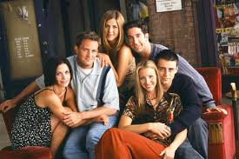
Elements of pop culture
Entertainment
Sports
News
Politics
Fashion
Technology
Fads

Slide 6
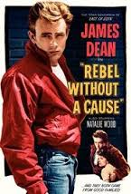
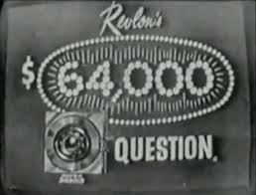
Entertainment: 1950
Entertainment is based off four categories- music, movies, games, and television shows.
Music: Elvis Presley
Movies: Rebel Without a Cause
Games: Game Shows on Television like $64,000 Question
Television: I Love Lucy
Entertainment is used to help people relax during their time away from work or school, and can help divert attention away from demands or pressures of problems outside the home.

Slide 7
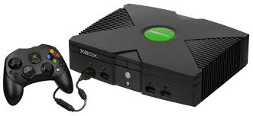
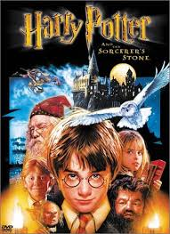
Entertainment: 2001
After 9/11 and beginning of War on Terror, entertainment became increasingly important to people’s daily lives
Music: Destiny’s Child
Movies: Harry Potter & Lord of the Rings
Television: Friends
Games: Xbox & Nintendo Gamecube released
Increase in 24/7 news cycle, where even smallest changes were tracked and reported
Terror Alert Level on Television

Slide 8
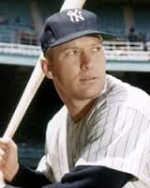
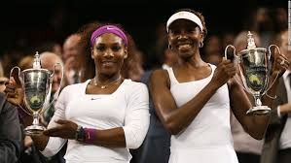
sports
1950s:
More African-Americans and Hispanic players were added to Major League teams due to integration
Hank Aaron breaks Babe Ruth’s record
Mickey Mantle begins 17-year career with the New York Yankees
2001:
Venus & Serena Williams win major tennis titles and major endorsements
Steroid Use becomes huge scandal in baseball

Slide 9
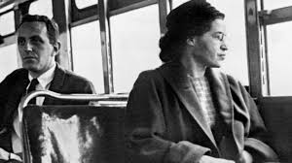
News- 1950’s
Pop culture news is defined by people, places, and issues that were brought to people’s attention
Hawaii and Alaska are added as 49th & 50th US states
Queen Elizabeth II is crowned in Great Britain, one of the few women to lead major world power
Rosa Parks is arrested after refusing to give up her seat to a white man in Montgomery, Alabama

Slide 10
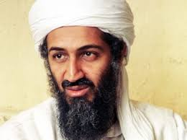
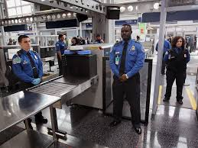
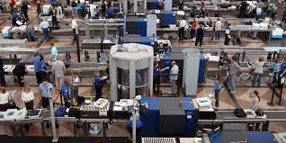
News- 2001
Letters filled with anthrax, a poisonous powder, are mailed to hundreds of people (including government offices) around the country
File-sharing network Napster officially blamed for declining music record sales
US begins manhunt for Osama bin Laden
Richard Reid tries to smuggle a bomb in his shoes, creating the TSA and all airplane security procedures

Slide 11
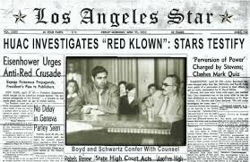
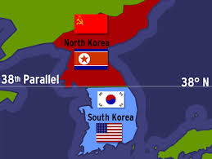
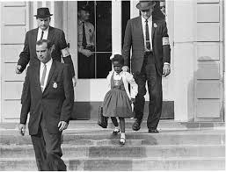
Politics-1950’s
Politics- the sets of attitudes and beliefs that give order and meaning to the rules that govern our behavior
President: Dwight D. Eisenhower
House of Un-American Activities begins actively looking for American citizens who are suspected of being Communist sympathizers
Communist N. Korea invades US-ally S. Korea, beginning US involvement in Korean War
Brown vs. Board of Education makes it illegal for public schools to be segregated

Slide 12
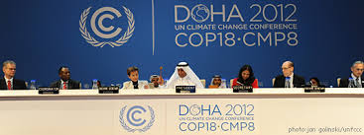
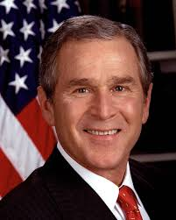
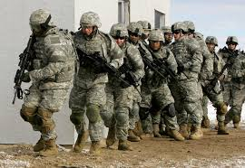
Politics- 2001
President: George W. Bush
9/11- terrorist attacks carried out by Taliban-controlled Afghanistan, 2 planes flew into World Trade Center in NYC, 1 plane flew into the Pentagon, and 1 missed its target (White House) and crashed in Pennsylvania
War on Terror- US expands invasion of Afghanistan to include all forms of terror, both domestic and abroad
US does not sign Kyoto Agreement, says climate change is not man-made

Slide 13
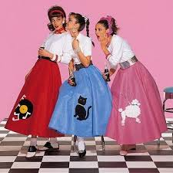
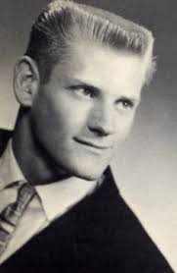
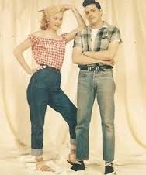
Fashion-1950’s
Fashion helps to establish self-identity and personal beliefs, and is reflective of social and religious norms within a cultural region
Rationing of fabric for war uniforms ends, changing civilian fashion: good fabric, fancy designs, and LOTS of material
Poodle skirts are popular among teenage girls
Men and boys popularize the crewcut, a haircut short on the sides and flat on the top
Denim jeans are starting to become casual wear for both genders

Slide 14
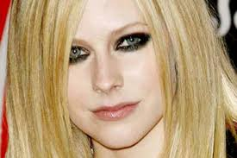
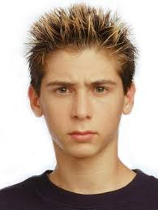
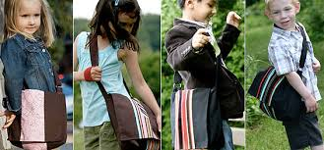
Fashion-2001
Both genders wear pants out in public
Girls begin flat-ironing hair and wearing much more eye makeup (shadow, eyeliner, mascara, etc.)
Boys began using wax to spike up their hair
Clothing had futuristic design and lighter colors
Messenger bags replace backpacks

Slide 15
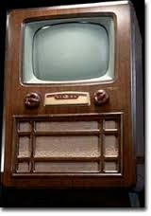
Technology- 1950’s
Technological Innovations- new processes or products that are introduced to make chores or tasks simple and effective
Access to technology helps increase interest in education, culture, politics, science, etc.
If culture determines the way we think and behave, technology determines how it is influenced and who it influences
In the 1950s, television sets became more affordable, so nearly every family had one.
Through national television networks, development of visible mainstream media, and investment from branded companies, television pioneered a national culture for the first time.

Slide 16
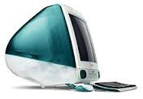
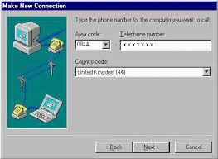
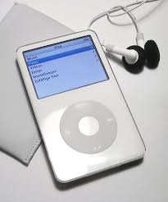
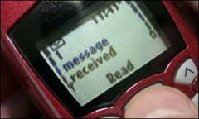
Technology-2001
Families have 3 or 4 television sets
Computers and the Internet bring culture at a quicker pace than TV; nearly every home has a computer
Cell phones begin receiving text messages
Apple announces the release of the iPod and iTunes, reducing the need for physical Compact Discs (CDs)

Slide 17
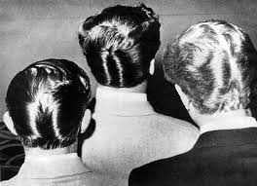
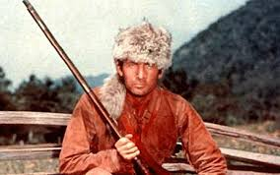
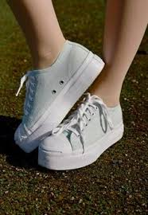
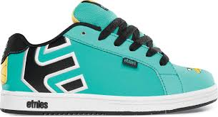
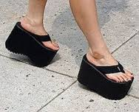
fads
Short-lived but intense behavior that develops within a group for a small period of time (weeks or months)
1950s
Raccoon-skin Caps, popularized by Disney’s Davey Crockett
Duck Tails- men combed their hair to the center and held it in place with gel to resemble feathers
2001
Platforms- every shoe could be a platform shoe
RazorScooters
Etnies- “skater” sneakers with wider laces

Slide 18
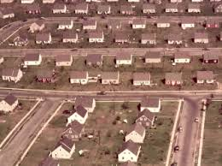
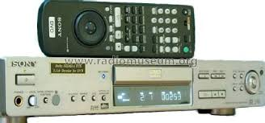
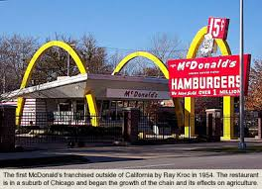
trends
Behaviors that experience popularity and eventually become permanent over time
1950s
People moved to the suburbs- clusters of pre-built homes that surrounded better schools, less traffic, more space
Fast food restaurants like McDonalds make their appearance
2001
DVD players replace video cassettes
Both genders will have piercings in both ears

