Slide 1
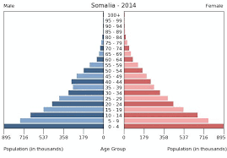
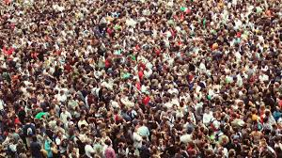
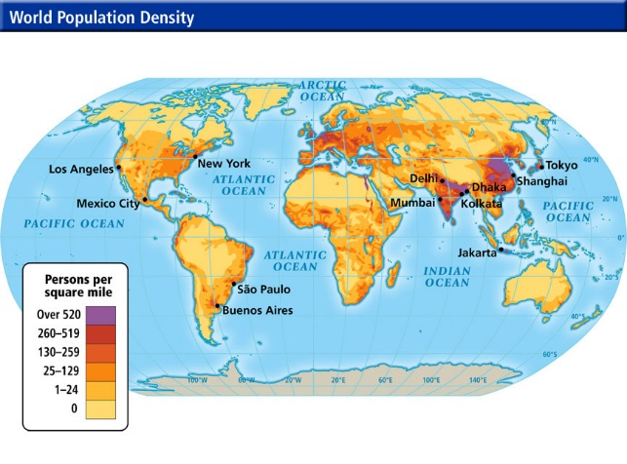
Populations
Demographics
Challenges of Growth
Migration

Slide 2
Just a reminder…
Notes color-coded in RED go on this side of the line.
These items will include:
Main Ideas
Big Concepts
Vocabulary Words
Notes color-coded in BLUE go on this side of the line.
These items will include:
Supporting details
Dates, Times, and Biographic details
Vocabulary Definitions
Any items in BLACK text are optional. Remember: the more thorough your notes, the more prepared you will be for exams.

Slide 3
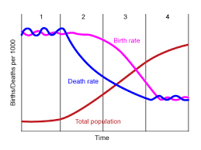
demographics

Slide 4
Demographics
Statistical study of the size, structure, and distribution of human populations and their response to changes in:
Birth (Birth Rates)
Death (Death Rates)
Time
Aging
Migration Patterns
The division and allocation of scarce resources relies on information gathered from demographics as well as rituals, habits, or customs

Slide 5
Demographic transition model
Uses birthrates and death rates to show how populations in countries or regions can change over time.
Originally created to show the changes in birthrates and death rates in Western Europe as an effect of industrialization.
Death rates fall quickly as a result of reliable food supplies, improved health care, and better living conditions.
Birthrates decline slower because social changes like cultural traditions, religious beliefs, etc. need more time.

Slide 6
Population Growth
Global Population has increased dramatically
Negative Effects of Rapid Population Growth May Include:
Famine, Disease, and Depletion of Natural Resources
Positive Effects May Include:
Levels of sophisticated technology, creativity

Slide 7
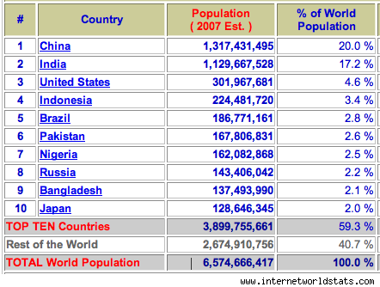
Growth Rates
A country’s total population is affected by:
Birth Rate- the number of live births each year per 1000 people
Death Rate- the number of deaths each year per 1000 people
Immigration- the number of people who move into the country
Emigration- numbers of people who leave the country to live in other places

Slide 8
Zero Population Growth
When the combined Birth Rate & Immigration Rate equal the combination Death & Emigration Rate, a country has achieved “Zero Population Growth”
Usually achieved only in highly industrialized societies
Most developing nations either have very high birth rates or high death rates

Slide 9
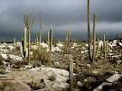
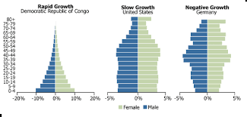
Challenges to growth

Slide 10
Patterns of Population Growth
Population Pyramids- diagrams that show the distribution of a population by age & gender.
Rapid Population Growth- use resources quicker, and the younger population (infants & children) can’t contribute to production of resources
Slow Growth- closest to zero growth goal, but still has issues with higher birth rates and immigration.
Negative Growth- the OLDER population (65+) can’t contribute to production of resources; smallest birth rates

Slide 11
Physical Challenges
Population Distribution- the patterns where people have decided to live across countries or continents
7 billion people on Earth share 30% of land area
Natural obstacles restrict where people can live.
2/3 of Earth is covered by water
½ of all land is unlivable due to:
Deserts- Sahara in Africa, Gobi in China, Death Valley in Nevada
Mountains- Alps in Europe, Himalayas in Nepal, Rockies in US
Uninhabitable Climates- Arctic Tundras, Deserts

Slide 12
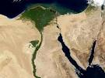
Most people will live in the same types of livable areas.
Specifically, areas where soil is fertile, water plentiful, and in a climate where crops can grow
The simplest way to calculate population density is to divide the total population of a region by the region’s land area
Most prefer to use a regions “arable land”, land used specifically for farming

Slide 13
Human Challenges
Technology improvements, economic activities, and discovery of valuable resources may attract settlers to a new area
They have also led to large increases in population

Slide 14
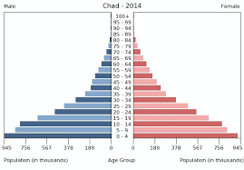
Responses to growth challenges
Different countries have varied reactions to population growth.
Host Population- the amount of people originally from the area
Chad, Africa: Rapid Growth
Relies on agricultural economies, but lack of government investment, frequent wars, and crop pests contributed to rampant hunger and higher death rates

Slide 15
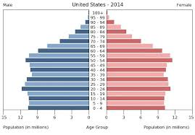
Responses to growth challenges
United States: Slow Growth
Death rates have declined as a result of better medical care, but birth rates and immigration numbers have increased
Economy is maintained by encouraging immigrants to work for lower rates and businesses using foreign labor, which has created issues with host populations.

Slide 16
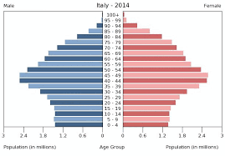
Responses to growth challenges
Italy: Negative Growth
Population is aging to the point where largest age group (45-49) is past child-bearing years and have not contributed to population growth.
Since people live longer, food and money resources are stretched among a larger populace.

Slide 17
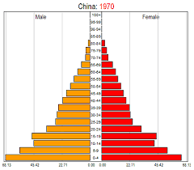
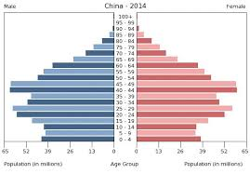
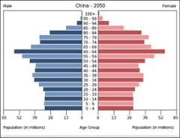
Responses to growth challenges: china

Slide 18
China’s one child policy
After Mao Zedong came to power in 1949, the government encouraged the growth of Chinese population. However, by 1960, the population had doubled and food resources were at all-time low
In 1974, government enacted One Child Policy, limiting Chinese families to only having one baby. People who did not follow the policy were fined for each additional child or subjected to sterilization procedures.
In 2013, families were allowed to apply to have additional children after government realized that by 2050, more than half of Chinese population will be over the age of 50 and unable to contribute to economy.
Due to cultural emphasis on male preference, there is an extreme shortage of girls in China’s population.

