Slide 1
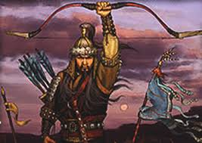
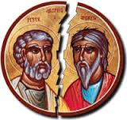
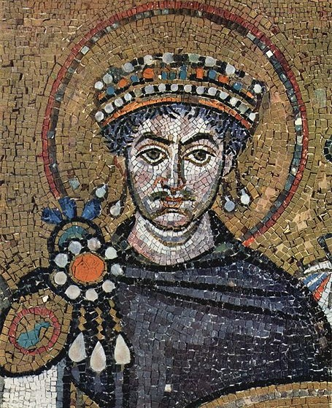
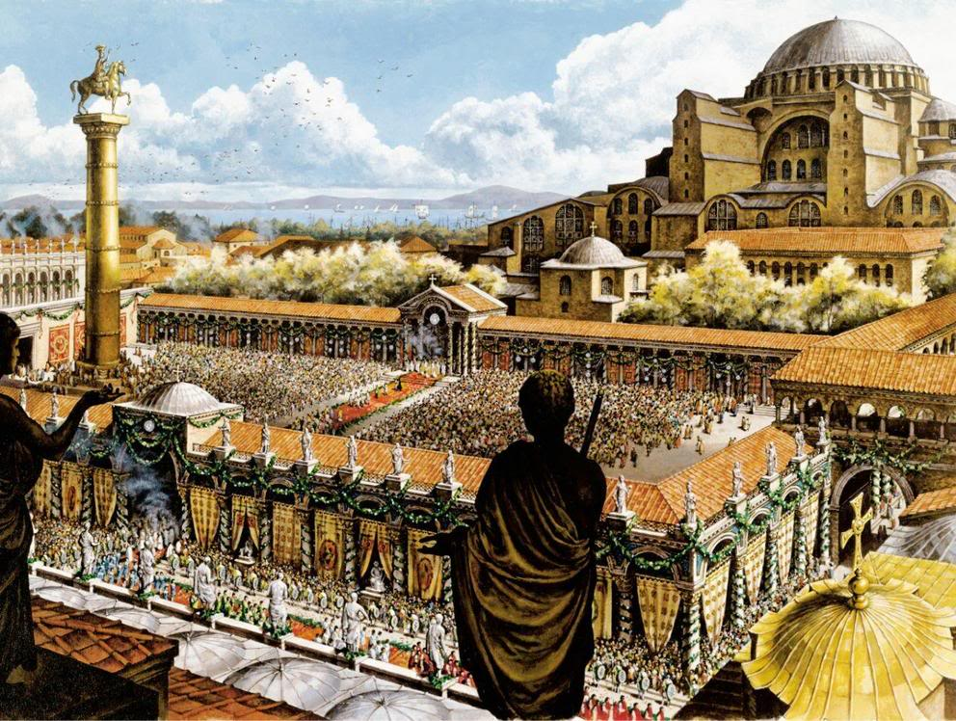
Post-Classical Empires
The Mongols
Byzantine Empire
Islamic Caliphates

Slide 2
Cornell note-taking method
Notes color-coded in RED go on this side of the line.
These items will include:
Main Ideas
Big Concepts
Vocabulary Words
Notes color-coded in BLUE go on this side of the line.
These items will include:
Supporting details
Dates, Times, and Biographic details
Vocabulary Definitions
Any items in BLACK text are optional. Remember: the more thorough your notes, the more prepared you will be for exams.

Slide 3
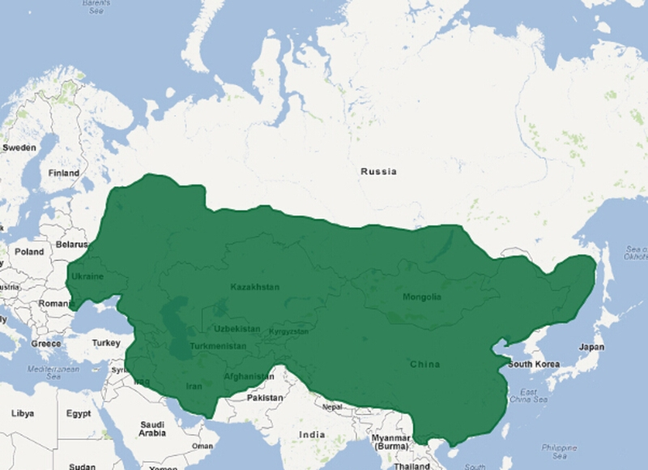
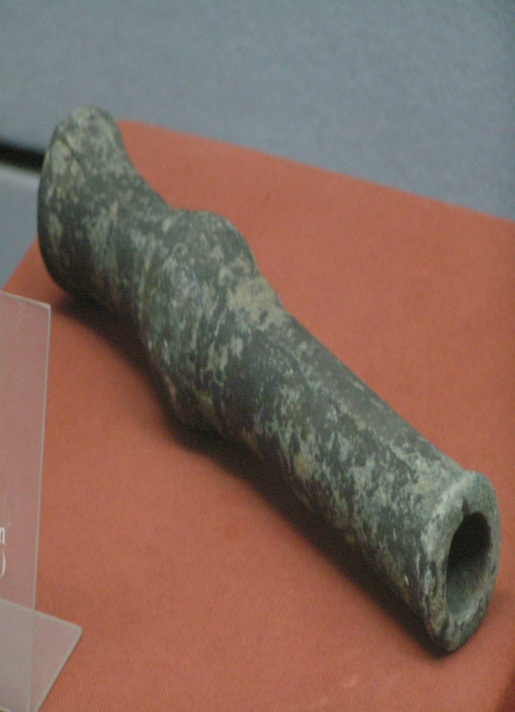
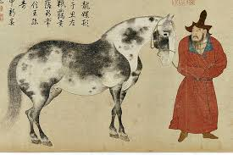
The Mongols

Slide 4
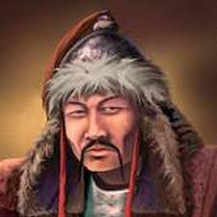
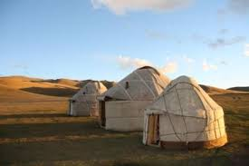
The Mongols
Mongols- skillful herders of sheep, horses, and camels in the Central Asian steppe who conquered majority of China, Russia, and Korean Peninsula
Very aggressive to their enemies
Loosely organized into tribes and clans
Yurts- small, portable tents that served as a Mongol’s home
Ghengis Khan- born “Temujin” in 1162 CE; he becomes clan leader and defeats his rivals to unify all of the Mongols and create a vast empire around 1200 CE
Adopts title Genghis Khan or “universal ruler”

Slide 5
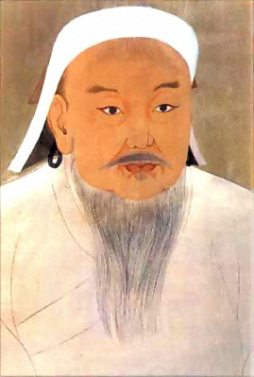
The Mongols: Strategy & Conquests
Strategies:
Used bows, arrows, and swords but also used canons – a new technology
Skilled attacking on horseback
Often faked a retreat to lure enemies into a trap
Genghis Khan created an elite group of 10,000 young warriors from all tribes loyal to him
Based military positions on merit, not your family
They showed no mercy to those who opposed but welcomed all who wanted to join
Conquests:
Attacked China in 1215 and burned 90 cities to the ground
Sacked and burned Samarkand and Bukhara, two great Silk Road cities in central Asia
In 1279, Genghis Kahn’s grandson Kublai Khan conquered China, Tibet, & Vietnam
Founds the Yuan Dynasty in China

Slide 6
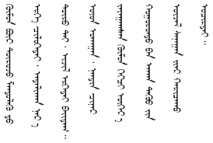
The Mongols: Pax Mongolica
After Mongol conquest, 100 years of peace
Mongols policed the roads and made travel safe & Silk Road trade increased
Harsh punishments for criminals helped to deter crime
Unified parts of China, India, Central Asia, Muslim Middle East, & Russia- transmitting all acquired cultures and technologies.
Forcibly relocated many artisans and merchants to central Asia
Created a written Mongol language
Practiced religious tolerance- spread Buddhism, Islam & Daoism
The Mongol Mail system (later copied in US as Pony Express) unified Asia

Slide 7
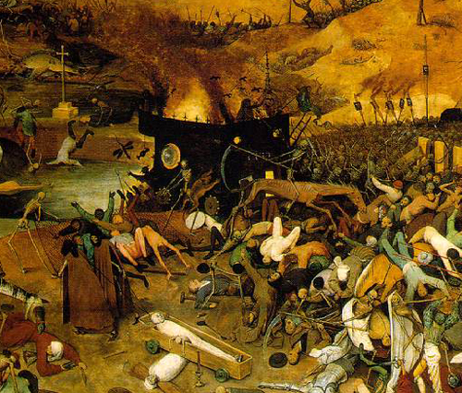
The Mongols: Decline
Khanates- pieces of the Mongol empire, ruled by a distinct Khan or leader
New leaders not as strong as Genghis or Kublai Khan
Resentment against Mongol rule grows in Russia and China
Empire becomes too big and diverse to manage
The Black Death- the Plague began in Asia but decimated Europe in 1347 killing 1/3 of the population

Slide 8
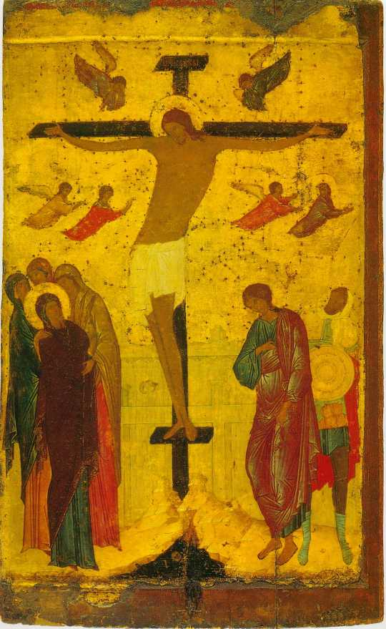
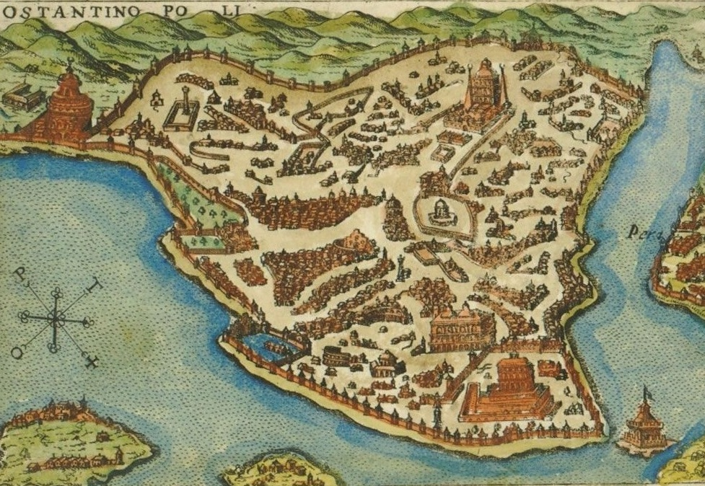
The Byzantine Empire

Slide 9
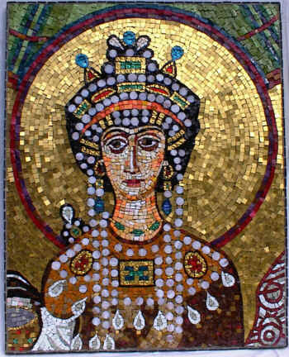
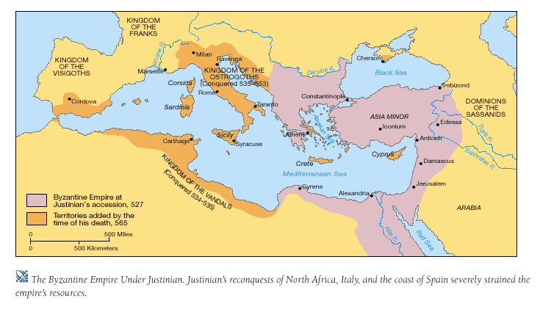
Byzantine Empire: Justinian
Justinian- Byzantine emperor from 527-565, conquered former Roman territories from Germanic tribes, held absolute power over church & state
Theodora- Empress, retained her own power to pass laws and develop women’s rights
Justinian’s Code- body of civil laws & reference guide, huge influence on European law
Divided into 4 parts:
Code: 5,000 Roman laws still useful
Codification of Laws: collected, revised, & organized all of Rome’s laws
Digest: Summaries & opinions from Rome’s greatest thinkers on law
Institute: textbook for law students
Novellae (New Law): legislations made after 534 C.E.

Slide 10
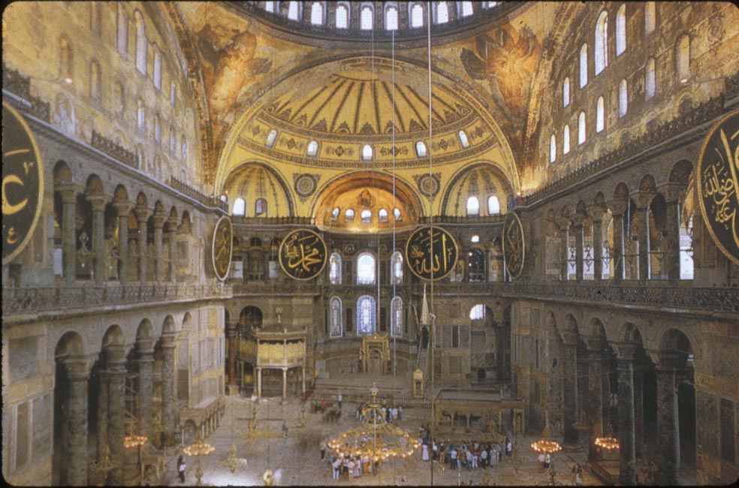
Byzantine empire: Golden Age
Heavily fortified the capitol Constantinople (rebuilt city of Byzantium); capital of Byzantine Empire, excellent geographic location
easily protected (water on 3 sides)
Harbor access to sea routes
Crossroads for overland trade
Government was ruled by series of strong emperors, centralized administration, and large army supported by diverse population
Developed Eastern Orthodoxy
Hagia Sophia- “Holy Wisdom”, built in 537 CE; Eastern Orthodox church that was also a Roman Catholic Cathedral (during Crusades) and later converted to a mosque (until 1931) during the Ottoman Empire.

Slide 11
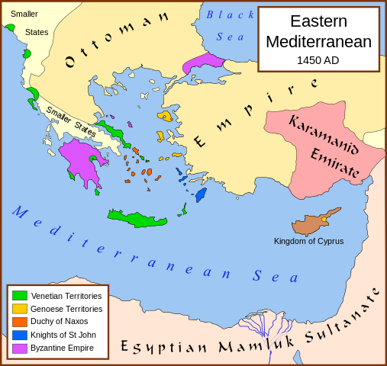
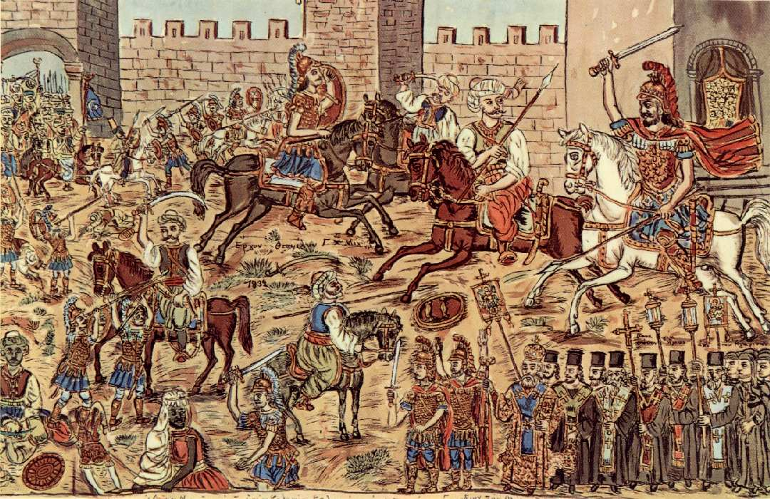
Byzantine Empire: Decline
Constantinople was first sacked during the 4th Crusade in 1204, and was under the control of Roman Catholic Crusaders
Ottoman Empire- Islamic forces led by Sultan Mehmed II conquer pieces of the empire, attack the city in 1453, ending the Byzantine Empire
After 7 weeks, the Ottomans finally take the city
City is renamed Istanbul and changes culturally to a Muslim/Arab city
Greek & Roman traditions preserved:
Greek language
libraries
Justinian’s Code
Scholars and artists fleeing the city help start the Renaissance in Italy

Slide 12
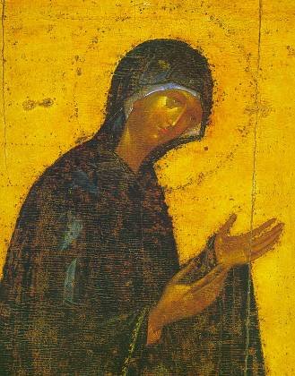
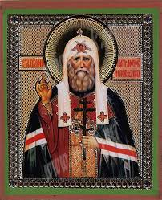
Byzantine Legacy: Eastern Orthodoxy
Byzantines united around their own form of Christianity that was separate from the Catholic Church
The main beliefs are the same, centered around teachings of Jesus of Nazareth
Today, Eastern Orthodox is one of the three main branches of Christianity
Differences of Eastern Orthodoxy:
Patriarchs- “first among equals”, leads Orthodox services, distributes communion, but does not claim rank or authority over other patriarchs
Cross- Orthodox Cross has three horizontal crossbeams; the middle crossbeam represents the Holy Trinity (same as Christian cross)
Top Crossbeam represents the plate INRI
Bottom Crossbeam represents a footrest; the right side slants upward toward where penitent thief St. Dismas was crucified on Jesus’ right, the left slants downward toward Gestas
Language- Services were conducted in Greek, the main language of the Byzantine Empire, or local languages where they were spoken
Icons- Religious images used for devotional prayers, which were thought to connect the believer to the image in the icon

Slide 13
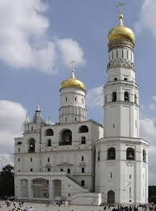
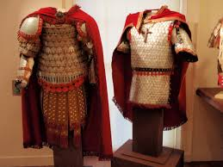
Byzantine legacy: russia
Russia formed as a nation in the early 9th century, and were mainly populated by tribes called Slavs.
Mongols invaded Russia in the 1200’s and ruled until 1480 CE
Ivan III (Ivan the Great) expelled the Mongols from Russian lands during decline of empire
Centralized power helped to expand Russian nation
Developed trade with Byzantines
Russian life and culture was heavily influenced by the Byzantine Empire, including:
Converting Slavic and Bulgar tribes to Christianity
Adoption of the Eastern Orthodox Church
Production of icons, tapestries, and artwork
Writing the Cyrillic alphabet

Slide 14
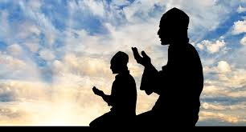
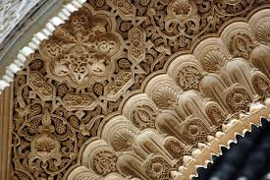
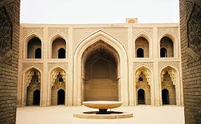
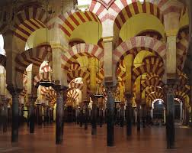
Islamic Caliphates
Islam
Sunni & Shia
Spread of Islam

Slide 15
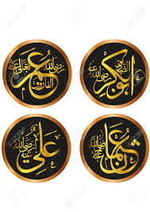
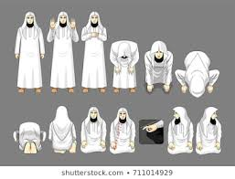
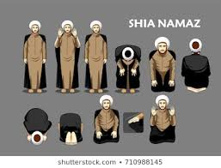
Islamic Caliphates: The Spread of Islam
Islam, founded by Mohammed around 610 CE, promoted the belief in a single, all-powerful deity named Allah
Same monotheistic God as Judaism & Christianity
Mohammed is seen as prophet, like Abraham, Moses & Jesus
Arabian Peninsula united with a common language, religion, and purpose.
Jihad- “holy war”, Muslims initiate conquests of neighboring lands to create a vast empire from Spain to India
After Mohammed’s death, disagreements over the next caliph (the religious and political successor to Mohammed) leads to a split between two major factions:
Sunni- believed that the next caliph should be politically strong, founders of the Umayyad Caliphate
Shi’ite (Shi’a)- believed caliph should be one of Mohammed’s descendants, from his daughter Fatima

Slide 16
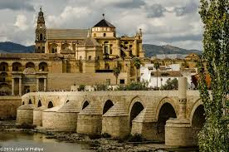
Islamic Caliphates: The Umayyads
Before the Umayyads, Islamic rule was non-centralized; mostly kept existing governments and administrations intact in order to collect taxes.
The military was organized, had a strong army, and built garrisons
Did not build sophisticated administrations, which was needed to sustain a massive empire
Not dynastic; political leadership was not transferred through hereditary lineage
Umayyads developed a dynastic and centralized Islamic political state modeled by the Byzantines and other neighboring groups
Shifted the capital from Mecca to Damascus (in Syria)
Replaced tribal traditions with an imperial government controlled by a monarch
They replaced Greek and Persian languages with Arabic as the main administrative language and reinforced an Arab Islamic identity.
Minted Islamic coins
Viziers- governors who oversaw smaller political units
Distinct Arab hierarchy emerged in which non-Arabs were accorded secondary status.
Did not actively encourage conversion, and most subjects remained non-Muslim.
Non-Muslim subjects were required to pay a special tax, allowing caliphate to afford their political expansion

Slide 17
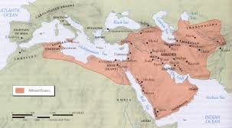
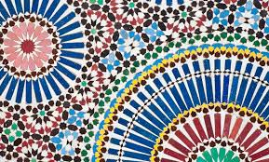
Islamic Caliphates: The Abbasids
Abbasids- removed the Umayyads from power after a violent revolt in 750 CE; claimed legitimacy through shared lineage from Mohammed’s uncle, Abbas.
The Abbasids were intent on differentiating themselves from their Umayyad predecessors, though they still had a lot in common.
Leadership was also dynastic and centralized.
Constructed a more inclusive government located in a new capital city, Baghdad.
The distinction between Arab Muslims and non-Arab Muslims diminished
Abbasid court preferred Persian culture and influence
Islamic Golden Age- from 800-1250 CE, time period where Islamic art and culture flourished. As a result, Islamic culture spread over the Abbasids’ vast territory.
Religious scholars, called ulema, defined religious institutions, took on judicial duties, and developed systems of law.
Arab mathematicians used the Indian concept of zero to develop algebra
Mohammed forbade making pictures of God, himself, or people, so Islamic art centers around geometric designs, flowers, and stars
House of Wisdom- public academy, intellectual center, and large collection of literary works in Baghdad

Slide 18
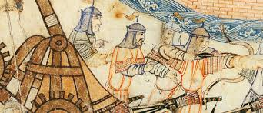
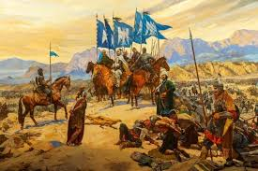
Islamic Caliphates: Decline
The Islamic Caliphates were very prosperous, and their vast wealth attracted foreign invaders
During the 13th century, the Mongols conquered most of the Eurasian land mass, including China, the Kievan Rus (Russia) and much of the Islamic caliphate in the west.
The destruction of Baghdad and the House of Wisdom by Hulagu Khan in 1258 is considered by some as the end of the Islamic Golden Age.
Baghdad was captured by a Mongol khanate, called the Seljuqs, that will eventually evolve into the Seljuk Turks, an ethnic Turkish tribe from central Asia
Although they are the conquering tribe, Turks will convert to Islam after the capture of Baghdad
Keeps Baghdad as the capitol of their new Ottoman Empire; they will conquer remainder of Middle East & Egypt by 1516, retaining control until end of WWI in 1918.

Slide 19
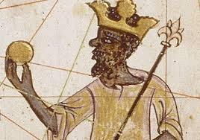
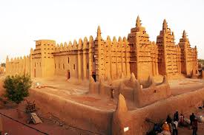
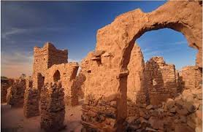
Kingdoms of africa

Slide 20
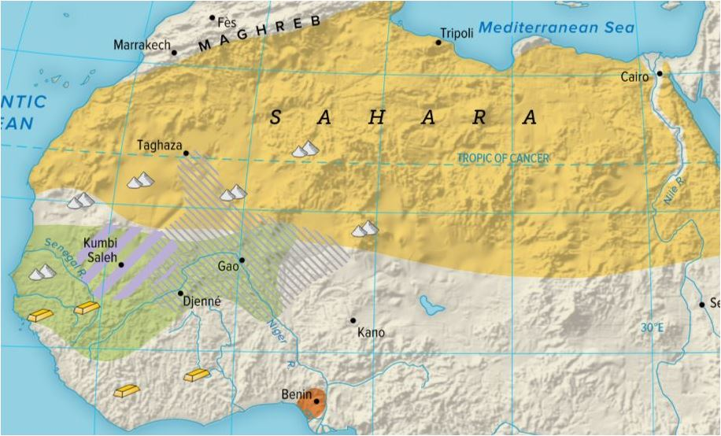
West African Kingdoms
Anthropologists believe that all humans originated in Africa and dispersed over time
Sahara Desert occupies much of north Africa, acted as a barrier between Sub-Saharan tribes and rest of developing world
Trade across Sahara continues after mapping the location of underground aquifers, called oasis
Camels are used for transportation, numerous camels traveling together are called caravans
Merchants are VERY invested in trade with West Africa due to large amounts of riches in their possession- especially GOLD
Africa Gold-Salt Trade- African kingdoms own many gold mines, but do not have access to salt, which is vital for human survival
Control over gold mines, trade routes, and calvaries will lead to the rise of powerful kingdoms in West Africa

Slide 21
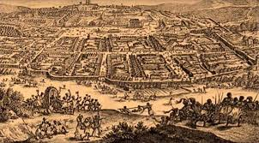
Kingdom of Ghana
Ghana- lasted c. 750-1200, located between Senegal and Niger rivers, known for:
Iron weapon production (swords, spears, lances, etc.)
Taxed all trade passing through, used revenue to train large cavalry
Built a capitol city, governed large territory through officials and noble class, and used war captives as slaves
In 1076, Ghana was invaded by N. African Muslims and converted to Islam.
Kingdom will collapse and dissolve into smaller states

Slide 22
Kingdoms of Mali & Songhai
Mali- c. 1240-1400, conquered former capital city of Ghanian kingdom and took control of gold-salt trades
Mansa Musa- expanded kingdom after displaying his wealth on a pilgrimage to Mecca attracted scholars and architects
Timbuktu- trade center on Niger River, built many universities and theological centers to study Quran
Empire collapses after weaker rulers have troubling managing vast territories
Songhai- 1464-1600 CE, became the largest of Africa’s trading kingdoms; profited from trade across the Sahara, established communication and taxation systems
Timbuktu continues to flourish under Songhai rule
Morocco (North of Sahara) invades in 1591 using muskets and gunpowder, quickly taking over the Songhai.
They are unable to govern over long distance, and the empire will break up into smaller pieces, ending the reign of West African kingdoms

