Slide 1
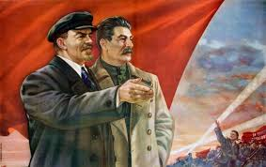
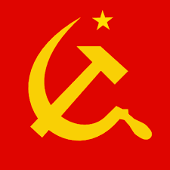
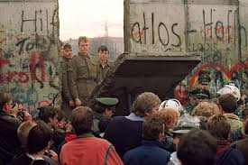
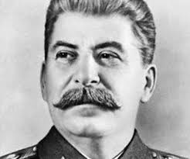
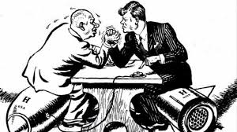
Power & Leadership
Economic Systems
Problems with Communism
Why do Civilizations Fall?

Slide 2
So far in lord of the flies…
Tensions are rising between Ralph & Jack
Clear divisions and factions between the two leaders are forming
Jack has become obsessed with killing a pig; he and his followers cover themselves with war paint and begin chanting
The signal fire is neglected, ruining their chance for escape when a ship passes by and can’t see them
The other boys interactions with each other are less civil and becoming more cruel and savage
A battle occurs overnight, still missed by the boys, who are neglecting their duties

Slide 3
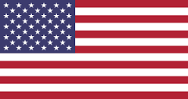
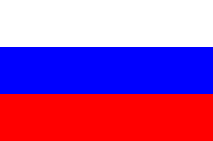
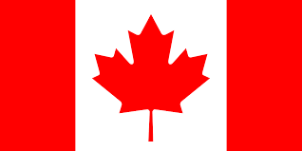
Economic systems
Capitalism- business owners and producers have the power to control prices with little government intervention
Ex: United States
Communism- government has total control over prices and production
Ex: Russia (former Soviet Union)
Socialism- government and private corporations have control over different aspects of economy
Ex: Canada

Slide 4
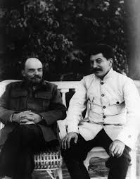
Problems with communism
Brutality of Josef Stalin- in late 1920s, launched a series of five-year plans intended to transform the Soviet Union from a peasant society into an industrial superpower.
Groomed to be Lenin’s heir, though even he was unsure of Stalin’s self-control
Centered on government control of the economy and forced collectivization of Soviet agriculture, in which the government took control of farms.
Stalin ruled by terror and with a totalitarian grip in order to eliminate anyone who might oppose him.
expanded the powers of the secret police
encouraged citizens to spy on one another
had millions of people killed or sent to forced labor camps.

Slide 5
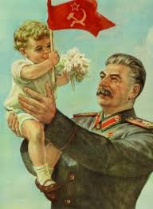
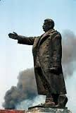
Problems with communism
Cult of Personality-when an individual uses mass media, propaganda, etc. to create an idealized and heroic version of themselves for their citizens to worship.
Terrorist organizations and religious extremist groups have all crafted cults of personality
Examples of Stalin’s Cult of Personality:
Cities were renamed in his honor.
Soviet history books were rewritten to give him a more prominent role in the revolution and mythologize other aspects of his life.
He was the subject of flattering artwork, literature and music, and his name became part of the Soviet national anthem.
His government also controlled the Soviet media

Slide 6
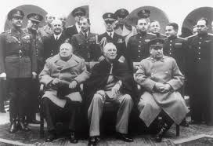
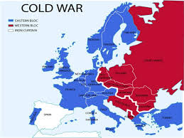
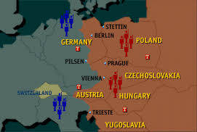
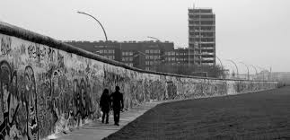
cold war
The Cold War (1945-1991)- long period of tension between USA & Allies (the West, democracies & capitalism) and Soviet Union (East, communist nations).
There was great distrust between the Soviet Union and the rest of the Allies after WWII. The Allies were concerned with the brutal leadership of Joseph Stalin as well as the spread of communism.
USSR- Union of Soviet Socialist Republics
Iron Curtain- boundary cutting off contact between Communist countries and the rest of Europe (capitalist)
Berlin Wall- portion of iron curtain that divided communist Germany from Capitalist Germany at the end of WWII
“Red Scare”- periods of extreme anti-communism in the United States, where many people were scared of communism spreading.

Slide 7
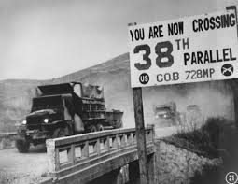
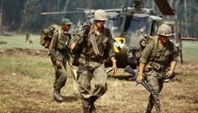
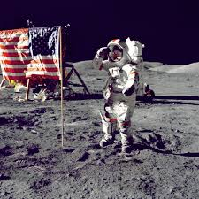
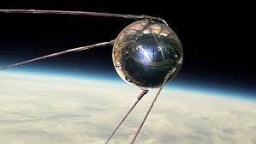
Cold War
Although they never officially declared war on each other, they fought indirectly through various means
Proxy wars- both sides supported other nations at war by providing financial and military support (soldiers & weapons)
Korean War
Vietnam War
Soviet-Afghanistan War
Arms Race- each side tried to have the best weapons and the most nuclear bombs; the idea was that a large stockpile of weapons would deter the other side from ever attacking
Cuban Missile Crisis
Space Race- each side tried to show who had better scientists and technology by accomplishing certain space missions first. Soviets launch 1st rocket and manned flight, US gets 1st man on the moon
During 1970s, Soviet Union and Communists fall behind in development, fall short in food production, and suffer from trade embargo & economic sanctions

Slide 8
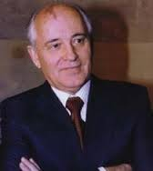
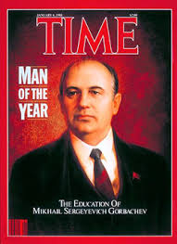
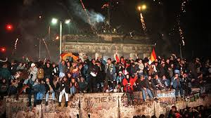
Fall of Communism
Mikhail Gorbachev- led Soviet Union through end of Cold War, fall of Communism, and served as first President of Russia
Glasnost- Gorbachev’s efforts to reform judicial system and social welfare in 1980s Soviet Union
Decrease in Censorship
Public Trials
Government transparency and free speech
Perestroika- restructuring of government and economic systems during Gorbachev’s leadership
Berlin Wall falls on November 1, 1989; Soviet Union officially falls in 1991, ending the Cold War

Slide 9
Why do civilizations fall?

