Slide 1
Propaganda of World War I

Slide 2
Propaganda #1

Slide 3
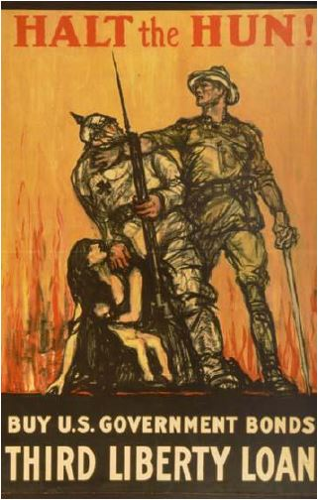
Propaganda #2

Slide 4
Propaganda #3

Slide 5
Propaganda #4

Slide 6
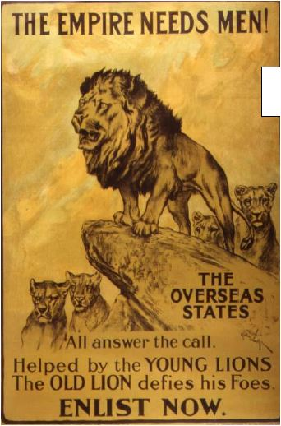
Propaganda #5

Slide 7
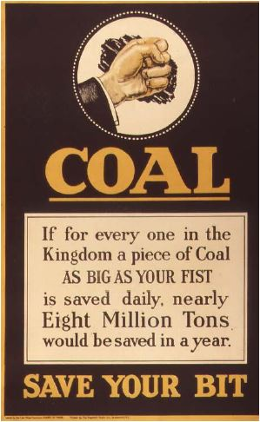
Propaganda #6

Slide 8
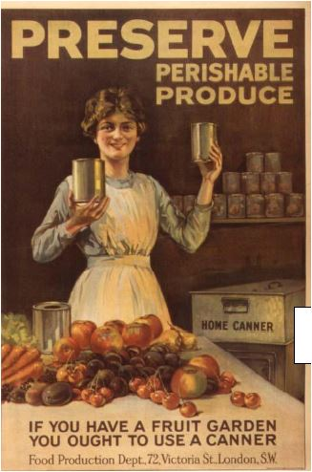
Propaganda #7

Slide 9
Propaganda #8

Slide 10
Propaganda #9

Slide 11
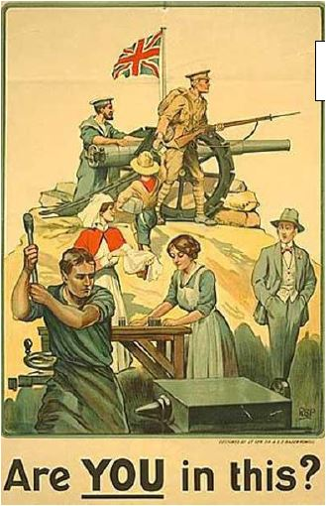
Propaganda #10

Slide 12
Propaganda #11

Slide 13
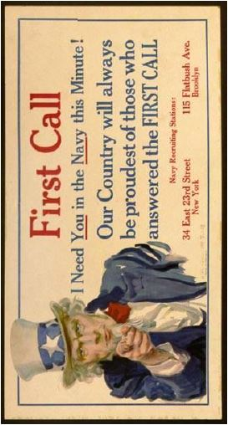
Propaganda #12

Slide 14
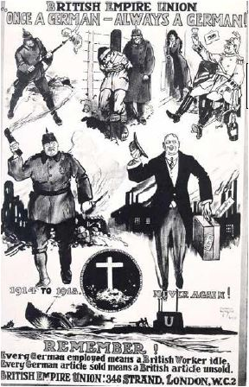
Propaganda #13

Slide 15
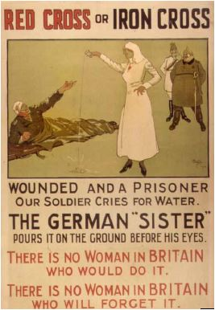
Propaganda #14

Slide 16
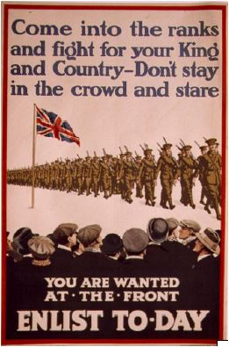
Propaganda #15

