Slide 1
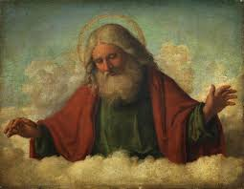
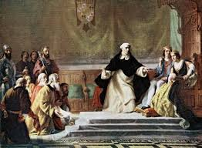
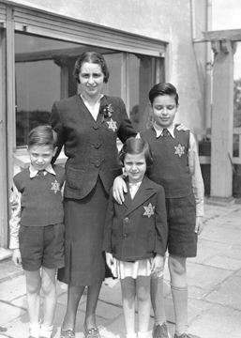
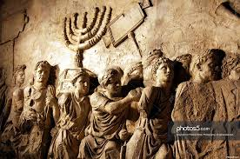
Religious Conflicts
Spanish Inquisition
The Holocaust
Two Claims to Palestine

Slide 2
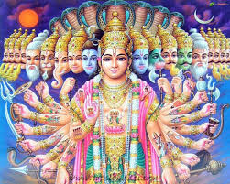
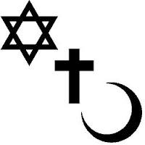
Monotheism & polytheism
Polytheism- The belief in multiple gods or goddesses; may have a Supreme deity and lesser deities that followers pray to or worship, or ghost-like forces or bad spirits may have equal or lesser status in prayers.
Hinduism & Buddhism
Monotheism- The belief in a single all-powerful deity, or god-like being; differs from earlier historical beliefs that hundreds of different gods were responsible for different tasks
Judaism, Christianity, Islam are monotheistic faiths that follow God of Abraham
Sikhism is monotheistic with elements of Hinduism

Slide 3
Jewish Diaspora
Abraham -formed a covenant (contract) with God in exchange for being led to the Promised Land (Canaan, Palestine, Israel)
1st to establish belief in single deity
Three monotheistic faiths have religious and political ties to Israel, specifically Jerusalem:
Christianity: where Jesus was crucified and resurrected
Judaism: Zion, God’s own city, site of Solomon’s temple
Islam: 3rd holiest city, where Muhammad ascended to heaven
Diaspora- after refusing to worship Roman emperor as a Divine being in 65 CE, the Romans drove the Jews out of Israel (Palestine).
Jewish people or communities who live outside of Israel, even if they have never been there, are referred to as living “in exile”
One objective of Judaism is the relationship with Israel and the need to protect it

Slide 4
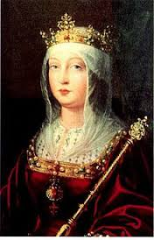
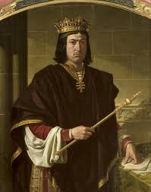
Spanish inquisition
Isabella & Ferdinand- (ruled from 1478-1504) royals whose marriage united Iberian kingdoms under one country, Spain.
Parents of future 1st wife of Henry VIII, Catherine of Aragon
Spanish Inquisition- court tribunals established to identify heretics in Spain; used brutal methods of torture to elicit confessions and promises to convert
Muslims and Jews living in Spain were forced to convert to Catholicism, creating a large converso population treated as second-class citizens
Reasons for authorizing Spanish Inquisition:
Desire to create religious unity
Need to weaken family alliances and local authority that challenge power of new joint monarchy
Confiscating lands of wealthy Jews and Muslims creates income revenue to fight end of Reconquista
Inquisitions outlawed in 1821

Slide 5
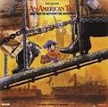
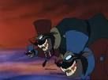
Russian Pogroms
Pogroms- Russian meaning “to demolish violently”; refers to violent attacks approved by the government, committed by local populations against Jews
Anti-Jewish riots in Odessa in 1821
1881-1884 C.E.
May Laws- restricted where Jews could settle, forbade non-Jews from issuing mortgages to Jews and prohibited Jews from conducting business on Sundays
Russian government systematically expelled the Jews from Moscow from 1891–92
Mass Jewish emigrations began from Russia to the United States and other countries.

Slide 6
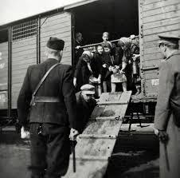
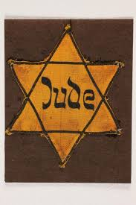
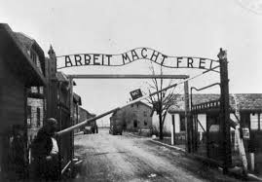
The Holocaust

Slide 7
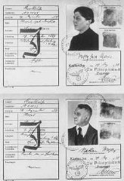
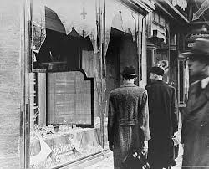
Jewish Persecution
Hitler wanted to create a “master race” where Aryan people would be considered a pure race and superior to other people
Anti-Semitism or prejudice against Jews had been around for centuries
Nuremberg Laws- Passed in 1935, stated anyone with any Jewish blood would be considered a Jew
Further restrictions were placed and persecution of the Jews increased
Kristallnacht -“Night of Broken Glass” took place November 1938; Jewish stores, houses, and synagogues were systematically destroyed
Marks the beginning of widespread government-led violence against Jews

Slide 8
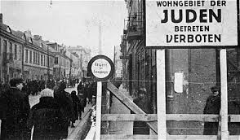
Jewish Persecution
Jewish Registries were created where all people with Jewish ancestry had to register with the government
Jews had to wear the Star of David badge everywhere the went
Forced to live in isolated ghettos
Ghetto- part of a city where a minority group (historically, Jewish groups) is forced to live due to social, economic, or legal administration.
Interaction with other minorities or races is not allowed.

Slide 9
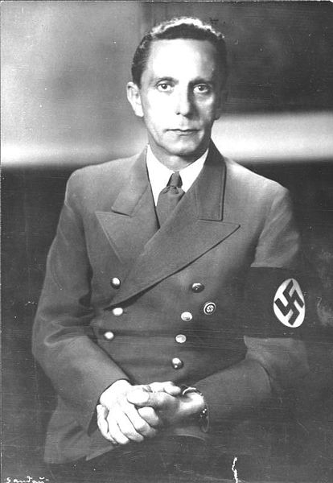
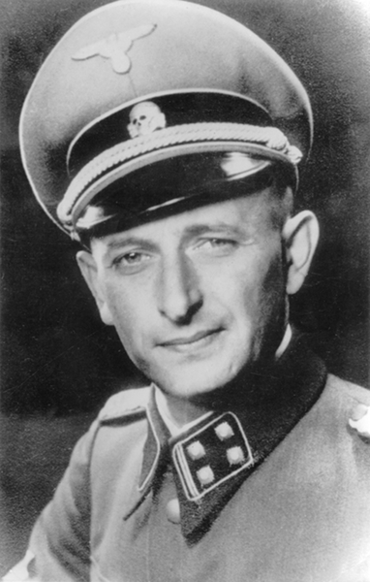
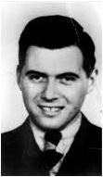
Final Solution
Plan developed in 1942 to eliminate all Jews from Europe; they were taken to concentration camps, where they were used for hard labor or killed
Dr. Joseph Goebbels- head of the Nazi Propaganda Ministry, controlled all communications, encouraged book burning to eliminate other ideas
Heinrich Himmler- leader of the SS, the Nazi’s secret police; formed death squads known as the Einsatzgruppen
Adolf Eichmann- helped organize the Holocaust, in charge of transporting Jews from ghettos to concentration camps
Dr. Josef Mengele- carried out experiments on Jewish people at Auschwitz

Slide 10
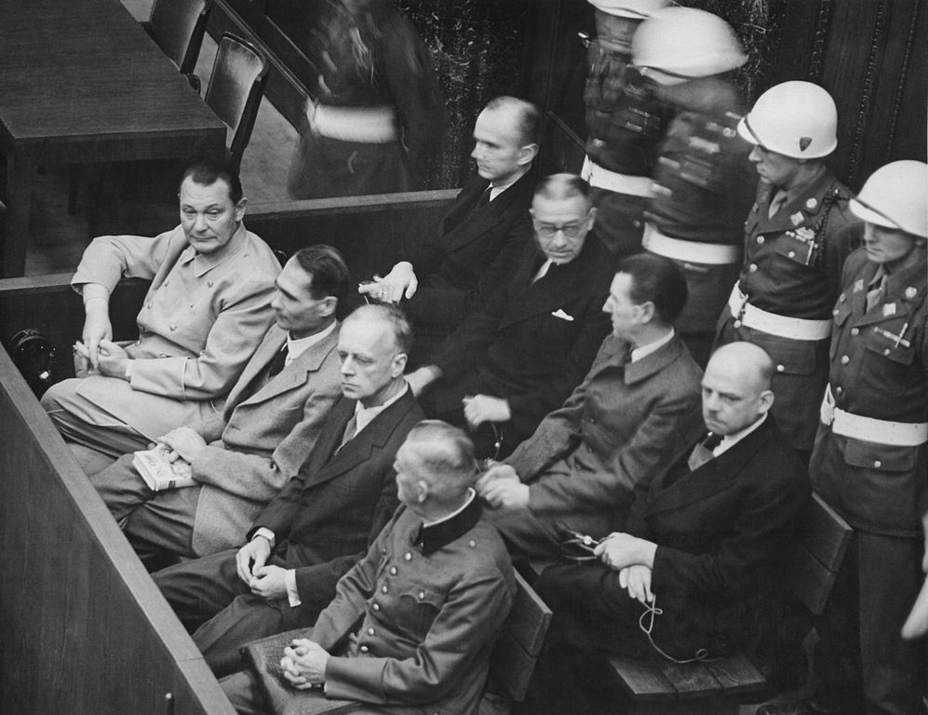
Liberation of the Jews
Allied forces reach camps starting in summer 1944; Soviet forces liberate Auschwitz and camps in Poland and Eastern Germany
American forces liberate Buchenwald and camps in the west
Nuremberg Trials- 22 major Nazi criminals were tried for their crimes in Nuremberg; most claimed to be “just following orders”,12 were sentenced to death
As the war ended, many top Nazis committed suicide while others escaped to South America where they hid for years

Slide 11
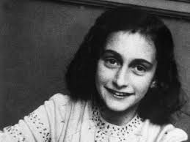
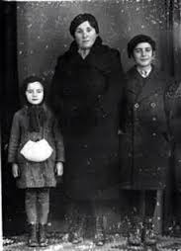
Liberation of the Jews
Genocide- the deliberate killing of a large group of people, especially those of a particular race or ethnic group
6 Million Jews, 1.5 Million Romani (Gypsies), 270,000 disabled or mentally ill, and 10 million of various Slav ethnic groups from Europe were killed over the course of the Holocaust
Other genocides in history:
Cambodian Genocide (Khmer Rouge)- 3 Million Cambodian Minorities (Chinese, Korean, Vietnamese) were executed in the “Killing Fields”, locations of mass graves from 1975-1979
Rwandan Genocide (Hutu vs. Tutsi)- 1 million Tutsi, 1994
Bosnian Genocide- 8373 ethnic Bosnians, 1992-1995

Slide 12
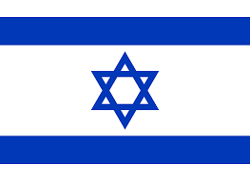
Arab- Israeli Conflict

Slide 13
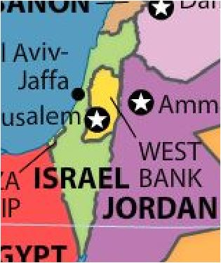
Two claims to Palestine
Palestine- considered the ethnic and historical homeland of the descendants of Abraham, the first prophet in Judaism & Islam
Palestinian Arabs- Muslim descent; prior to WWI, led the Ottoman Empire that controlled Palestine
Israelis- Jewish descent; began immigrating to Palestine as part of the Zionist movement.
Zionism- movement for the re-establishment, development, and protection of a Jewish state in Israel (the modern-day location of the “The Promised Land”)

Slide 14
Two claims to Palestine
1947- United Nations splits Palestine into a two-state nation called Israel.
Palestinians attack Israelis and begin a war to reclaim lost territory, Israel campaigns to take over whole nation
Gaza Strip- valuable because of its coastal location, under Palestinian control
West Bank- location of Jerusalem and major Holy Sites for Judaism, Islam, and Christianity

Slide 15
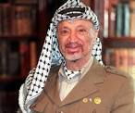
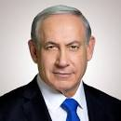
Two claims to Palestine
Oslo Accords in 1993 set current policy of land ownership in place, but is deeply unpopular with both Palestinians and Israelis.
Violence in the area is almost continual
Golda Meir- 1st female Prime Minister of Israel, sanctioned Mossad actions against Palestinian terrorists in response to Munich Olympics massacre
Yasser Arafat- President of Palestinian Liberation Organization from 1969-2004, committed acts of violence to protest Israeli settlement in the Gaza Strip
Benjamin Netanyahu- current Prime Minister of Israel, promoted Israeli re-settlement of Gaza Strip after previous administrations condemned it

