Slide 1
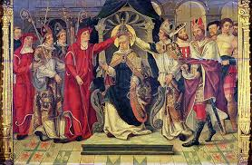
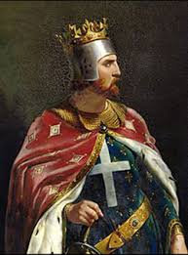
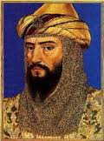
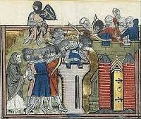
The Age of Faith
Western Europe
Japan

Slide 2
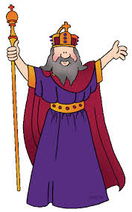
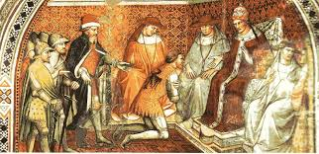
The Age of Faith: Influence of The Church
Secular (non-religious) authority declines while Church authority grew
Monasteries preserved Greco-Roman culture & achievements.
Missionaries are used to teach Latin alphabet to Germanic tribes and convert them to Christianity
Parish priests serve religious & social needs of the people.
Pope- leader of the Roman Catholic Church, oversees the spread of Christianity and interpretation of Church doctrine, is considered an important diplomat.
Powers usually were used to interfere or intervene in government matters; most often used to punish kings and nobles who ignored Church customs and mandates
Excommunication- officially excluding someone from sacraments and services of the Church
Interdict- prohibits active members from participating in sacraments

Slide 3
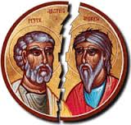
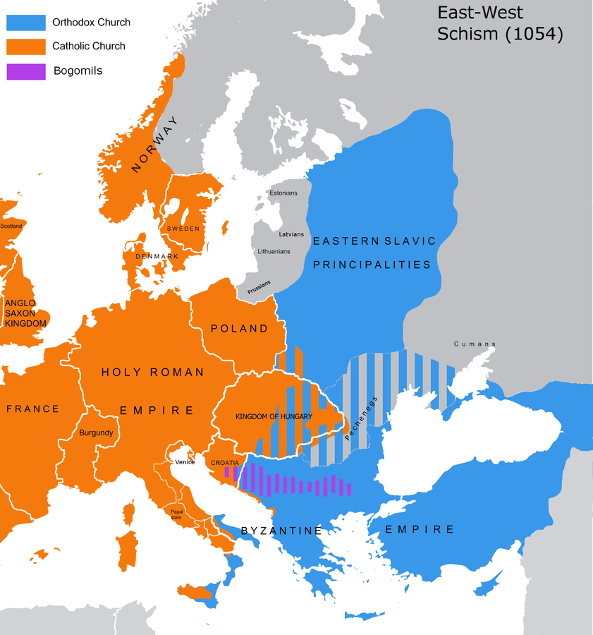
The Age of Faith: Great Schism of 1054
The Great Schism- permanent split that occurred in 1054, forms 2 out of 3 branches of Christianity
Eastern Orthodox Church- Greece, Russia, and surrounding areas
Roman Catholic Church- All areas west of Rome
Church leadership- Popes vs. Patriarchs, Government vs. Church Law, Power of the Bishops
East: Government has higher authority over Church, Patriarchs and Bishops lead the Church together
West: Popes have power over government, Pope is highest ranking official in church
Capitol city location: Rome vs. Constantinople, expansion of Islam into Europe
Priest’s Lifestyles:
East- Priests can marry and raise families, divorce is allowed under certain conditions
West- Priests can’t marry, divorce is not allowed
Christianity
Roman Catholic
Roman Catholic
Protestant
Eastern Orthodox

Slide 4
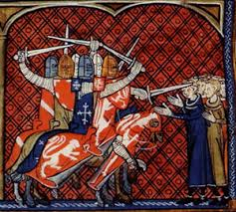
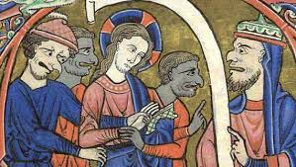
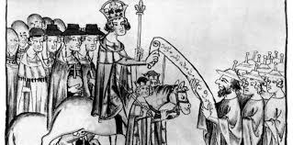
The Age of Faith: Anti-Semitism
Anti-Semitism- hostile behavior exhibited toward Jews just because they are Jewish. May take any of the following forms:
religious teachings that proclaim the inferiority of Jews
political efforts to isolate, oppress, or otherwise injure them
prejudiced or stereotyped views about Jews
Hostility toward Jews dates to ancient times, as they were criticized and punished for their efforts to remain a separate social and religious group.
The rise of Christianity increased hatred of Jews. Church clergy promoted false theories as facts, including:
all Jews were responsible for the crucifixion of Jesus of Nazareth
The Diaspora (scattering of the Jewish people from Canaan) was punishment for continued failure to abandon their faith and accept Christianity
However, converting to Catholicism was also perceived as insincere and as having materialistic motives
Faith was perceived as the principal form of self-identity and intensely influenced both public and private life, Jews found themselves increasingly isolated as outsiders to society.
As outsiders, Jews were objects of stereotyping and subject to acts of violence
Were often scapegoats for natural catastrophes; e.g. many people believed that Jews brought on the "Black Death" though historians have now traced the origins of the disease to pests brought along the Silk Road

Slide 5
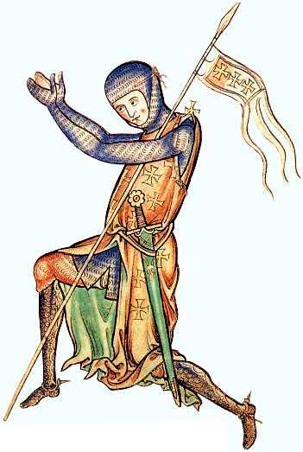
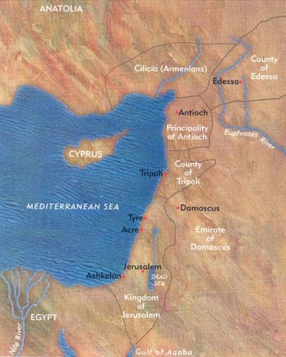
The Age of Faith: The Crusades
Crusades- numerous military expeditions to liberate Jerusalem from Muslim control and spread Christianity; took place between 1095-1291 CE.
From Latin “crux” (cross)
Crusaders “take up the cross” to recover Holy Land from Muslims
Most Western European men left their homes to fight the Crusades, for a variety of reasons:
Knights: would be able to use their fighting skills, fulfill a need for adventure
Possible wealth or instant salvation (guaranteed entry to Heaven) if killed
Peasants: earned their freedom from feudal bonds

Slide 6
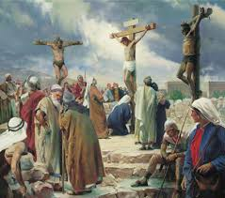
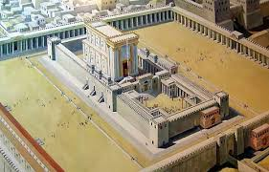
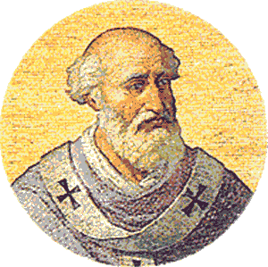
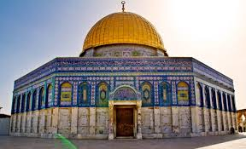
The Age of Faith: The Crusades
Over time, Jerusalem became an important city to followers of all three monotheistic faiths:
Christians: where Jesus was crucified and resurrected
Jews: Zion, God’s own city, site of Solomon’s temple
Muslims: 3rd holiest city, where Muhammad ascended to heaven
Pope called for men to “defend the Holy Land” and recapture it from Muslim control. Reasons include:
Increase power in Europe
Heal split between Roman Catholic and Byzantine/ Greek Orthodox Church
Saw land in the Middle East as a good place for Europe’s growing population

Slide 7
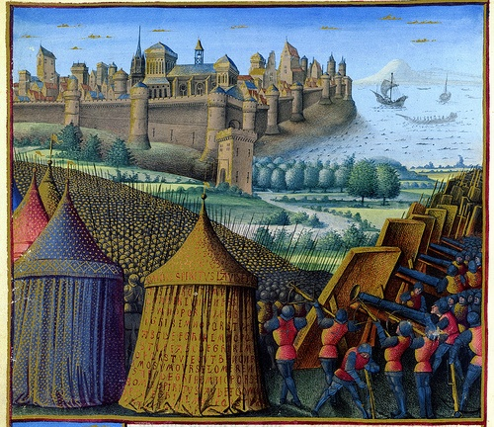
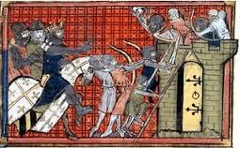
The Age of Faith: the Crusades
The First Crusade: 1096 – 1099 CE
Four groups of crusaders meet from various parts of Europe in Constantinople to establish a game plan to take Antioch and Jerusalem
Killed Jews and Muslims on the way to capturing Jerusalem, eroding delicate relationship between Jews and Christians
Crusaders capture Jerusalem in 1099
Despite promises for citizen’s safety, Crusaders killed many men, women, and children upon their entrance to Jerusalem
Some crusaders stay and create the nation of Palestine

Slide 8
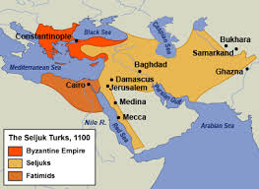
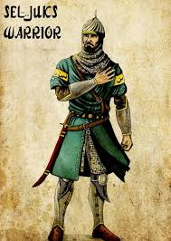
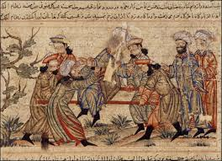
The Age of Faith: The Crusades
Second Crusade:1147 – 1149 CE
Muslim armies declare a jihad, or holy war, to reclaim territories lost during the First Crusades
Seljuk Turks- Sunni Muslims in Turkey who expanded their armies in Damascus (present-day Syria) and capture established Crusader states in Palestine
Crusaders are defeated and fail to recover lands

Slide 9
The Age of Faith: the Crusades
Third Crusade: 1189 – 1192 CE; Pope Gregory issued call to defend Jerusalem after its capture by Saladin and his forces in 1187 CE
Richard the Lionheart- Richard I, son of Henry II, King of England from 1189-1199 CE. Immensely popular in England, became known as a warrior king due to his personal courage, many victories, and almost constant fighting in various wars and battles throughout his reign
Re-established Christian control of surrounding areas of Jerusalem, but did not actually attack the city
Only one major battle is fought, the two generals never meet
Saladin – Sultan of Egypt & Syria (1174-1193 CE) general of Muslim troops, eventual founder of Ubayyid dynasty; known for military genius, justice, and diplomacy to consolidate Muslim kingdoms under his rule
Saladin’s truce – he keeps Jerusalem but will allow pilgrims access to Holy Sites

Slide 10
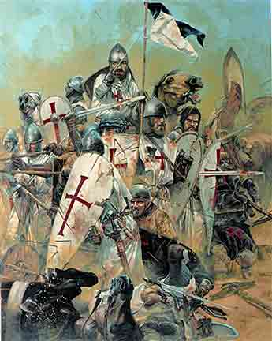
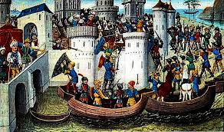
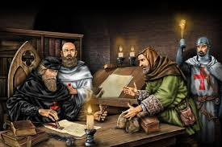
The Age of Faith: The Crusades
Fourth Crusade & All the Rest: 1204 CE; called by Pope Innocent III to rescue Jerusalem from Muslim control
Crusaders decide not to go to Jerusalem
Constantinople- Crusaders attack city instead after a political coup ends with the death of Christian-sympathetic emperor
Constantinople is raided for riches, relics, and religious artworks
Fourth Crusade becomes known mostly for profiteering than religious dominance
Battles between European nations over territory, especially between England and France, take precedent over religious wars, and Crusaders became pre-occupied with general intolerance of other faiths

