Slide 1
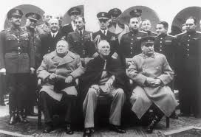
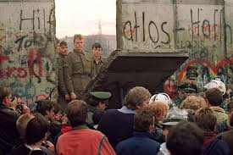
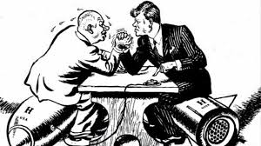
The Cold War
Building the Iron Curtain
“Race” to Win
Fall of Communism

Slide 2
Cornell note-taking method
Notes color-coded in RED go on this side of the line.
These items will include:
Main Ideas
Big Concepts
Vocabulary Words
Notes color-coded in BLUE go on this side of the line.
These items will include:
Supporting details
Dates, Times, and Biographic details
Vocabulary Definitions
Any items in BLACK text are optional. Remember: the more thorough your notes, the more prepared you will be for exams.

Slide 3
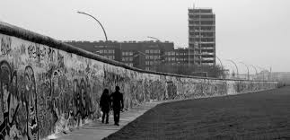
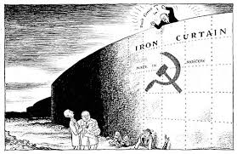
Building the Iron Curtain
Problems with Communism
Division of Germany

Slide 4
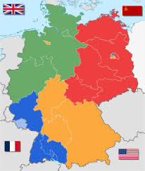
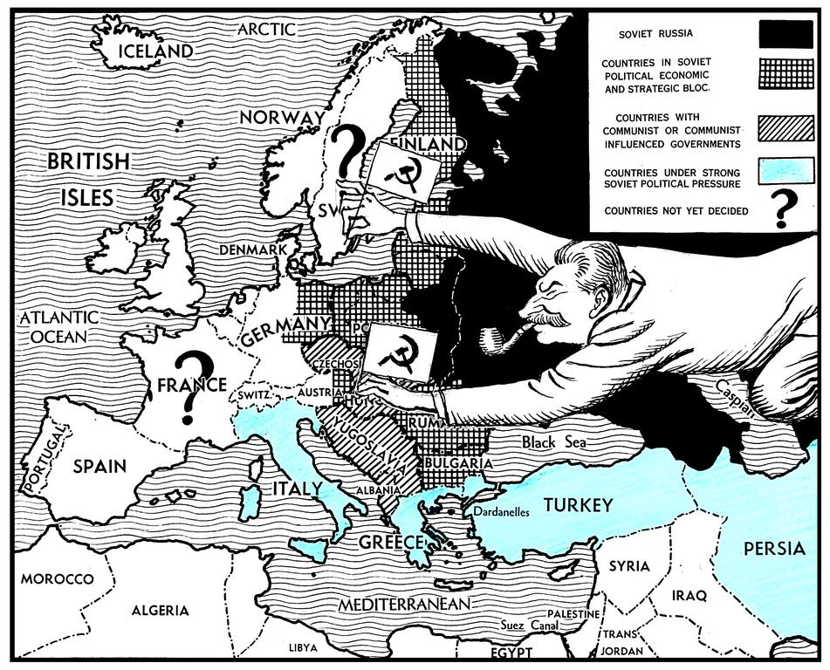
Yalta Conference
The Cold War (1945-1991)- long period of tension between USA & Allies (the West, democracies & capitalism) and Soviet Union (East, communist nations).
Yalta Conference- meeting to discuss Germany’s unconditional surrender in February 1945 between leaders of the Allied Powers of WWII, including:
Winston Churchill, Prime Minister of UK
Joseph Stalin, premier of Soviet Union
Franklin D. Roosevelt, U.S. President
Agreed to set up four occupation zones to be run by their countries plus France.
Occupation Zone- local populations and state/local governments follow policies carried out by a government that is temporarily in charge of the area
Stalin agreed to permit free elections in Eastern Europe
Scheduled meeting for April in San Francisco to create United Nations

Slide 5
Problems with Communism
Western Democracies
Soviet Communism
Political System: Citizens elect their representatives and national leaders. People have the right to form their own political parties.
Individual Rights: Citizens have basic rights, including freedom of speech, freedom of the press, and freedom of religion.
Economic System: Economic freedoms allow people and corporations to own land and businesses. Businesses provide goods and services in order to make a profit.
Political System: Dictatorship controlled by Communist Party leaders. Communist Party is the only political party allowed to operate.
Individual Rights: Ordinary citizens had few rights. Government controlled radio, television and newspapers. Secret police arrested critics of government. Religion was discouraged.
Economic System: Private property is abolished. State ownership and central planning allowed government to control all production.

Slide 6
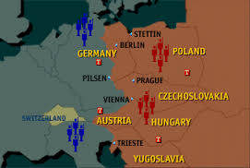
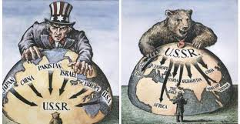
The iron curtain
Distrust and tensions grew between U.S. and Soviet Union when Stalin broke his promise of free elections in Eastern Europe and installed governments dominated by the Soviet Union.
Stalin claimed that Eastern European nations were acting as a buffer zone to protect USSR security
Albania, Bulgaria, Czechoslovakia, Hungary, Poland, Romania become Soviet satellites
Churchill refers to this as the “Iron Curtain” while U.S. begins developing containment policy
Iron Curtain- boundary cutting off contact between Communist countries and the rest of Europe (capitalist)
Containment- U.S. would offer assistance to prevent Communism from spreading to new nations (Truman Doctrine) and help rebuild post-war economies for potential trade partners (Marshall Plan)

Slide 7
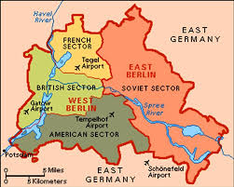
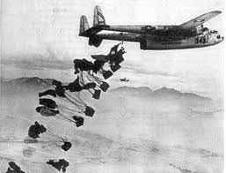
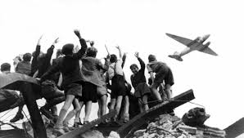
Berlin Airlift
When Germany was divided into four zones after Yalta, Berlin (capital city) was divided also even though it was entirely in the Soviet Zone.
In 1948, Western Allies (France, U.S. & U.K.) began merging their zones to eventually reunify Germany
USSR, which had been invaded by Germany during both wars, retaliated by cutting off all highways and railroads leading to Berlin
Meant to force Allied Occupations to leave
Berlin Airlift- Allied cargo planes flew over the Soviet occupation zone to deliver food, fuel and other goods to the people who lived in western Berlin
A year later, Stalin lifted the blockade; did not force Allies out or prevent future unification of Germany, but amped up tensions with U.S.

Slide 8
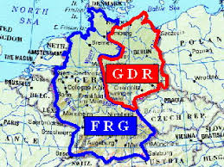
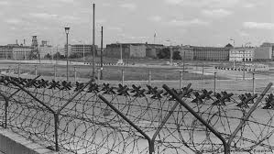
Division of Germany
Federal Republic of Germany- West Germany, officially unified from the Allied Occupation Zones in May 1949
German Democratic Republic- East Germany, new country formed out of the Soviet Zone, still controlled by USSR, in October 1949
Over the next decade, nearly 3 million refugees would defect from the East to the West, mostly through divided Berlin
Berlin Wall- portion of iron curtain that divided communist Germany from Capitalist Germany; built in 1961, made of concrete surrounding a “death strip” full of barbed wire, attack dogs, and armed soldiers

Slide 9
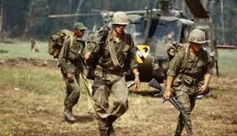
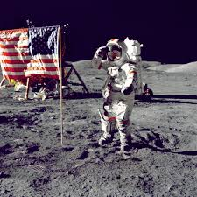
The “Race” to Win
Arms Race
Space Race
Proxy Wars

Slide 10
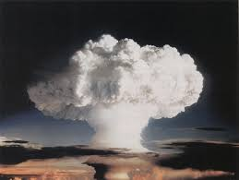
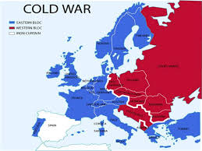
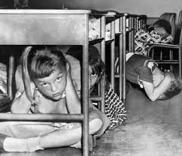
Arms Race
Arms Race- competitive increase in the quantity or quality of instruments of military power by rival states in peacetime
Buildup of arms was a major characteristic of Cold War
Nuclear weapons technology made possibility of all-out war extremely dangerous
In 1949, the Soviets successfully tested an atom bomb; President Truman authorized development of the hydrogen bomb, or “superbomb.”
“Mike”, the first H-bomb test in 1952, created a 25-square-mile fireball that vaporized an island, blew a huge hole in the ocean floor and had the power to destroy half of Manhattan.
Soviets launched their test in 1955
Constant threat of nuclear annihilation will impact domestic, military, and political life

Slide 11
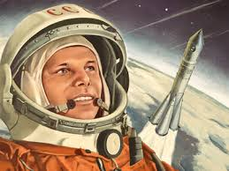
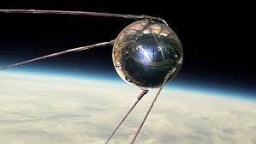
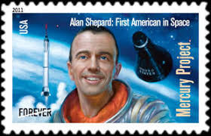
Space Race
Sputnik- October 4, 1957, a Soviet R-7 intercontinental ballistic missile launched world’s first artificial satellite and the first man-made object into the Earth’s orbit.
President Dwight Eisenhower signed a public order creating the National Aeronautics and Space Administration (NASA), a federal agency dedicated to space exploration in 1958
U.S. launched its own satellite, Explorer I, designed by the U.S. Army under the direction of rocket scientist Wernher von Braun
Soviets launched the first man, Yuri Gagarin, into space in April 1961.
Alan Shepard become the first American man in space
President John F. Kennedy set a goal for the U.S. would land a man on the moon by the end of the decade
Neil Armstrong of NASA’s Apollo 11 mission, became the first man to set foot on the moon, on July 20, 1969 effectively winning the Space Race for the Americans.

Slide 12
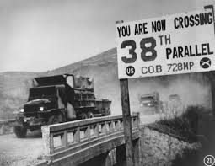
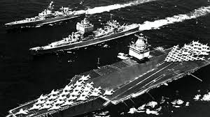
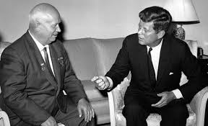
Proxy Wars
Korean War- North Korean People’s Army, supported by USSR, invaded South Korea, backed by U.S. (resolved in 2018)
First military action of the Cold War.
American troops entered the war to aid South Korea; believed they were fighting communism itself
Fighting stalled without a clear winner, and 38th Parallel permanently separated North from South as fortified boundary called Demilitarized Zone (DMZ).
Cuban Missile Crisis- 13-day political and military standoff in October 1962 over the installation of nuclear-armed Soviet missiles on Cuba, just 90 miles from U.S.
President Kennedy enacted a naval blockade around Cuba to neutralize any threats to U.S. national security.
Soviet leader Nikita Khrushchev removes the Cuban missiles in exchange for the U.S. promising not to invade Cuba.
Kennedy also secretly agreed to remove U.S. missiles from Turkey.

Slide 13
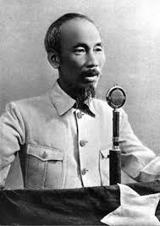
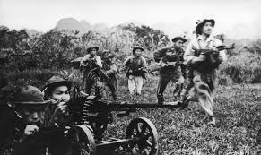
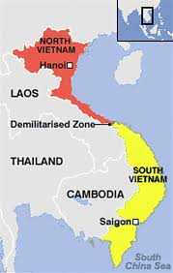
Proxy Wars
Vietnam War- Nationalist leader Ho Chi Minh created a Communist state in North Vietnam and launched a guerrilla war against South Vietnam (backed by capitalists)
U.S. provided soldiers and helicopters to fight in South Vietnam, and frequently bombed areas where Viet Cong (North) were known to gather
Domino Theory- thinking they were literally resisting communism, U.S. believed if one Asian country became communist, the others would follow
U.S. is unable to prevent Viet Cong from gaining ground, and withdraw from conflict in 1973.
South Vietnam falls to Viet Cong in 1975, unifying Vietnam under communist rule

Slide 14
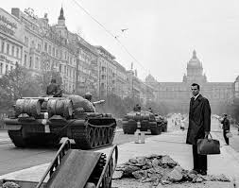
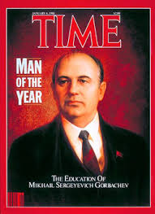
Fall of communism

Slide 15
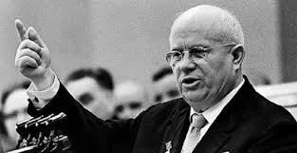
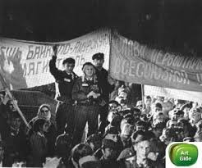
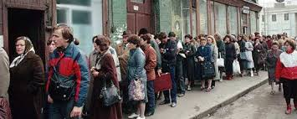
Back in the U.S.S.R.
After becoming Prime Minister in 1957, Nikita Khrushchev began De-Stalinization policies, removing the mythical influences of Joseph Stalin from Russian politics
Allowed critique of Stalin, the government, and Communism for the first time
Soviet Union will experience long period of stagnation, due to government planners being unable to predict people’s needs (and not knowing what to produce) while people had little incentive to work hard since it did not impact their salary
Farms failed to produce enough food
Consumer goods became low-quality, unable to compete with goods from Western nations
Corruption grew rampant in the Communist party

Slide 16
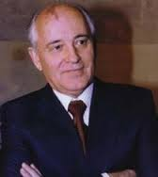
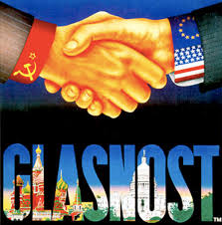
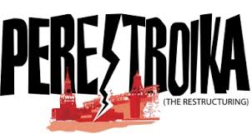
Gorbachev’s New Direction
Mikhail Gorbachev- Prime Minister of U.S.S.R from 1985-1991, aimed to reform government with new policies while preserving communism
Glasnost- series of political and judicial reforms meant to introduce “openness” to Russian society
Decrease in Censorship- restrictions on the press and bans on free speech were lifted, government transparency increased
Public Trials- included released of government critics from prison
Democratization- move towards free government elections, transition was slow
Perestroika- restructuring of government (removal of “old school” leaders and politicians) and economic systems during Gorbachev’s leadership

Slide 17
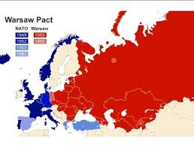
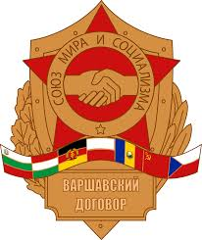
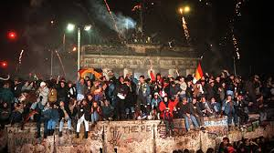
Fall of Berlin Wall
Warsaw Pact- member states would come to the defense of any member attacked by an outside force, and all member nations created a unified military force under the Soviet Union.
Soviet Union, Albania, Poland, Romania, Hungary, East Germany, Czechoslovakia, and Bulgaria signed in 1955
December 1988: Gorbachev states that all nations should be free from outside interference, USSR would reduce the number of troops and tanks that were based in the Eastern Bloc countries.
Warsaw Pact was dissolved in July 1991
Fall of Berlin Wall- East Berlin’s Communist Party announced citizens of the GDR were free to cross the country’s borders at midnight on November 9, 1989; people used hammers and picks to knock away chunks of the wall while cranes and bulldozers pulled down sections.
Berlin was united for the first time since 1945.
1990: East Germany officially left the Pact and reunited with West Germany; the reunified Germany then became a member of NATO.

Slide 18
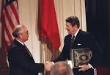
Breakup of the Soviet Union
The divide between the extreme wealth and the poverty of Soviet citizens created a backlash from younger people who refused to adopt Communist Party ideology as their parents had.
In the 1980s, U.S. President Ronald Reagan isolated the Soviet economy from the rest of the world, causing oil and gas revenue to drop dramatically.
Gorbachev’s reforms were slow to produce change, which sped up the collapse of the Soviet Union, leading to independence movements in the Soviet satellites of Eastern Europe.
An unsuccessful coup by Communist Party hard-liners in August 1991 diminished Gorbachev’s power and positioned democratic forces, led by Boris Yeltsin, for a political takeover.
On December 25, Gorbachev resigned as leader of the USSR. The Soviet Union ceased to exist on December 31, 1991.

