Slide 1
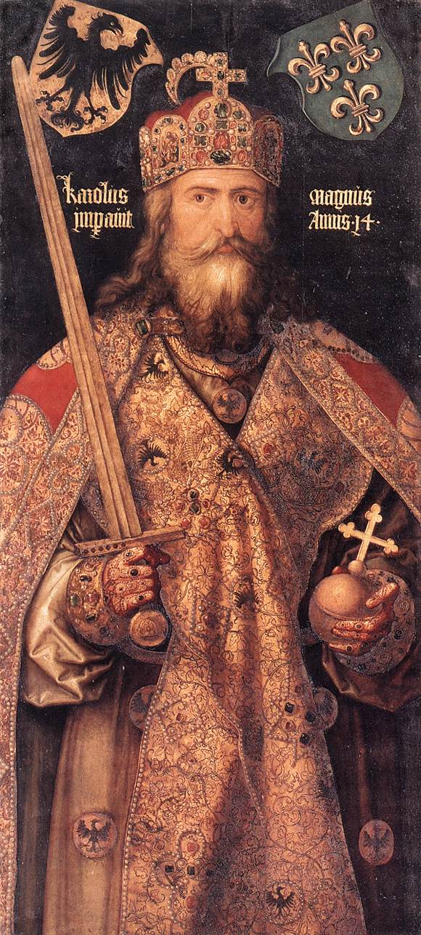
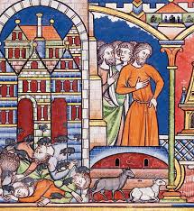
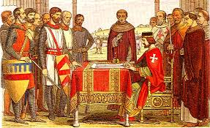
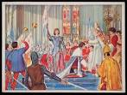
The Middle Ages
Holy Roman Empire
Early European Nations
The Crusades

Slide 2
Cornell note-taking method
Notes color-coded in RED go on this side of the line.
These items will include:
Main Ideas
Big Concepts
Vocabulary Words
Notes color-coded in BLUE go on this side of the line.
These items will include:
Supporting details
Dates, Times, and Biographic details
Vocabulary Definitions
Any items in BLACK text are optional. Remember: the more thorough your notes, the more prepared you will be for exams.

Slide 3
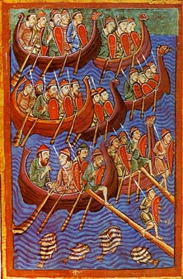
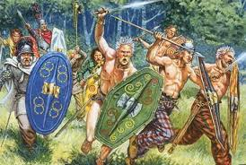
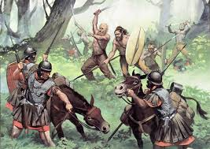
The Dark Ages
Germanic Kingdoms
Barbarians
Vikings

Slide 4
Intro to the Middle Ages
Medieval- comes from the Latin meaning “middle”; refers to the transition period from ancient to modern times
Main Ideas:
Theology becomes more important, will become a major factor in relations between Christianity & Islam, resulting in the Crusades
Trade routes open communication between groups, allowing for the diffusion of culture, religion, math, and science
Spread of diseases will wipe out large portions of population, especially the Black Death
Nations begin to take shape, and certain families will be designated as their protectors

Slide 5
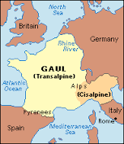
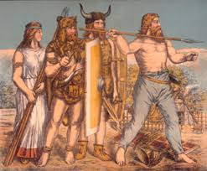
Dark Ages: Turmoil in Europe
Germanic Kingdoms- formed out of early barbarian tribes; lived in small communities with unwritten customs, led by kings and warrior nobles based on loyalty
Most successful Germanic Kingdom was established by the Franks
As a result of Germanic invasions:
Trade declined
Roads, bridges, and cities fell into disrepair
No written laws or enforcement
No learning except in monasteries
Loss of a common language due to many dialects
Time period is often referred to as “Dark Ages”

Slide 6
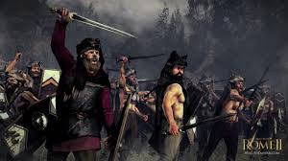
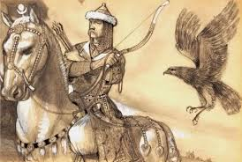
Dark Ages: Turmoil in Europe
Barbarians- members of various Germanic tribes who were not of Roman descent; they invaded parts of Europe and set up their own kingdoms in former provinces of Roman empire
Constant warfare between groups disrupted trade and travel became unsafe
Magyars- early Hungarian people, once hired as mercenaries by the Byzantines, converted to Christianity
By the 900s, the Magyars had reached Gaul and southern Italy
Fight and pillage like Vikings
defeated by Saxons, forced into central Europe
Attacks cease in 955

Slide 7
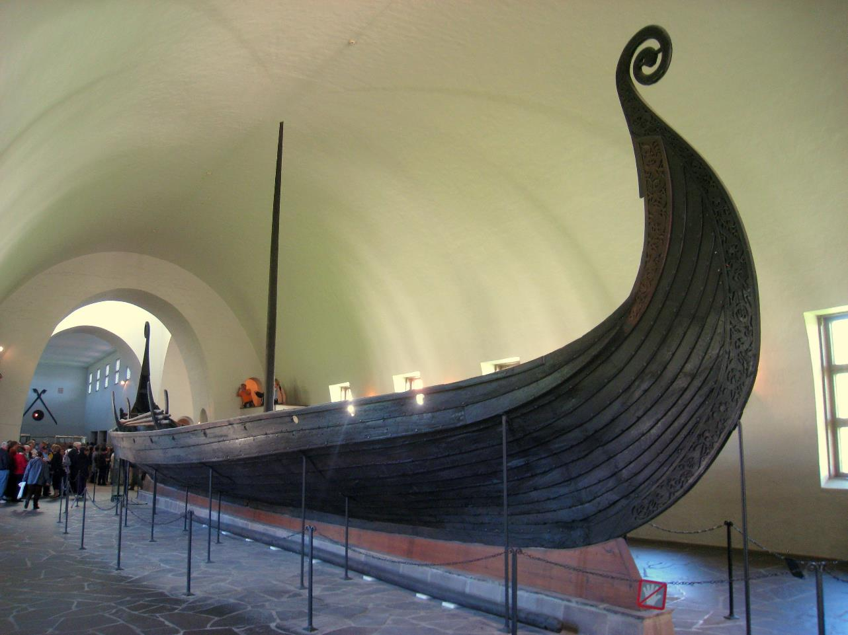
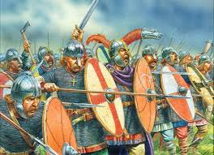
Dark Ages: Turmoil in Europe
England was under Roman control until 410 CE
Angles and Saxons- migrated from continent to England, filled power vacuum after fall of Rome
This is where “Anglo-Saxon” comes from
Vikings- originally from Scandinavia (Modern Denmark, Norway and Sweden); dominated Northern Europe from about 700 to 1100 CE,
Raided European towns and settled in other areas
Name 'Viking' means “pirate raid“ in Old Norse

Slide 8
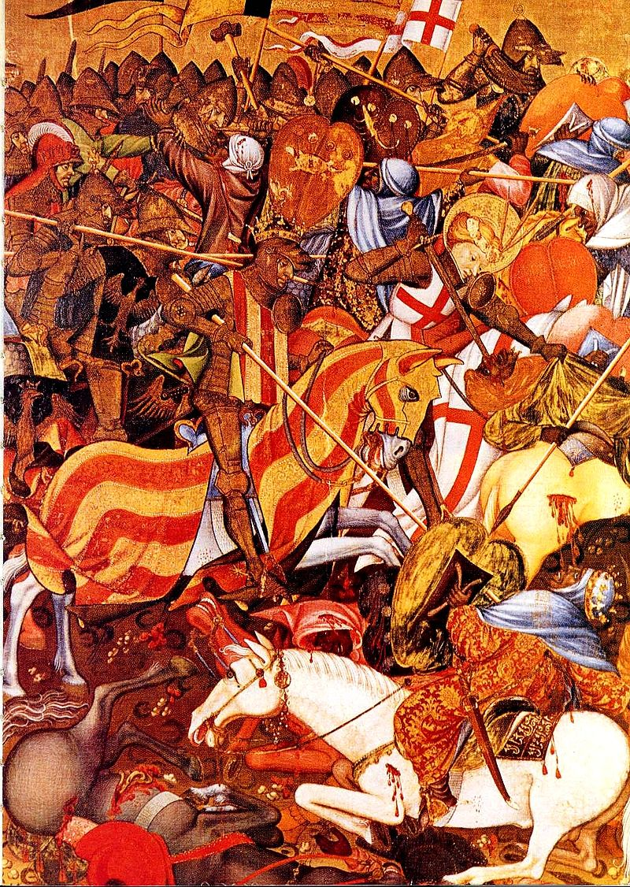
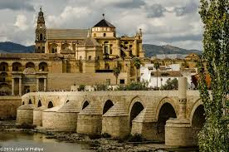
Building European Nations
Holy Roman Empire
England
France
Spain

Slide 9
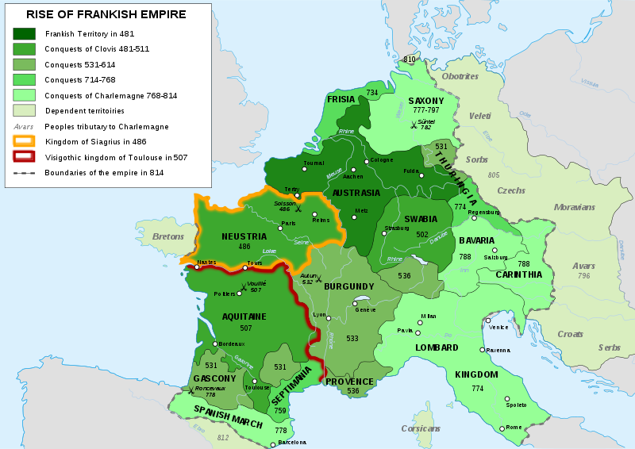
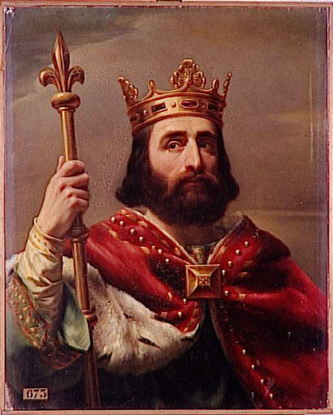
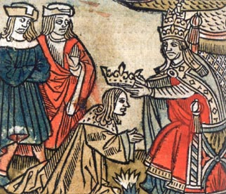
Holy Roman EMpire: The Franks
Franks- Germanic group in Gaul, converted to Catholicism & align with the Church, founded the Merovingian dynasty which ruled the Franks for 200 years
United by King Clovis I
Charles Martel- known as “Charles the Hammer”, became “Mayor of the Palace” (majordomo) in 714 CE
Battle of Tours- led by Charles Martel in 732 CE, the Franks stopped the spread of Islam into Europe
Pepin the Short- Charles Martel’s son; a strict Catholic, he protected Catholic Church against the Lombards, an invading Germanic tribe
The Church anointed him “King by the Grace of God”
Carolingian Dynasty– founded by Pepin the Short, the family ruled over majority of Western Europe from 751-987 CE

Slide 10
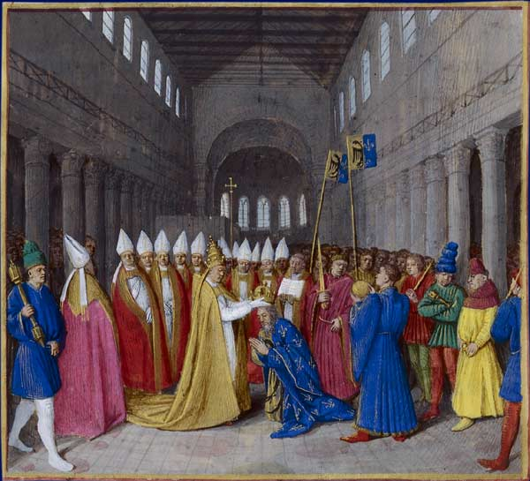
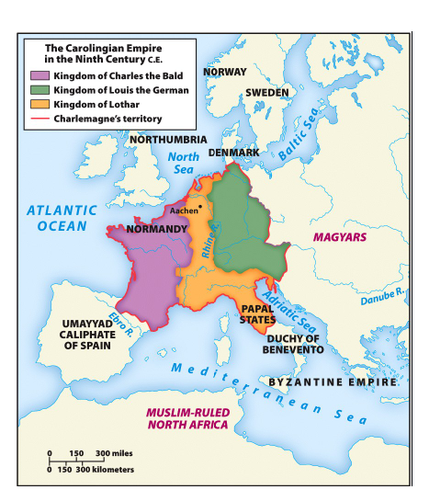
Holy Roman Empire: Charlemagne
Charlemagne- son of Pepin the Short; ruled from 768-814 CE, and was known for extending Frankish Empire, spreading Christianity, & encouraging learning
Holy Roman Emperor- a reward for years of protecting and serving the Catholic Church, Charlemagne was crowned with new title on Christmas Day, 800 CE by Pope Leo III
Charlemagne’s grandsons fought for control of the empire after his death
In 843, they signed the Treaty of Verdun, which divides the empire into 3 kingdoms.
One kingdom will evolve into France, while the other two will become Germany and the Low Countries

Slide 11
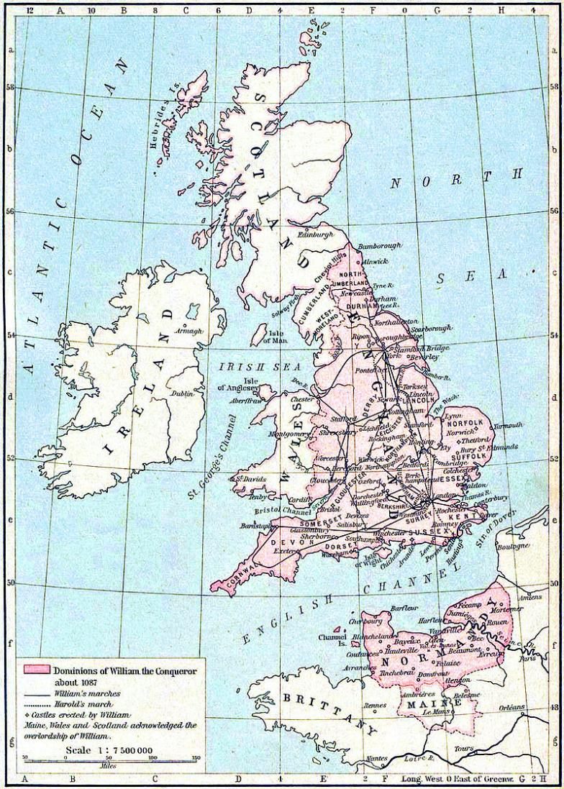
Building Nations: England
Alfred the Great- unites Anglo-Saxon kingdoms in the 870 CE, defended the kingdom against Viking conquest
Æthelstan- Alfred’s grandson, became the first King of England, and established the House of Wessex as the ruling family, in 927 CE
Defeated an invasion by the King of Scotland
Descendants would continue to fight foreign kings for control of England throughout their reign
His line continued until Edward the Confessor died without an heir in 1066
Bayeux Tapestry- embroidered cloth that serves as historical account of William the Conqueror’s invasion of England and defeat of Harold of Wessex to claim the throne of England
Common Law- development began in 1066 and reformed over many years, mostly during rule of Henry II. Introduced the use of juries and allowed judges to form a unified body of law based on previous decisions

Slide 12
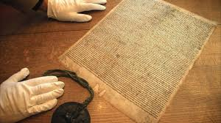
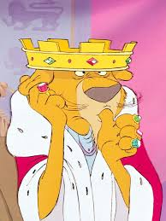
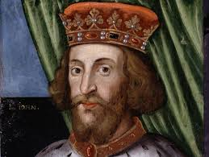
Building Nations: England
Plantagenet- French noble family who ruled England beginning with Henry II in 1126-1485; warrior family who expanded territory but would lose central powers of the throne
Magna Carta- signed in 1215 by King John, son of Henry II and brother of Richard the Lionheart, limited royal power for the first time.
Guaranteed free men rights to a trial by jury and property protection and promised protections for the Church.
Created a council of nobles the King had to listen to before creating new taxes.
Origins of current Constitution & Parliament in UK

Slide 13
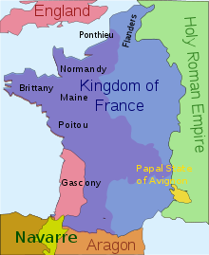
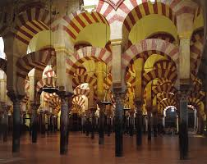
Building Nations: France & Spain
France- After breaking off from Holy Roman Empire, is a collection of small feudal lands that are very valuable
Capetians- dynastic noble family founded by Hugh Capet after he was elected to throne by nobles in 987 CE
Will eventually expand control, enlarge territory & appoint loyal officials across France
Spain- Visigoths on the Iberian peninsula convert to Christianity in 587
Muslims- controlled territory in Spain, north Africa, Mediterranean islands, Middle East and sought to establish a stronghold in Europe
Becomes one cause of the Crusades
Influenced architecture, art, and city-planning
Reason why many Spanish & Arabic words sound the same
Reconquista- Spanish wars and battles beginning in 772 CE to reclaim Muslim territory, lasts over 700 years (to 1492).

Slide 14
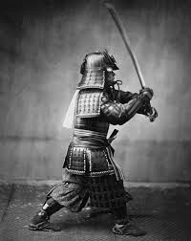
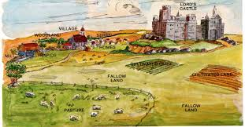
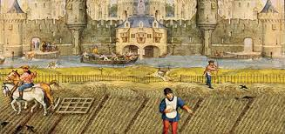
Feudal Society
Manorialism
Social Classes
Feudal Japan

Slide 15
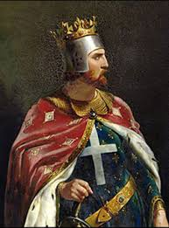
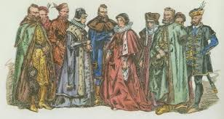
Feudal Society: Social Characteristics
To protect themselves from violence and provide for basic economic needs, Western Europeans adopted the Franks’ feudal society.
Kings granted a feud (or fief), land ownership, to a nobleman (vassal) in exchange for his loyalty and aid during war
Strict class structures formed on the basis of land and military power
Mobility between classes was limited, people could not change their social positions
Lord – had total authority over his lands, collected rent, settled disputes, provided military defense during war
Lady – had an active role but limited; she worked in lord’s absence

Slide 16
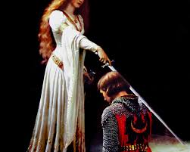
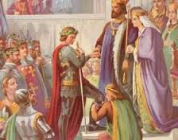
Feudal Society: Social Characteristics
Knights – mounted warriors, began their training at age 7; their allegiance was declared to the king but their loyalty was to their lord
1100s – warfare decreases, tournaments start. Tournaments mimic battle and carry the same glory for the victor
Chivalry- behavior code all knights followed; combined warrior ethics, rules of loyalty and courtly manners, to establish a code of honor and morals
Knights had “three masters” under chivalry:
Feudal Lord
Heavenly Lord
Lady- Despite being a “master” women had few rights in society and were thought to be inferior
Ideal knight is loyal, brave, and courageous

Slide 17
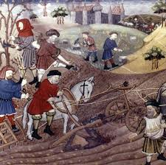
Feudal Society: Economic Characteristics
Manorialism- economic system that arranged rural society around an estate, usually a castle or manor, where administrative, legal, or social gatherings took place .
Manor- self-sufficient estate that consisted of the lord’s house, surrounding villages and the people who worked the land
Varied in size, depending on lord’s wealth
Manors produced their own food, clothing, shelter and provided their own protection with a trained army of knights
Serfs- peasants who lived on the estate gave the lord a portion of their harvest or products in exchange for protection and other services
Lord had complete control over serfs, and could pass laws, require labor, and settle disputes. Serfs were contractually bound to the land and had no voice.

Slide 18
Feudal Society: Political Characteristics
In a feudal society, the nobles who had the most land were the most powerful.
Built large castles for protection, maintained armies of knights
King relied on nobles for military aid, especially when fighting foreign invaders
This often caused political tension between the nobles, who fought amongst themselves for power or rebelled against the King’s authority.
Many civil wars resulted from nobles seizing land and power for themselves at the cost of the nation.

Slide 19
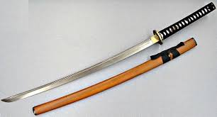
Feudal Society: Japan
In 1192 CE, Japanese nobles became more powerful than the emperor, due to many years of open warfare between families. Emperor was not overthrown, but remained as a symbolic figurehead.
Shogun- provided military protection, created policy, and collected taxes. Even though ranked below the emperor, he was more powerful.
Daimyo- equally as powerful as the Shogun, but did not interfere with politics. Divided land between large estates.
Samurai- pledged loyalty to Daimyo and Shogun, followed a strict code of honor, completed military training in exchange for social status and wealth.

Slide 20
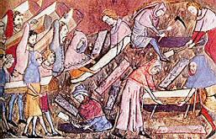
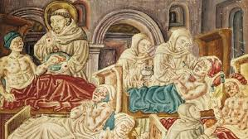
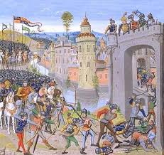
Decline of the middle Ages
The Crusades
Black Death
Hundred Years’ War

Slide 21
Effects of the Crusades
Feudalism breaks down, as nobles will have to sell off their lands in order to pay for the Crusades
Kings gain authority over Pope & nobles
Bitterness remains among Muslims, Christians, and Jews over each other’s actions
Interactions lead to establishment of trade networks, new ways to build faster ships, use of magnetic compasses

Slide 22
The Black Death
Circa 1347-1352, aka Bubonic Plague
12 trade ships arrived in Europe after crossing the Black Sea from Asian trade routes; disease had already made its way through Silk Road
Fleas and rats from the ships infested crowded European areas and transmitted the disease to humans
Humans spread the disease through bad personal hygiene and through breathing contaminated air
Most noticeable symptom of disease included swelling boils in armpits and groin. Symptoms also included:
Fever/Delirium
Diarrhea/Loss of Bowel function
Vomiting
First major world pandemic; people avoided the sick, closed entire towns, abandoned shops & crowded areas

Slide 23
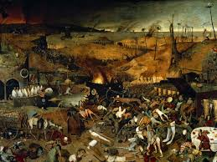
The Black Death
Killed estimated 75-200 million people
Religious zealots interpreted the disease as a sign of God’s displeasure with humans
Forced relocations of Jews and Muslim settlements
Many Jews will inhabit Eastern European nations, which will be their main base until World War II.
Many people participated in public acts of penance (prayer) or self-punishment
Feudal system will break down due to labor shortage after massive loss of life
Many peasants escaped serfdom when towns and cities offered freedom in exchange for peasant labor to rebuild
Disease reappeared sporadically during 15th century, but mostly died out due to improvements in sanitation

Slide 24
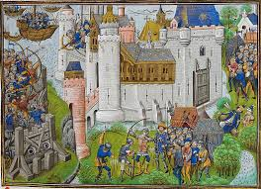
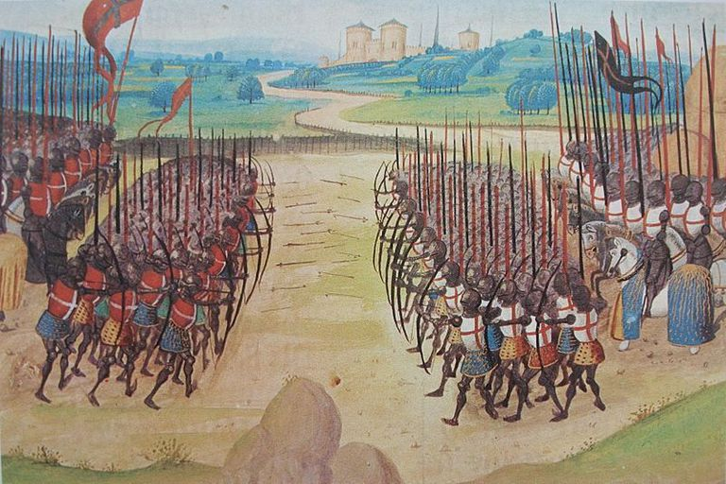
The Hundred Years’ War
circa 1337-1453 CE; series of conflicts between France and England over French throne
When French king Charles IV died without an heir, English king Edward III unsuccessfully tried to claim the throne
Kicked off long periods of warfare, mostly over control of significant territories, with England trying (and failing) to conquer France
Joan of Arc- young French maiden who became a soldier, drove the English out of Orleans, and crowned the new French king as a reward for her support.
Was captured by the English and burned at the stake as a witch

Slide 25
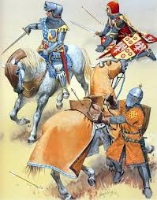
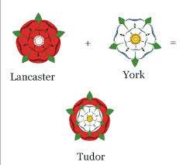
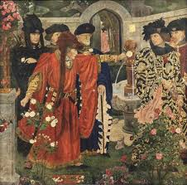
The Hundred Years’ War
War strengthens national unity for each side; kings will develop standing armies of foot soldiers that are loyal to the state, NOT a nobleman
New weapons are introduced in battle, including:
cannons and gunpowder from China
English Long Bow, reason for many early English victories
Knights become less crucial for victory, another reason feudalism breaks down
Permanently weakens the Plantagenet’s political power in England, leading to rebellions from rival families to take the throne, aka the War of the Roses (1455-1485)
Results in the Tudor Dynasty, including Henry VIII and Elizabeth I, shaping England during Renaissance & Reformation

