Slide 1
Types of Communities
Urban
Suburban
Rural

Slide 2
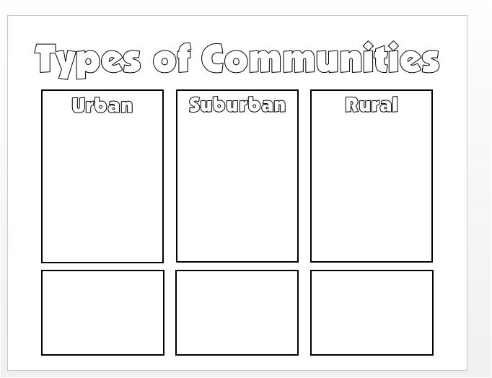
How to use this Presentation
With your SHOULDER BUDDY, discuss the following factors of different types of human communities
Determine which category each factor belongs in on your answer document and WRITE IT DOWN
There are NO REPEATS; use each factor ONE TIME ONLY

Slide 3
Metropolitan areas with large populations
(ex. New York City)

Slide 4
Smaller residential communities that are on the outskirts of a city or large town

Slide 5
A community with a low population density and space between residences

Slide 6
Contains many man-made structures like commercial buildings, paved roads, bridges, railways, and designated residential areas

Slide 7
Relies on either state highways or dirt roads to connect neighboring properties

Slide 8
Offers access to city jobs through commute as well as some local jobs

Slide 9
Relies on agriculture and related jobs

Slide 10
Thrives on business development
(ex. Finance, Technology, Trade, etc.)

Slide 11
Mostly contains residential areas; may contain a few businesses for convenience

Slide 12
Thrives on peoples’ need for better living conditions

Slide 13
Communities rely on access to natural resources (water, soil, etc.) for productivity

Slide 14
Offers numerous and diverse employment options

