Slide 1
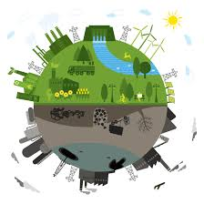
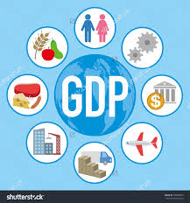
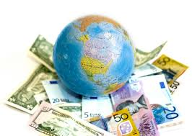
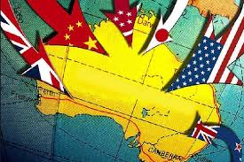
Causes & Effects of uneven development
Standard of Living
GDP & GNP
Depressions
Economic Sanctions

Slide 2
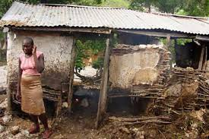
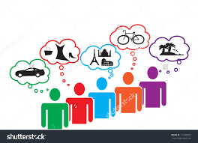
Standards of living
Standard of Living- refers to the wealth, comfort, material goods and necessities that are available to people living in a certain area.
HDI (Human Development Index) will rank countries based on goods, services, and incomes produced in addition to health, education, and political & religious freedoms.
HDI uses various political, economic, social, and demographic indicators, commonly including:
Birth Rate
Death Rate
Literacy Rate- percentage of population over the age of 15 that can read and write
Life Expectancy- the estimated life span of an average member of any given group

Slide 3
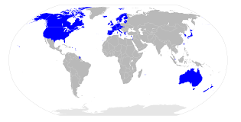
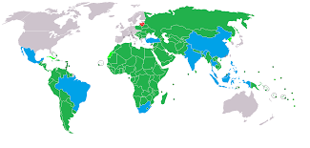
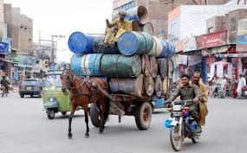
Levels of Development
Uneven Development- inequalities in economic conditions between countries; based on changes (or lack of) in economics, demographics, social, and political factors
Your Standard of Living will determine what type of society you live in:
More Developed Country (MDC)- countries with long life expectancy, low birth rates, and high education and income levels
Newly Industrialized Country (NIC)- countries with shorter life expectancies, higher birth rates, and lower education and income levels.
These countries have recently become industrialized, or competitive economies.
Less Developed Countries (LDC)- countries that have the shortest life expectancies, the highest birth rates, and little to no education or income levels.
Most of these nations still rely on agricultural-based economies

Slide 4
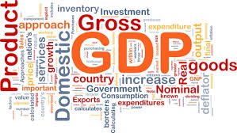
GDP & GNP
Determining a country’s Standard of Living includes looking at economic factors like:
Income
Job Opportunities
Access to Education & Health Care
Political Stability
Gross Domestic Product- the total amount of all goods and services a country produces in a year
MDC=HIGH GDP
LDC=LOW GDP
Gross National Product- the goods and services and income from foreign investments produced in a country in a year

Slide 5
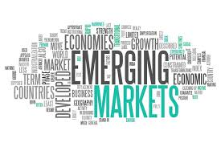
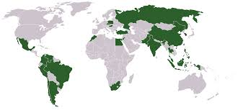
economic sanctions
Competition between developed nations leaves little room for under-developed or emerging markets
Emerging Markets- not as advanced as developed nations, but have stronger economies and services than newly industrialized nations
Some nations will change from capitalist economies to communist or socialist in order to offset the effects of competition not only between countries but also between regions (coasts, inland, forests, etc.)
Leads to the creations of trade barriers and economic sanctions

Slide 6
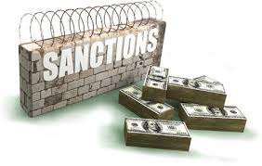
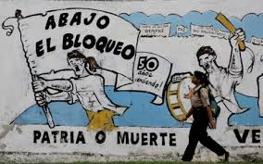
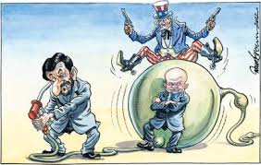
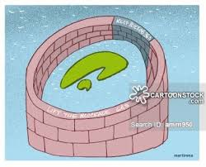
economic sanctions
Economic Sanctions- financial penalties applied by one or more countries against a targeted country in response to policies or behaviors that are not popular or favorable
U.S. enacted economic sanctions against South Africa from 1970-1991, in order to force an end to apartheid
Embargo- prohibition or complete elimination of trade with a particular country or group of countries
U.S. has maintained embargo on Cuba since 1962 as punishment for numerous violations of human rights and political freedoms; however, it has had little effect towards changing policies
Embargoes can delay a country’s development, especially in technology and health care

Slide 7
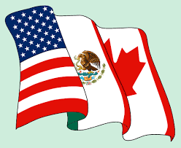
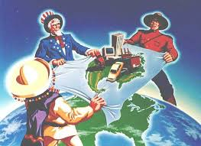
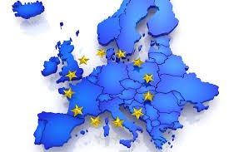
Trade Zones
Trade Zones- reduced or eliminated taxes between friendly nations in order to prioritize economic relations and investment with each other
NAFTA- North American Free Trade Agreement; eliminates trade taxes and improves job availability between Canada, United States, and Mexico
European Union- promotes a single market for trade, commerce, money, and migration between European nations
Brexit- vote conducted to determine Great Britain’s continued membership, without whom EU will probably not survive

Slide 8
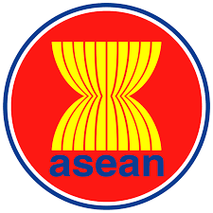
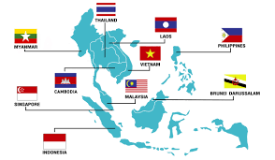
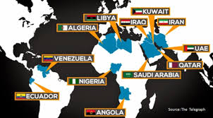
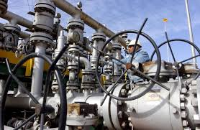
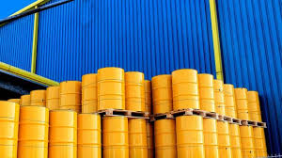
trade Zones
Association of Southeast Asian Nations (ASEAN)- promotes political and economic cooperation between Philippines, Indonesia, Malaysia, Singapore and Thailand
OPEC- Organization of Petroleum Exporting Countries; promotes stability of oil production and prices among member nations in order to create a steady supply of oil to world consumers
Allows member nations to intervene with pricing, which negatively impacts consumer (price gouging)

Slide 9
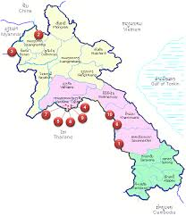
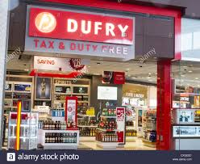
Special economic zones
Special Economic Zones (SEZ)- an area that sells a country’s products located within a host country's national borders, goals include: increased trade, investment, job creation and effective administration
Businesses within SEZ’s follow the laws that have been setup for that area, not the laws of the host country
Items purchased in SEZ’s are often not taxed, and can be bought for lower prices than in stores that are in the host country
“Tax & Duty Free” in Downtown Brownsville

