Slide 1
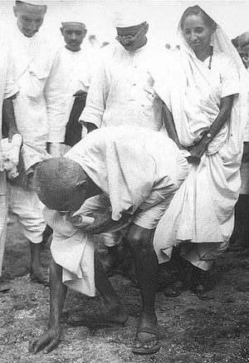
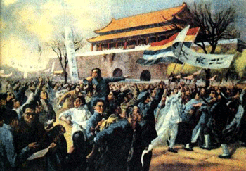
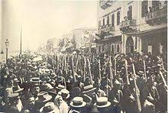
uprisings in asia
China
India
Iran & Turkey

Slide 2
Cornell note-taking method
Notes color-coded in RED go on this side of the line.
These items will include:
Main Ideas
Big Concepts
Vocabulary Words
Notes color-coded in BLUE go on this side of the line.
These items will include:
Supporting details
Dates, Times, and Biographic details
Vocabulary Definitions
Any items in BLACK text are optional. Remember: the more thorough your notes, the more prepared you will be for exams.

Slide 3
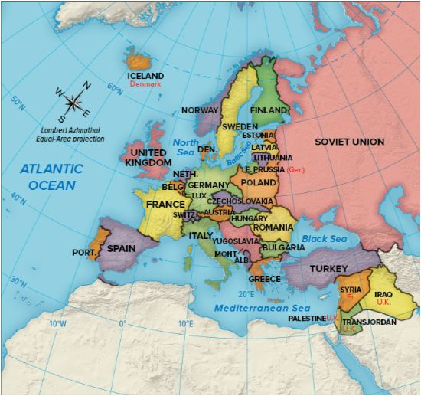
Interwar Period in Asia
Totalitarian regimes, usually based on communist and socialist ideals, replaced empires in Europe and Asia at the end of WWI
Italy, Germany, Russia (USSR), Japan
Economic depressions in Europe affect trade relations with Asia, which inspires protests and uprisings
Imperial China collapses
India gains self-rule
Uprisings in Iran & Turkey

Slide 4
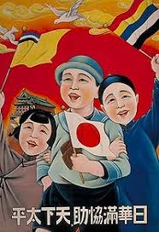
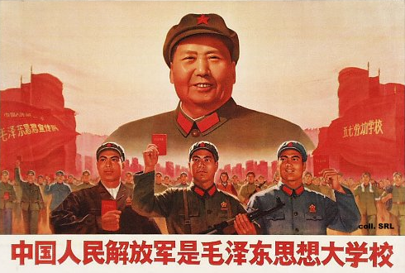
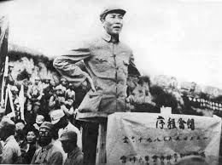
China

Slide 5
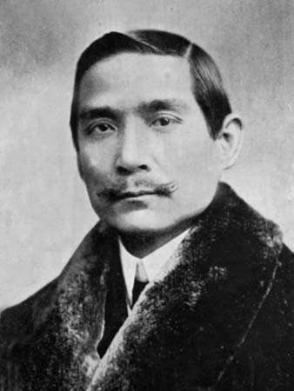
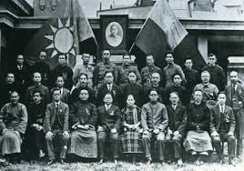
Collapse of Imperial CHina
Kuomintang- National People’s Party of China, organized by Sun Yat-sen, overthrows the Qing Dynasty in 1911 and forms the Republic of China
Party theory based on Three Principles of the People: Nationalism, Democracy, and People’s Livelihood (jobs, food, money, etc.)
Sun Yat-sen becomes President, but turns over position in order to work on strengthening his party (returns later in the 1920’s)
Republic doesn’t last and local warlords take over

Slide 6
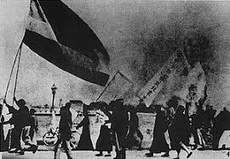
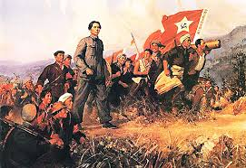
May Fourth Movement
China enters World War I; declares war against Germany with the Allies in 1917
Requests all German spheres-of-influence, specifically Port of Shandong, be returned to China after their defeat
Treaty of Versailles- Germany territories in China turned over to Japanese
May Fourth Movement- uprisings, protests, and demonstrations throughout China in response to Treaty of Versailles and rejection of Western ideals
Resurgence in Chinese nationalism, political mobilization, and populism
Chinese intellectuals turned to Lenin Soviet communism instead of Western democracy

Slide 7
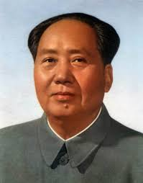
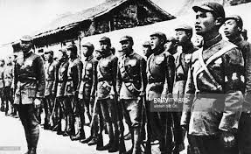
Mao Zedong
Mao Zedong- Beijing University assistant librarian, follower of Karl Marx, believed the peasants could be the true revolutionaries
Organizes the Chinese Communist Party
In 1923, Kuomintang Nationalists and Chinese Communists form First United Front to disband warlord control
1927- Chinese Communists are exiled to SE China, but launch an uprising in Nanchang to seize political power
Chinese Civil War- fought between Nationalists and Communists in two stages; Nationalists win the first stage (1927-1937) and set up a new Republic
Nationalists- led by Chiang Kai-shek, supported by China’s middle classes, recognized by the United States & Great Britain
Communists- supported by peasants, recognized by Lenin
Mao & 100,000 Communists will flee throughout China after their defeat, recruiting followers along the way
Nationalists & Communists form Second United Front to combat Imperial Japanese aggression in Manchuria and other Chinese regions before WWII

Slide 8
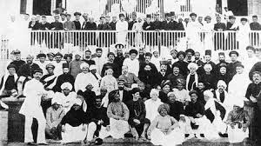
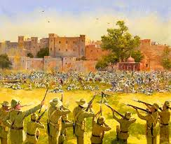
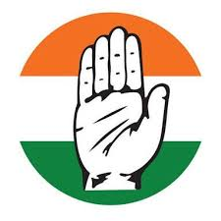
India

Slide 9
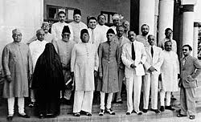
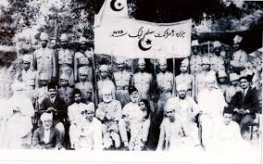
India fights for self-rule
Indian National Congress- first nationalist movement in India; formed to protest British imperialism, earliest group to push for united, self-ruling India
Made up of mostly intellectual elites who were slow to make radical changes in government; also did not work to include lower classes and Muslims
All-India Muslim League- nationalist movement that served the needs of the Muslim population in India, will become a major power player behind the creation of Pakistan
During WWI, high casualty rates, soaring inflation compounded by heavy taxation, a widespread influenza epidemic and the disruption of trade during the war escalated tensions in India

Slide 10
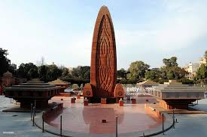
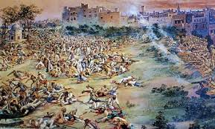
India fights for self rule
Rowlett Acts of 1919- enacted to combat nationalist tensions in India; could be used to imprison any Indian suspected of terrorist activity
Led to stricter control of the press, arrests without warrants, and indefinite detention without trial
If released, suspects were prohibited from participation in education, political, or religious practices.
Amritsar Massacre- British Indian forces fired into crowds who they believed were gathering to rebel against the government; the crowds were actually Indian Sikhs celebrating a religious festival and peacefully protesting Rowlett Acts
400 Indians killed, 1500 more wounded
Permanently eroded any goodwill left between Indian Nationalist groups and British government

Slide 11
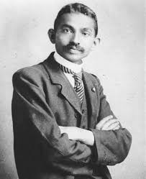
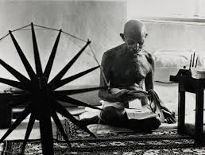
Mahatma GandHi
Mohandas K. Gandhi- Indian lawyer turned activist for Indian Home Rule; practiced non-violent passive resistance and civil disobedience
Known as Mahatma, “The Great Soul”
Went on hunger strikes to protest treatment of “untouchables” of caste system
Worked for peace between Hindus & Muslims
Stressed the importance of economic independence for India, including:
the manufacture of khaddar in order to replace imported textiles from Britain
boycotts of British manufacturers
Protests against institutions representing British influence in India, including legislatures and schools.

Slide 12
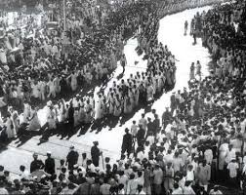
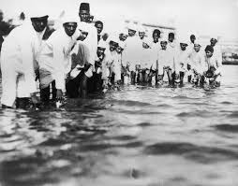
Civil disobedience
Salt Acts- trade prohibitions outlawed Indians from collecting or selling salt and forced them to purchase it from British traders, creating a monopoly for British economy
Gandhi encouraged followers to collect salt anyway, defying the law without inciting violence
Salt March- Indians collected salt crystals across the country in a mass protest from March 12- May 21, 1930
Hundreds, including Gandhi, were arrested by British forces
After release in 1931, Gandhi met with British representatives to discuss Indian independence.
Indian Independence granted in August 1947

Slide 13
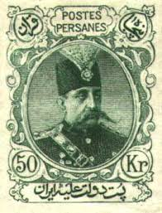
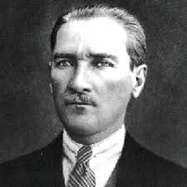
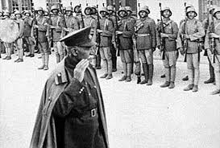
Iran & Turkey

Slide 14
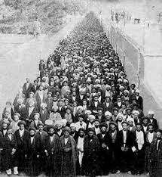
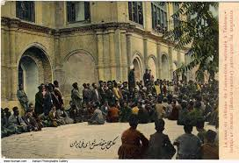
Persian Constitution of 1906
Tobacco Concession of 1890- Persian government sold tobacco fields to British companies to fund his extravagant lifestyle, often for much less than what the land or tobacco was worth
Majority of Persians were employed in tobacco industry; many forced to work for lower wages
Persian Shah continues to raise taxes, sell more resources to Europeans, and spend extravagantly
Leads to protests against the Shah
Persian Constitution of 1906- government is transformed to constitutional monarchy, with a written constitution granting powers to representative Parliament

Slide 15
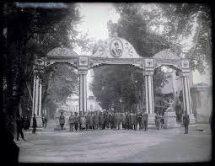
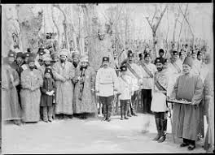
Iranian Constitutional Revolution
Triumph of Tehran- Muhammad Ali Shah Qajar, the next Shah, dissolves Parliament and tries to reinstate his power without a constitution; protesters march on Tehran and demand his removal
He is deposed and exiled; the next Shah, his son Ahmad Shah Qajar, is removed from power in a “bloodless coup”
Reza Shah Pahlavi- deposed the Qajar family and was appointed the new ruler of Persia in 1925; instituted many social, political, and economic reforms for state modernization
In 1935, Shah Pahlavi changed the name of Persia to Iran to reflect how citizens referred to their country
Persia had been a name given by the Ancient Greeks who referred to the whole empire by the name of an ancient city

Slide 16
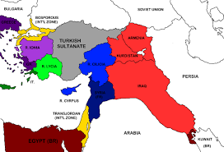
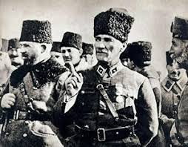
End of the Ottoman Empire
Paris Peace Conference- ends hostilities of WWI; the Ottoman Empire, a Central Power, is occupied and partitioned by several European nations
British forces occupied Turkey, established martial law and began arresting members of nationalist groups
Mustafa Kemal Ataturk- commander of Ottoman forces in WWI, begins organizing remaining troops to protest against what he sees as threats to independence
Helps establish Turkish Nationalist Movement
Forms the Grand National Turkish Assembly to maintain Turkish independence amid treaty negotiations
Turkish War of Independence begins in May 1919

Slide 17
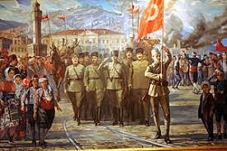
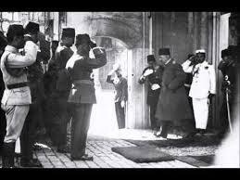
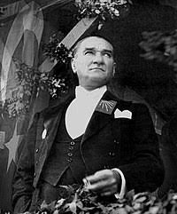
Birth of the Republic of Turkey
Britain uses proxy forces from other countries to fight the Turkish Army, including:
France (minor fighting)
Greece
Armenia- at least 98,000 killed; weakened government will be taken over by USSR in mid-1920s
Treaty of Lausanne- signed on July 24, 1923; Allied Powers recognize the Grand National Turkish Assembly as the government of Turkey
Results in the overthrow of the powerless Sultan, Mehmed IV, and ends over 600 years of Ottoman monarchy
Turkey is officially recognized as an independent nation in October 1923
Mustafa Kemal Ataturk is elected President; institutes social, economic, and political reforms to modernize the nation

